Slide 1

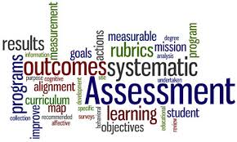

Slide 2
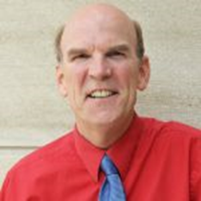

Who We Are When Working in Assessment
Carl Brun works with Gen Ed and other programs
Aligning curriculum with standards
Collecting syllabi and posting to website
Analyzing data and sharing the results
Renee Aitken works with Assessment and Accreditation
Building a university level assessment process
Collecting, analyzing data, and sharing the results
Sharing assessment plans and procedures across the university
Supporting the HLC Academy Gen Ed Assessment project

Slide 3
Wright State Assessment
Program review every 5 years
Program Accreditation (ABET, NCATE, etc.)
ULO Assessment in Ged Ed and other programs
Course Evaluations, Student Surveys, Grades, Test Scores
Oversight by the Assurance of Learning Committee
Answering the question:
HOW DO WE KNOW OUR STUDENTS ARE LEARNING?

Slide 4
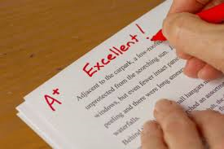
Faculty Already Do Assessment
Build learning outcomes in courses (syllabi)
Measure student learning in courses (assignments, tests, grades)
Participate in program and course reviews
Participate in program accreditation
Serve on committees supporting student learning
Provide data when requested
Final step in process:
Collecting and using data to support a sustainable
Assessment System

Slide 5
What is Assessment
Grading is used to evaluate an individual students’ learning and performance.
Assessment is used to evaluate many students against a learning outcome.
Assessment goes beyond grading by systematically examining patterns of student learning across courses and programs and using this information to improve educational practices.

Slide 6
Why a Formal Assessment Process
Helps document how we know students are learning
Supports data driven course/program/university improvement
Provides measurable support for teaching and learning
Provides information for accreditation bodies, State and Federal inquiries on how we assess student learning across time
Data collection and analysis of student learning to drive course improvement
Continued approvals by Accreditation bodies
Wright State continues to grow

Slide 7

Assessment Projects to Support Faculty
Program Review Process using Forms (done every 5 years)
Online Workshops on Assessment (Fall 2015)
Seven 2-hour online workshops (14 hours)
Certificate at the end
Building an online data collection process for ULOs
Working with the UCRC
Gen Ed courses measure Wright State Core ULOs (HLC Academy Project)
ULOs to be measured in 2 places – in Gen Ed and Upper level courses

Slide 8
Gen Ed Assessment is Simple for Faculty
Assigned the Course
Course is targeted for ULO assessment
Teach the Class
Identify assignment to measure assessment
Use master syllabus language in the assignment
Use data for improvement
Remind students to upload assignment
Volunteer to review student work in assessment system
Review data to make changes

Slide 9
GOOD NEWS!!
Wright State will be getting Taskstream to support Gen Ed Core assessment
New platform
We will be piloting it for Taskstream
Support will be available
Will make process easier

Slide 10
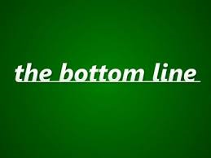
Bottom Line for Faculty
Accept the addition of a ULO in Gen Ed Courses and Upper level courses
Develop a measurable assignment for assessment of that outcome
Add language to syllabus so students submit the assignment
Volunteer to score the assignment against the rubric
Apply analysis of results to personal teaching and learning
Help in building assessment of Wright State Core in upper level courses
Understand the value of assessment

