Slide 2

Debate Season
March 1 - Super Tuesday
March 15 - Ohio Primary
July 18-21 – Republican National Convention
July 25-28 – Democratic National Convention
September 26 - Wright State University Presidential Debate
October 4 - Longwood University Vice Presidential Debate
October 9 - Washington University Presidential Debate
October 19 - University of Nevada Presidential Debate
November 8 - Election 2016

Slide 3
Debate Season
New courses in Communications, Political Science, History
Panel discussions:
  Role of Science and Mathematics in Democracy
  Outbreaks, Public Health and Public Policy
Wright Vote in partnership with League of Women Voters
K-12 initiatives
  Think TV
  Ohio Department of Education

Slide 4
Debate Season
WWSU election show hosted by faculty
Film series
Mock Debates
Student Volunteers
  Communications
  Social Media
  Criminal Justice
  Computer Science
  At large

Slide 5
Debate Season
Community Engagement
  Host Committee
  Hosting national/international media
  Hosting Commission on Presidential Debates
  Raider Country Issues Forums
  SOCHE
  Alumni Watch Parties
  Student Watch Parties
  Faculty Watch Parties

Slide 6
Funding
Cost Recovery
State Appropriations
JobsOHIO
In-kind support
Corporate/Private Sponsorships

Slide 7
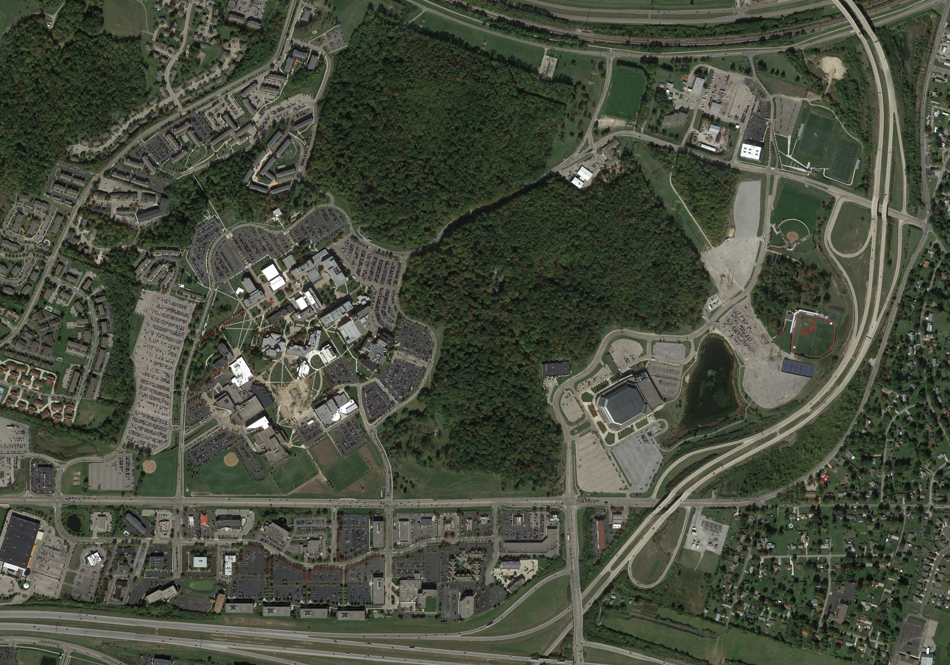
Traffic Flows
X
X
Debate Perimeter
Free Speech

