Slide 1
LOFT report
Full report available @ Faculty senate website

Slide 2
mission
research & make recommendations re: services, resources, infrastructure, & planning to meet the needs of a 21st century university & to promote excellence in WSU’s Library system
review & identify areas of excellence in WSU library collections & services, & make recommendations re: how to maintain those areas & develop further areas of renown
review & recommend improvements to the communication channels to insure faculty input guides investments in future research & teaching resources

Slide 3
process
meetings & discussions
data-gathering:
  commissioned & reviewed reports from WSU Libraries
  designed & conducted a faculty survey
  consulted with other relevant campus entities
  reviewed reports & findings from ALA
subcommittees:
  budget
  collections
  facilities
  staff
  technology
findings & recommendations

Slide 4
findings
budgetary concerns are affecting WSU Libraries’ ability to fulfill their multiple missions, especially with regards to collections;
communication between WSU Libraries & faculty needs to be improved;
collaborations between WSU Libraries & other constituencies on campus need to be enhanced, especially with regards to the future use of new technologies;
WSU Libraries should be prioritized in future fundraising & development endeavors, especially with regards to the library’s facilities;
a regular process of review that emphasizes best practices established by peer &aspirational institutions should be implemented, and Lake Campus Libraries are in need of urgent consideration

Slide 5

excellence
OhioLINK
Interlibrary Loan (ILL)
Electronic journal subscriptions
staff, staff, staff:
  “helpful, courteous, and good at what they do…”

Slide 6
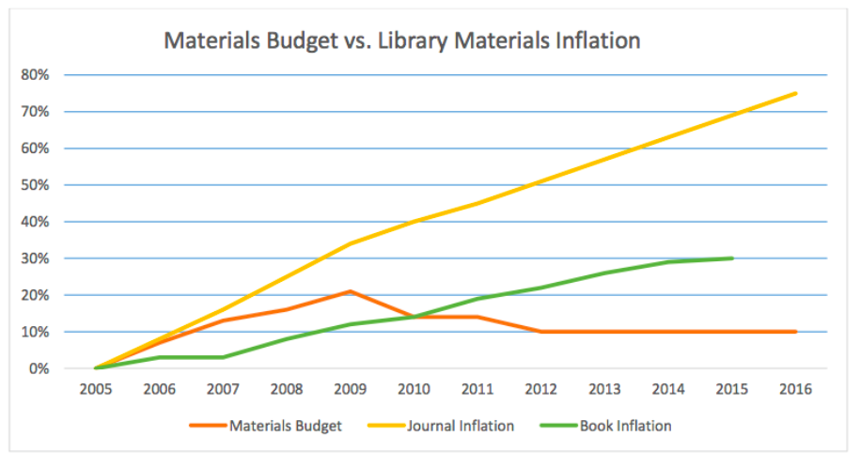
budget & collections

Slide 7
communications

Slide 8
technology & collaboration
Is there anything that you would like to do at the library that’s currently unsupported by the library’s holdings or facilities?
“
”
“
”
STAC for faculty
build a less confusing website
“
”
I would like to be able to meet to collaborate with my colleagues and to use a computer facility for developing projects related to my research.
“
”
Faculty need a space to work…
Writing rooms just for faculty...
At peak usage times: 98% of computers in use

Slide 9
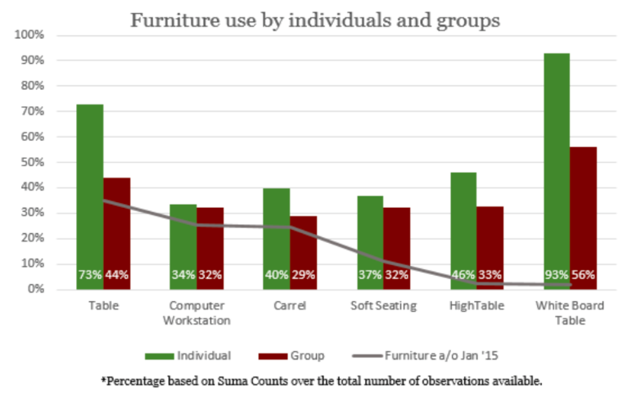
facilities & fundraising
Current seating capacity: 8.6% FTE
Industry Standard: 10-20% FTE

Slide 10
recommendations
that the administration recognize the critical importance of establishing a stable & predictable budget as well as generating additional revenue streams so that the library’s funds for purchasing materials necessary for faculty research & teaching do not continue to diminish;
that the Faculty Senate collaborate with WSU Libraries to establish a “Faculty Advisory Committee” comprised of rotating, representative faculty from each college/school to improve communication to & from these groups, & to steer decisions about collections, policies, facilities, technology, staff, & development;
that the administration work with WSU Libraries & the “Faculty Advisory Committee” to develop & prioritize a plan for the maintenance & update of the libraries’ facilities;
that the Faculty Senate & administration collaborate to develop a process for regular, periodic reviews of WSU Libraries (including Lake Campus) that benchmark WSU Libraries to their peer libraries & identify best practices at aspirational institutions;
that WSU Library’s areas of excellence continue to be supported, including: the hiring of excellent staff, OhioLINK & ILL, & STAC

