Slide 1
Faculty Senate Meeting
December 11, 2017
President
Cheryl B. Schrader

Slide 2
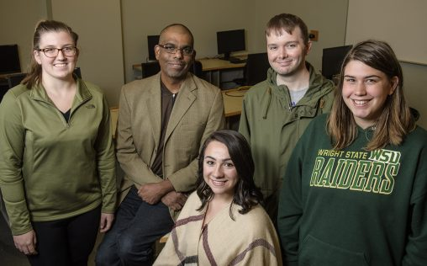
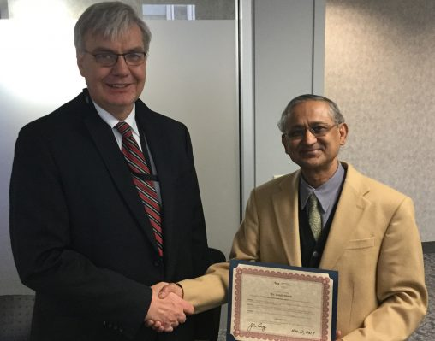
Faculty Achievements
Poverty Project
Technology Commercialization Award

Slide 3
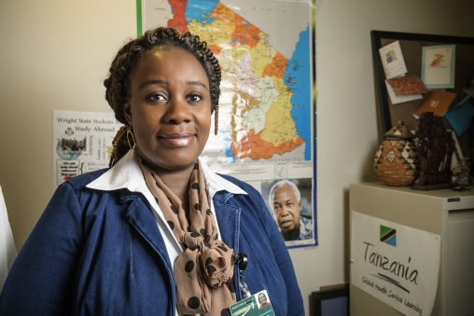
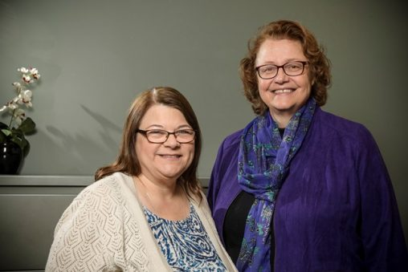
Faculty Achievements
Carnegie African Diaspora Fellowship
Improving Teamwork

Slide 4
Budget Update
Month
August
September
October
November (preliminary)
Cumulative Net Surplus Over $6M Goal
$5,900,000
$5,000,000
$3,500,000
$6,900,000
(yet tracking $3.3M over in compensation expenses compared to remediated budget)

Slide 7
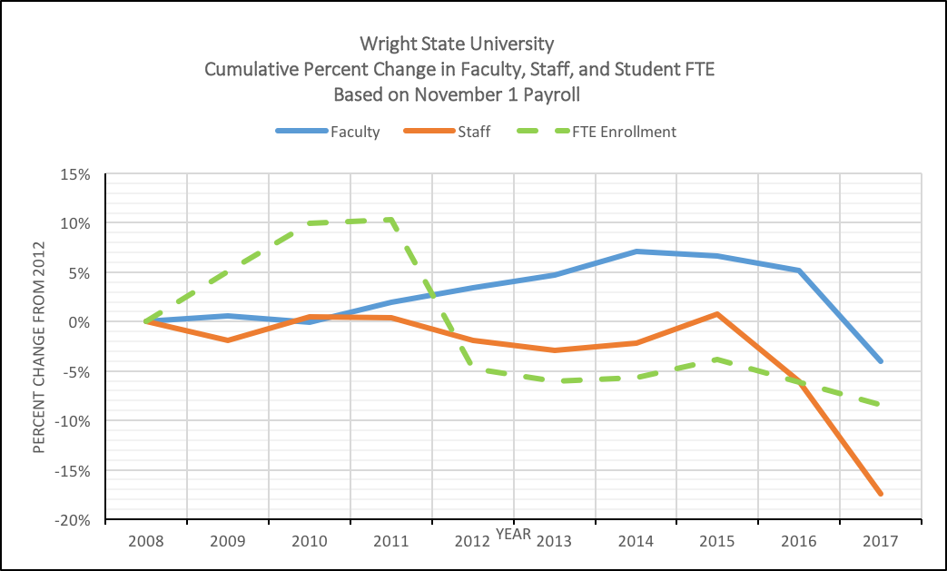

Slide 8
Strategic Planning
December 9—Discussed plan, process and timeline with Board of Trustees
Forming Strategic Planning Steering Committee
Full launch in January
Plan approved in October

Slide 9
Upcoming Events
Saturday, December 16
Commencement
Saturday, February 10
Faculty/Staff Appreciation Night

