Slide 1

Presentation to the
Board of Trustees
Wright State University
Mary Ellen Ashley
Vice President Enrollment Management

Slide 2
Readiness for Recruitment
Requires:
Organizational Structure
Hiring Talent
Training and Team Building
Collaboration across University
Inclusion of the Lake Campus

Slide 3
Readiness for Recruitment
Requires continued:
Coordination with Marketing
Understanding Communications Planning
The Right Tools
Research

Slide 4
Enrollment
Management Tools
        Enrollment RX, CRM NEW

Slide 5
CRM:
Constituency Relationship Management
Benefits:
  Can capture all applications when fully implemented
  Allows students and staff to use (1) system to record and see enrollment process and progress

Slide 6
CRM:
Constituency Relationship Management
Think “Amazon”
Benefits continued:
  When “The Marketing Cloud” is fully implemented,
  will allow staff and faculty to build email
  relationships and market to prospective students.

Slide 7
CRM:
Constituency Relationship Management
Benefits continued:
  Will be able to decentralize reports and facilitate targeting prospective students in “just in time” mode.
  Events management module can assist recruitment with registration and marketing of campus tours, campus visits, open houses, calling events, and orientation, to name a few.

Slide 8
Marketing Coordination
      Created Junior Campaign ★NEW★
      Expanded Senior Campaign ★NEW★
      Work on Lake’s Behalf
      Added Direct Mail ★NEW★

Slide 9

Junior Academic Teaser
  Covers academic support, career guidance, undergraduate research, study abroad, and honors. Encourages prospective students to learn more about our majors.

Slide 10

Viewbook
MAJOR RECRUITING PIECE
Info re: University & Dayton
How to apply
First-year experience
Financial aid
Campus housing
Advanced experiences
Student resources
Campus life
Academic colleges, Majors
Encourages prospective students to visit and apply.

Slide 11
Direct Mail -- NEW
Seniors
Juniors
Events
Travel
Lake Campus
Financial Aid
Orientation
College Additions
    Building a PowerPoint to visually share communication plans

Slide 12

Green and Gold Day
Invites prospective students to attend our Fall Green & Gold event.

Slide 13
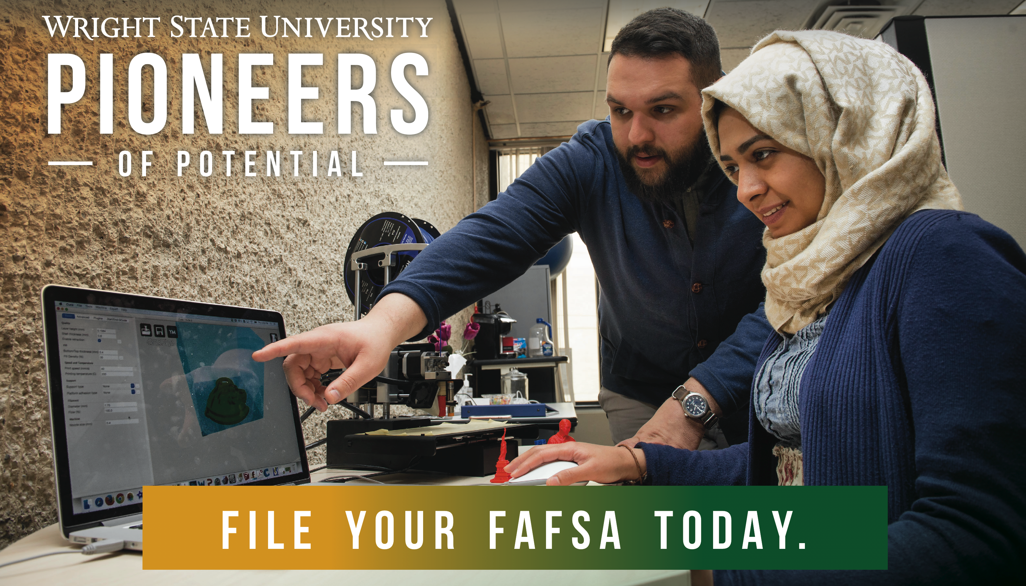
Financial Aid

Slide 14
Enrollment Marketing Includes:
Ads: Newspapers, statewide events, web
Billboards
Radio
Social Media

Slide 15
Prospect Recruitment
Ruffalo Noel Levitz – Vendor Partner - NEW
Name buys:
  ❖ ACT  NRCCUA
  ❖ SAT  CBSS
Juniors (60,000) — ★NEW★ this year; build pool
Seniors (40,000) — Starting 3rd year; add applicants

Slide 16
Prospect Recruitment
Ruffalo Noel Levitz – Vendor Partner - NEW
Market 1 – Raider Country
Market 2 – Ohio
Market 3 – Indiana Reciprocity
Narrows to “potential Wright State University fit”
Multi-channel approach: emails, calls
“De-dup” for us and provide regular reports on progress

Slide 17
Inquiry/Application Recruitment
Mine pipeline pools like:
College Credit Plus partners ★NEW★
Student Paths partners ★NEW★
Upward Bound
Greene County Scholarship Program ★NEW★
Montgomery County College Promise - ★NEW★

Slide 18
Inquiry/Application Recruitment cont.
Mine pipeline pools like:
Campus Events
Athletics
All Admissions recruitment activities
All College Events
TOTAL INQUIRIES
26,046
(66% Seniors)
TOTAL UG APPS.
5,696

Slide 19
Admissions Recruitment
  Ohio Articulation Meetings 4
  Guidance Counselor ACT Workshop 68 ★NEW★
  High School Visits
  College Fairs
  Alumni Coordination
  Student Road Raiders 50 ★NEW★
  Open Houses 3,000
  Green and Gold Day
  Admitted Student Day

Slide 20
Admissions Recruitment
High School Visits/Fairs
TOTAL 2015
890*
TOTAL F16
572*
*Includes Lake and CCP

Slide 21
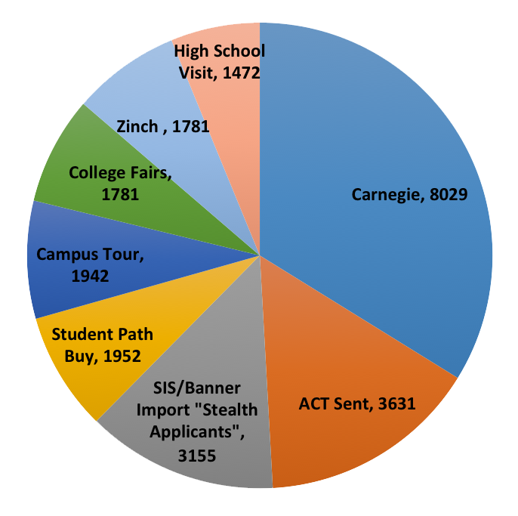
First Inquiry Sources

Slide 22
First Inquiry Sources

Slide 23
Admissions Tours/Visits
Elementary schools
Middle schools
High school
TRIO programs:
  Gear Up
  Talent Search
  Upward Bound
Day care centers
Teen Centers
YWCA/YMCA programs
Social Services programs
Cincinnati History Museum
Boys & Girls Club
County Court programs
TOTAL 2015
23,444
All Types
⬅➔
TOTAL 2016
24,635

Slide 24
Adult & Transfer Recruitment
Includes:
Veterans/military
Lake transitions
Community college articulations:
  11 MOUs
  146 programs
  21 guides
  Scholarship Incentives ★NEW★

Slide 25
Adult & Transfer Recruitment continued
Includes:
Corporate ★NEW★
Hospitals ★NEW★
Dayton Metro Libraries ★NEW★
Scholarship programs
    Mathile
    Montgomery College Promise ★NEW★
TOTAL FAIRS/COMMUNITY COLLEGE VISITS
182

Slide 26
Raider Connect Outreach
Financial Aid/Registration/Payment Presentations:
  Financial Aid awareness nights
  FAFSA Workshops
  Registration Workshops
  Veterans/Military Orientation
  Independent Scholars Orientation
  Graduate School Orientation
  UCIE Orientation
TOTAL
110

Slide 27
Orientation
    Final “Marketing” events include:
      Summer Orientation ★NEW★
      22 Undergraduate sessions
      15 Graduate sessions
      2,499 Undergraduate students
      5,000 Undergraduate family members
      UG First Friday Welcome -
      1500 students ★NEW★

Slide 28
Orientation
Final “Marketing” events include continued:
  Spring Orientation ★NEW★
  3 Undergraduate Sessions - 100+ Students
  Summer School Orientation ★NEW★
  Transfer Track added ★NEW★
  College Credit Plus Senior Orientation ★NEW★

Slide 29
Research
Ohio Maps
Degree–Seeking by County
First-time Students by County
Transfer Students by County

Slide 30
Research
First Inquiry – Students Admitted
High School Outreach – Penetration rates in 30 mile radius
Competition Data
Student Attrition Data by semester
College Credit Plus Enrollment Grades by College and Courses
Financial Aid Scholarship Reports

Slide 31
Research
Student Profiles
New Undergraduate Degree–Seeking Students
New Undergraduate Degree–Seeking Students, Lake Campus
College Credit Plus, Dayton and Lake
International Students
Diversity

Slide 32
Short Term
Ways to Increase Enrollment
Campus coordination, SEM Teams
Continuing students
Ending “melt”
Building connections
Increasing pipeline yield:
  College Credit Plus
  Scholarship programs
  TRIO programs

Slide 33
Short Term
Ways to Increase Enrollment
Corporate/community partners
  Premier Health 72 ★NEW★
  Veterans Administration 10 ★NEW★
  Fidelity Health 15 ★NEW★
  Care Source NEW
  Dayton Children’s Hospital NEW
  Ohio Dept. of Rehabilitation & Corrections NEW
  College – corporate partners NEW
  Warren County Job & Family Services NEW
  WPAFB – undergraduate NEW

