Slide 1


HOW DO WE KNOW OUR STUDENTS ARE LEARNING?
Carl Brun
Renee Aitken

Slide 2
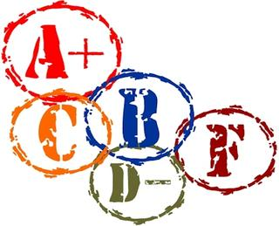
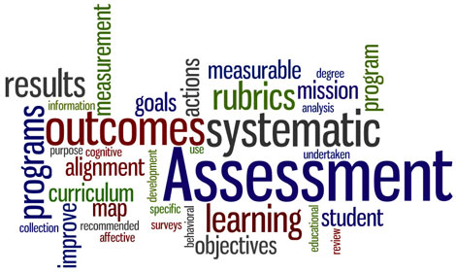
What is Assessment?
Grading is used to evaluate individual student learning and performance.
Assessment is used to evaluate many students against a learning outcome.
Assessment goes beyond grading by systematically examining patterns of student learning across courses and programs and using this information to improve educational practices.

Slide 3

What Assessment Is Not
It is not a trap for faculty. The expectation is that you will use assessment data to improve your courses to improve learning. Data is shared only with faculty and in a very high-level way with others, such as this committee and chairs, both which are groups that will work with the faculty to improve student learning.
It is not a one-time only process – you should have a cycle of assessment.

Slide 4
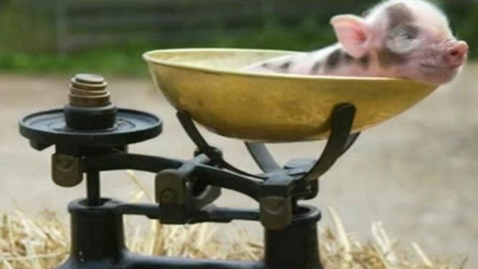
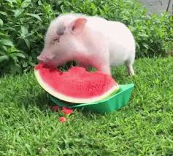

"It's not so much what you are measuring that is important; it's that what you are measuring is measurable. This is truly indicative of campus success."

Slide 5
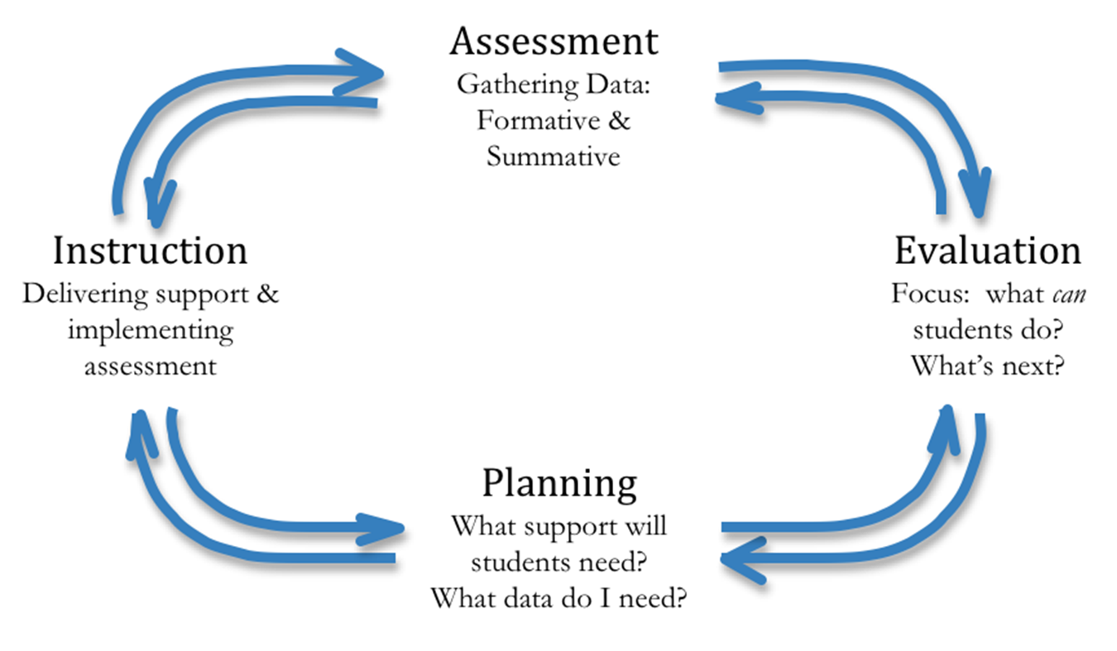
Assessment is a Cyclical Process

Slide 6
All Things Assessment (at the course level)
  What do you want your students to know when they leave your classroom? (Creating actionable objectives and outcomes)
  Where will you determine if they know it? (Mapping outcomes to assignments)
  What will you use to measure it consistently across all students? (Developing a rubric, marking test questions)
  When will you measure it?
  Using the data to make changes to help students learn.
  Measuring again.
  Mapping to the program outcomes so students are learning what they need to be successful.

Slide 7
…And now for something COMPLETELY different…

Slide 8
Why a Formal Assessment Process for Core?
In this skills-driven world, general education is under attack
In this discipline-driven world, general education is under attack
Core is the foundation for all majors
Assessment can help answer the question – “what are the outcomes of core?”

Slide 9
All Things Assessment at the Core course level
  What do you want your students to know when they leave your classroom? (Creating actionable objectives and outcomes)
    WSU Core Brochure – These outcomes were not your choice
    Overall goal of Core
    University Learning Outcomes
    Element Outcomes
    Attribute Outcomes

Slide 10
All Things Assessment at the Core course level
  Where will you determine if they know it? (Mapping outcomes to assignments)
  Undergraduate Curriculum Review committee Memo – Again, these outcomes were not your choice
    2017-2018 Element 3
    global traditions Outcomes – All Inclusive
    Multicultural competency
    Integrated writing
    the assignment – This is your choice!!!
    Make sure the assignment matches the rubric
    Most opportunity for success is using an assignment from near the end of the semester – students have “practiced” the outcomes
    Do not have a “not applicable” option

Slide 11
All Things Assessment at the Core course level
  What will you use to measure it consistently across all students? (Developing a rubric, marking test questions) – This is your choice!!!
  Options:
  Use a rubric you already use that measures the element 3 outcomes and the attributes for your course
  Adapt aacu rubrics
  Adapt past core rubric for global awareness and Intercultural knowledge and competency
  Adapt past core rubric for integrated writing
  Select from other rubrics available from taskstream
  Select from other reliable and valid rubrics

Slide 12
All Things Assessment (at the course level)
  When will you measure it?
    Spring 2018
  Using the data to make changes to help students learn.
    Data results should be available during the Summer 2018
    Use results to write and submit report to the UCRC during Fall 2018
  Measuring again.
  Mapping to the program outcomes so students are learning what they need to be successful.

Slide 13
Core Assessment Plan due nov 20, 2017
Element 3 Core Outcomes & IW & MC Attributes
Identify the course sections:
Dayton, Lake, and Online
Identify the assignment to evaluate
Develop or Choose a rubric to use to evaluate based on the core outcome
How will the data be collected, analyzed, and reviewed (state by whom)

Slide 14
The Help Team
  Carl Brun - works with Core
    Aligning curriculum with standards
    Collecting syllabi and posting to website
    Analyzing data and sharing the results
    UH280A
    Ext. 2155
  Renee Aitken - works with Assessment and Accreditation
    Building a university level assessment process
    Collecting, analyzing data, and sharing the results
    Sharing assessment plans and procedures across the university
    UH280C
    EXT. 4984

