Slide 1


HOW DO WE KNOW OUR STUDENTS ARE LEARNING?
Carl Brun
Marie Hertzler

Slide 2
Why are you here?
Carl
What is assessment?
Why do Assessment?
Marie
Overview of the charge of the undergraduate Core Oversight Committee
2018-2019 is the “year of Element 6 – Natural Science
Carl & marie
What exactly do we have to do and by when?

Slide 3
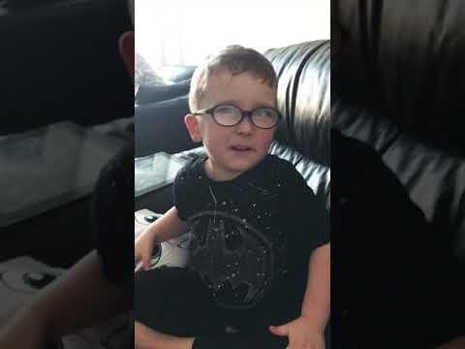
Why are you here?

Slide 4
Because we have to
HLC requires assessment of all academic programs
Negative consequences of higher education push for assessment
An Insider’s Take on Assessment_ It May Be Worse Than You Thought - The Chronicle of Higher Education.html
http://c.ymcdn.com/sites/www.aalhe.org/resource/resmgr/docs/Int/AAHLE_Fall_2017_Intersection.pdf “A Guide for the Perplexed” by David Eubanks
Pressure to assess has led to conclusions from small sample sizes, methods that are not valid or reliable; “Common Sense” conclusions can create more inaccuracies
My experiences are that The “trying” has led to positive changes

Slide 5
Assessment and me – Carl’s Story
Evaluation of social work programs
A Practical guide to evaluation (2005, 2014)
Required of social work accrediting body
WSU has tried multiple ways to assess all academic programs
Bill Rickert, Joe law, Renee Aitken
WSU has tried multiple ways to assess all Core
Lily Howard, Herb Dregalla, Joe Law, and now Me

Slide 6
Assessment and me – Marie’s and ucrc’s Story
mandate from Faculty senate to oversee wsu core courses
Learning Outcomes and Attributes (IW, SRV/SRVI, MC)
six-year cycle; one element each year; 10 to 30 courses
trust the assessment template

Slide 7
Assessment and me – your Story
Each of you are assessment experts
You ask yourself all the time “why are my students getting this” or “Why are they not getting it”?
You’ve participated in HLC required assessment
You may have participated in core assessment in the papst
You may have participated in accreditation in the past
Use that expertise to develop your department’s assessment of Element 6

Slide 8

Enough of the disclaimers – On with the material

Slide 9


What is Assessment?
Grading is used to evaluate individual student learning and performance.
Assessment is used to evaluate many students against a learning outcome.
Assessment goes beyond grading by systematically examining patterns of student learning across courses and programs and using this information to improve educational practices.

Slide 10

What Assessment Is Not
It is not a trap for faculty. The expectation is that you will use assessment data to improve your courses to improve learning. Data is shared only with faculty and in a very high-level way with others, such as this committee and chairs, both which are groups that will work with the faculty to improve student learning.
It is not a one-time only process – you should have a cycle of assessment.

Slide 11
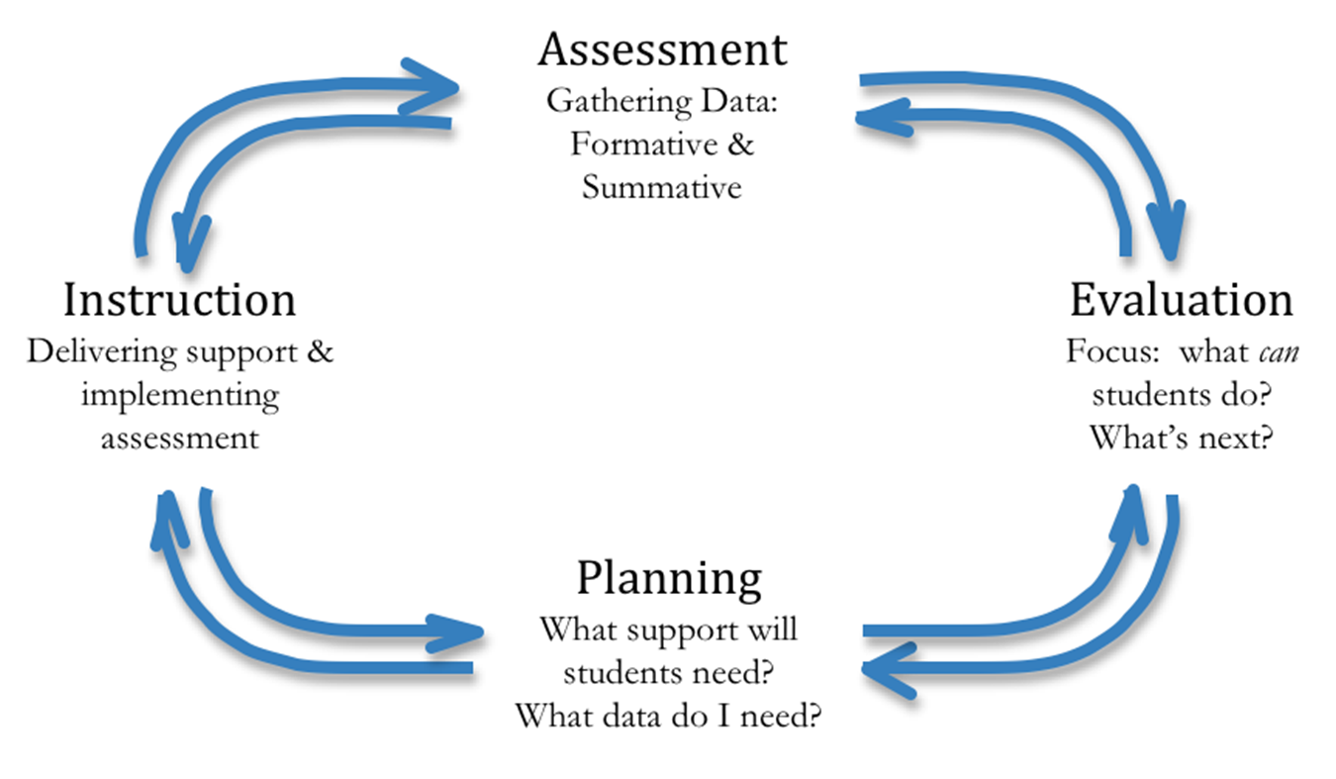
Assessment is a Cyclical Process
Biology Lab Example

Slide 12
Why a Formal Assessment Process for Core?
In this skills-driven world, general education is under attack
In this discipline-driven world, general education is under attack
Core is the foundation for all majors
Assessment can help answer the question – “what are the outcomes of core?”

Slide 13
All Things Assessment (at the course level)
What do you want your students to know when they leave your classroom? (Creating actionable objectives and outcomes)
Where will you determine if they know it? (Mapping outcomes to assignments)
What will you use to measure it consistently across all students? (Developing a rubric, marking test questions)
When will you measure it?
Using the data to make changes to help students learn.
Measuring again.
Mapping to the program outcomes so students are learning what they need to be successful.

Slide 14
All Things Assessment at the Core course level
What do you want your students to know when they leave your classroom? (Creating actionable objectives and outcomes)
WSU Core Brochure – These outcomes were not your choice
Overall goal of Core
University Learning Outcomes
Element Outcomes
Attribute Outcomes

Slide 15
Core element 6 outcomes
Introductions to the scientific understanding of the physical and biological phenomena
Understand the nature of scientific inquiry
Critically apply knowledge of scientific theory and methods of inquiry to evaluate information from a variety of sources
Distinguish between science and technology and recognize their roles in society
Demonstrate an awareness of theoretical, practical, creative and cultural dimensions of scientific inquiry
Discuss fundamental theories underlying modern science
Your course needs to address all element 6 outcomes
The core assessment needs to address at least one of the outcomes

Slide 16
All Things Assessment at the Core course level
Where will you determine if they know it? (Mapping outcomes to assignments)
Core Course assessment plan, section 1: general information
2018-2019 Element 6 –Natural Sciences courses
Summer, fall, or spring
All sections, including honors, online, and lake
Integrated writing
Who is taking the lead
At least two reviewers; instructors will not review own papers
questions on section 1?

Slide 17
All Things Assessment at the Core course level
Where will you determine if they know it? (Mapping outcomes to assignments)
Core Course assessment plan, section 2: assessment plan
the Outcomes – This is your choice!!!
You need to choose at least one of the element 6 outcomes
You can adapt the outcome – AFS example “Critically apply knowledge of social science theory” was amended to “Critically apply knowledge of Afrocentrism”
Let us know if you adapt the LO
Do not simply list all 5 if you don’t plan to assess all five, Please!!

Slide 18
All Things Assessment at the Core course level
Where will you determine if they know it? (Mapping outcomes to assignments)
Core Course assessment plan, section 2: assessment plan
the assignment – This is your choice!!!
Keep IT SIMPLe (S____)
Can use qualitative, open-ended assignments or quantitative, closed ended exam questions
Open-Ended:
Assignments or exam essay questions– preferably individual, written assignments submitted to pilot
Match the outcome # to the title of the assignment or question (eventually you will submit a description of the question or assignment
Select a rubric to measure the outcome as evidenced by the student response to the question
Most opportunity for success is using an assignment from near the end of the semester – students have “practiced” the outcomes
Do not have a “not applicable” option
Lab assignments have been used in the past

Slide 19
All Things Assessment at the Core course level
Where will you determine if they know it? (Mapping outcomes to assignments)
Core Course assessment plan, section 2: assessment plan
the assignment – This is your choice!!!
Closed-ended:
exam questions (“marker questions”)
Match the Outcome # to the Exam Question
Select the questions that are evidence that the learning outcome was met
Do not select questions with an “all of the above” response
State the benchmark by which the learning outcome will be expected
Any questions about section 2 up to this point?

Slide 20
All Things Assessment at the Core course level
Where will you determine if they know it? (Mapping outcomes to assignments)
Core Course assessment plan, section 2: assessment plan
Collecting and submitting the student assignment(s)
Open-Ended questions
Downloading to pilot is the best option
Anonymity of the papers can only be done if you ask the students not to put identifying information on the papers – no student name, no professor name, no section name
Otherwise, reviewers will know the identity of the student, professor, and section name – most feasible option
Close-ended questions (this option should be added to the plan)
You must have a process for summarizing the data and reporting the outcomes against the benchmark

Slide 21
All Things Assessment at the Core course level
What will you use to measure it consistently across all students? (Developing a rubric, marking test questions) – This is your choice!!!
Rubric selection Options:
Use a rubric you already use that measures the element 6 outcomes and the IW attribute, if applicable
Adapt aacu rubrics
Critical thinking
Inquiry and analysis
These two overlap, highlight in yellow the items you want to use
Iw rubric
Select from other rubrics available from watermark
Select from other reliable and valid rubrics

Slide 22
All Things Assessment at the Core course level
What will you use to measure it consistently across all students? (Developing a rubric, marking test questions) – This is your choice!!!
Rubric selection Options:
If you are using forced choice exam question only, you will not have a rubric!!
The grid at the bottom is the rating grid by the Core Oversight Committee
Questions about filling out the plan?

Slide 23
All Things Assessment (at the course level)
THE ASSESSMENT LOOP
When will you measure it?
2018-2019
Using the data to make changes to help students learn.
Data results should be available during the Summer 2019
Use results to write and submit report to the UCRC during Fall 2019
Measuring again.
Mapping to the program outcomes so students are learning what they need to be successful.

Slide 24
CORE ASSESSMENT PLAN TIMELINE - MARIE
trust the assessment template
staying on schedule:
plan submission by april 2: pilot, continuous year, core course assessment plan 2018-19
UCRC review of each assessment plan
feedback to each department chair and assessment lead faculty by May 1
implementation during summer or fall 2018 or spring or summer 2019
written report due to UCRC by October 1, 2019
ucrc reviews reports and submits summary with recommendations to department and faculty senate

Slide 25
The Help Team
Marie Hertzler – committee chair
MH231
Ext. 2641
Marie.Hertzler@wright.edu
Will Romine – COSM representative to the committee
BS221B
Ext. 3422
William.romine@wright.edu
Carl Brun – Core coordinator
UH280A
Ext. 2155
Carl.brun@wright.edu

Slide 26

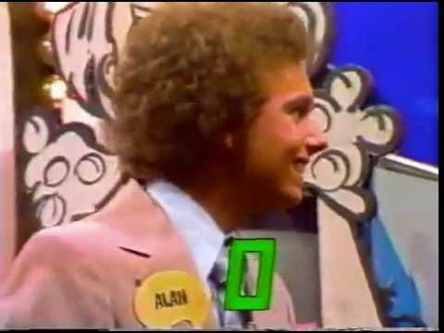
WE MADE IT!

