Slide 1
Faculty Senate Presentation
Computing and Telecommunications Services (CaTS)

Slide 2
Two-Factor Authentication (2FA)
What is 2FA?
Two-factor authentication is an extra layer of security that requires not only a username and password, but also authenticates with a device in your possession (cell/smart phone, key fob, landline phone).

Slide 3
Two-Factor Authentication (2FA)
Why use 2FA?
2FA protects against phishing, social engineering and password attacks and secures your accounts from attackers exploiting weak or stolen credentials.
With Banner 9, UIDs and PINs will no longer be used for authentication. All services will be accessed using the campus ‘w’ username and password.

Slide 4
Two-Factor Authentication (2FA)
Where will 2FA be used?
WINGS
Office 365
VPN – Coming Soon
WINGS Express (grades, payroll, leave reports/timesheets) – Coming Fall 2018
Pilot – Coming Soon
User experience/trusted networks

Slide 5
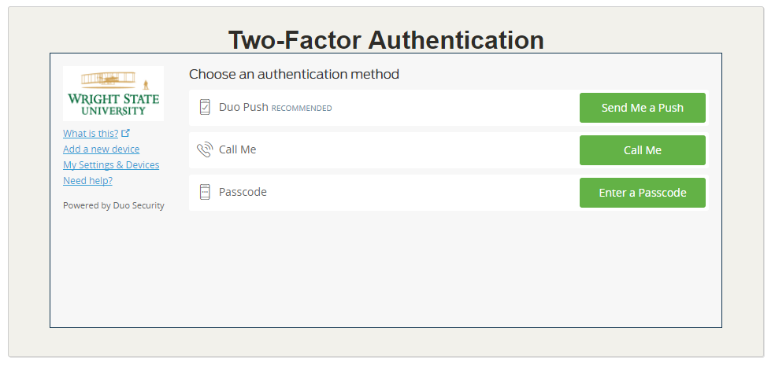
Two-Factor Authentication (2FA)

Slide 6
Two-Factor Authentication (2FA)
Timeframe:
Opt-in period starts now
Visit wright.edu/2fa to enroll
Mandatory 2FA to start late Fall 2018
Anyone enrolling in 2FA will have their password set to never expire

Slide 7
Classroom Computer Proposal
CaTS is proposing to replace existing classroom Mac Minis with Windows-based PCs.

Slide 8
Rationale
Apple last updated the Mac Mini in October 2014
Dual boot setup creates complexities and essentially doubles the number of computers to support
Incompatibility with Windows 10 on older Mac Mini’s
Data collected for Spring Semester 2017 indicated there were 14,993 logins, of which 23% were using Mac OS X
Estimated annual cost savings of $12,000

Slide 9
Accommodations for Mac Users
Adapters given to any faculty who needs one
VGA cables will be provided in all rooms
AppleTV and ShareLink (wireless display) currently available in 19 rooms
Plan to upgrade 18 more rooms in Summer 2018
AppleTV and ShareLink is standard for all new room builds/upgrades
Potential for MacBook Air checkout at the Help Desk for the entire Semester
Potential for Mac Mini delivery to classroom

Slide 10
Other Notes
General Mac support on campus will not be impacted
All Workstation and Help Desk staff are now Apple certified
Rollout of Casper in 2017
Mac computer labs will continue to be available around campus
CAC (122, 201, 205, 288), 058 Dunbar Library, ERC (CEHS), etc.

Slide 11
Desire to Learn (D2L)
2017 On Premise Cost | 2017 Cloud Quote | 2018 Cloud Quote
$135,000 | $219,000 | $133,000
Current contract ends July 2018
New 2-year agreement starts August 2018
Ability to renew for an additional 2 years at the same rate

