Slide 1
Faculty Senate Meeting
January 22, 2018
President
Cheryl B. Schrader

Slide 2
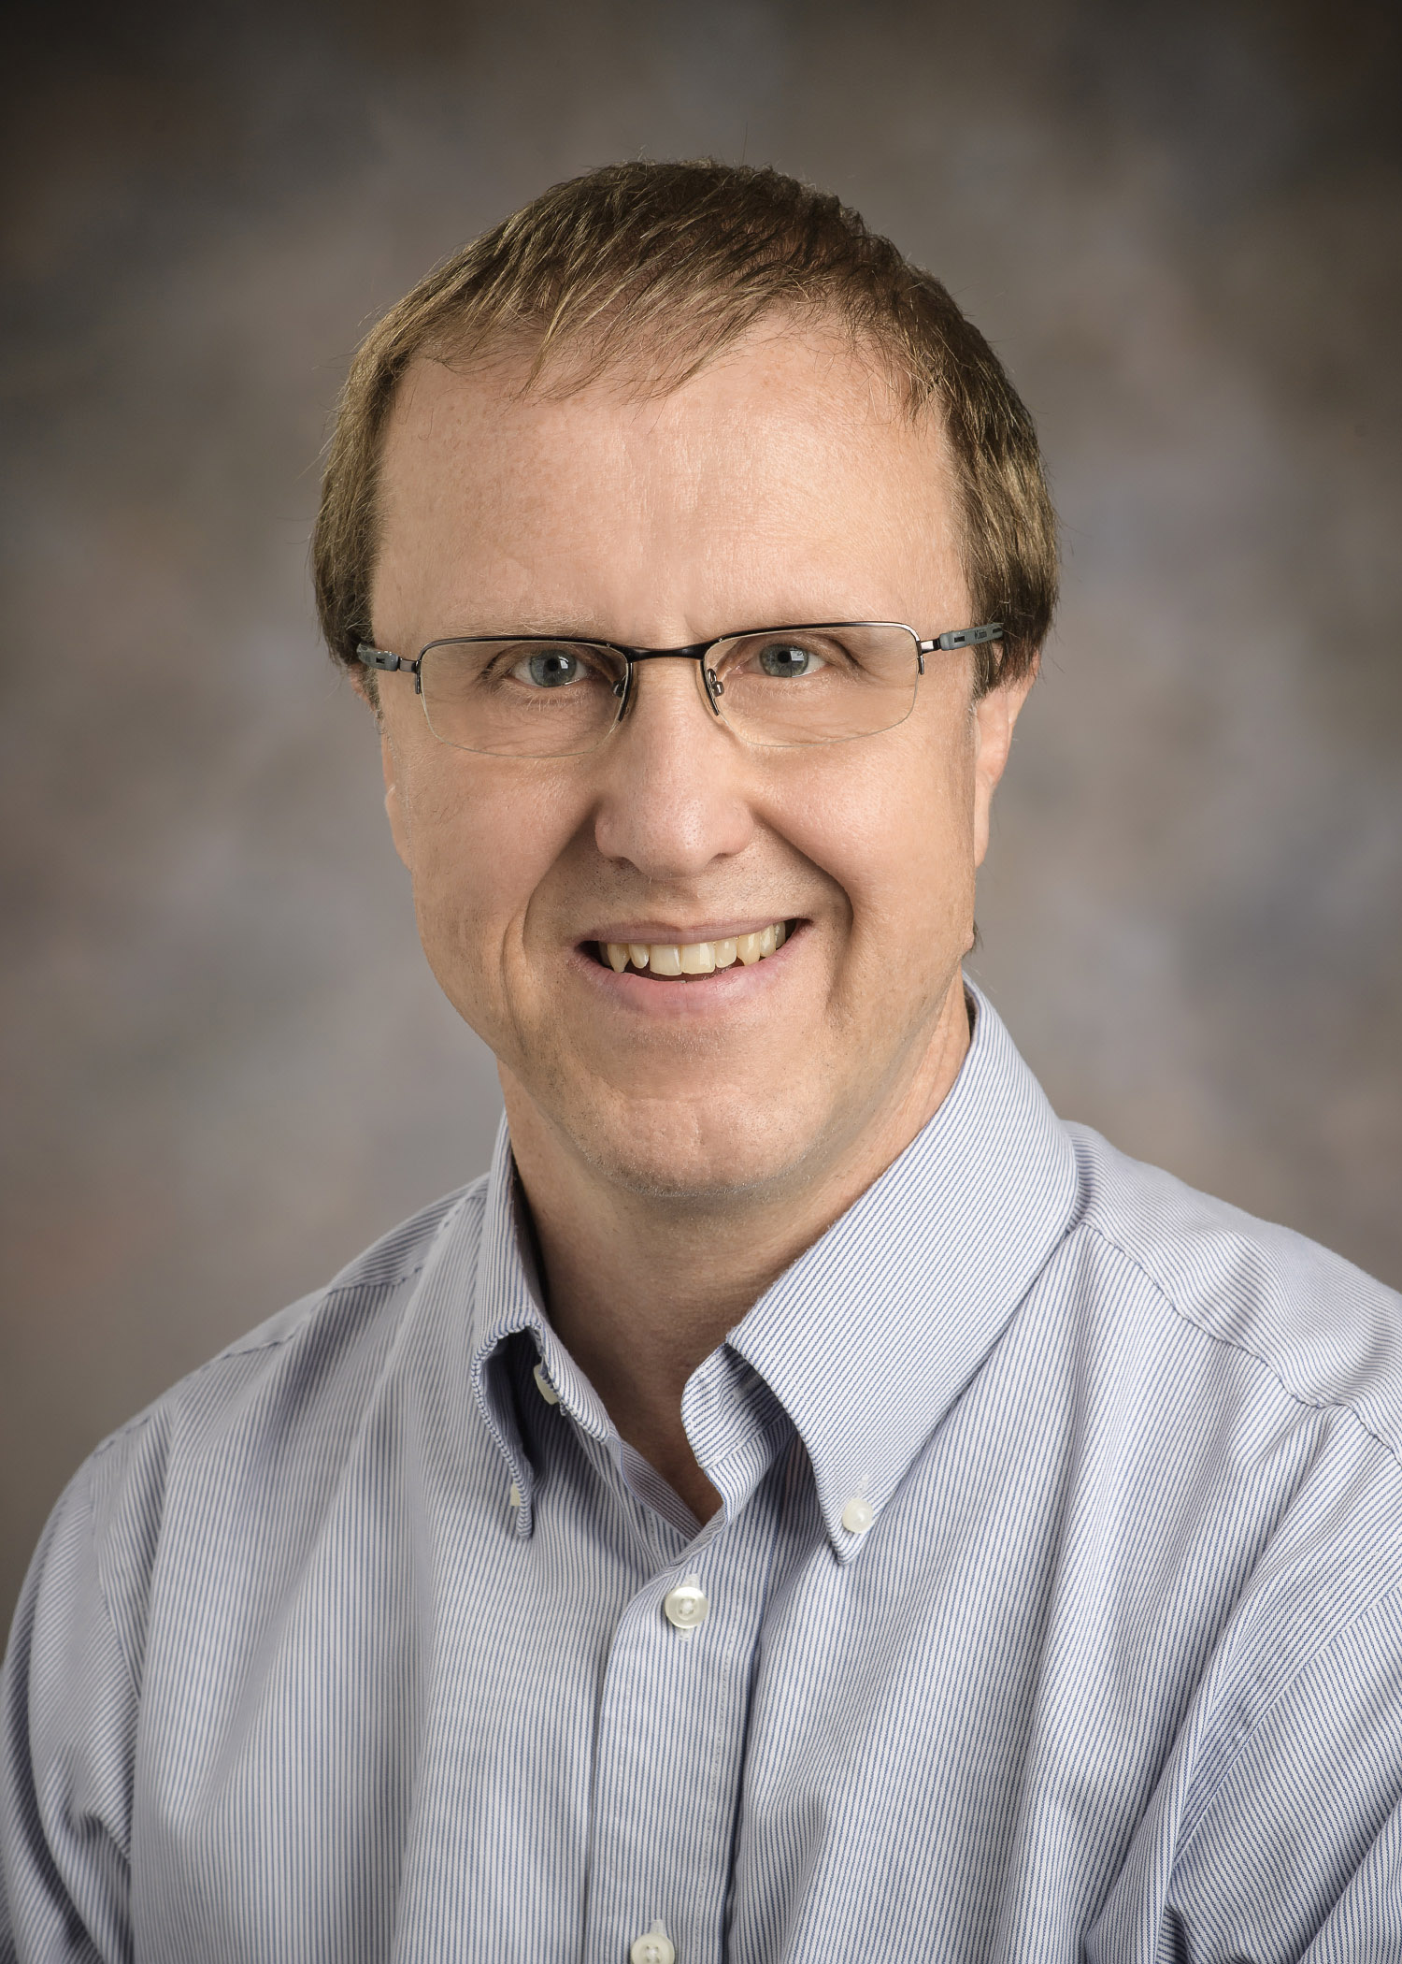
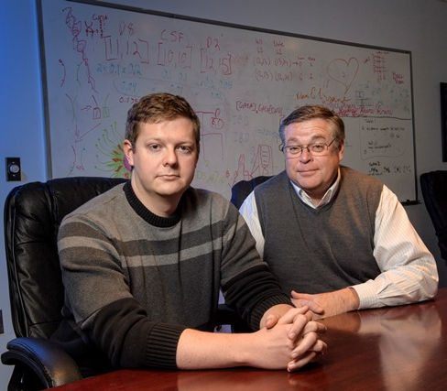
Faculty Achievements
Playing key role in DNA software debate
Treating weakness in patients following critical illness

Slide 3
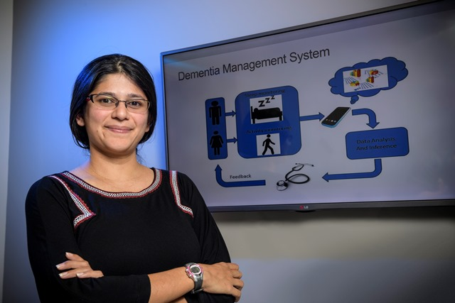
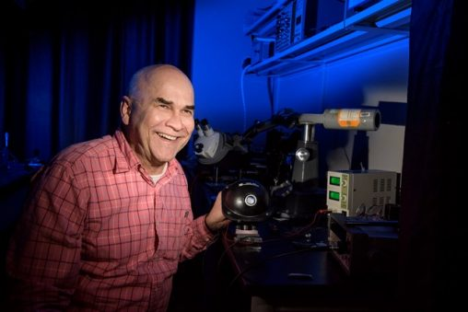
Faculty Achievements
Developing a promising, new semiconductor for LED lighting
Studying burnout among the caregivers of dementia patients

Slide 4
Budget Update
Let’s Talk Forum
Wednesday, January 24
11:30 a.m. to 1:00 p.m.
Student Union Apollo Room
Budget Forecast
Senate Bill 6
Fiscal Watch

Slide 5
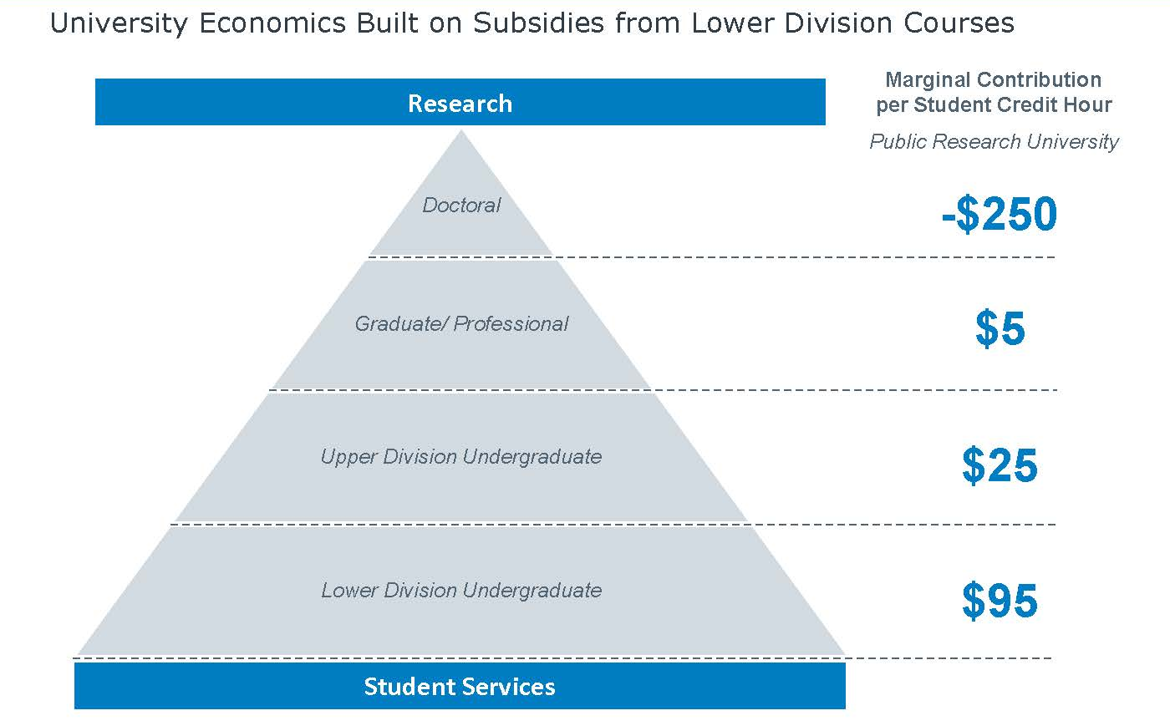
Higher Education Funding Challenges
Source:
EAB. (2017). The future of arts and sciences: Understanding key drivers of shifting demand and engaging faculty in program revitalization. Academic Affairs Forum, 71.

Slide 6
Strategic Planning
Strategic Planning Steering Committee
Three co-leaders
David Bright, chair of the Department of Management and International Business
Michael Wiehe, director of the Applied Policy Research Institute
Cheryl B. Schrader, president
About 30 members
Timeline
Prepare Fall 2017
Launch January 2018
Approve October 2018

Slide 7
Strategic Planning
Program Efficiency Review
Two co-leaders
Craig Woolley, chief information officer
Dan Krane, professor of biological sciences
Review all academic and non-academic programs
Website
wright.edu/strategicplan

Slide 8
Upcoming Events
Wednesday, January 24
“Let’s Talk” Forum
Saturday, February 10
Faculty/Staff Appreciation Night
Saturday, March 24
ARTSGALA

Slide 9
Go Raiders!
Friday, January 26
Men’s Basketball vs. Detroit Mercy
7:00 p.m.
Sunday, January 28
Men’s Basketball vs. Oakland
2:00 p.m.
Thursday, February 8
Women’s Basketball vs. Detroit Mercy
5:00 p.m.

