Slide 1
Faculty Senate Meeting
March 19, 2018
President
Cheryl B. Schrader

Slide 2
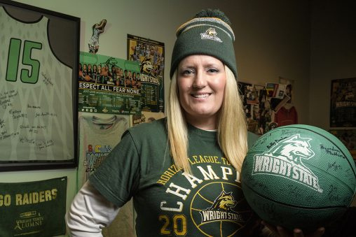
Faculty Achievements
Women’s basketball superfan

Slide 3
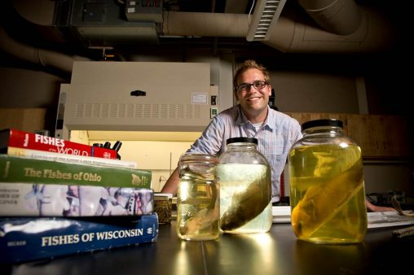
Faculty Achievements
Water quality research

Slide 4
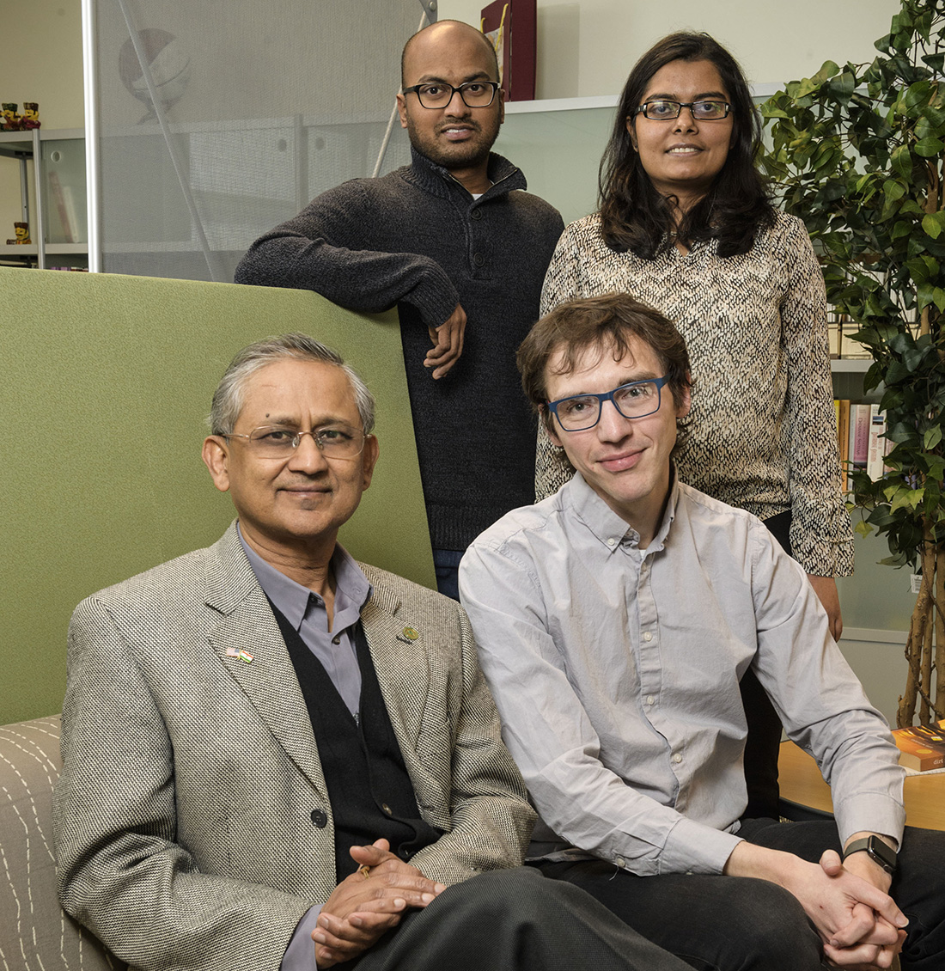
Faculty Achievements
Reducing street gang violence

Slide 5
Budget Remediation Levers Levers in Progress
Move departments from leased space to campus
Reduce outsourced custodial services
Eliminate HVAC outsourced management
Renegotiate software agreements
Eliminate domestic partner benefits
Implement academic and administrative reorganization
Sell excess property—Miami Valley Research Park
Sell excess property—Yellow Springs
Lease empty space to outside entities
Renegotiate AM housing agreement
Implement energy savings measures
Eliminate SEI investment consulting agreement
Implement Guaranteed Tuition
Continue to eliminate vacant positions
Outsource management of Nutter Center

Slide 6
Budget Remediation Levers Potential Future Levers
Delay purchases until next year
Sell excess property
Develop property on Colonel Glenn
Reduce in-house custodial and service levels
Raise parking permit rates
Reinstate austerity measures
Cancel searches
Sweep salary offsets
Freeze new research incentive fund expenditures
Spend foundation funds in lieu of university funds
Initiate furloughs

Slide 7
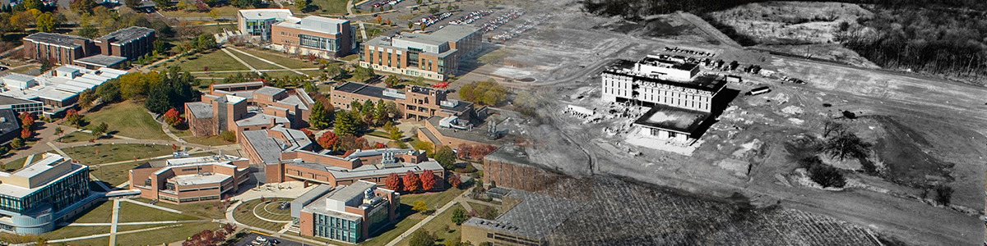
Celebrating 50 Years
Founded to meet the research needs of the region
Potential early names: Buckskin University, Whatsamatta U,
Ohio Institute of Technology
Officially became the Raiders in 1971

Slide 8
Earned Media
 | Ad Value | Clips | Impressions
Athletics (March 1-7, 2018) | $4.64M | 2,131 | 70M
Athletics FY18 (to date) | $16.43M | 13,815 | 192M
University FY18 (to date) | $1.57M | 1,749 | 23.67M

Slide 9
Social Media February 28 – March 7, 2018
 | Total | Change
Messages Received | 1,725 | +235.6%
Impressions | 1,305,717 | +23.2%
Engagements | 25,130 | +40.4%

Slide 10
Upcoming Events
Saturday, March 24
ARTSGALA
Friday, April 6
Amigos Latinos Gala

Slide 11

