Slide 1
Faculty Senate Meeting
November 5, 2018
President
Cheryl B. Schrader

Slide 2
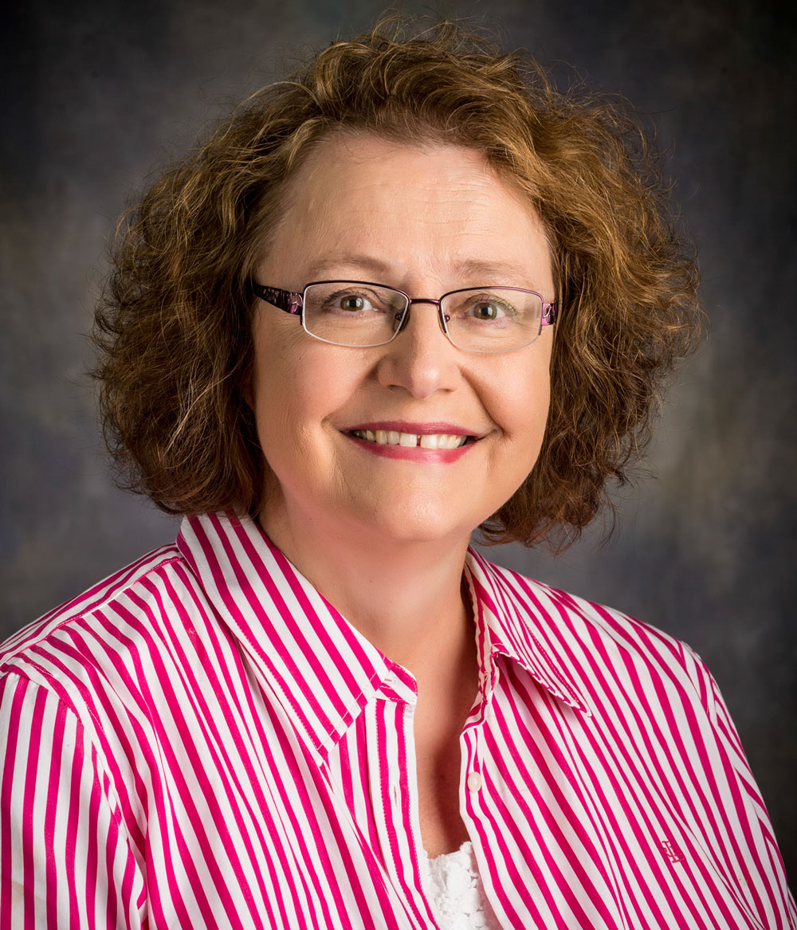
Faculty Achievements
Honored by the American Association of Colleges of Nursing

Slide 3
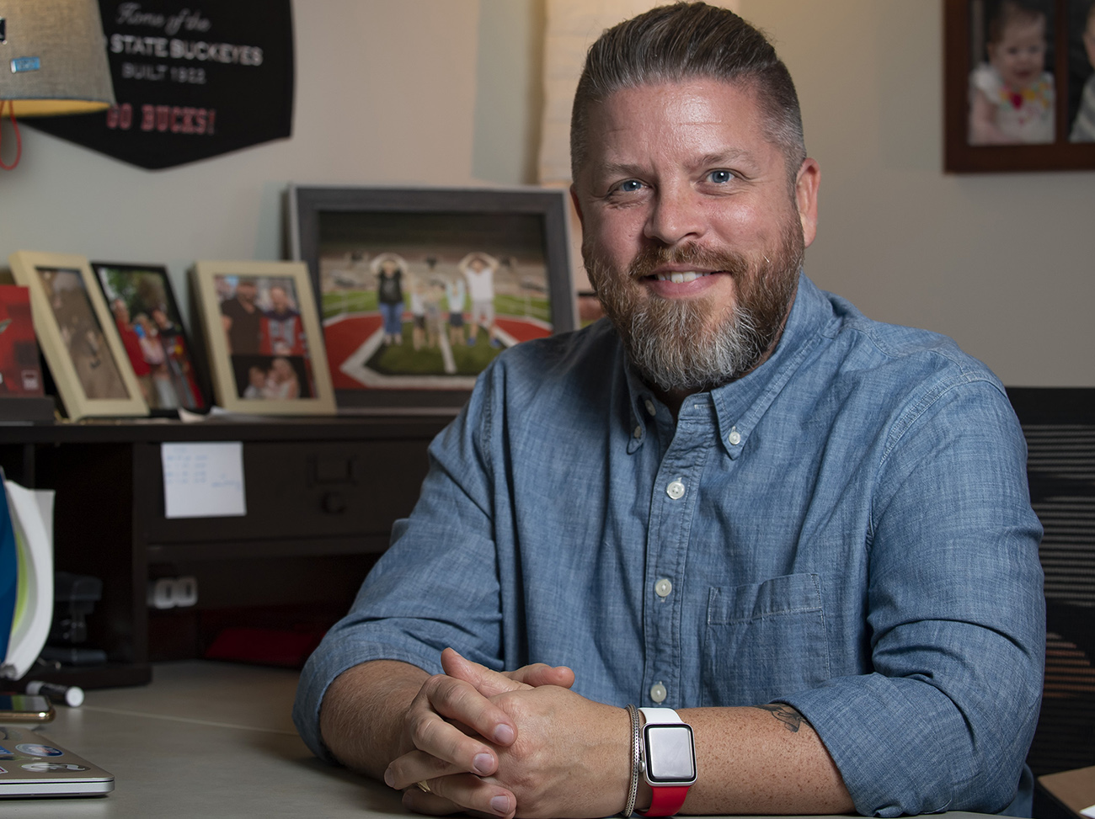
Faculty Achievements
Researching student debt

Slide 4
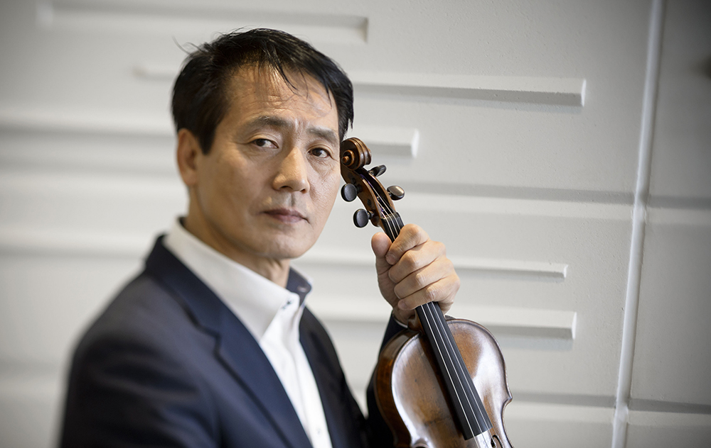
Faculty Achievements
Honored at the Pepsi Music Awards in Venezuela

Slide 5
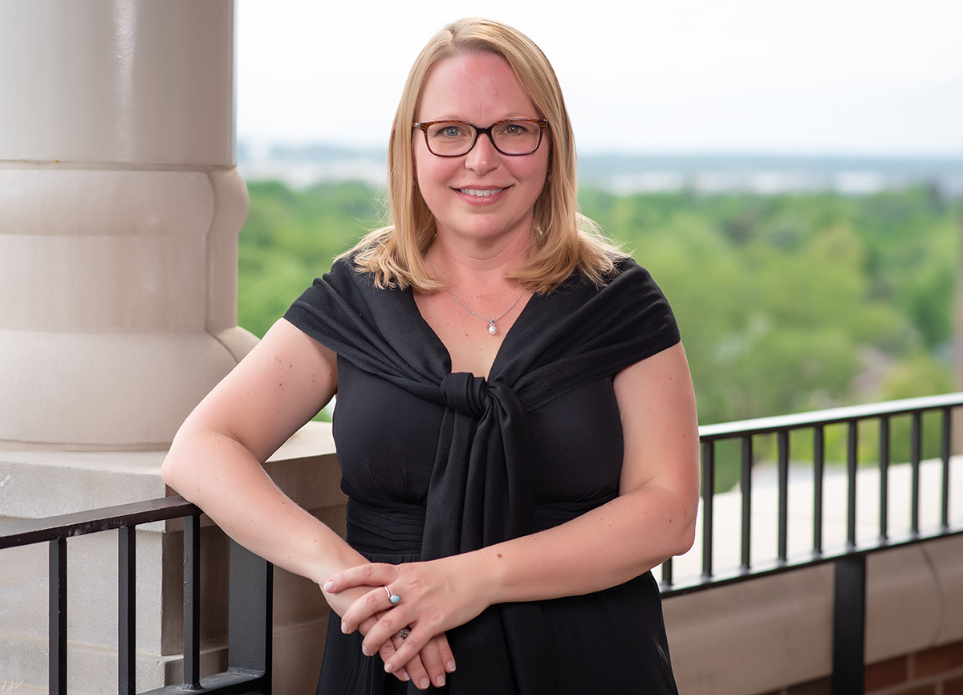
Faculty Achievements
HERS Summer Institute

Slide 6
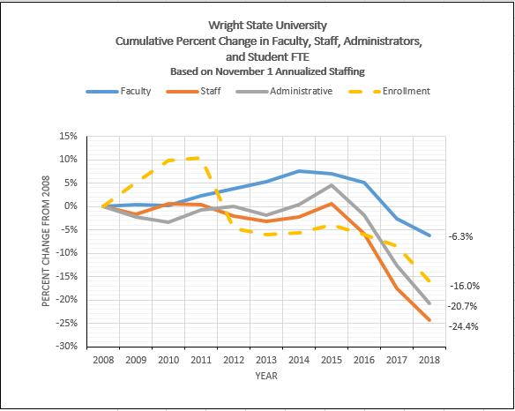

Slide 7
Upcoming Events
Green and Gold Fridays
Show your Wright State pride
Men’s Basketball vs. Western Carolina
Wednesday, November 7
7 p.m., Nutter Center
Women’s Basketball vs. Belmont
Thursday, November 15
7 p.m., Nutter Center
Raidersgiving
Thursday, November 22
Noon, Nutter Center McLin Gym

