Slide 1

Strategic Planning Update
Faculty Senate
October 8, 2018

Slide 2
Strategic Plan: Senate’s Role
Executive Responsibility
Review and Comment
Mission Statement (Policy 1120)
Vision Statement (Policy 1130)
Values Statements
Strategy Statement

Slide 3
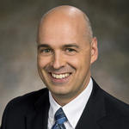
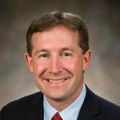
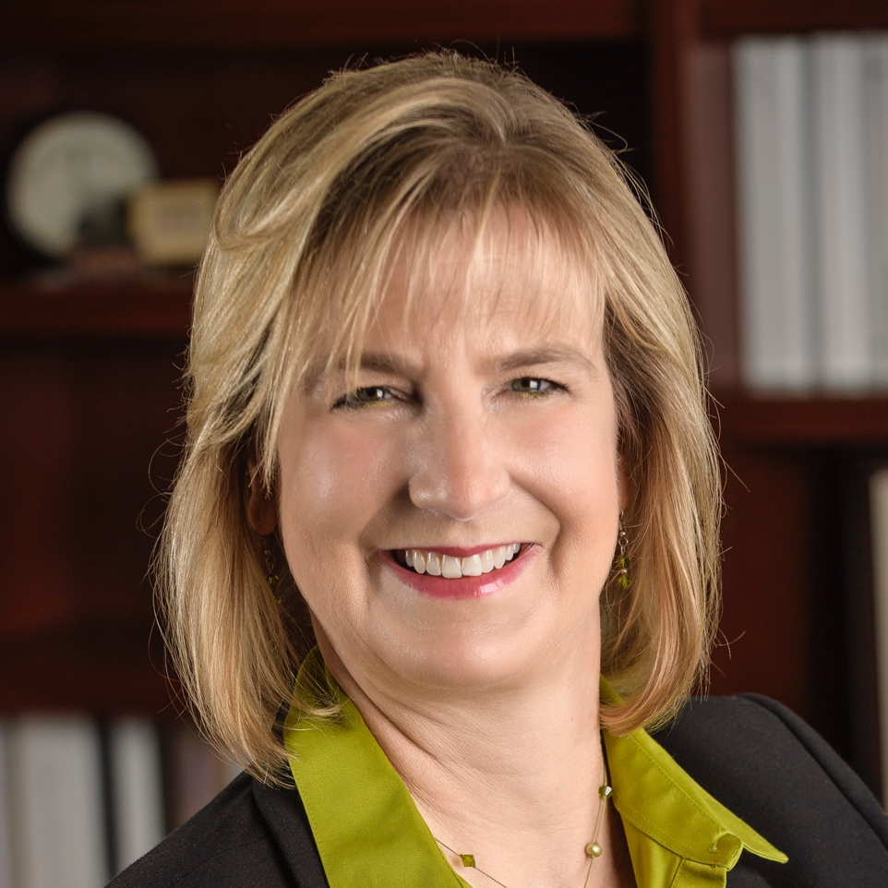
Wright State University Expertise
20+ years in leading strategic planning, innovation and change management
Professor of Electrical Engineering
Professor of Electrical Engineering
David Bright
Professor of Organizational Behavior
Specialist in change management and organization development
20+ years of facilitation experience
Mike Wiehe
Director of the Center of Applied Policy and Research Institute (APRI)
Two-time Wright State University alum
Extensive experience in government and public sector consulting
Cheryl Schrader
President
Professor of Electrical Engineering
20+ Years of leading strategic planning and change management

Slide 4
Wright State University Expertise
Julia Acosta
Jay Albayyari
Jennifer Ann Attenweiler
Eric Bennett
Matt Boaz
Walt Branson
Caroline Cao
Emmanuel Clayton
Angela Clements
Seth Baugess
Debbie Kimpton
Ryan Fullenkamp
Seth Gordon
William Holmes
Jonathan Jackson
Madhavi Kadakia
Burhan Kawosa
Douglas Leaman
Carol Loranger
Mindy McNutt
Mark Anderson
Nova Lasky
Daniel Palmer
Carol Patitu
Petey Peterson
Gretchen Rentz
Sara Seibert
Aaron Skira
Amanda Spencer
Tom Webb
Amy Barnhart
Katie Halberg
Greg Scherer
Over 100 volunteers actively participated in project groups

Slide 5

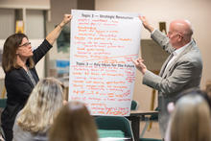
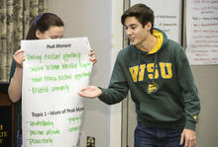
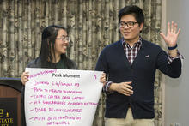
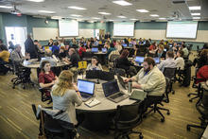

An Inclusive Process
Community Dialogue
Strategic Planning Summit
Drafting
Feedback
Refining
Community Dialogue
February and March
10 sessions
320 participants
22 potential themes

Slide 6
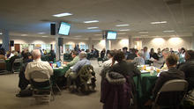
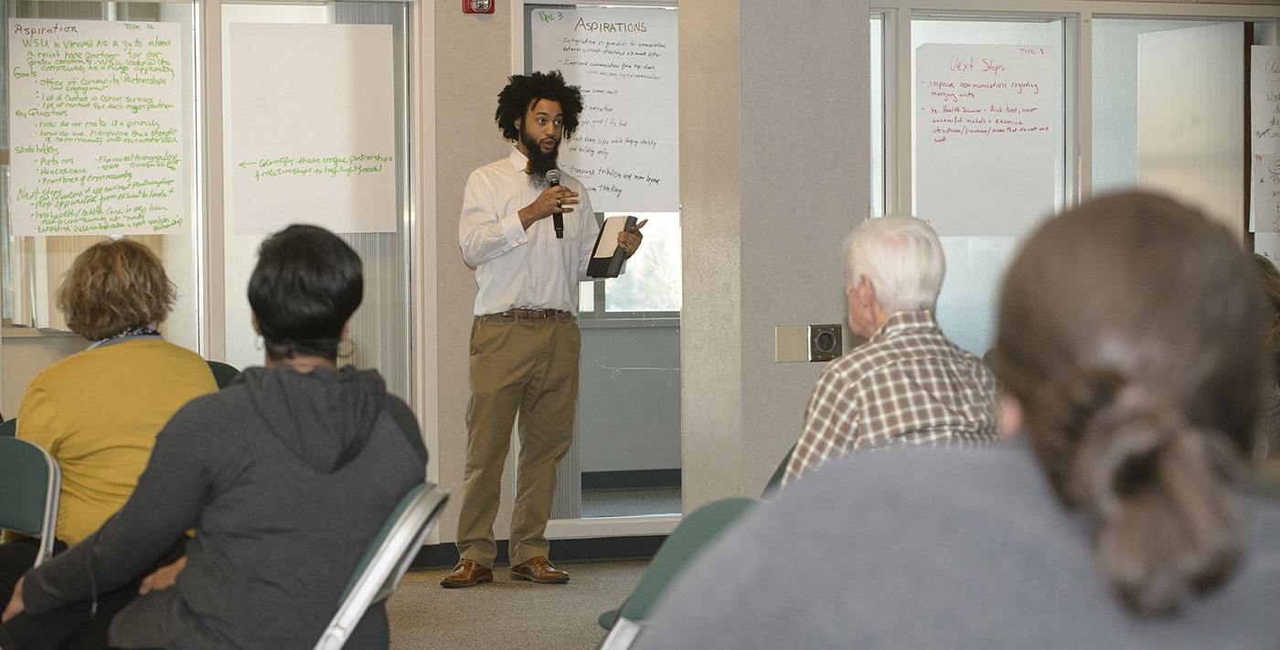
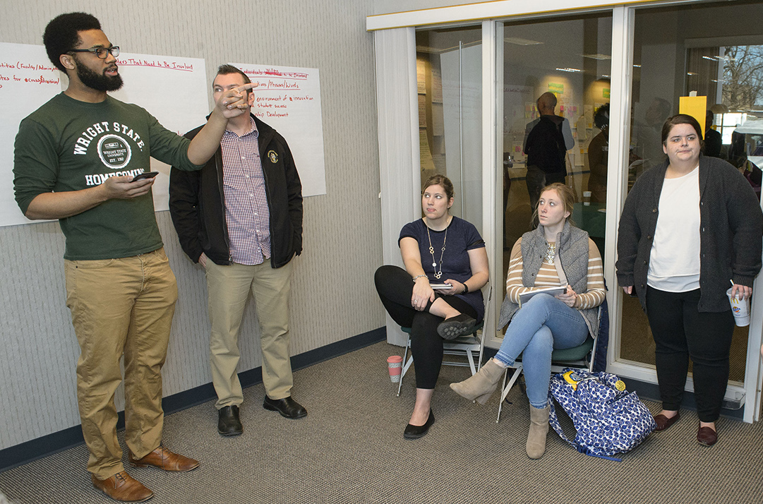
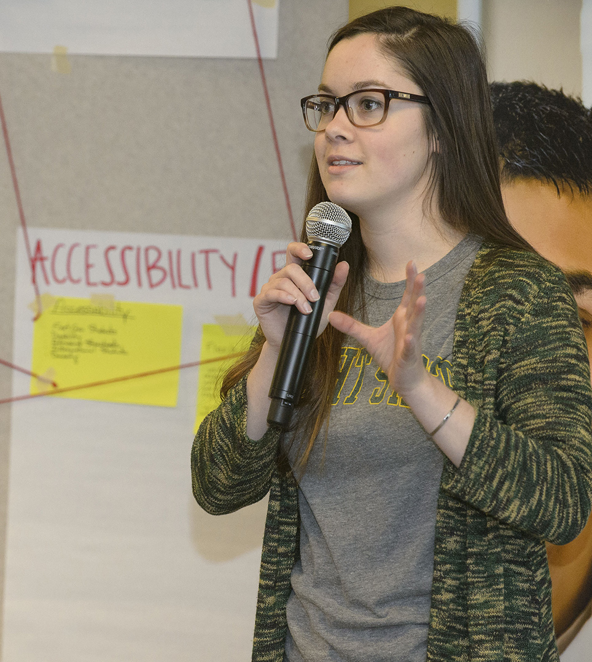
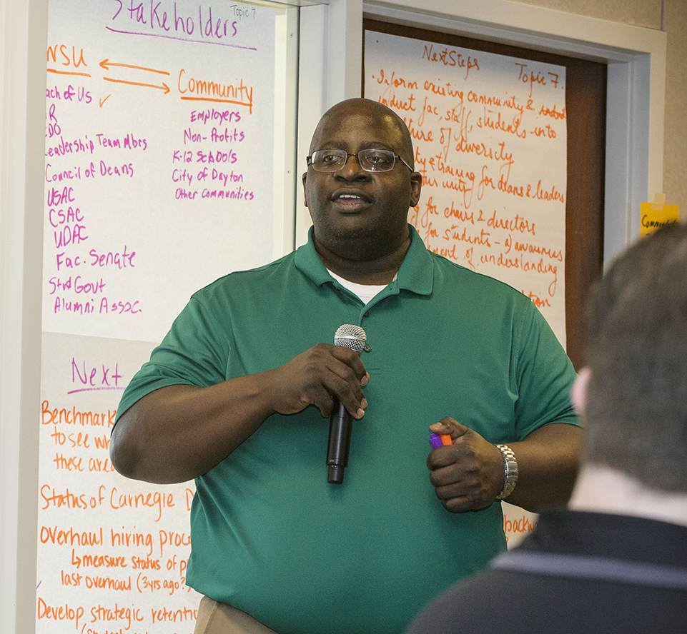
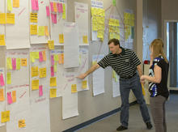
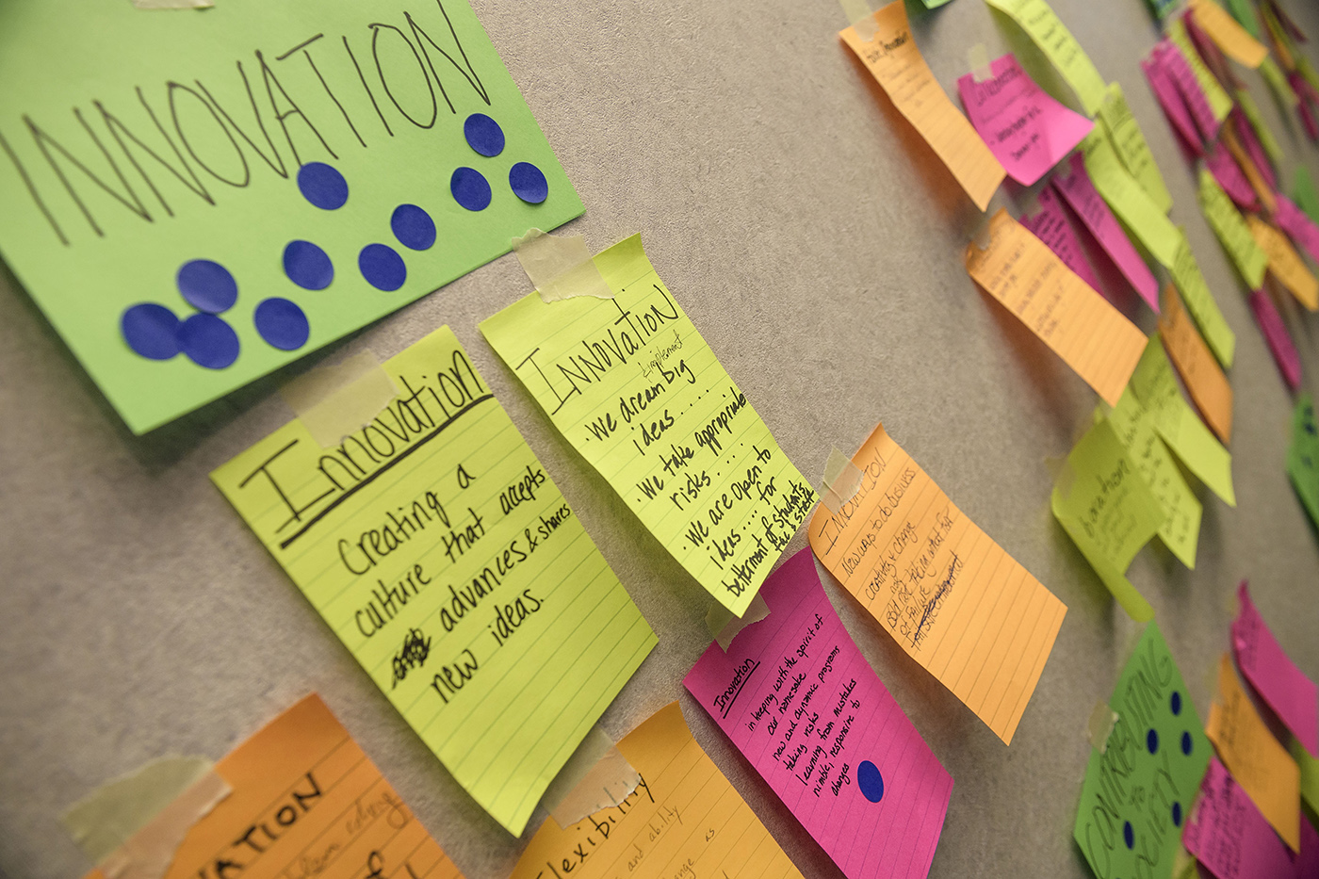
An Inclusive Process
Community Dialogue
Strategic Planning Summit
Drafting
Feedback
Refining
Summit
March 22-24
4 sessions
150 participants
Collective sense-making
8 themes for values
Key ideas for mission and vision

Slide 7
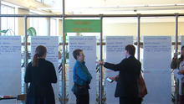
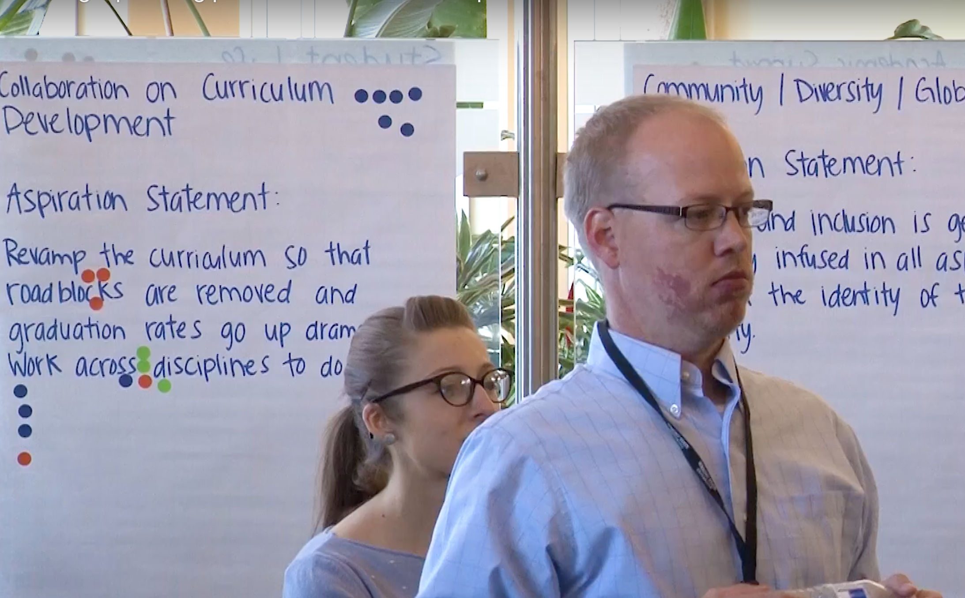
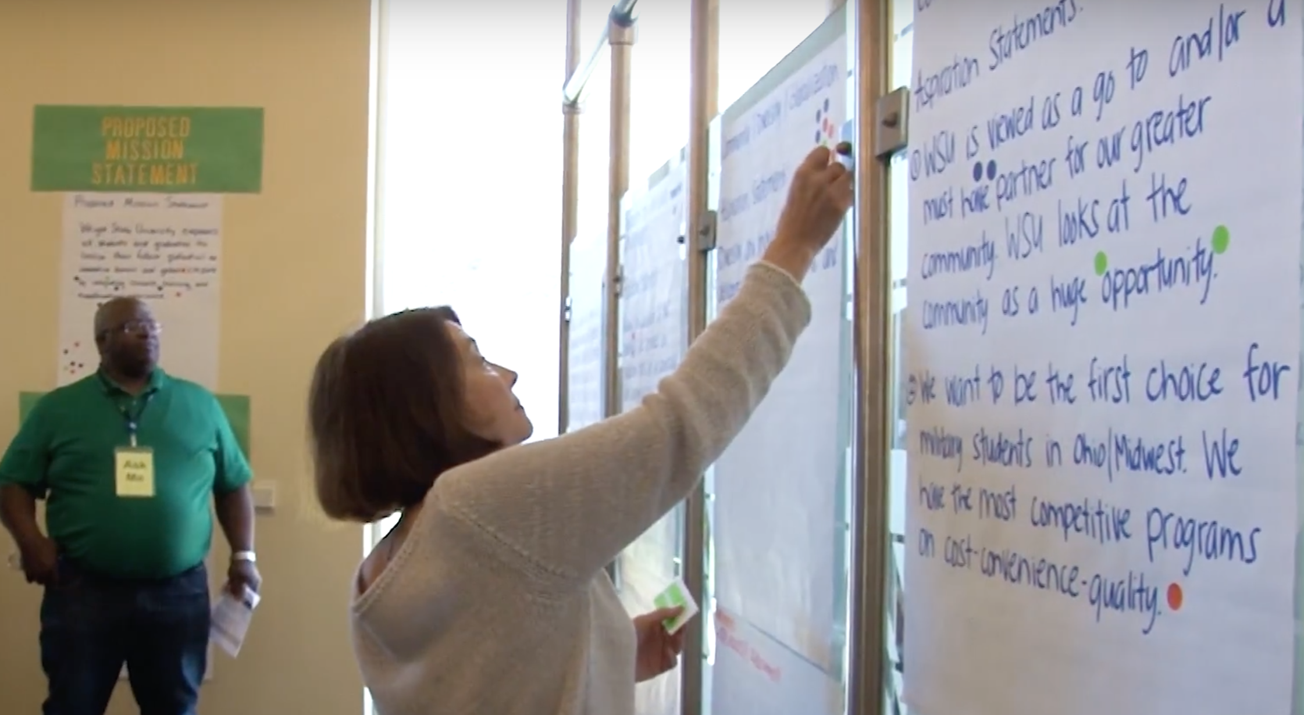
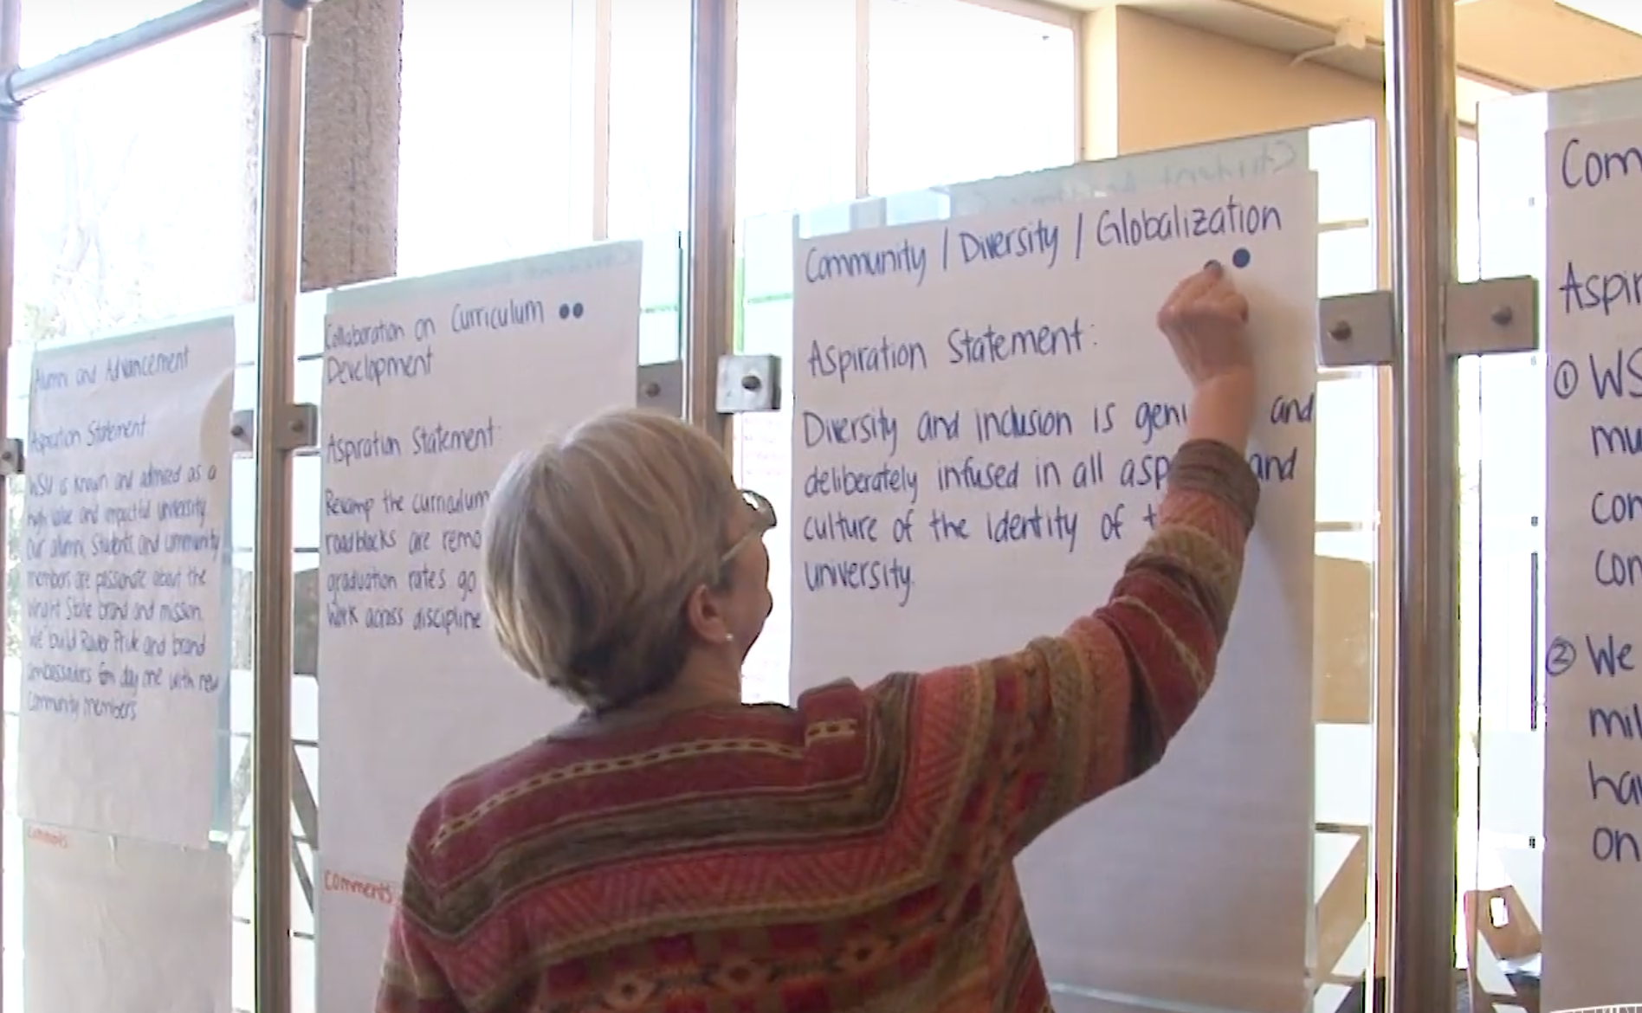
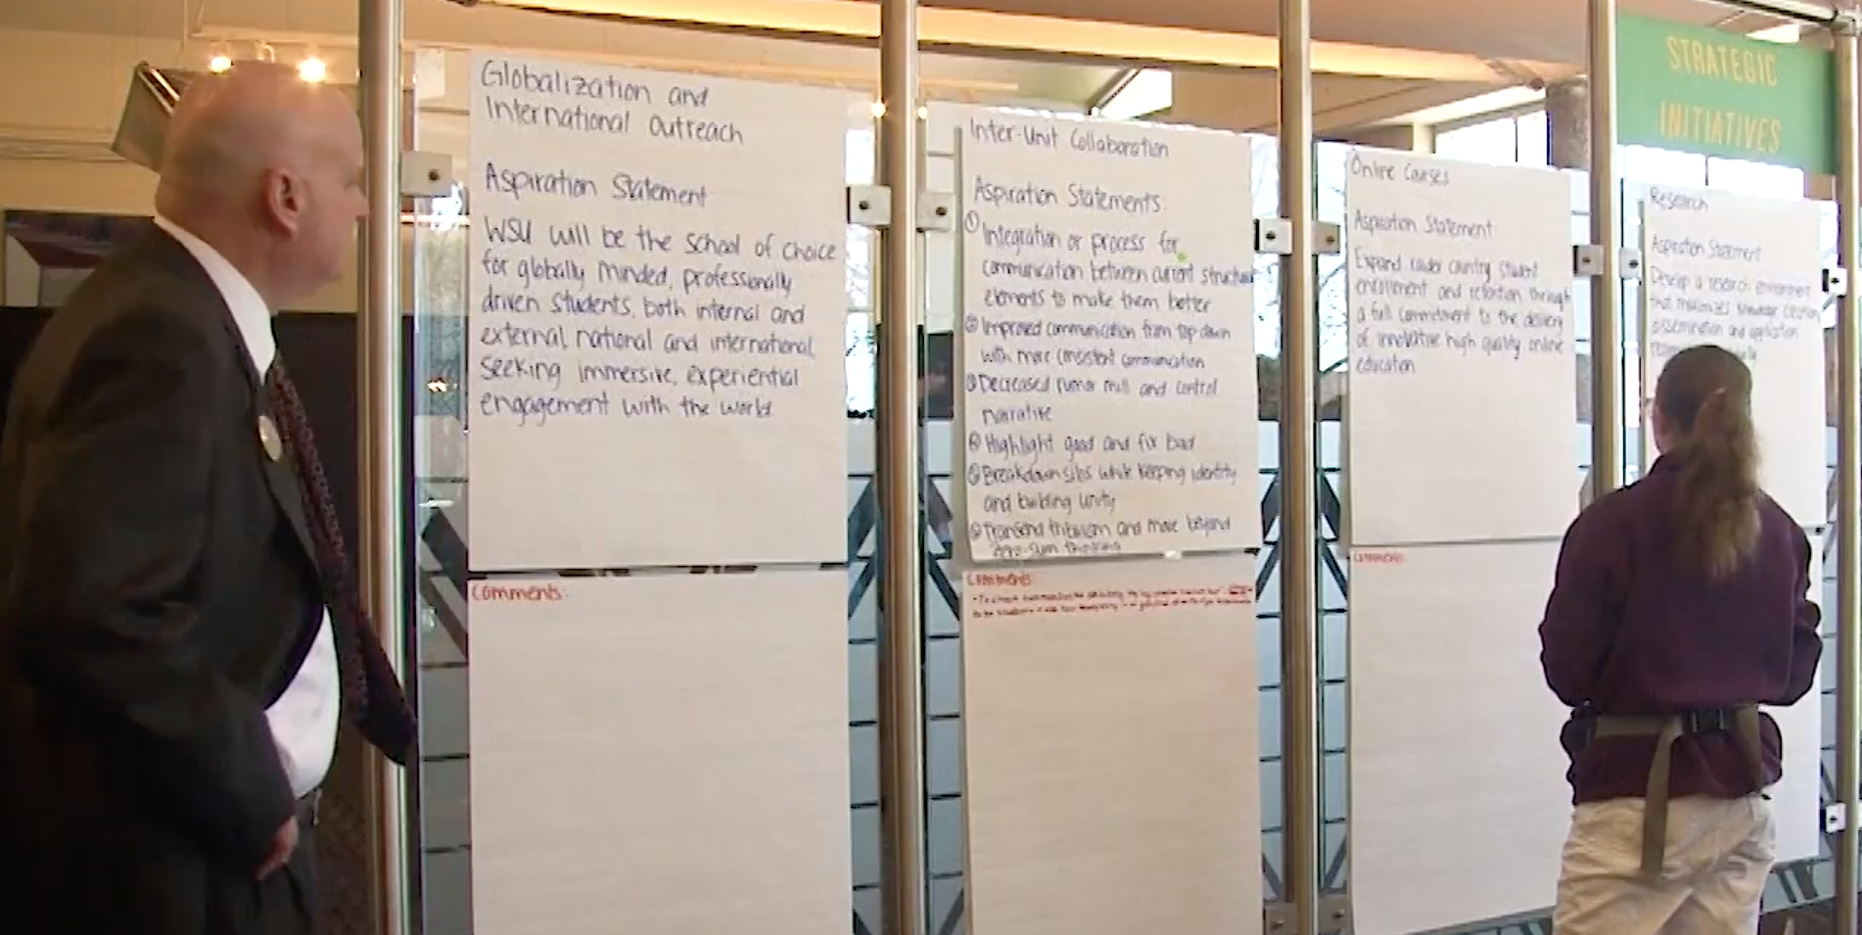
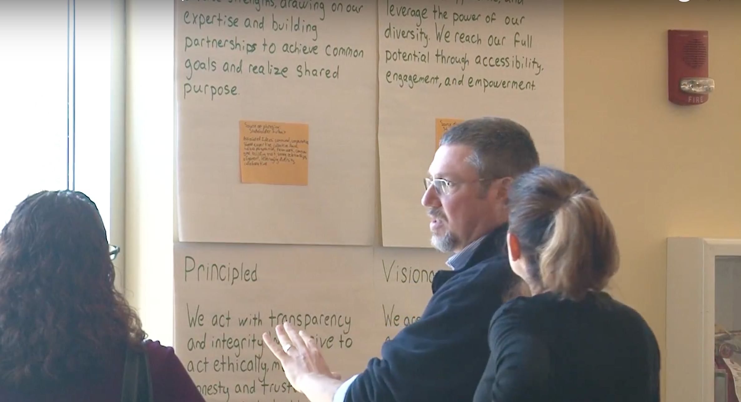
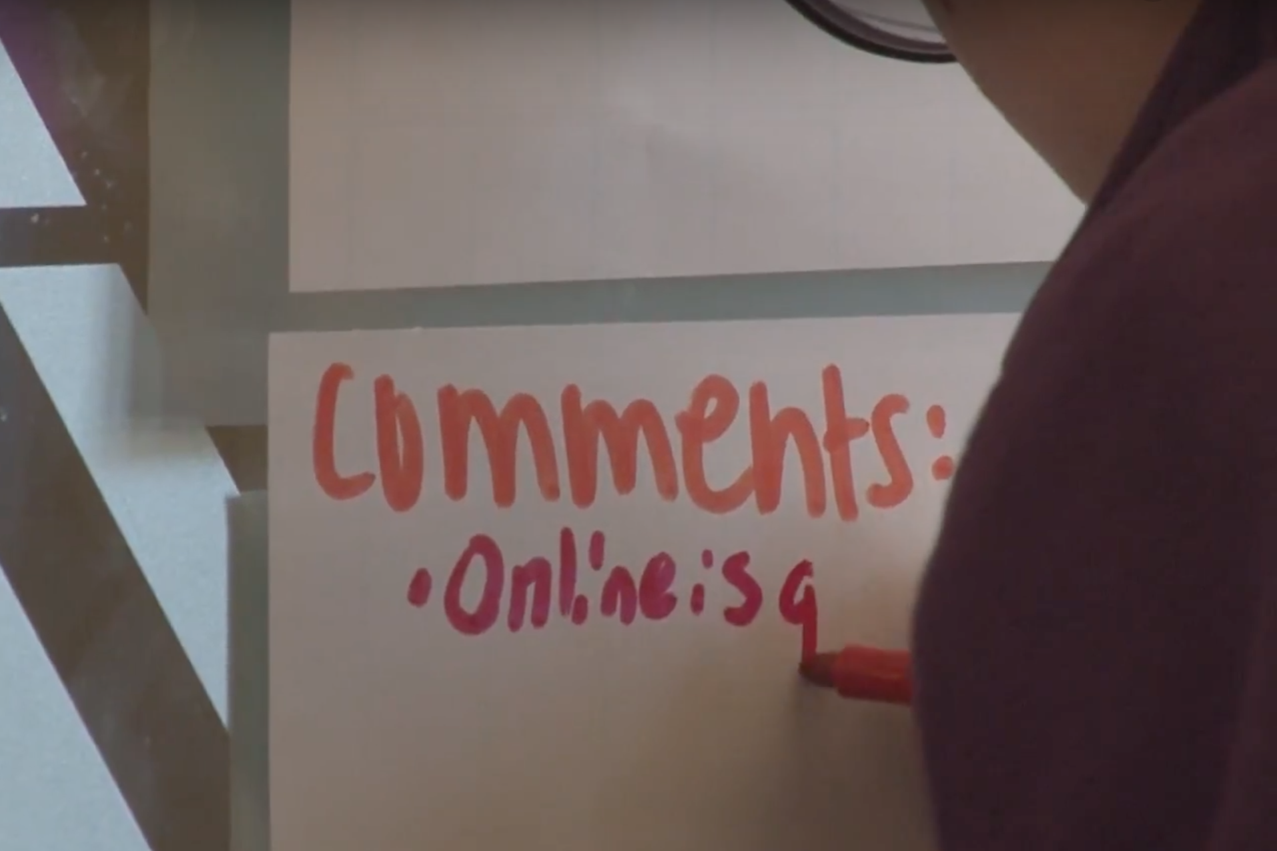
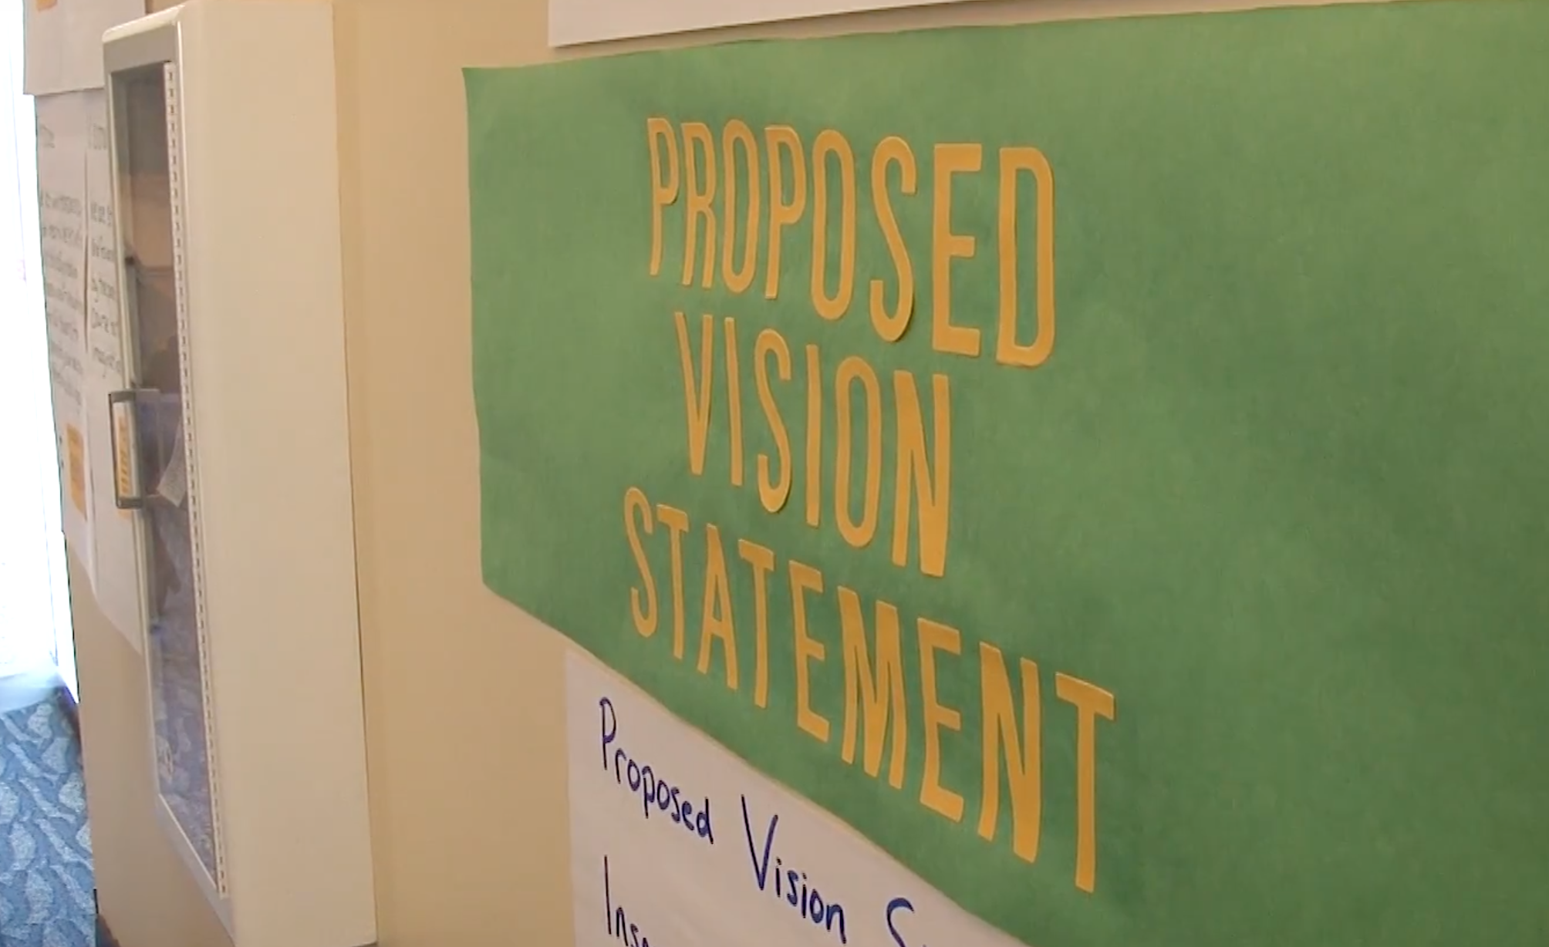
An Inclusive Process
Community Dialogue
Strategic Planning Summit
Drafting
Feedback
Refining
Drafting
March-April
Steering Committee integrated ideas
First statements of mission, vision, and values
Open House with ~150 participants

Slide 8
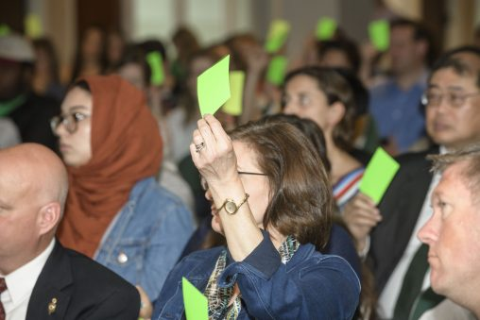
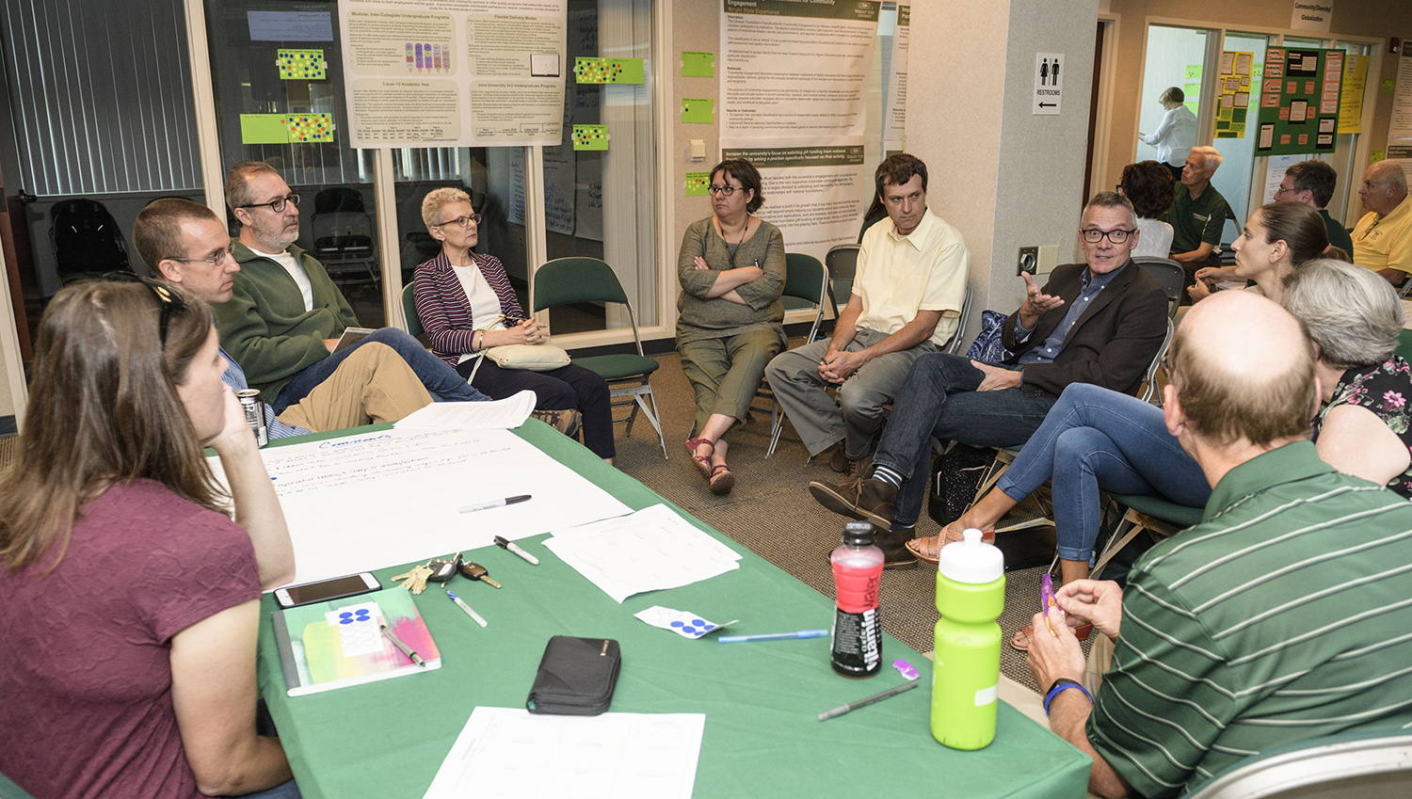
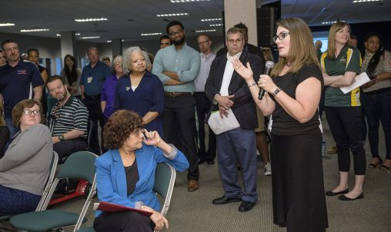
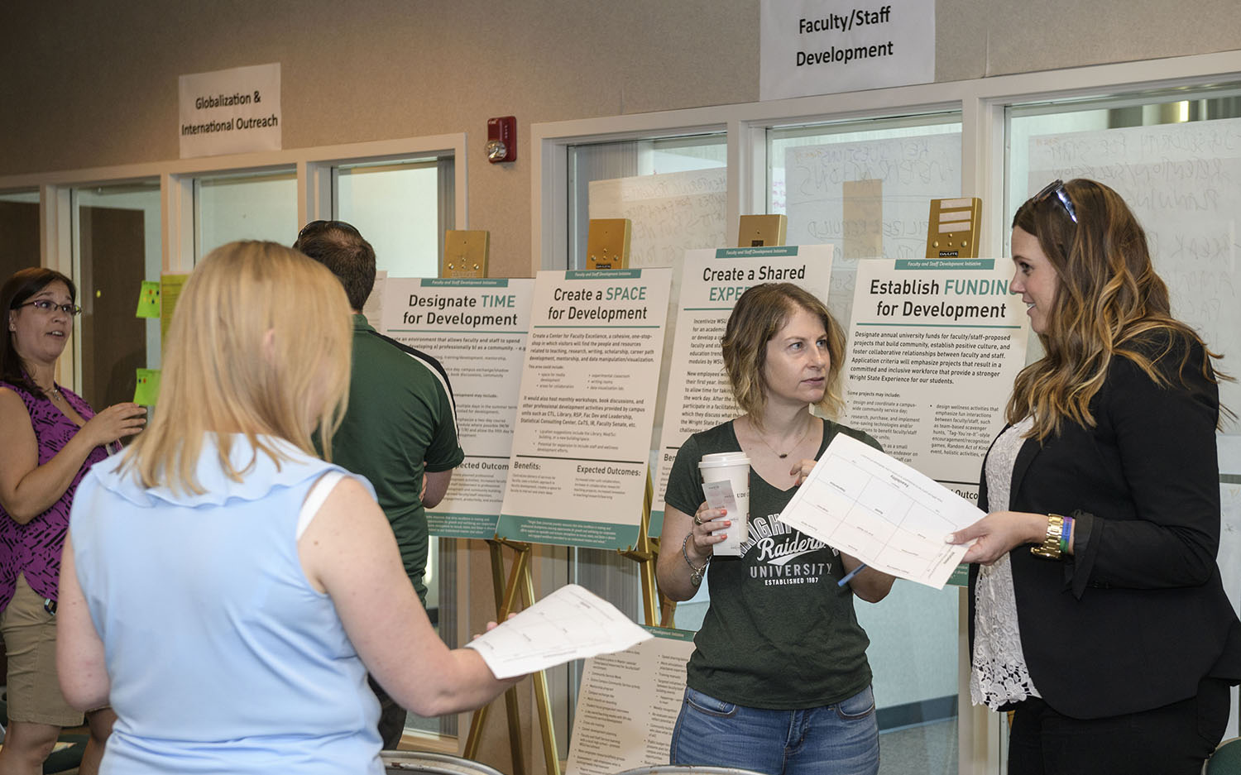
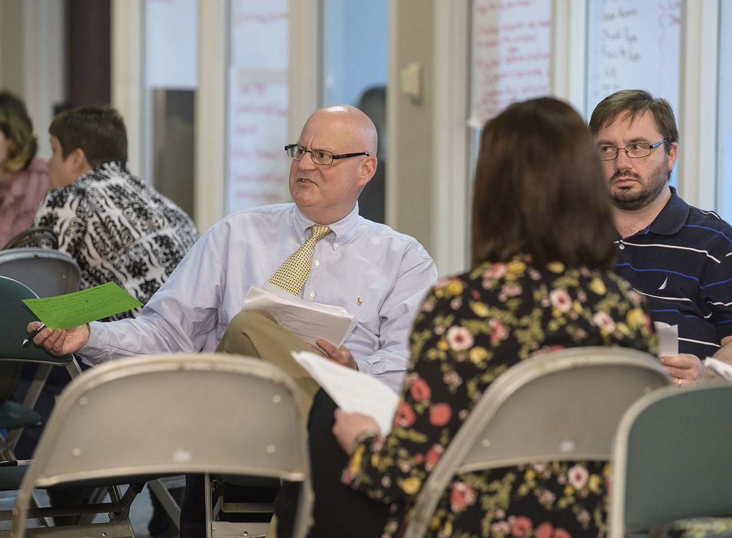
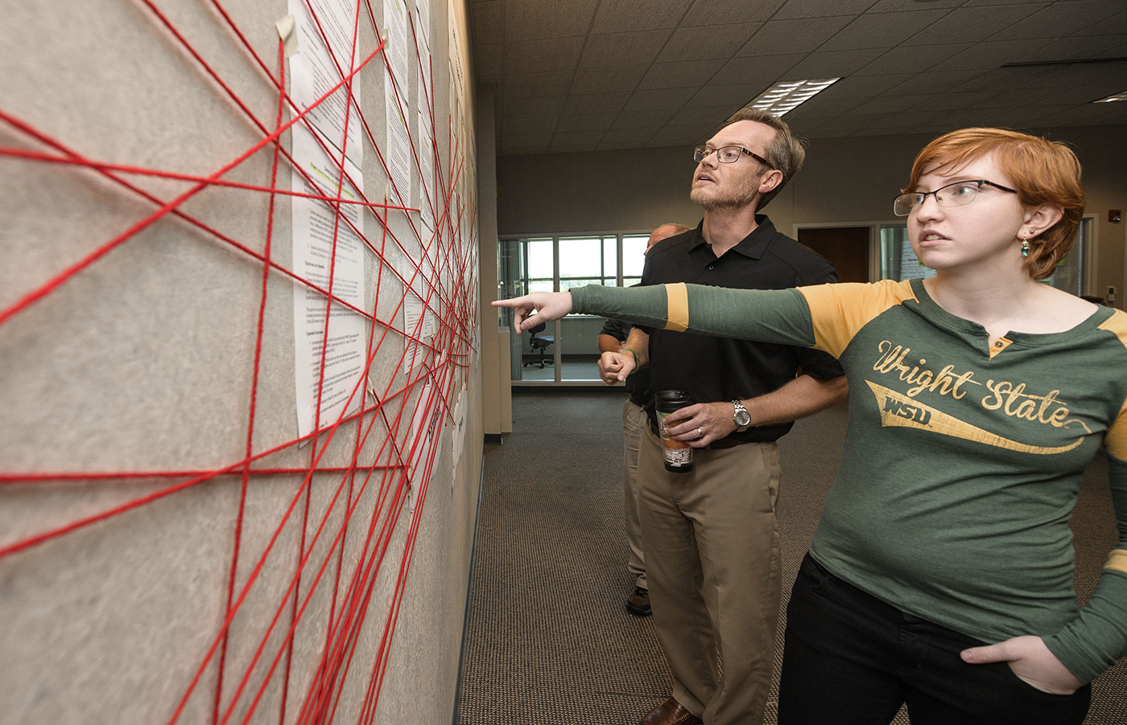
An Inclusive Process
Community Dialogue
Strategic Planning Summit
Drafting
Feedback
Refining
Feedback and Revisions
Summer
Six half-day mini-summits
Stakeholder surveys
Four USLG meetings
  University leadership
  Faculty Senate Exec Committee
  Steering committee
  Project group coordinators
Revised mission & vision statements
Draft strategy statement

Slide 9
An Inclusive Process
Community Dialogue
Strategic Planning Summit
Drafting
Feedback
Refining
Refining
Early Fall
Two USLG meetings
Two BoT presentations
Summary document
  The Wright State Experience
  Mission
  Vision
  Two sets of values
  The strategy statement

Slide 10
An Inclusive Process
Community Dialogue
Strategic Planning Summit
Drafting
Feedback
Refining
Refining
Early Fall
Two USLG meetings
Two BoT presentations
Summary document
  The Wright State Experience
  Mission
  Vision
  Two sets of values
  The strategy statement
This phase is still active –
We need faculty input

Slide 11
An Inclusive Process
Community Dialogue
Strategic Planning Summit
Drafting
Feedback
Refining
Our Request of Senators
One month to seek perspective
Upcoming meetings
  Oct 12 USLG meeting
  Oct 17 Steering Committee meeting
  Oct 19 BoT meeting
  TBA SGA sponsored forum
  We will to meet with faculty as requested
Provide feedback to any steering committee member
Be specific as to who and why
Resolutions will be brought forward in November

Slide 12
Mission Statement
Proposed
In the spirit of the Wright brothers, we empower all students to excel in their chosen careers through integrated learning, research, innovation, and experience.
Current
We transform the lives of our students and the communities we serve.
We will:
build a solid foundation for student success at all levels through high-quality, innovative programs;
conduct scholarly research and creative endeavors and impact the quality of life; and
engage in meaningful community service
drive the economic revitalization of our region and our state and empower all of our students, faculty, staff, and alumni to develop professionally, intellectually, and personally.

Slide 13
Vision Statement
Proposed
To be a diverse, inclusive university that transforms the educational, economic, and social fabric of the communities we serve.
Current
Wright State University, inspired by the creative spirit of the Wright brothers, will be Ohio's most learning-centered and innovative university, known and admired for our inclusive culture that respects the unique value of each of our students, faculty, staff, and alumni and for the positive transformative impact we have on the lives of our students and the communities we serve.

Slide 14
Values Statements
Values that Define our People
Principled
Visionary
Innovative
Collaborative
Inclusive
Values that Define our Mission
Foster student success
Create new knowledge
Transform our world
Current
People: Success, diversity
Learning: Discovery, innovation, scholarship
Partnerships: Regional, entrepreneurial, global
Relationships: Collegial, professional, ethical
Sustainability: Social justice, economic opportunity, environmental protection
Stewardship: Fiscal, intellectual

Slide 15
Proposed Strategy Statement
By 2025, The Wright State Experience will provide a premium return on the investments of students and partners through a student-first system that leverages the unique strengths and resources of Raider Country.

Slide 16
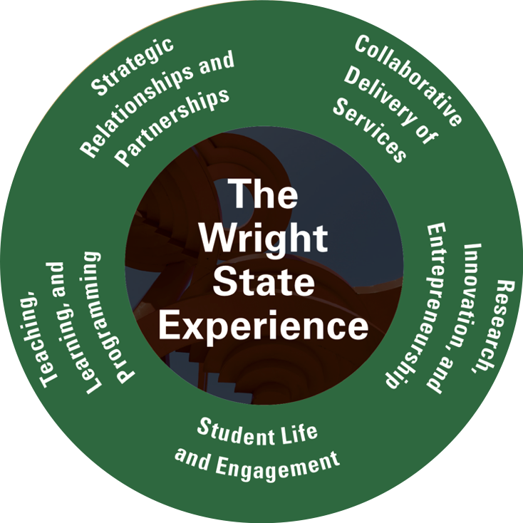
Focusing the Strategic Plan

Slide 17
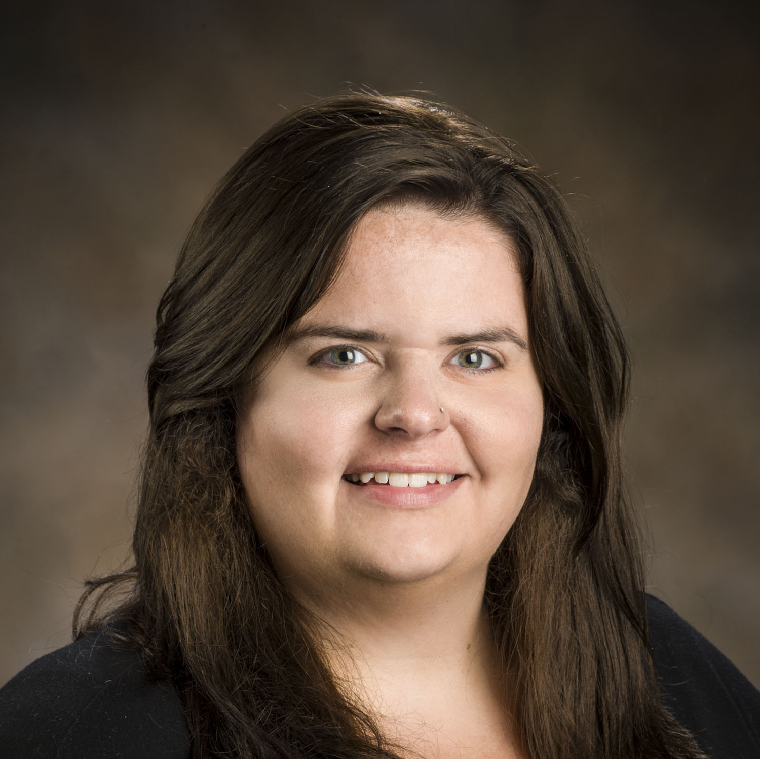
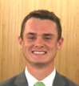
Participant Perspectives
Sara R. Seibert
Ph.D. candidate, biomedical sciences
SGA graduate studies liaison
Strategic Planning Steering Committee
Daniel Palmer
Business Economics Major
SGA president
Strategic Planning Steering Committee

Slide 18
An Inclusive Process
Community Dialogue
Strategic Planning Summit
Drafting
Feedback
Refining
Our Request of Senators
One month to seek perspective
Upcoming meetings
  Oct 12 USLG meeting
  Oct 17 Steering Committee meeting
  Oct 19 BoT meeting
  TBA SGA sponsored forum
  We will to meet with faculty as requested
Provide feedback to any steering committee member
Be specific as to who and why
Resolutions will be brought forward in November

