Slide 1
Faculty Senate Meeting
September 10, 2018
President
Cheryl B. Schrader

Slide 2
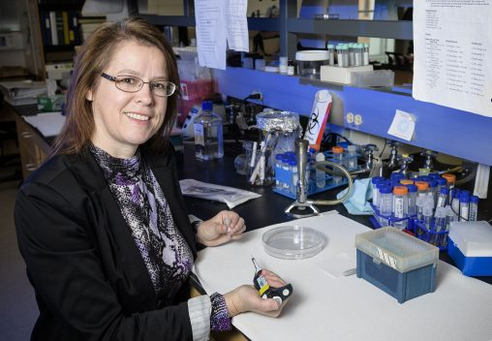
Faculty Achievements $1.8 Million NIH Award

Slide 3
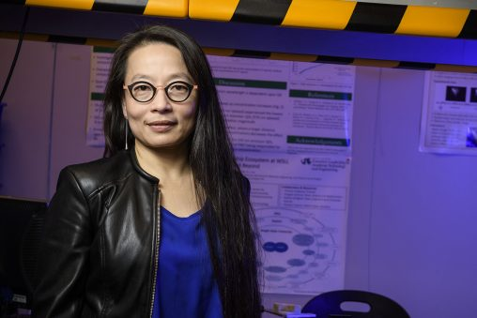
Faculty Achievements ELATE program graduate

Slide 4
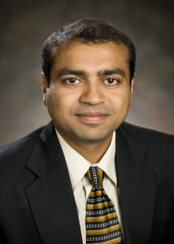
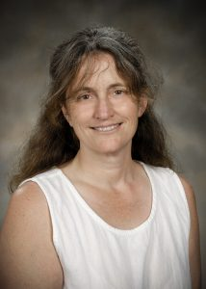
Faculty Achievements
Optimizing trauma centers
Studying New Zealand rivers

Slide 5
Budget Update
Ended FY18 with a $10.1M surplus
$4.1M above target
Spent nearly $53M less in FY18 than in FY17
FY17 ended with a $24.6M deficit
Plan to spend $20M less in FY19 than in FY18 based on a 6.2% decline in enrollment
Need to adjust for shortfall in enrollment, increases in medical costs, additional recurring previously unbudgeted items

Slide 6
Growth Mindset Advisory Team
Laser-focused on a growth mindset
Build enrollment
Diversify and expand revenue streams
Members
Cheryl B. Schrader Sue Edwards, Chair
Doug Fecher Michael Bridges
Stephanie Green Bruce Langos
Austin Rains Burhan Kawosa
Walt Branson Greg Sample
Jennifer McCamis Mary Jean Henry
Mark Anderson Paul Carney
John Shipley Craig Woolley

Slide 7
Upcoming Events
Green and Gold Fridays
Show your Wright State pride
Air Force 5K
Friday, September 14
6 p.m.
Welcome Reception for Provost Edwards
Tuesday, September 18
3 to 4:30 p.m., Student Union Atrium
Homecoming Weekend 2018
Friday, October 5 and Saturday, October 6

