Slide 1
Faculty Senate Meeting
April 22, 2019
President
Cheryl B. Schrader

Slide 2
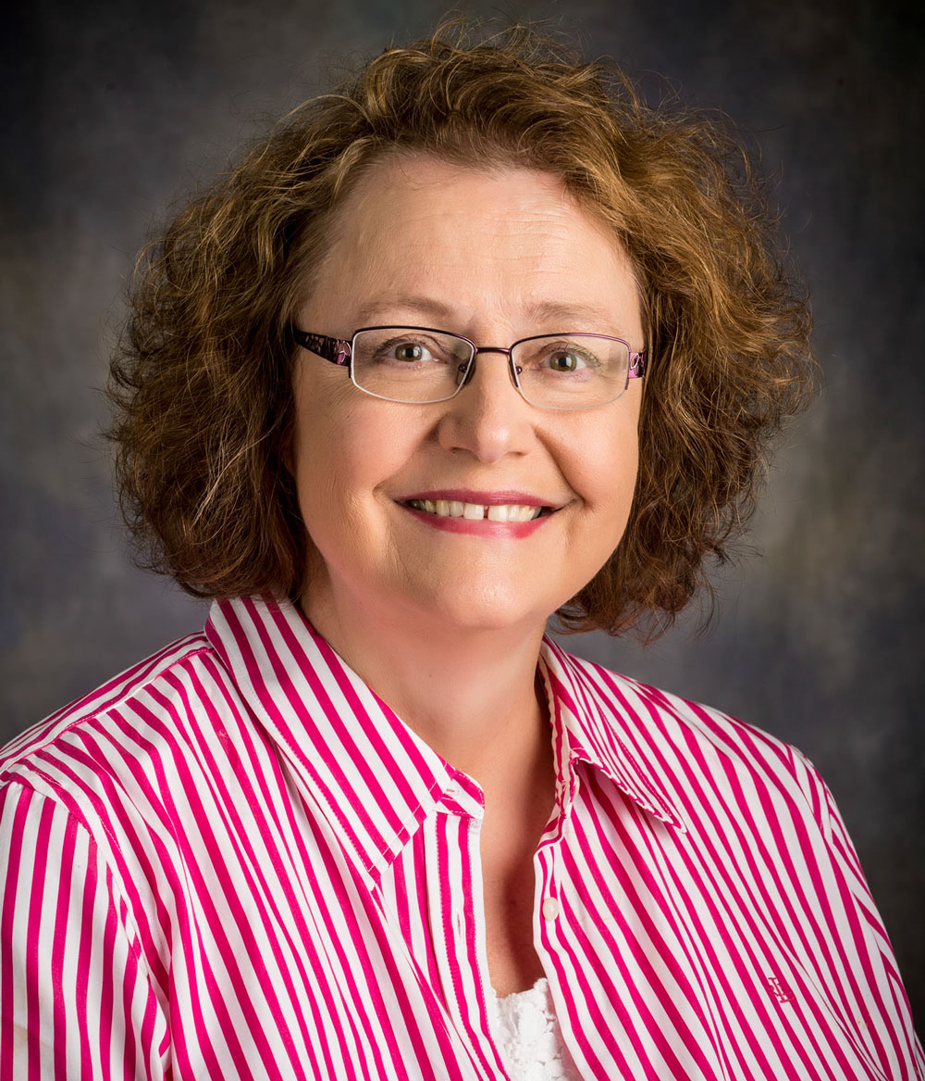
Faculty Achievements Honored for excellence in disaster nursing

Slide 3
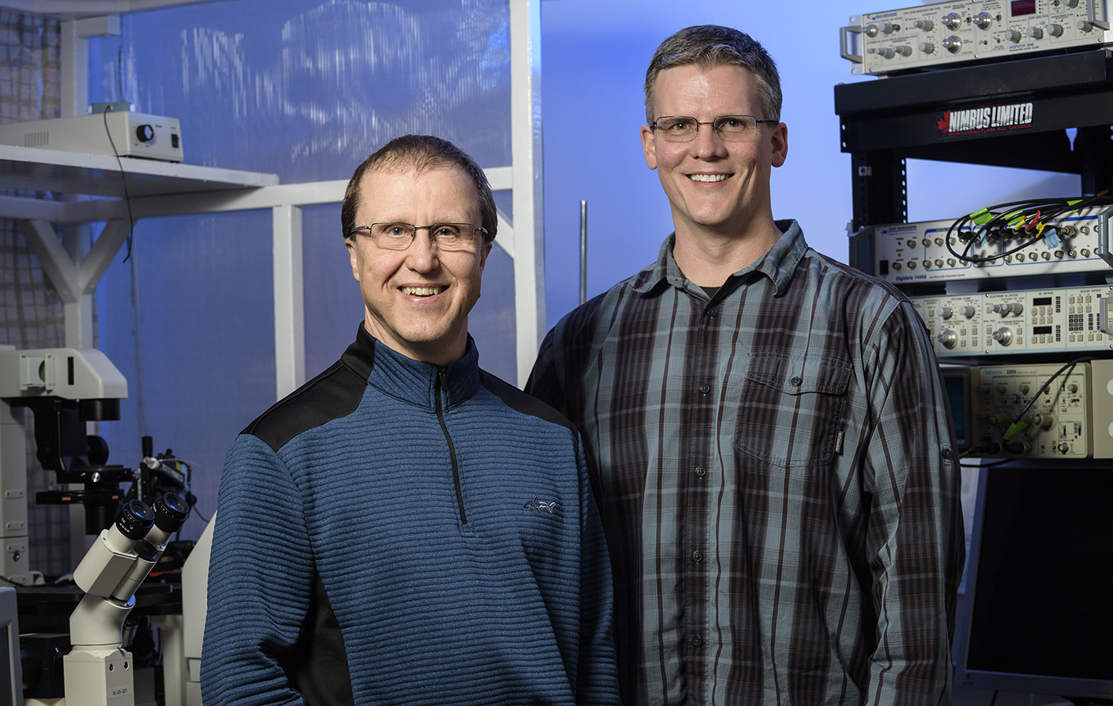
Faculty Achievements $2.7 million in federal grant money

Slide 4
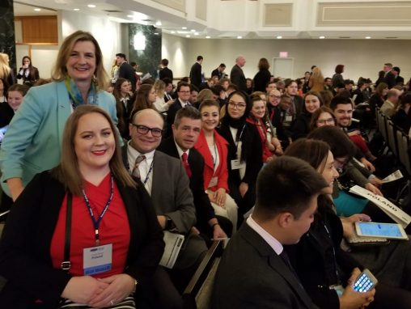
Faculty Achievements 40 years of Model UN excellence

Slide 5
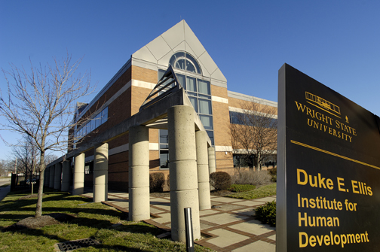
Faculty Achievements SOPP marks 40th anniversary

Slide 6
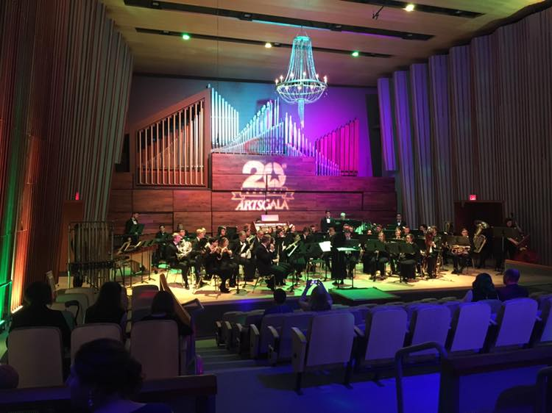
Faculty Achievements ArtsGala celebrates 20th year

Slide 7
Enrollment Update
Direct from High School Students
Applications up 7.5%
Admits up 5.5%
Admits are up outside of Raider Country:
Cuyahoga County (Cleveland)
Franklin County (Columbus)
Hamilton County (Cincinnati)

Slide 8
Enrollment Update
New Transfer Students
Applications down 11%
Admits down 5.7%
Current Students
Summer tuition and fees down 17.9%
28% decrease in current students with balances due

Slide 9
Enrollment Update
Planning and Initiatives
Developing a comprehensive, coordinated enrollment management plan
Expanding online offerings
Improving transfer student admission processes
Creating additional articulation agreements
Optimizing use and awarding of scholarships
Developing continuing education and micro-credentials
Marketing programs in new ways

Slide 10
Commencement
Saturday, May 4
10 a.m.
Wright State Nutter Center
2,082 graduates
22 associate degrees
1,457 bachelor’s degrees
592 master’s degrees
32 doctoral degrees

