Slide 1
Participation Roster Processes for 2021 & CircleIn Digital Studying Platform
Tim Littell
Associate Provost
Division of Student Success
Faculty Senate Presentation
December 7, 2020

Slide 2
Agenda
CircleIn
Participation Roster Processes for 2021

Slide 3

digital studying platform
Tutoring appointments are down by about 1/3 this semester
Social distance = disengaged students
This is a NSF-backed app and website that is tied to our courses integrated in Pilot
Uses gaming theory to engage students in the course material
Goals: help students to study remotely, to collaborate with their classmates, and feel connected and productive
Notes:
Tutoring appointments are down by about a third this semester, so student engagement, digital collaboration, and strong study habits are extremely critical in this COVID learning environment.
We know that social distance = disengaged students, so rather than wait for students to contact our academic success centers for support,
we are hopeful that this proactive approach will help students to study remotely, to collaborate with their classmates, and to feel connected and productive, even while at distance.
This is a NSF-backed app and website that is tied to our courses integrated in Pilot. that uses gaming theory to engage students in the course material

Slide 4
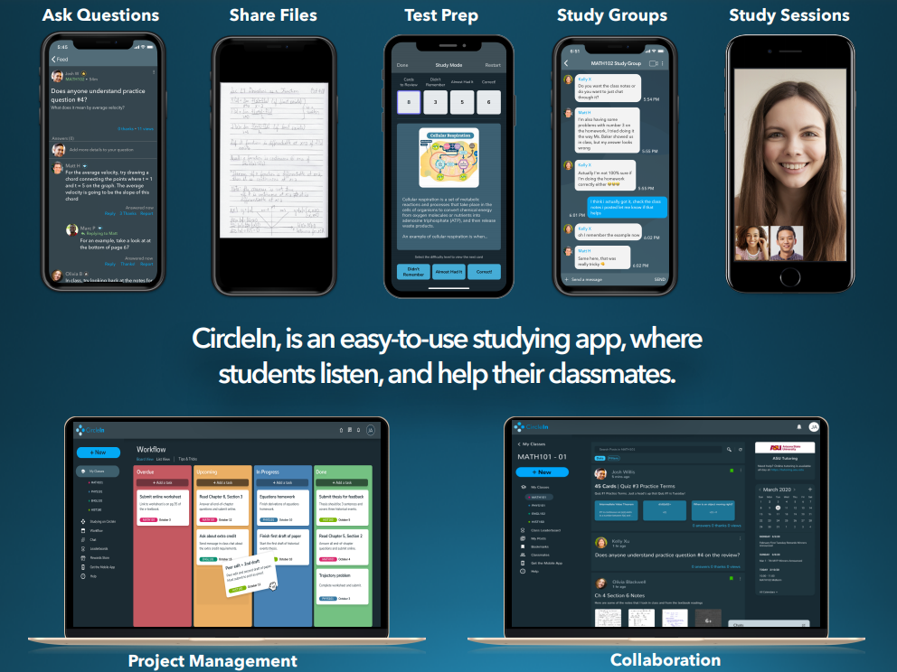

Slide 5
digital studying platform
CircleIn Faculty Presentation: Thursday, January 7, 10:30-11:30 a.m.
Zoom link will be sent to your email
Agenda:
Overview of CircleIn's NSF-backed model
How CircleIn is using the internet to change the culture of studying to help students be far more productive
The top study applications that students will have access to
How CircleIn is “hands-off” for faculty and how other faculty are leveraging CircleIn
Q&A
Notes:
Tutoring appointments are down by about a third this semester, so student engagement, digital collaboration, and strong study habits are extremely critical in this COVID learning environment.
We know that social distance = disengaged students, so rather than wait for students to contact our academic success centers for support,
we are hopeful that this proactive approach will help students to study remotely, to collaborate with their classmates, and to feel connected and productive, even while at distance.
This is a NSF-backed app and website that is tied to our courses integrated in Pilot. that uses gaming theory to engage students in the course material

Slide 6
Participation Roster Processes for 2021
ADMIN DROP: Never Participated
Spring 2021 Progress Report Category Addition

Slide 7
Why?
An Overview of Title IV Regulations
“Federal regulation (34 CFR 668.21) requires that students begin or establish attendance in each course in order to be eligible for title IV, HEA program funds that were credited to the student’s account each semester.
This does not mean that the institution has to have an attendance policy.”
To reduce the number of financial petitions from students who have never attended WSU.
Notes:
How many WSU use Financial Aid to pay for school? 69%

Slide 8
What is considered participation by Title IV Regulations?
For in-person or hybrid courses, this means students must attend/participate in at least one class session or complete an academically related activity.
For online courses, determining if a student began attendance is more complicated. Documenting that a student has logged into an online class is not sufficient, by itself, to demonstrate participation. A school must demonstrate that a student participated in class or was otherwise engaged in an academically related activity.

Slide 9
What is an academically related activity as defined by Title IV Regulations?
Is
Is not
submission of an academic assignment,
submission of an exam,
documented student participation in an interactive tutorial or computer-assisted instruction,
a posting by the student showing the student’s participation in an online study group,
a posting by the student in a discussion forum showing the student’s participation in an online discussion about academic matters, and
an email from the student or other documentation showing that the student-initiated contact with a faculty member to ask a question about the academic subject studied in the course.
Living in institutional housing;
Participating in the school’s meal plan’
Participating in a student-organized study group,
Logging into an online class without active participation; or
Participating in academic counseling or advising.

Slide 10
How can we facilitate this?
Wright Way Policy 3430: Course Registration, Add, Attendance, and Drop Policy
3 Administrative Drop
.3.2 Conditions
Administrative Drops may occur due to a number of circumstances, including the following:
1) Students who do not establish attendance may be administratively dropped from a course in which they are registered. The instructor must promptly notify the student and the Office of the Registrar for the students to be removed from the class roster.
Notes:
This current policy DOES not appear to comply with Federal regulations and must be changed. It does NOT supersede Federal Regulations.

Slide 11
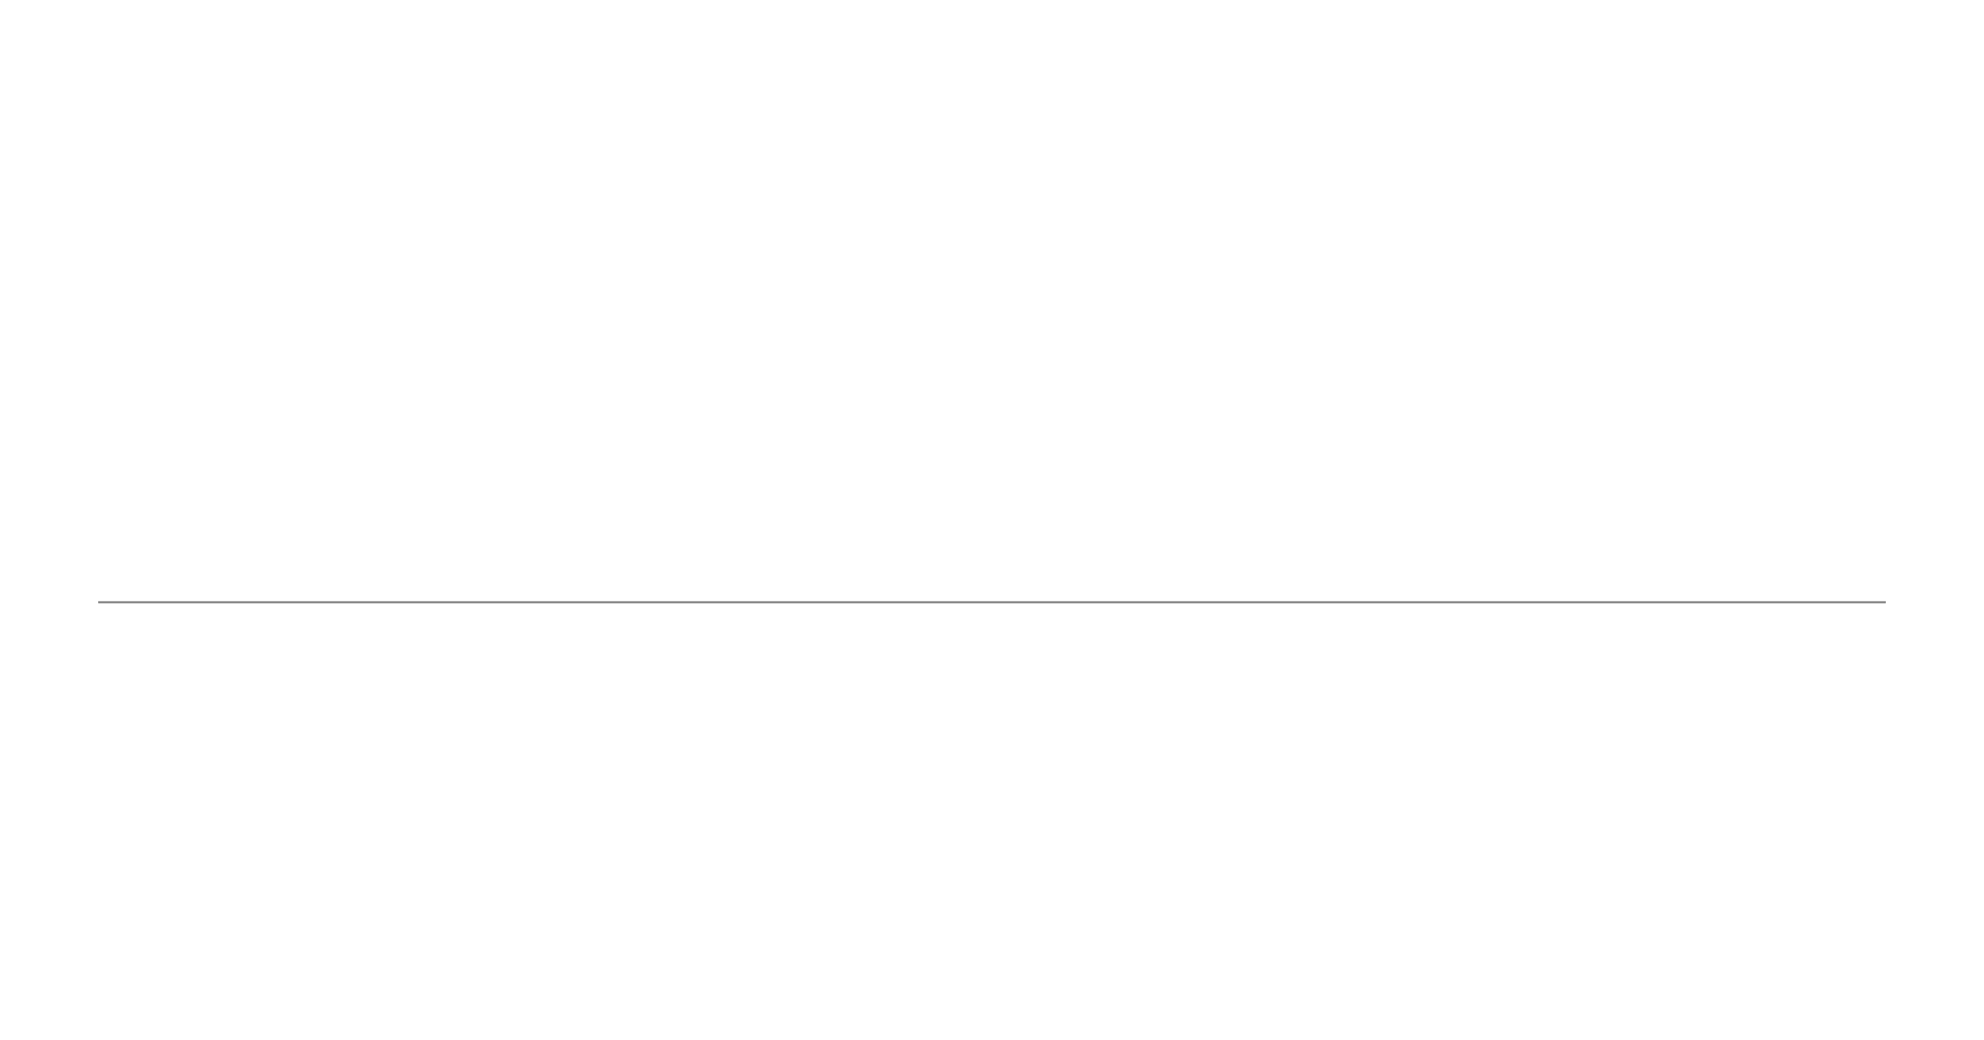
Faculty Guide – Submitting Progress Reports through RAPS
DIVISION OF STUDENT SUCCESS
12/07/202
0 | P a g e
Notes:
The RAPS Progress Report function allows us to create an easy way for faculty to notify both the student and registrar by clicking on the students name.

Slide 12

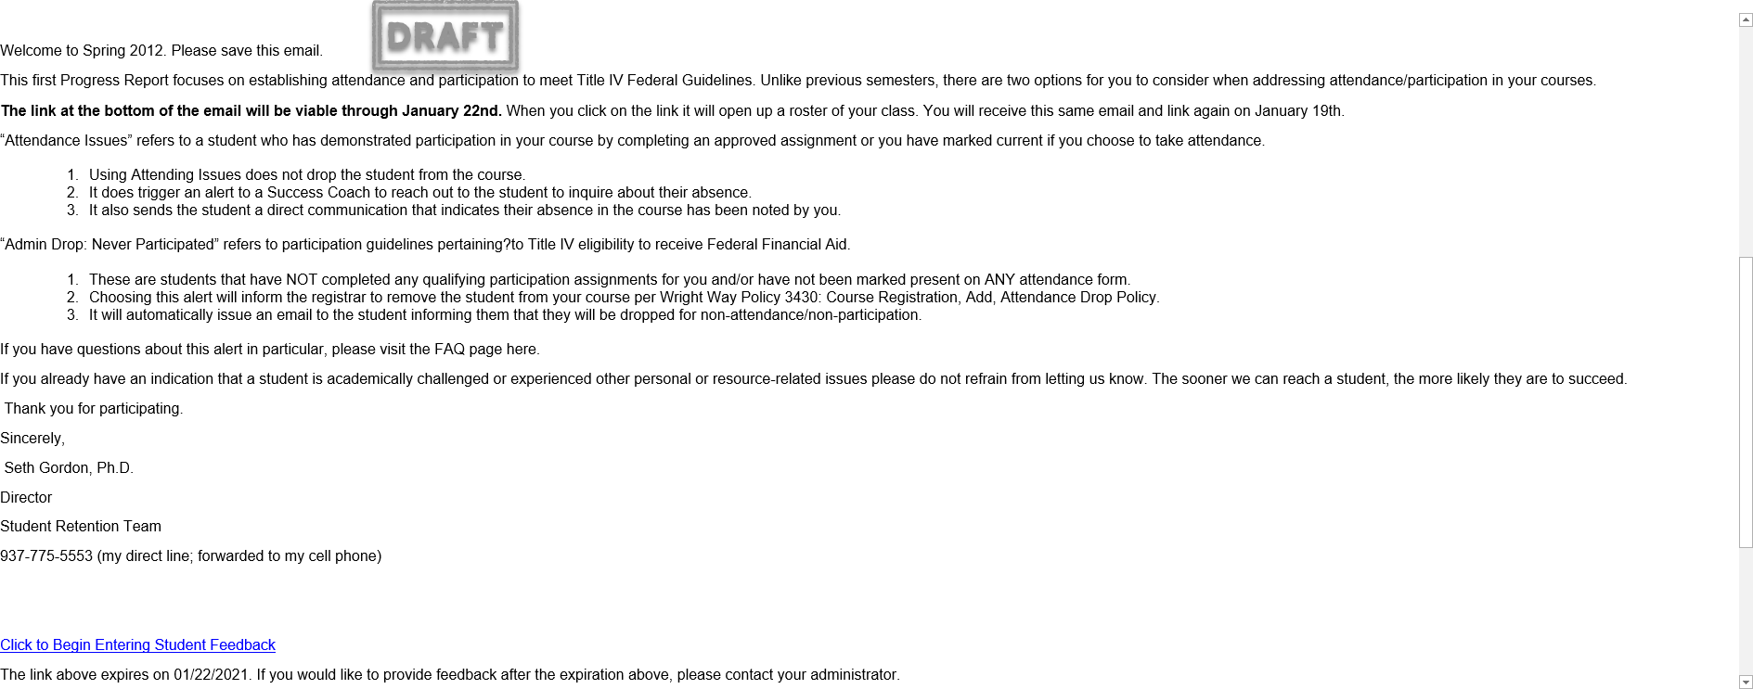
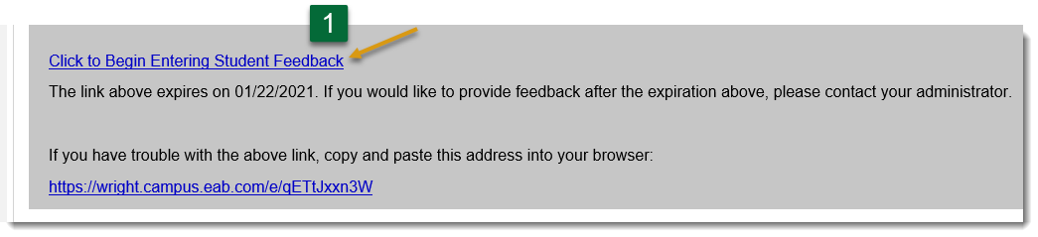
Step 1: You will receive a progress report email, providing detailed information regarding the student feedback request. To provide feedback, click on the link in the email message to access the Progress Report form. Note: the link is customized to your classes.
Faculty Guide-Submitting Progress Attendance/Participation Progress Reports through the Raider Academic Progress System (RAPS)
Notes:
Will Receive this progress report on the first day of classes – January 11 and again on Jan 19. Jan 22nd is the last day to drop with a 100%

Slide 13

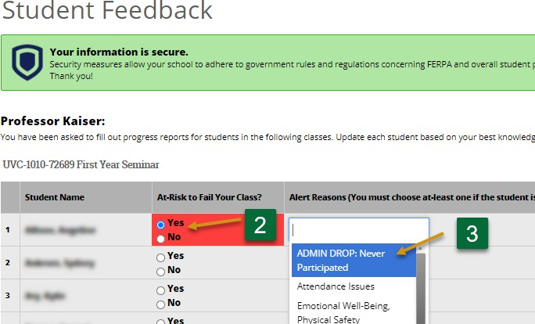
Step 2: Locate the students who have never participated in the course and select YES for the “At-Risk to Fail Your Class?” Column.
Step 3: Select ADMIN DROP: Never Participated as the alert reason from the drop-down list.

Slide 14
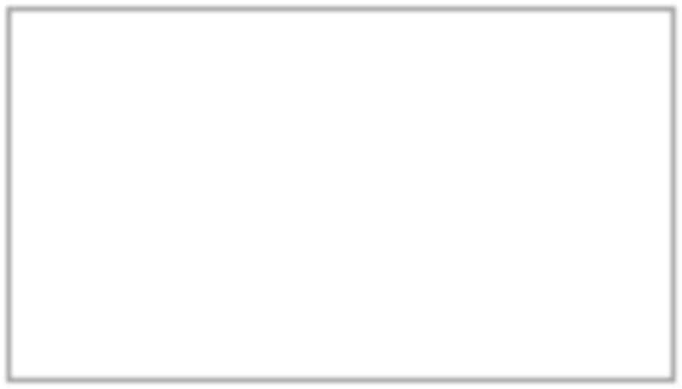
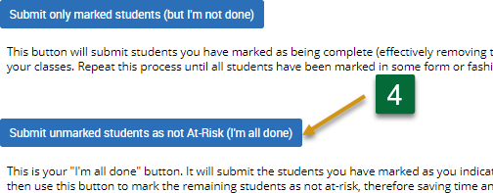
Step 4: Click on the “Submit unmarked student as not-At Risk (I’m all done) button. This option will close out your progress report, and students not marked will be identified as not at risk.

Slide 15
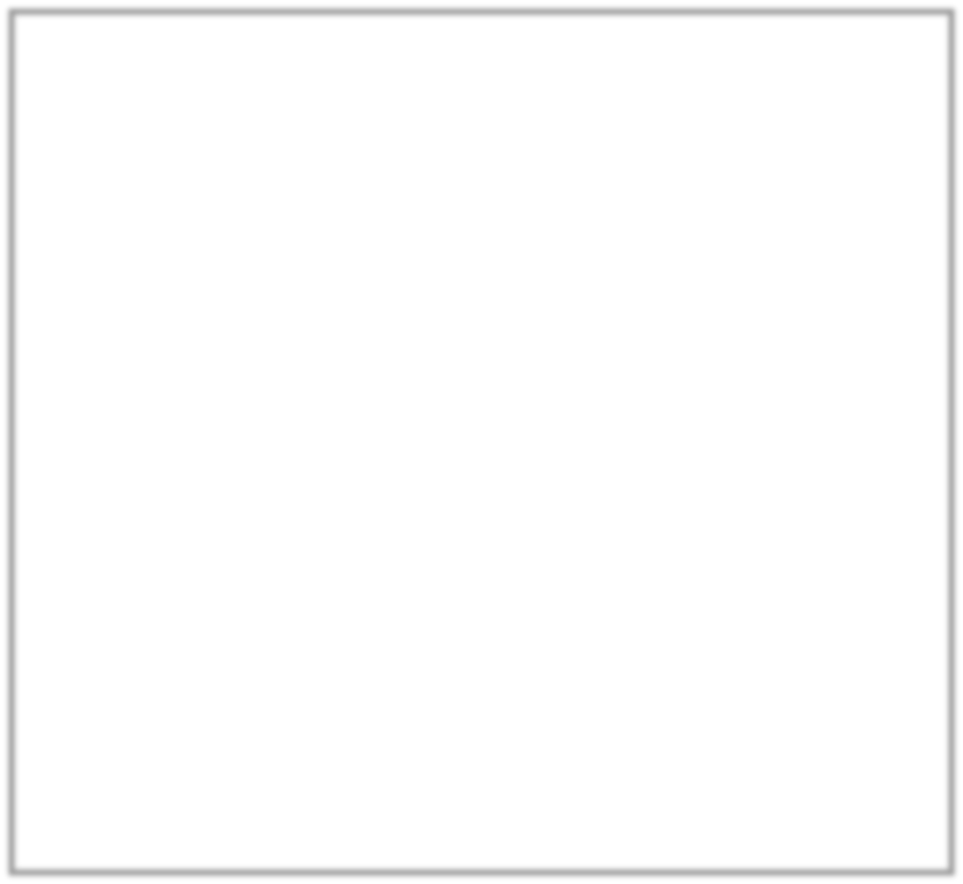
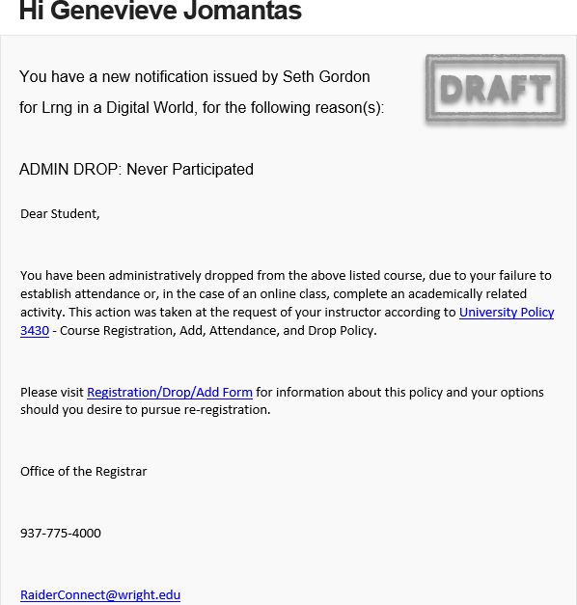
Outcome: Students flagged at risk for no participation will receive an email regarding their course inactivity regarding university Policy and referred to the Registrar Office for questions/concerns regarding options.
Notes:
This is NOT the current text of the email but an example. Students will be provided a link that will provide them clear directions on how to re-register should there be an error.

Slide 16
Faculty Support
We are working on:
Having both a screen shot pdf and a video tutorial
Having a FAQ page for Faculty that provides context, links to source information and how-to-guides
Having a FAQ page for students on how to re-register
Developing communication to all Spring term faculty and students before the start of the term

Slide 17
Thank you
Please send any questions or suggestions to:
Tim Littell at tim.littell@wright.edu
Seth Gordon, Director, Student Retention Team, seth.gordon@wright.edu
Mary Holland, Registrar, mary.holland@wright.edu
For Title IV Questions: Kim Everhart, Director, Financial Aid, kim.everhart@wright.edu

