Slide 1


Athletics Department
Bob Grant
We have a specific & unique mission:
Men’s Sports:
Baseball
Basketball
Cross Country
Golf
Soccer
Tennis
Women’s Sports:
Basketball
Cross Country
Soccer
Softball
Tennis
Track & Field
Volleyball
No overemphasis on Athletics
Never a “win at all costs” mentality
Minimum spending w/ maximum results
No bad behavior tolerated

Slide 2











SPENDING
Division 1 Ohio schools
Athletic Expenditures:
$187.2 $48.3 $37.1 $33.1 $29.5 $29.3 $29.2 $24.4 $15.9 $12.8 $11.9
Cost per Student to Subsidize Athletics:
$1,359 $1,327 $1,135 $1,028 $944 $872 $845 $769 $719 $717
(EADA 2017-2018 & Cleveland.com, March 2019)

Slide 3









SPENDING
WSU Athletics accounts for 4.6% of the University’s Total Expenses
Horizon League Athletic Expenditures:
$16.7 $15.9 $14.9 $14.9 $13.2 $12.8 $11.9 $11.3 $10.2 $8.9
(EADA 2017-2018 & Revenues and Expenses 2004-2017 NCAA Division 1 Intercollegiate Athletics Programs Report-page 32)

Slide 4
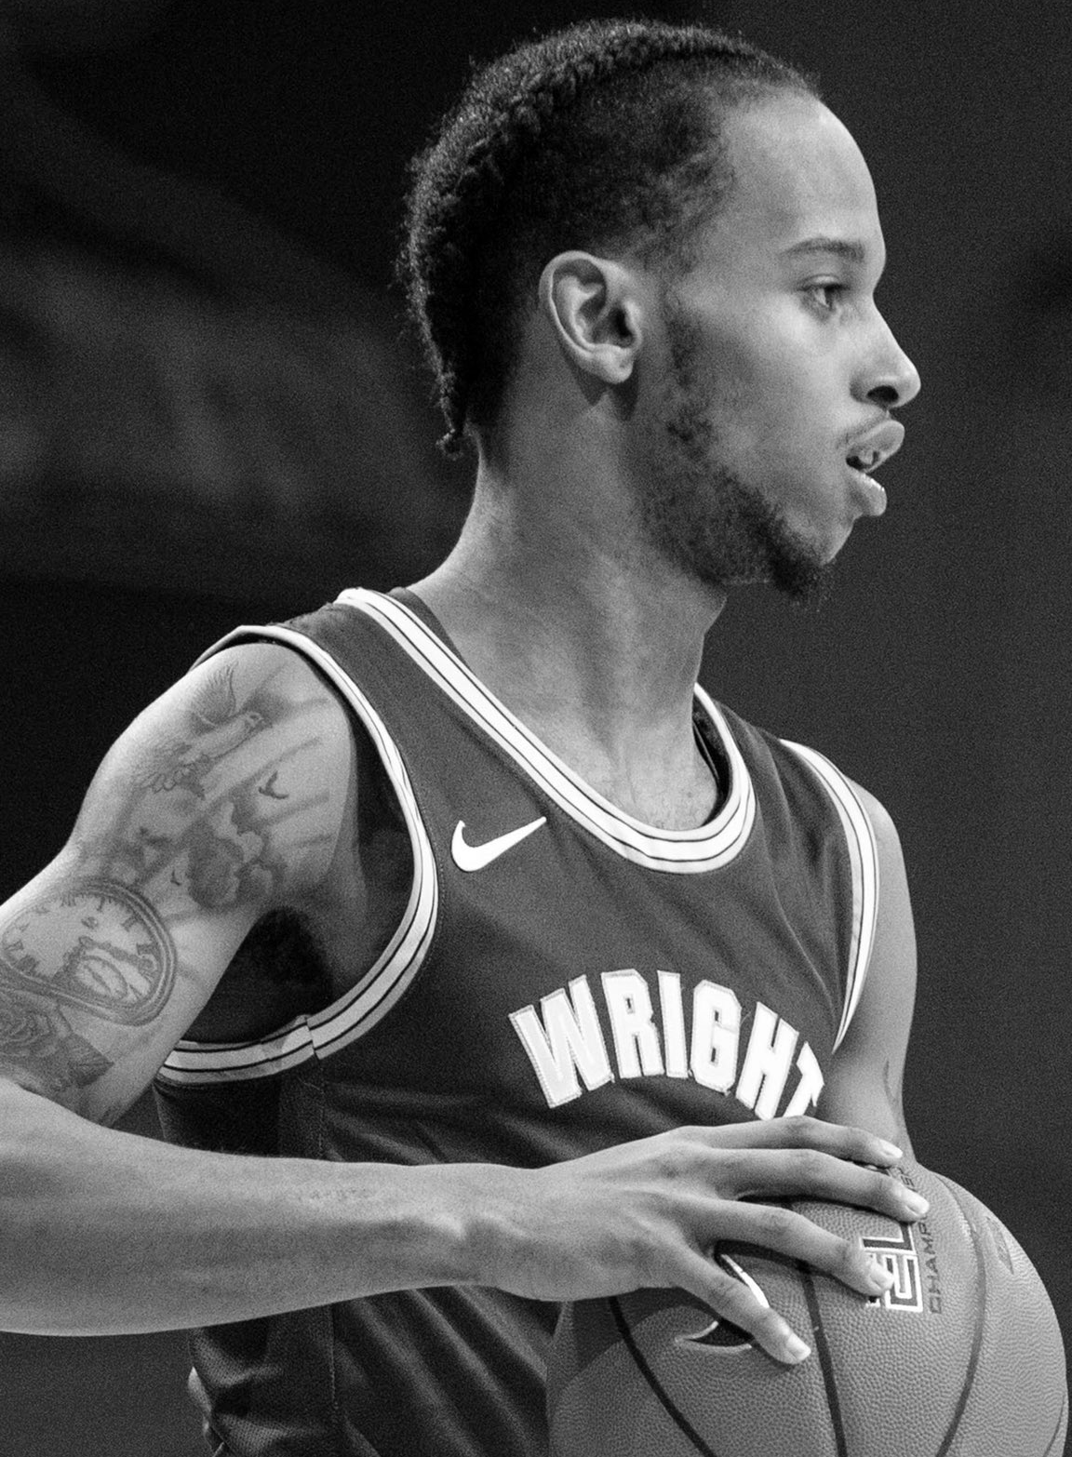
TUITION / SSI
STUDENT-ATHLETE CONTRIBUTION:
$4.1M
3
“FULL RIDE” SPORTS
MEN’S BASKETBALL | WOMEN’S BASKETBALL | VOLLEYBALL

Slide 5
ACADEMICS / RETENTION
52
STRAIGHT TERMS
WITH A CUMULATIVE
GPA OF 3.0 OR BETTER
87%
GRADUATION SUCCESS RATE
Get them | Keep them | Graduate them

Slide 6
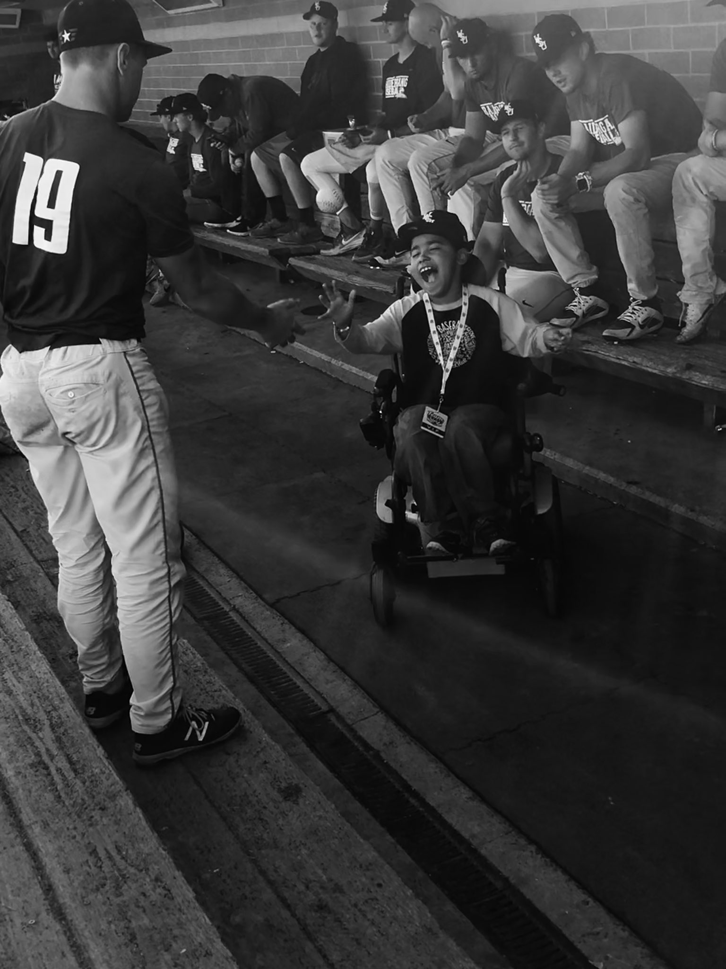

ENGAGEMENT
ATTENDANCE
BRAND BUILDING/EXPOSURE
NATIONAL TV
CORPORATE SPONSORS
DONOR ENGAGEMENT
HIGH SCHOOL KIDS
COMMUNITY SERVICE

Slide 7


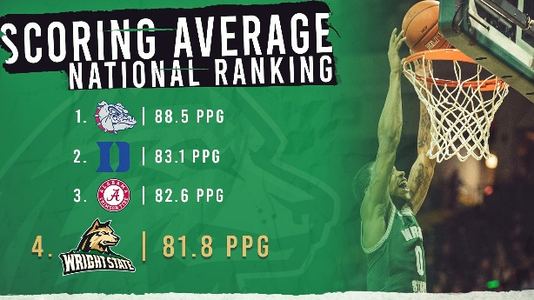


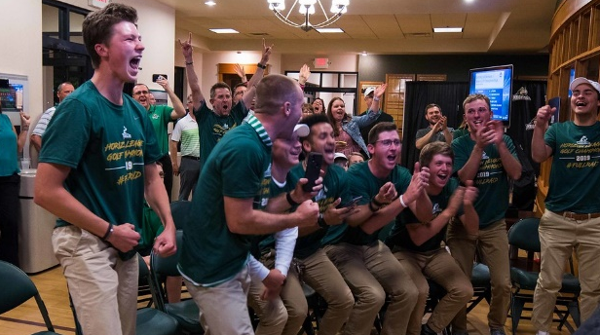

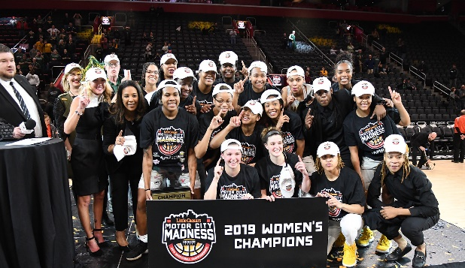
ATHLETIC SUCCESS
MEN’S BASKETBALL
WOMEN’S BASKETBALL
VOLLEYBALL
MEN’S SOCCER
BASEBALL
GOLF
M^{C}CAFFERTY
#RAIDERUP | #GETROWDY

Slide 8
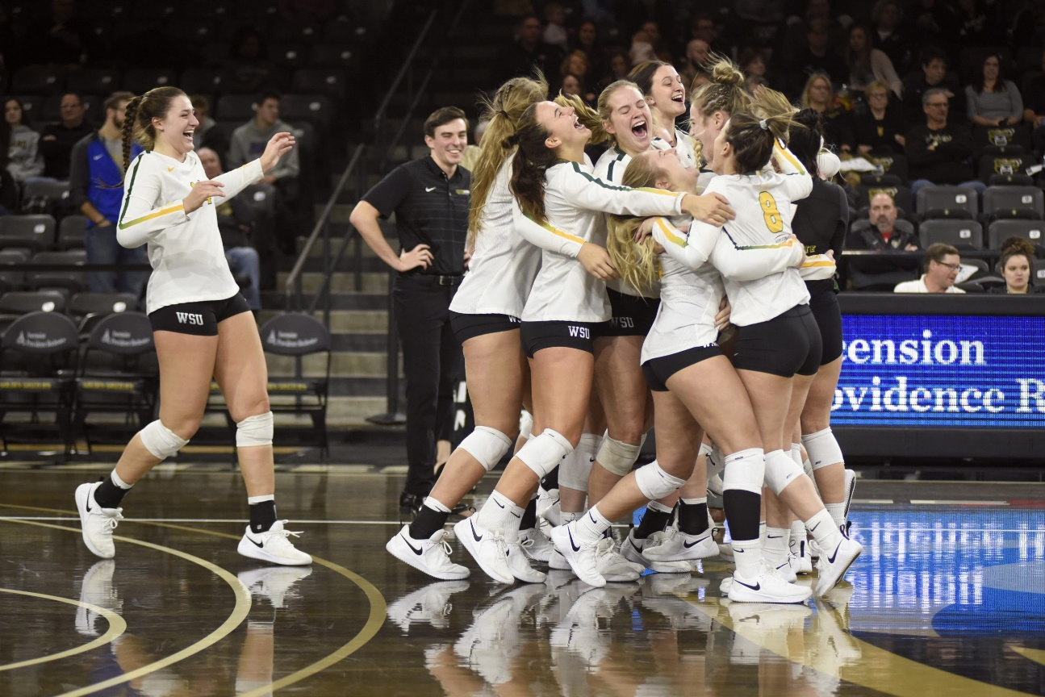
HAPPINESS
91%
OF OUR
STUDENT-ATHELTES
WOULD CHOOSE
WRIGHT STATE AGAIN

Slide 9

GO Raiders

