Slide 1
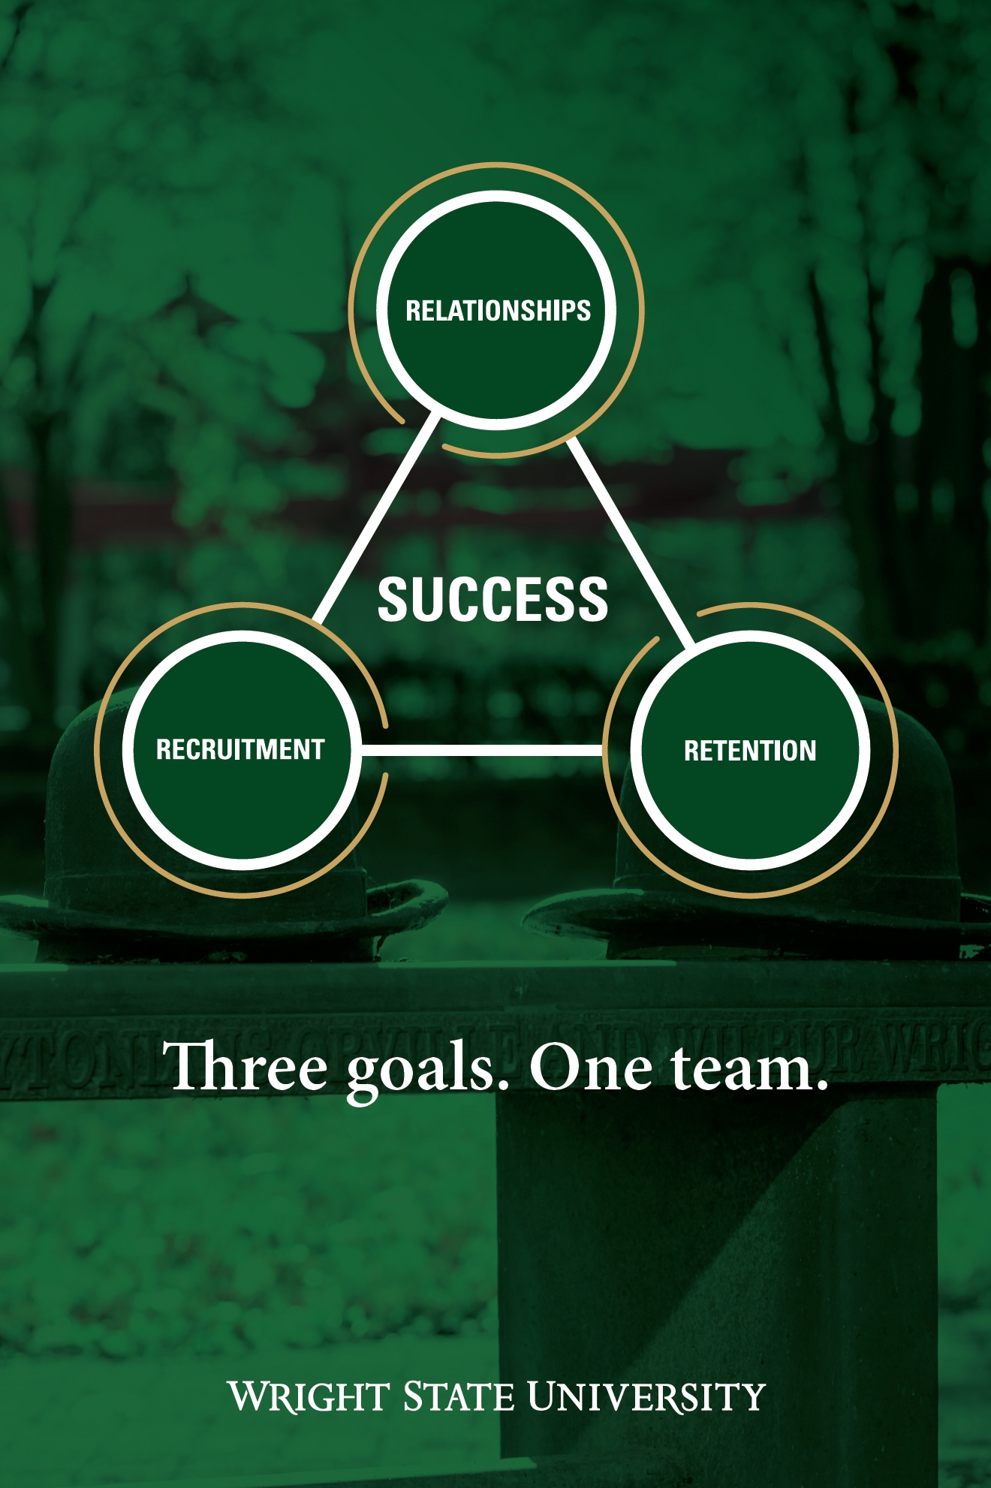
President’s Report Faculty Senate Meeting March 29, 2021

Slide 2
Inclusive Excellence Searches
All Searches are now complete:
Vice President for IE – Dr. Matt Chaney
Intercultural Specialists
Bolinga Center – Quatez Scott
LGBTQA Center – Emily Yantis-Houser
Latin & Hispanic Cultural Center – Fermin Recarte
Asian & Native American Center - TBA

Slide 3
Presidents Council on Inclusive Excellence
Subcommittees
Dr. Leslie Neyland-Brown
Chair Faculty & Staff Engagement
Dr. Chris Taylor
Policy
Mr. Michael Griest
Student Success

Slide 4
Recruitment & Retention Task Force
Jen McCamis - CoChair
Tim Littell - CoChair
Tammy Kahrig – CoChair
Mark Anderson - Marketing
Aaron Skira - IR
Laura Luehrmann –Fac Senate
Kendall Goodrich – Fac Senate
Andrew Froehle – Fac Senate
Lisa Kenyon - CTL
Debbie Lamp – Staff Senate
Jen Lamott – Staff Senate
Franchesca Alford – Staff Senate
Chris Taylor – Student Affairs
Quatez Scott – Bolinga Center
Sue Polanka –Libraries

Slide 5
University Alliance for Recruitment, Retention, & Completion (UARRC)
Faculty Senate, President
Staff, Senate Chair
Dean of the Graduate School
Co-Chairs of Each Action Team
Yield Committee (Recruitment)*, Chair
Jen McCamis & Faculty, Co-Chairs
College Reps
VP Academic Affairs
Student-Centered Data, Chair(s)
Tammy Kahrig & Aaron Skira, Co-Chairs
Staff
Admin
Student-Centered Policies, Chair(s)
Amanda Spencer, UAAC* & Faculty, Co-Chairs
-USSC*
-UPAC*
-Staff Senate
-Mary Holland, Registrar
-Tammy Kahrig, VP
-Quatez Scott - IE
Student-Centered Instructional Practices, Chair(s)
Lisa Kenyon &
Faculty
4 faculty members
New Student Experience, Chair(s)
Dean, & Joanie Hendricks, Co-Chairs
Fac Senate, Chair
Staff Senate
SGA
Student Affairs
Supportive Campus Culture, Chair(s)
Chris Taylor &
Faculty, Co-Chairs
-VP IE
-IE
-GSAC
-Sharon (Lynette) Jones
-Tim Littell
Experiential Learning & Workforce Development, Chair(s)
Kendell Goodrich & Career Service Co-Chairs
Reps from Other Colleges
-Andy Froehle

Slide 6
Return to Campus
Has begun and will progress gradually
Single Office Employees
Can and should resume working on-campus
Shared Workspace Employees
Can resume working on-campus, we will preserve physical distancing through staggered schedules, physical changes to the workspace

Slide 7
Return to Campus
Vaccinations
Working with ODH & Governors office
Encourage all University employees to get a COVID-19 vaccination as soon as it is available to them.
Wright State Physicians have a very limited number of doses per week – They will be running a vaccination clinic each week
ODH Website https://gettheshot.coronavirus.ohio.gov/
Walgreens, CVS, Kroger covid vaccine sites

Slide 8
Medical Accommodations
Contact ODS
https://www.wright.edu/inclusive-excellence/disability-services/americans-with-disabilities-act-accommodations

Slide 9
Strategic Planning
Working Group
Will be put together in April in preparation for a comprehensive review of the current set of information gathered
Charting the Path Post COVID
Work will begin early Fall semester
Must define our Mission & Vision

Slide 10
Strategic Planning
Mission Statement (2013)
We transform the lives of our students and the communities we serve.
We will:
• build a solid foundation for student success at all levels through high-quality, innovative programs.
• conduct scholarly research and creative endeavors that impact quality of life.
• engage in meaningful community service.
• drive the economic revitalization of our region and our state and empower all of our students, faculty, staff, and alumni to develop professionally, intellectually, and personally.

Slide 11
Strategic Planning
Vision (2013)
Wright State University, inspired by the creative spirit of the Wright brothers, will be Ohio’s most learning centered and innovative university, known and admired for our inclusive culture that respects the unique value of each of our students, faculty, staff, and alumni and for the positive transformative impact we have on the lives of our students and the communities we serve.

Slide 12
Events
Bolinga Center
“What is HERstory” Series
Dr. Nicole Carter -The Combahee River Collective Today 4-5pm
https://wright.webex.com/webappng/sites/wright/meeting/download/ab3afa3610e04180813816c04f6675d7?siteurl=wright&MTID=mb65661c0b344c01700761f5ea860dbf4
Dr. Sharon Lynette Jones –Conversations with Angela Davis Tomorrow 6-7pm
https://wright.webex.com/webappng/sites/wright/meeting/info/4be7d681c6cd4f7f96052ed46ea6f2f5?siteurl=wright&MTID=mfc5239787ac693262e9876cd899d8047
Virtual Kente Stole Celebration – April 21 7-9pm

Slide 14
Strategic Plan - Pillars
Transformational Education (EXAMPLE ONLY)
We will provide the students of Wright State with a highly accessible, affordable high quality educational experience, comprised of challenging academic programming, experiential learning opportunities, community engagement, quality cocurricular activities and service.
Undergraduate Education
Experiential learning
Stackable credentials
Reduce time to degree completion
Flexible Scheduling
Digital Education
Peer mentor programs
Summer Bridging programs

