Slide 1
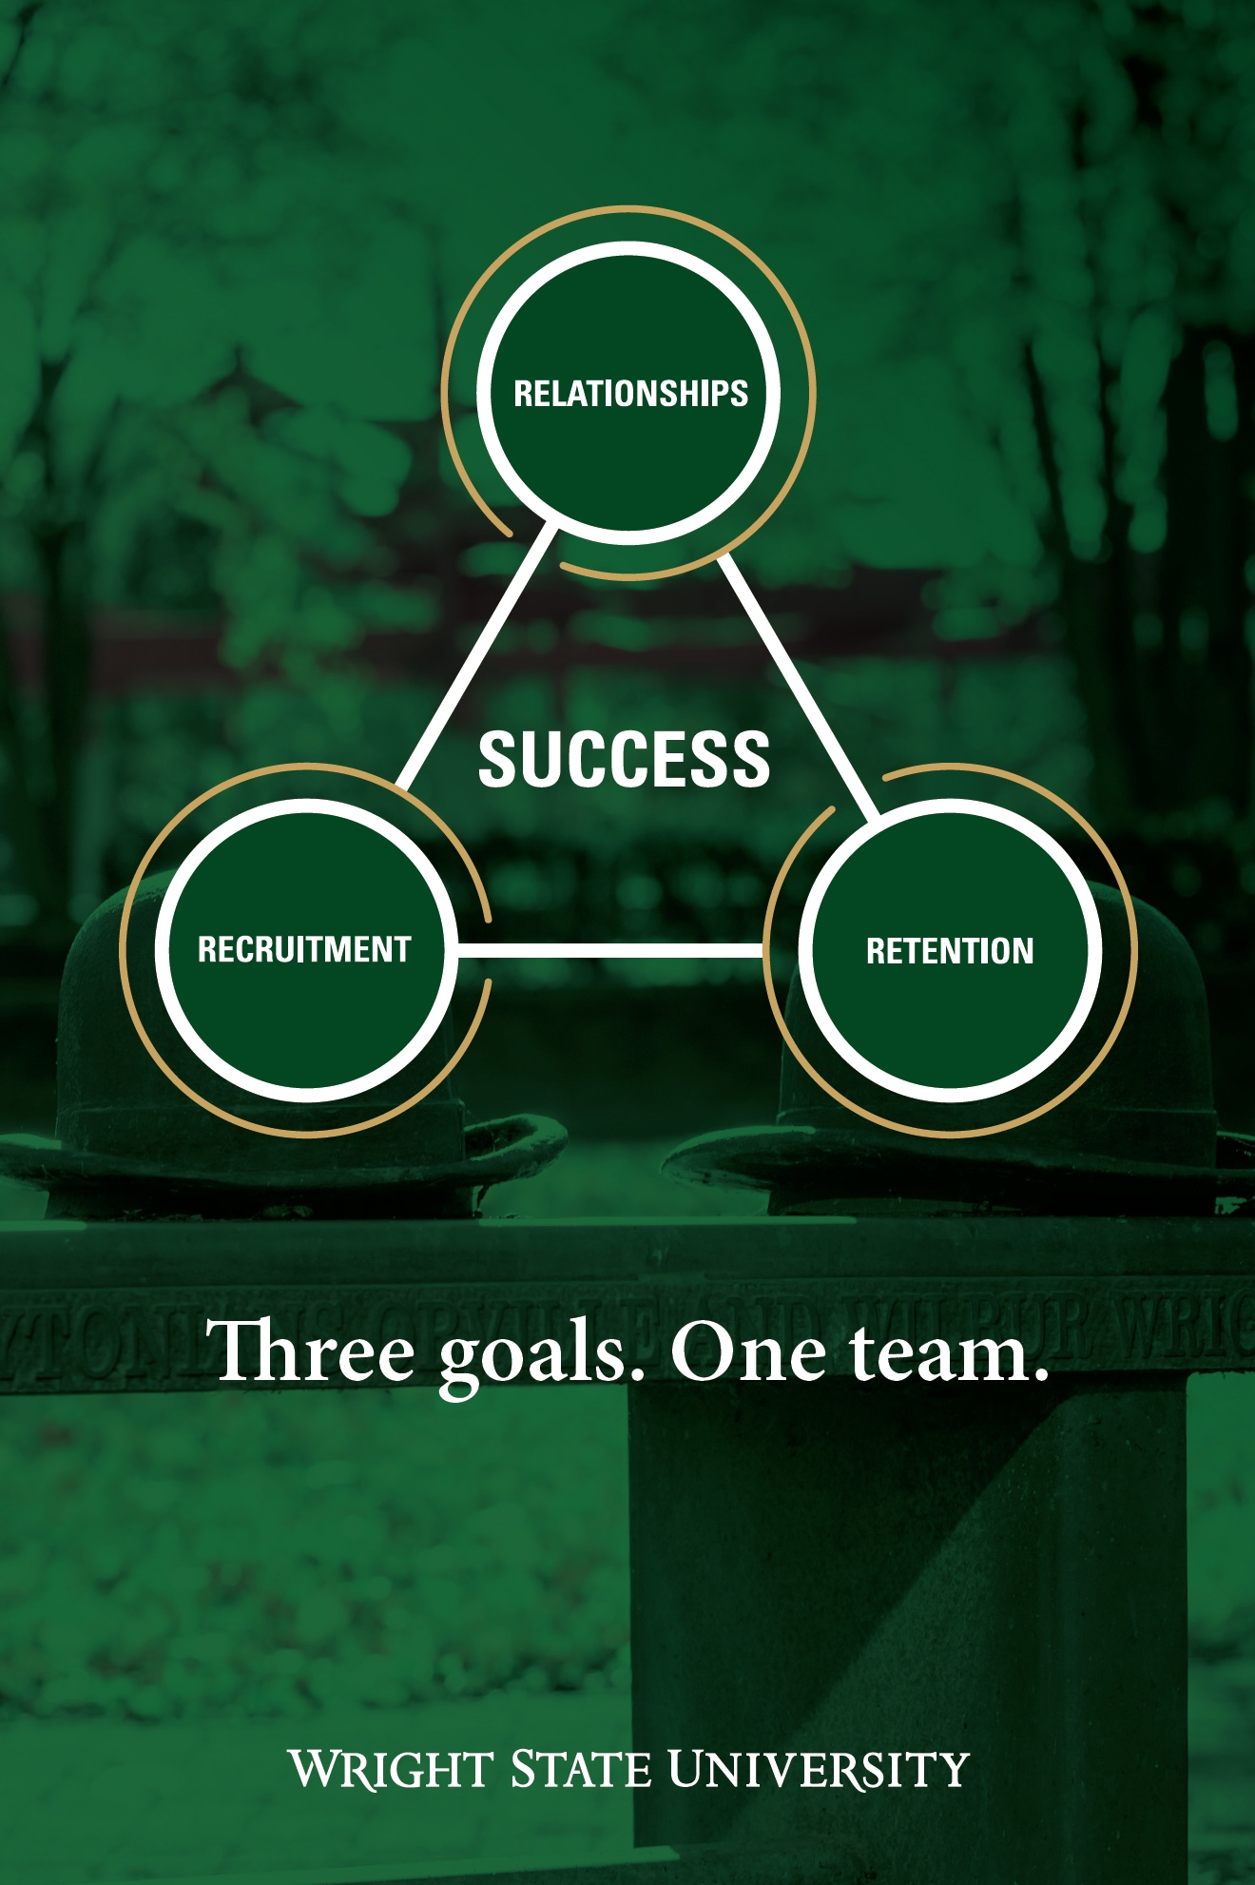
President’s Report Faculty Senate Meeting April 25, 2022

Slide 2
Enrollment

Slide 3

Admitted Student Events
SIGNING DAY 2022
Monday, May 2
4-7 P.M.
Student Union
Take an official Signing Day photo
Get your questions answered about becoming a Raider
Meet with current students and alumni
Register for Orientation
Apply for housing
Submit the statement of intent

Slide 4
Admitted Student Events
#RAIDERSTRONG POSTCARD WRITING CAMPAIGN
April 20-May 13
Handwritten welcome messages on postcards
Admitted students for the Fall 2022 semester.
high school seniors, adult students, and transfer students.
To volunteer, please complete the sign-up sheet at https://forms.office.com/r/4q0aH3jJNe
Volunteers are asked to complete a minimum of 10 postcards, and are, of course, welcome to complete multiple packets.
Packets can be completed in the admissions office or picked up and returned to Admissions. Volunteers will receive full instructions and sample messages.

Slide 5
Thank You!!

