Slide 1
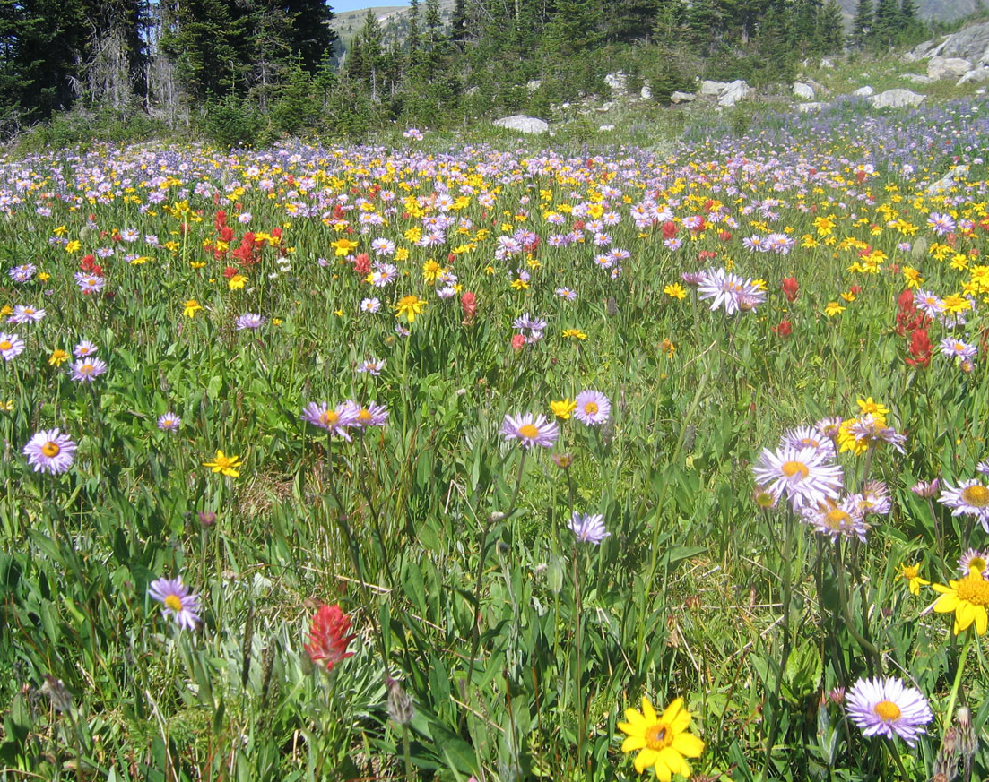
Wright State Beautification Proposal
A Brief Overview

Slide 2
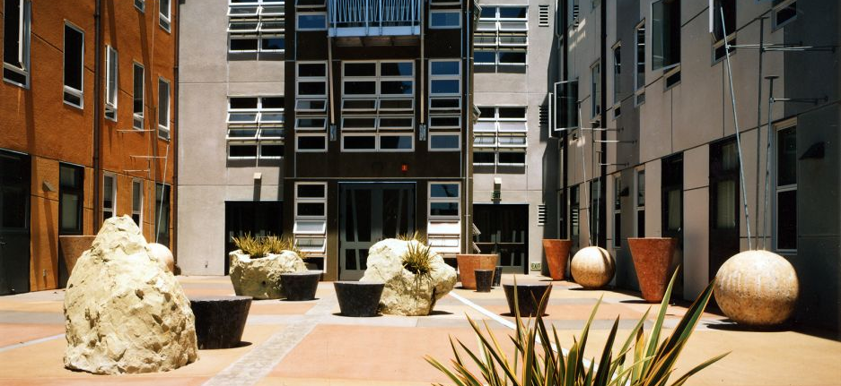
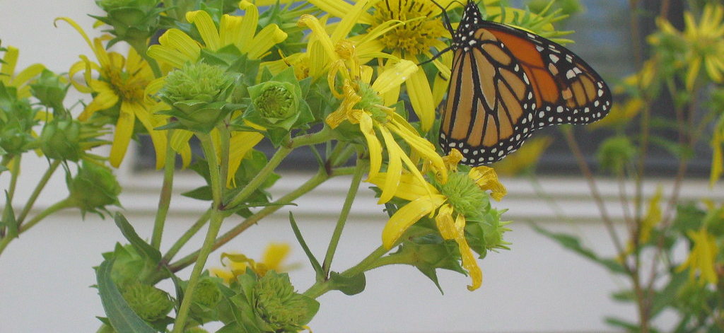
Summary
Reintroduction of native plants and flowers into spaces that are not utilized
Planting of rain gardens with salt tolerant plants to protect drinking water and Runkle Woods from runoff
Installation of outdoor classrooms and recreational spaces for increased campus enjoyment
Creation of FSC and cultural plots for campus
This Photo by Unknown author is licensed under CC BY.
This Photo by Unknown author is licensed under CC BY-NC-ND.

Slide 3
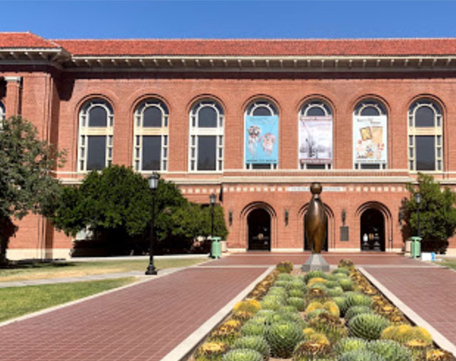
Examples in other universities
Most Ivy Leagues
  Include biodiversity gardens focused around studies on ecology
  Usually include rain gardens, microhabitat restoration
OSU/ UC/ OU
  Conducting beautification with natives and non- native, non- invasive
  Work with communities to increase biodiversity in surrounding areas (spillover)
University of Arizona
  Increased biodiversity to help with aquifer regeneration
This Photo by Unknown author is licensed under CC BY.

Slide 4
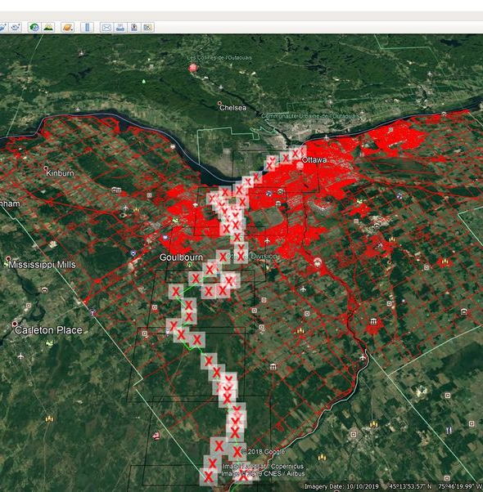
Steps to be taken
GIS Survey of campus for the following:
  Sunlight hours and campus shade zones
  Traffic areas to consider planting
  Stormwater uptake and retention areas
  Unutilized grassy areas that can be converted
Identify microclimates based on survey
  Work with ES and Bio to identify plants that are native and will have best chance of growing
Work with landscape architect and budget to maximize effect
This Photo by Unknown author is licensed under CC BY-SA.

Slide 5
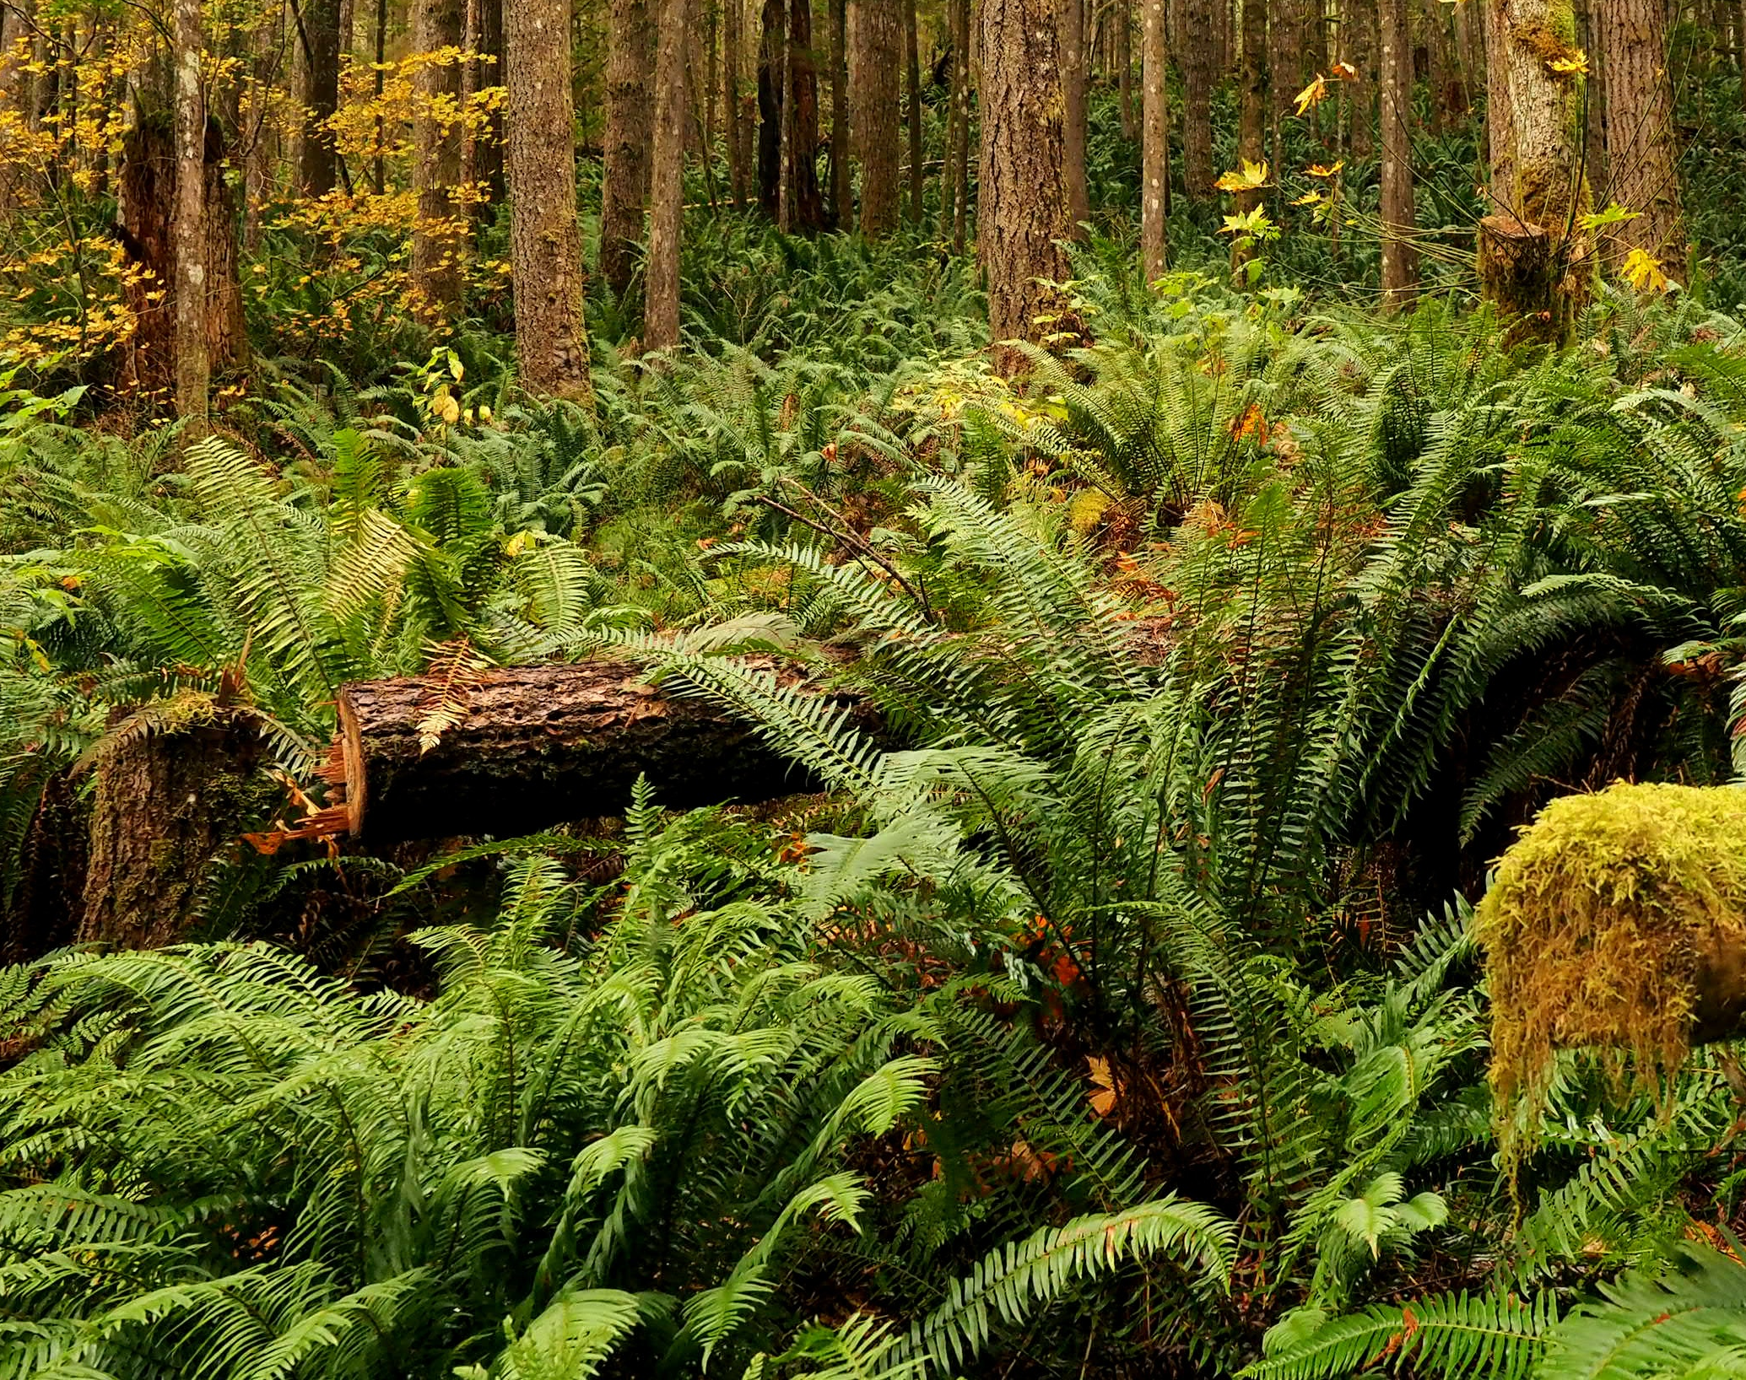
Considerations
Beautification and biodiversity can dramatically reduce lawn care budget for university
Interdisciplinary studies can and should be developed with these techniques across colleges
Great chance for student engagement to help design plots (adopt a plot)
Excellent response from campus community
Staging can reduce upfront cost

Slide 6
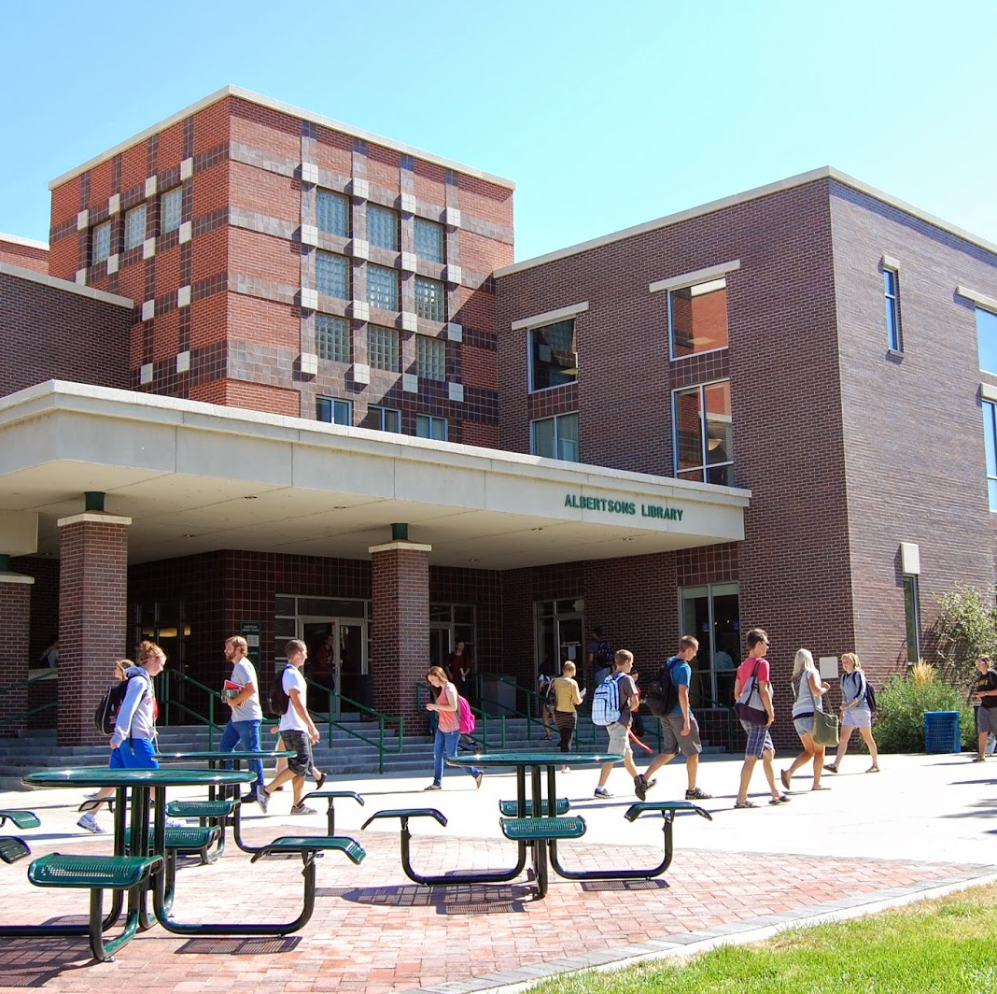
Recommendations
Make beautification and biodiversity a priority in the master plan
Focus on multiple use projects
  Rain gardens to protect groundwater from runoff while beautifying the drive into campus
  Eliminate ivy from planters to protect concrete while introducing new biodiversity
  Outdoor classrooms and sitting areas to increase time on campus
Utilize campus resources
  Lots of grad students looking for projects
This Photo by Unknown author is licensed under CC BY-SA-NC.

