Slide 1
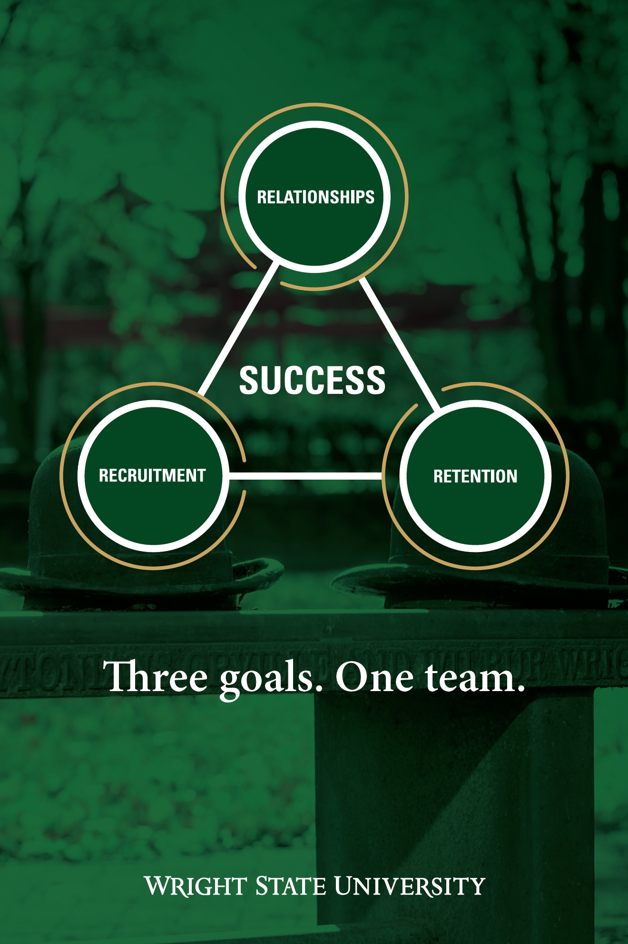
President’s Report
Board of Trustees
April 29, 2022

Slide 2
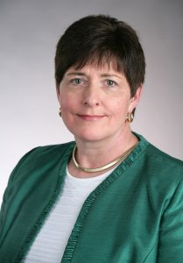
Provost – Dr. Amy Thompson
Moving Forward

Slide 3
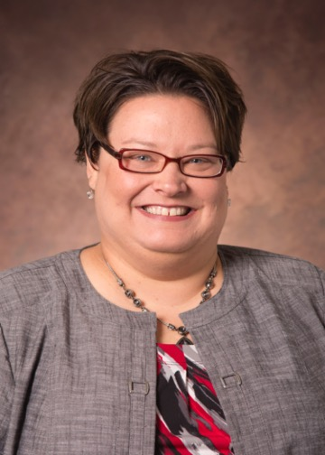
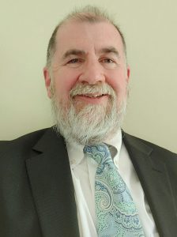
New Faces in Leadership
Moving Forward
University Registrar
Dr. Lisa Runyan
Dean College of Liberal Arts
Dr. Gary Schmidt

Slide 4
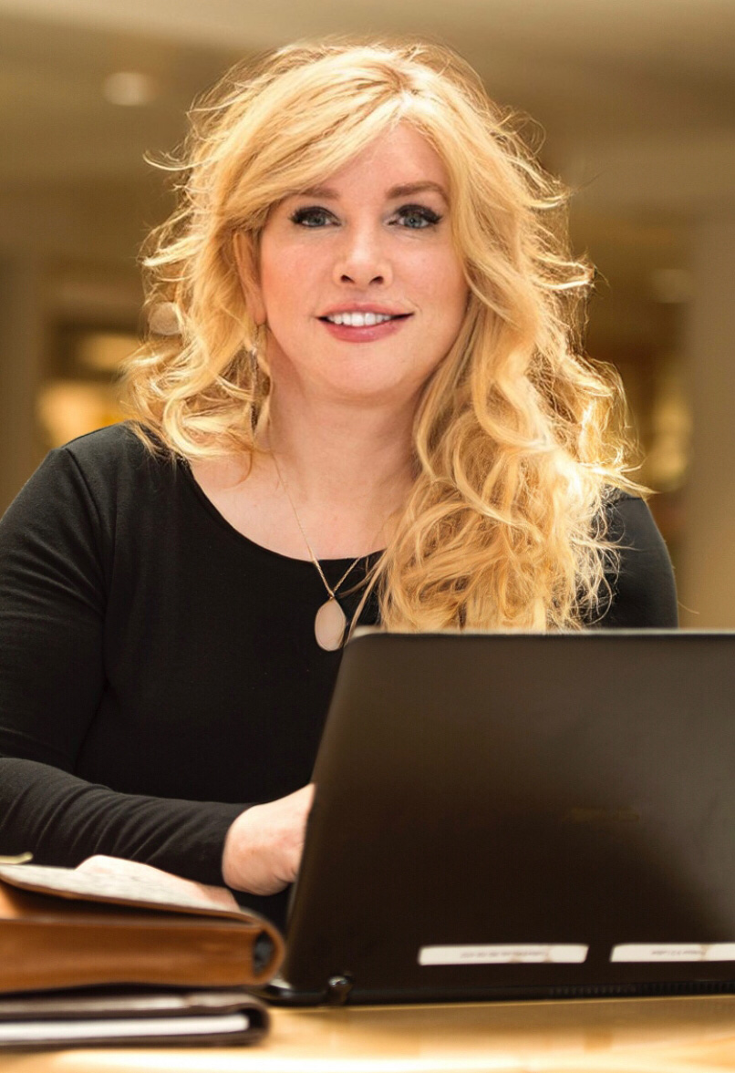
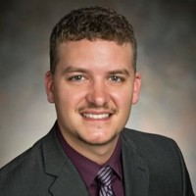
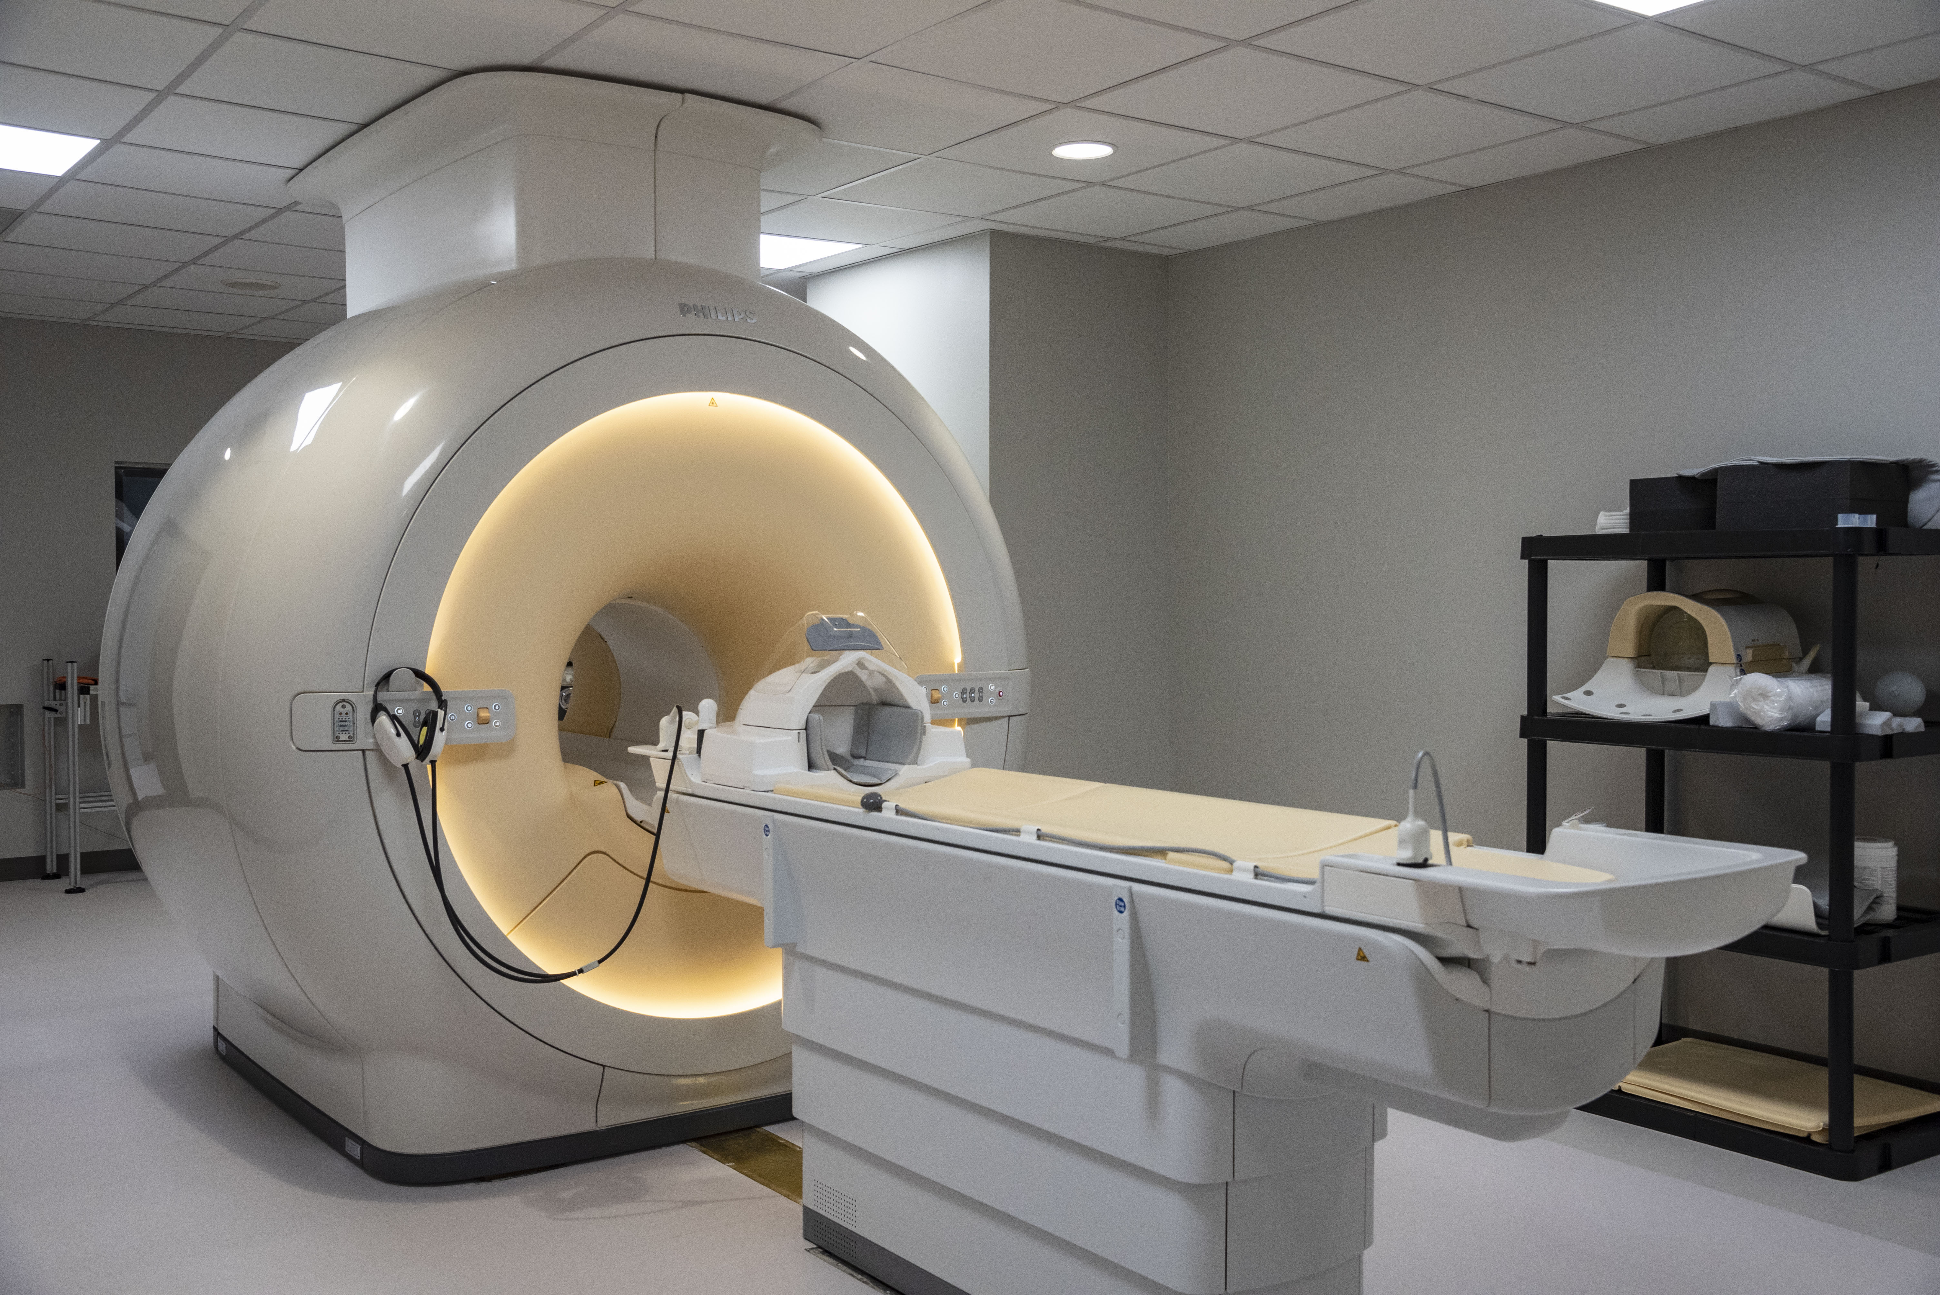
Moving Forward
Dr. Matthew Sherwood
Director of the Center of Neuroimaging and Neuro-Evaluation of Cognitive Technologies
Dr. Nella Ludlow
Quantum Computing

Slide 5
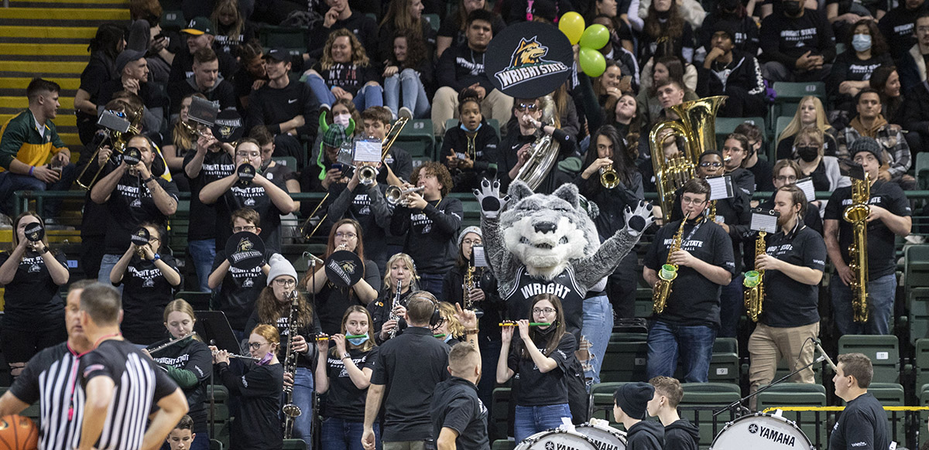
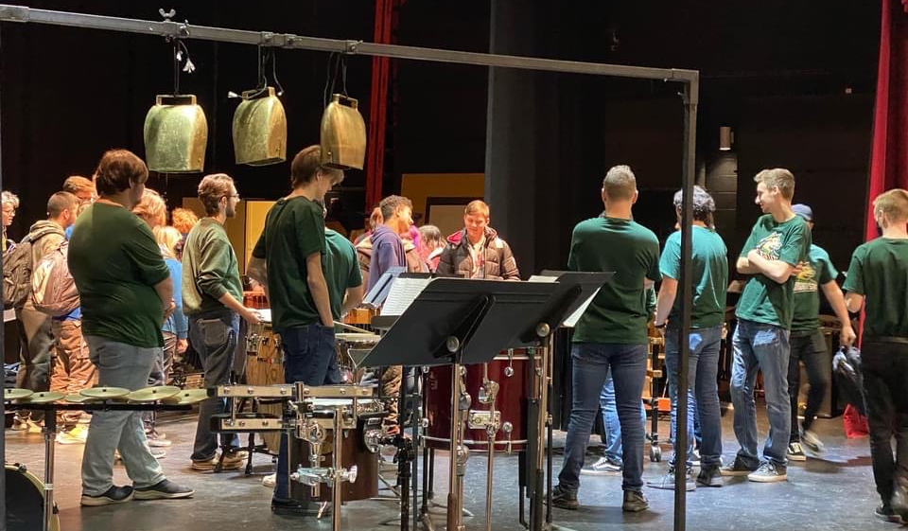
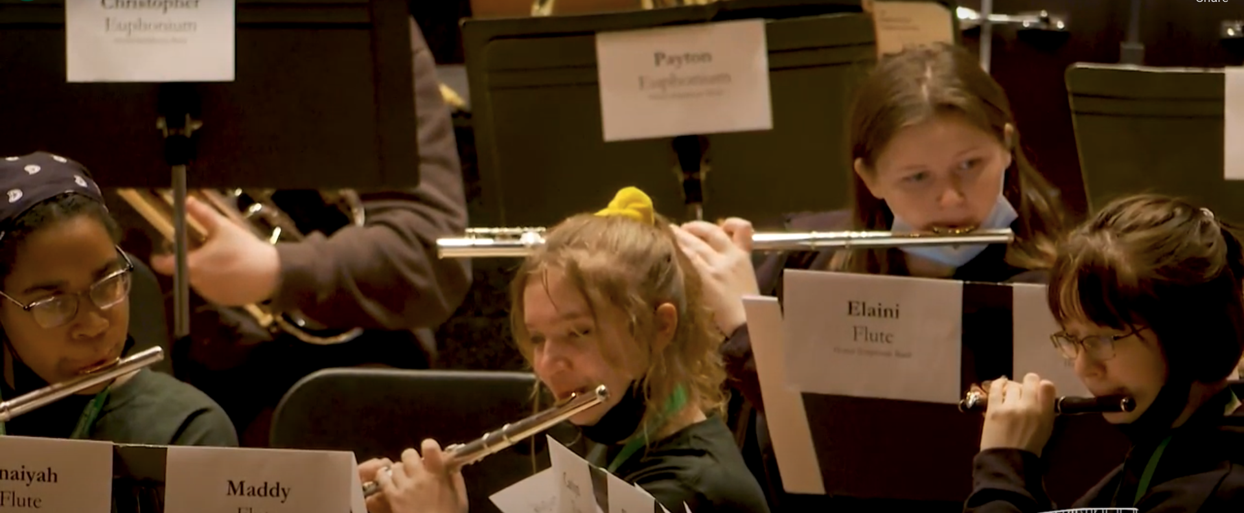
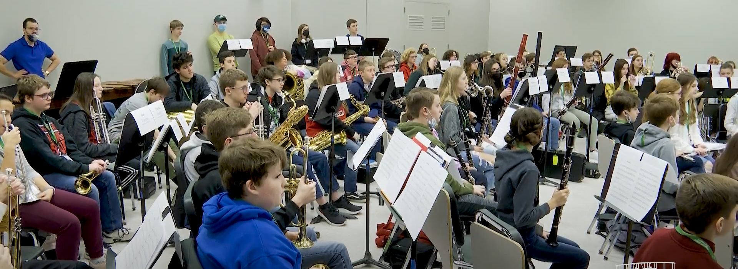
Recruitment
🎼School of Music 🎼

Slide 6


Recruitment
Take Flight Program
Fee waiver for summer orientation
Dell Latitude Laptop
$100 in textbook vouchers each academic year
Dedicated student success coach, academic advisor, and career consultant
Special workshops related to internships, research opportunities, and career development
On-campus employment through the Federal Work-Study Program

Slide 7
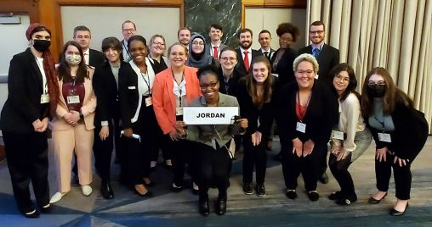
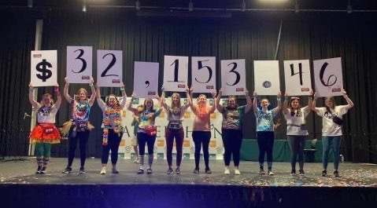
Bragging Rights
Miracle Makers Raise Over $32K
for Dayton Children’s Hospital
WSU Model UN Named Outstanding Delegation

Slide 8
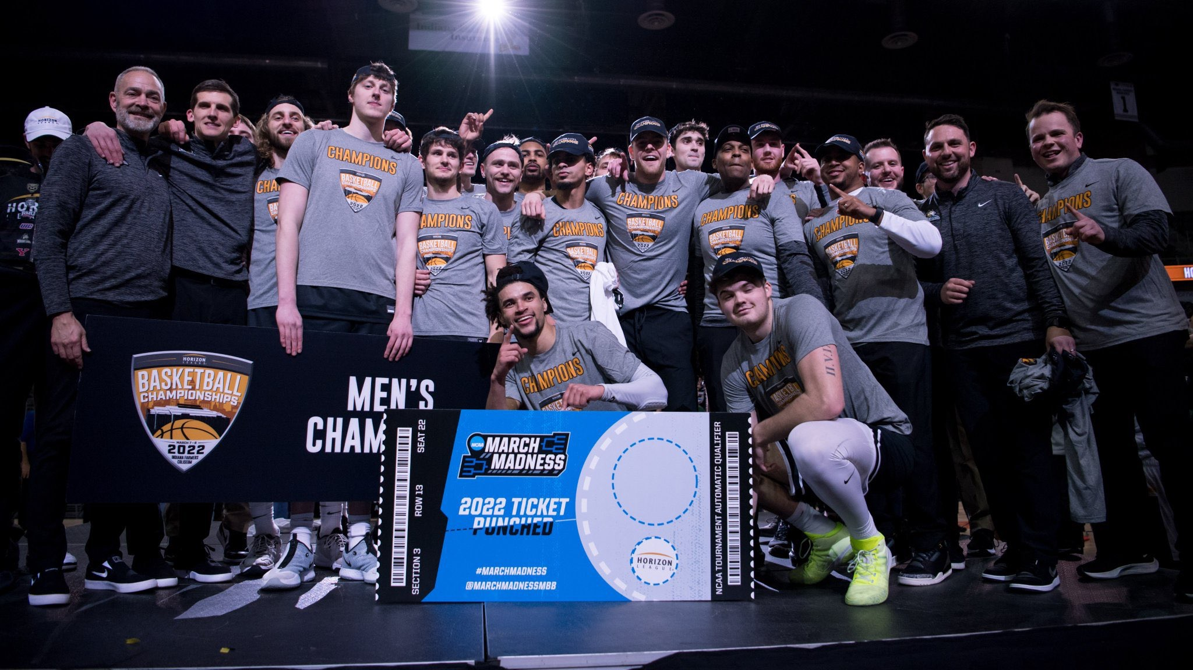

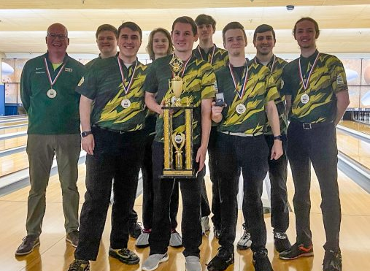
Bragging Rights
Horizon League Champions
Men’s Basketball
Horizon League Champions
Men’s Golf
Men’s Club Bowling
National Champions

Slide 9
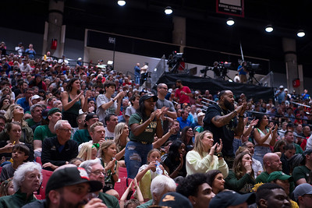
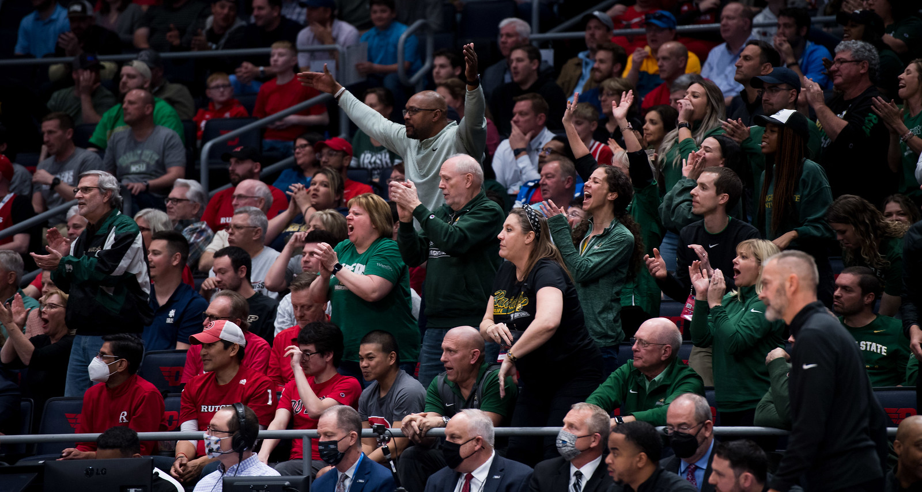
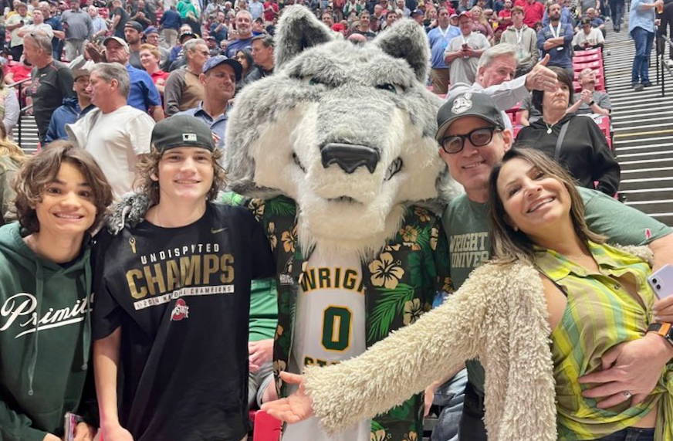
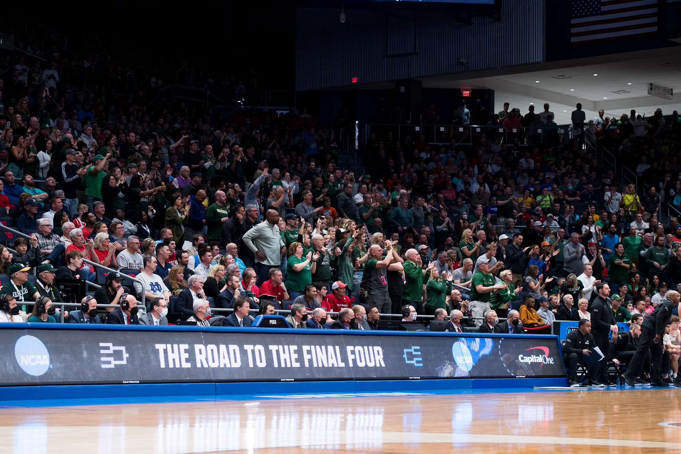
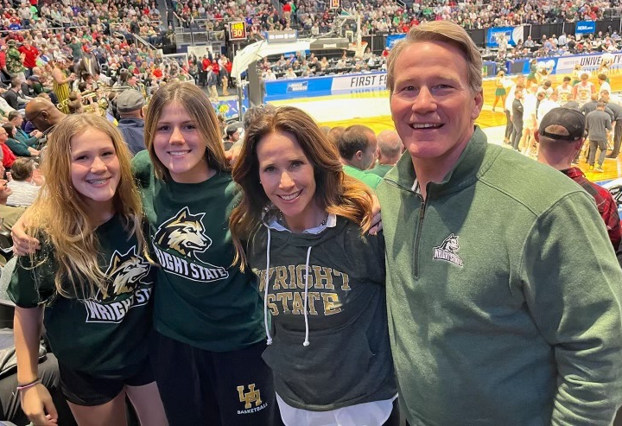
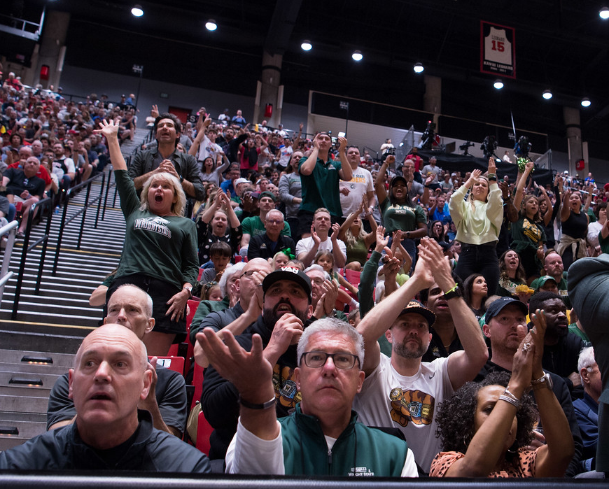
March Madness School Spirit

Slide 10
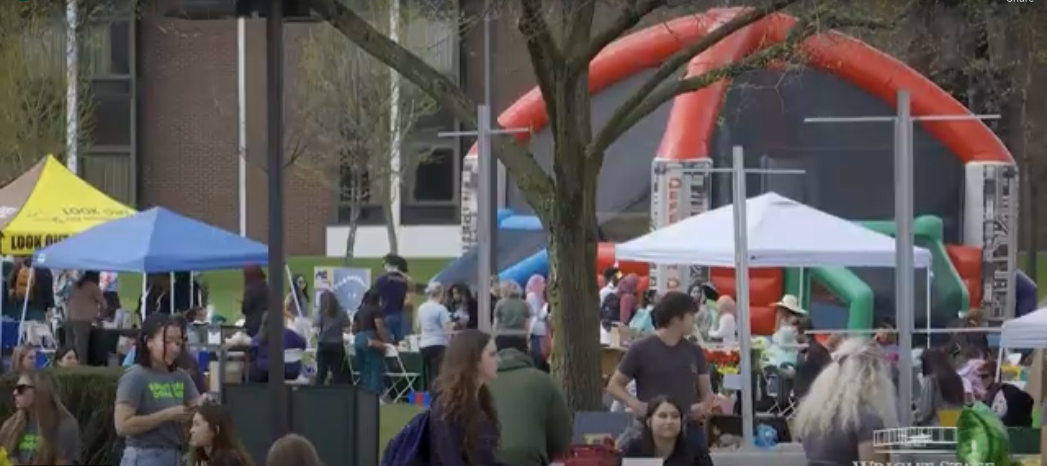
School Spirit

