Slide 1
Board of Trustees Update
Jonathan Ciero

Slide 2

Raider Nights in the City
Successful year!
  7 events, 150+ total attendees
Events in Dayton, Cincinnati, Columbus, and Indianapolis
Hopeful for this to continue next year

Slide 3
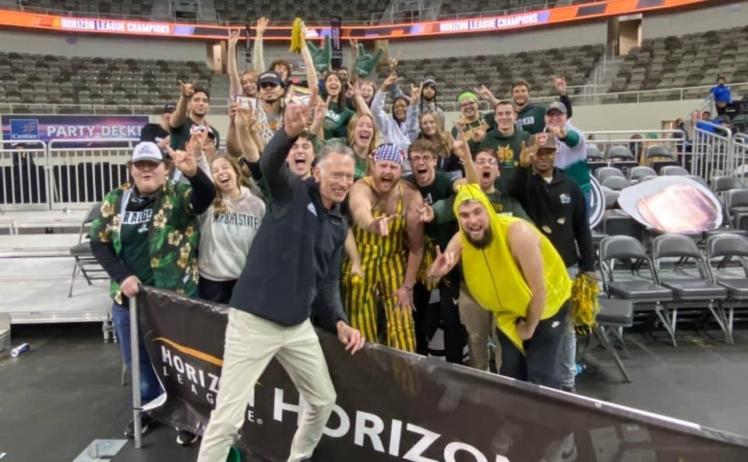
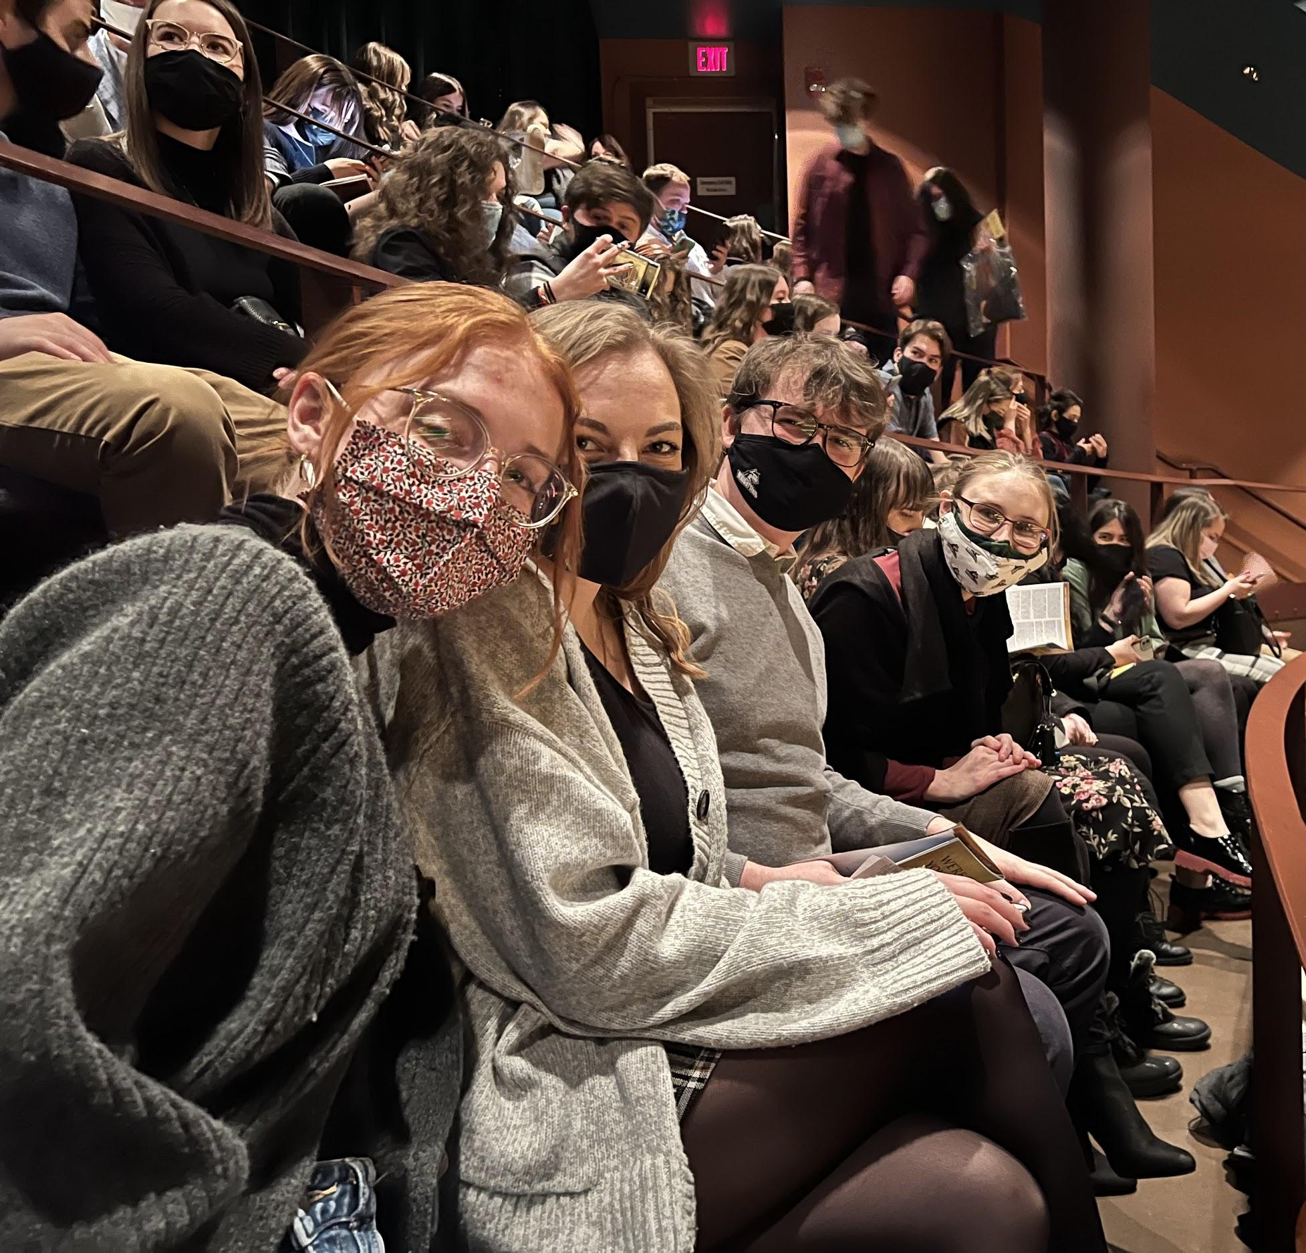
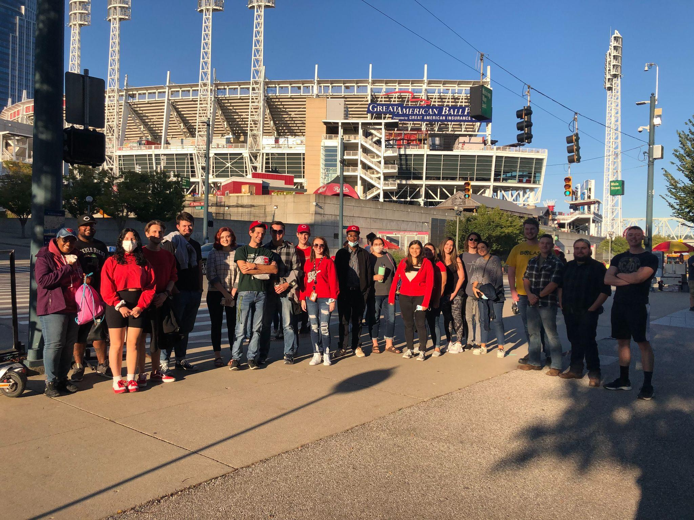
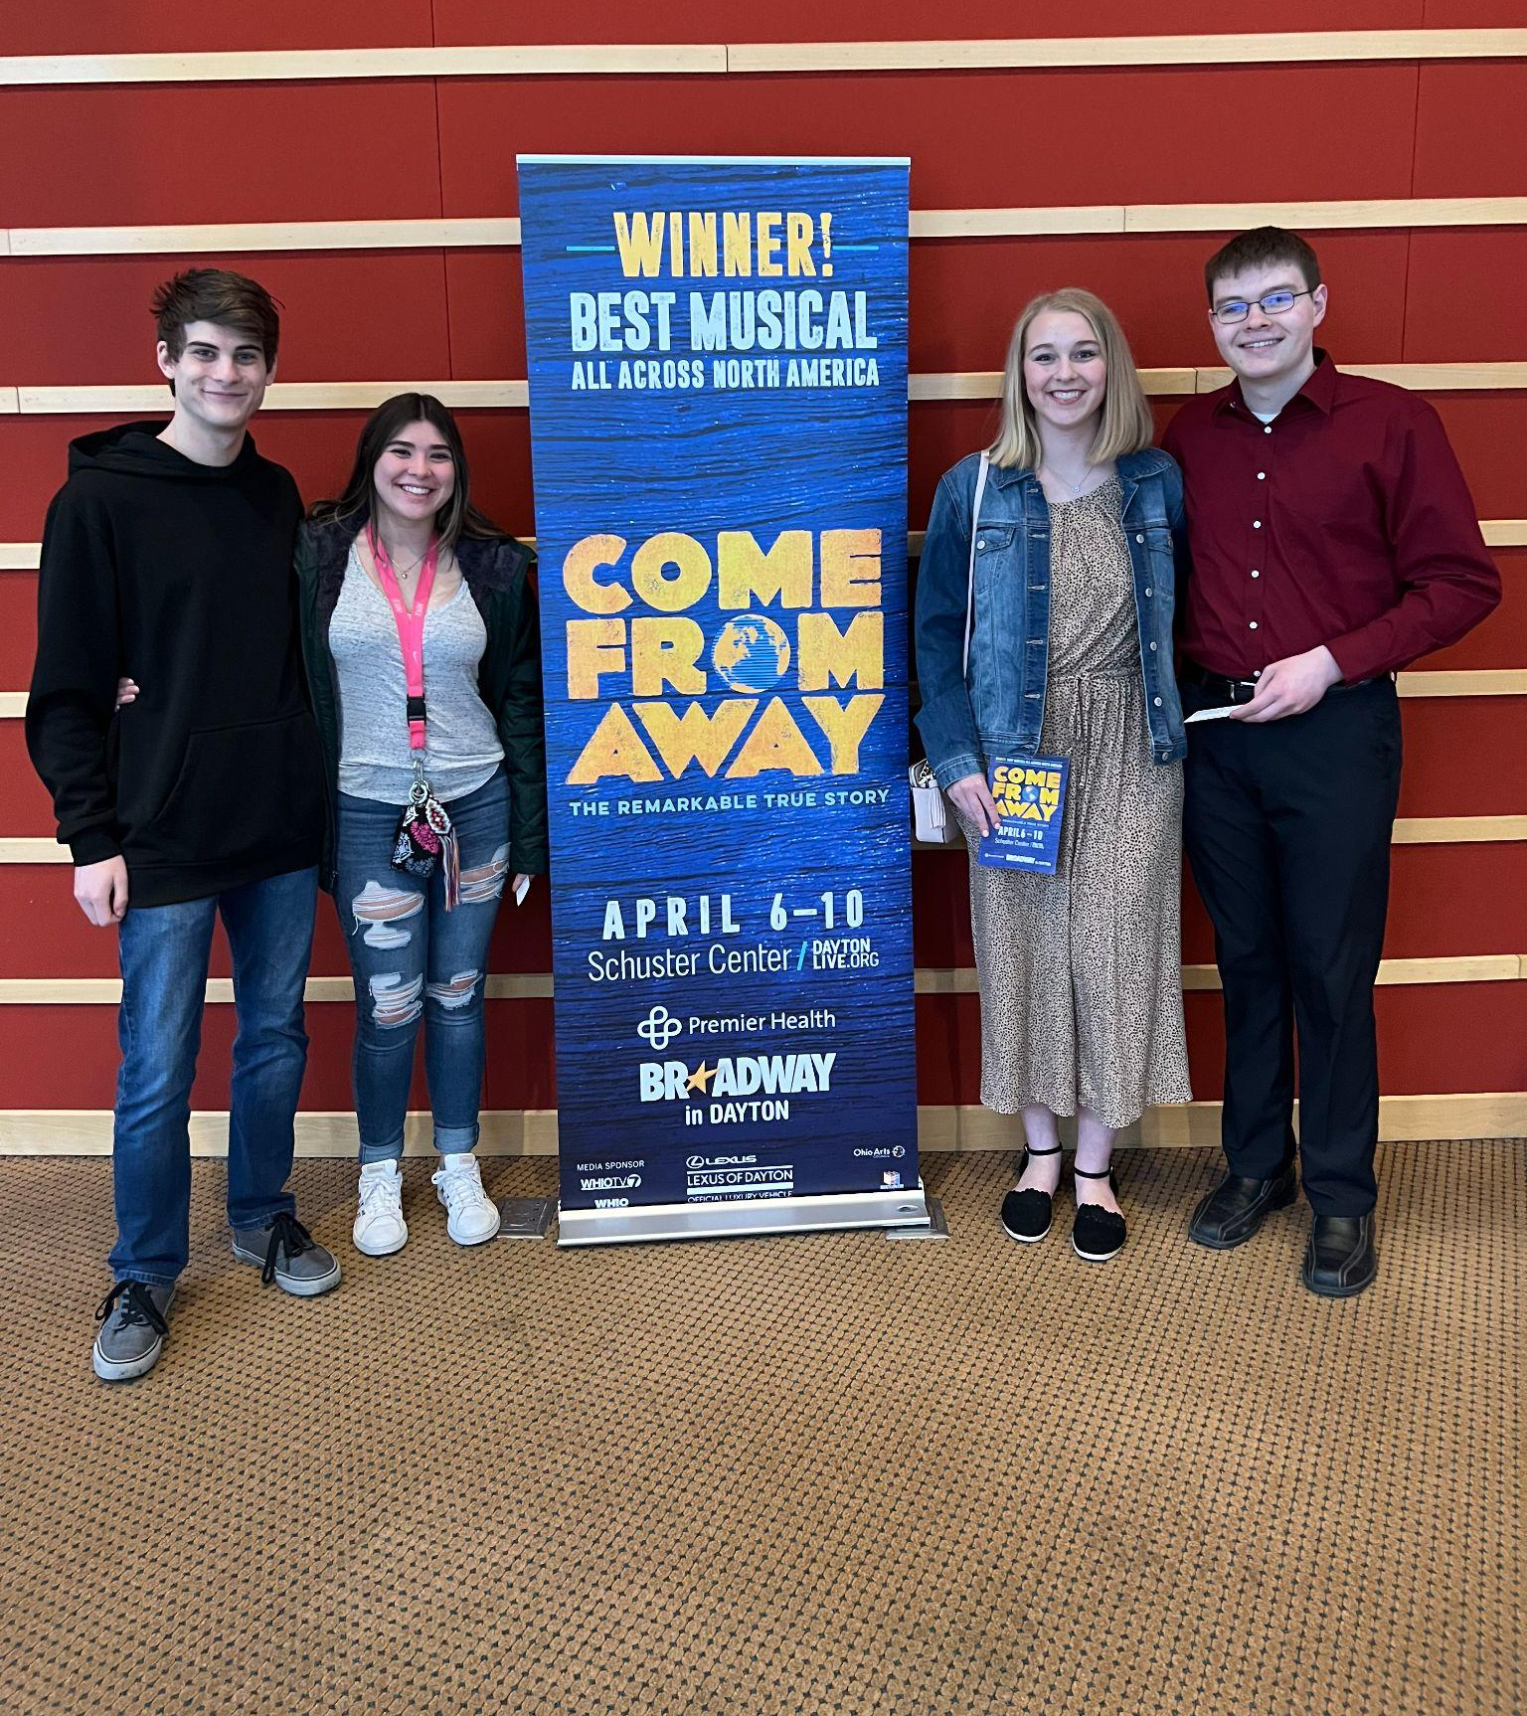

Slide 4
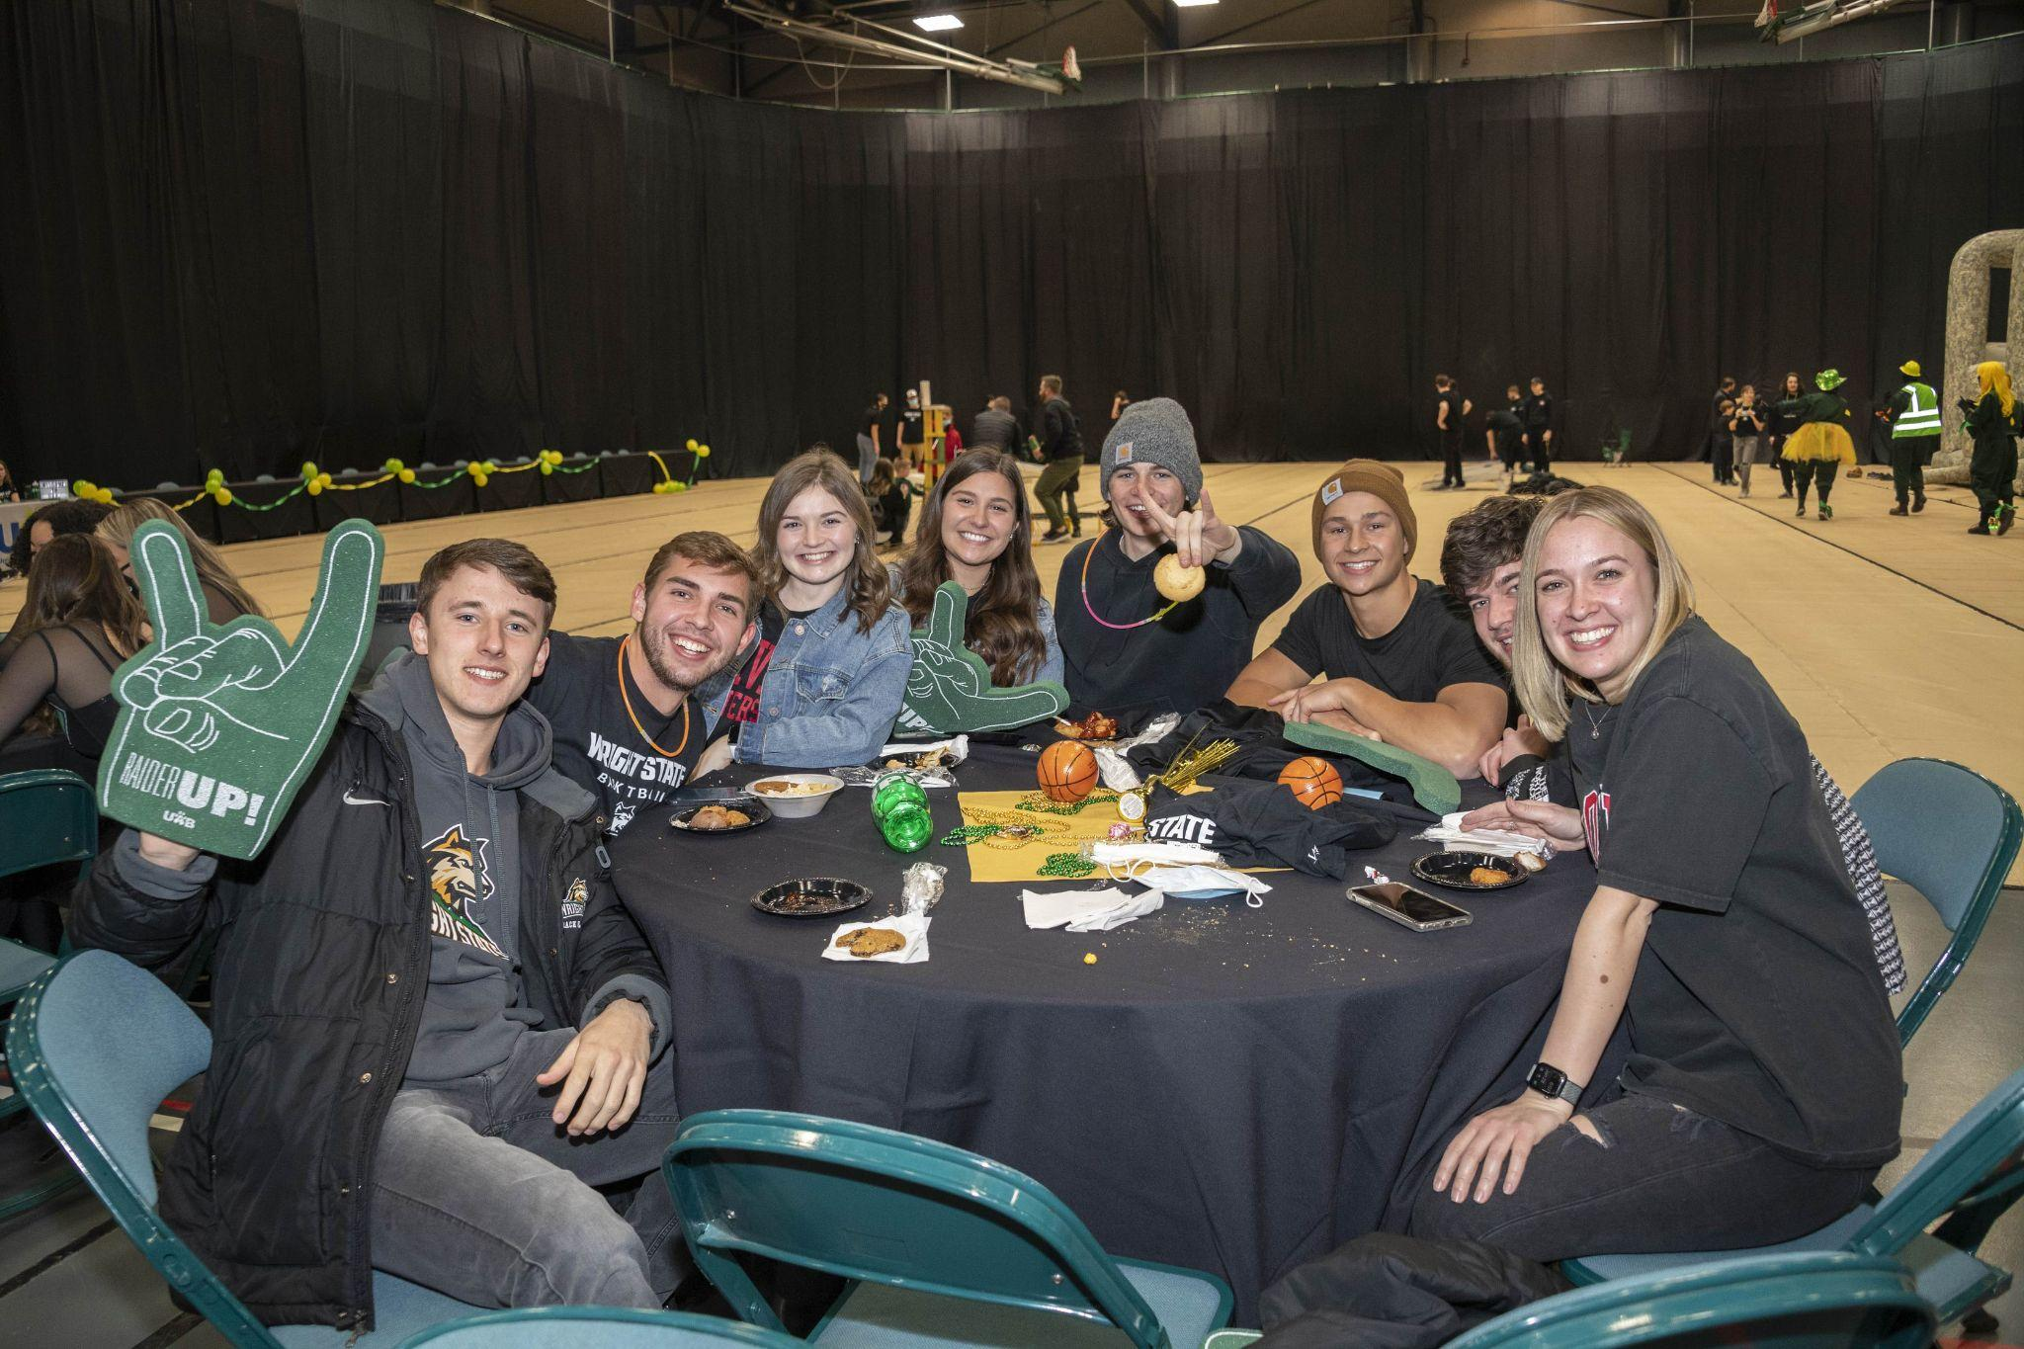
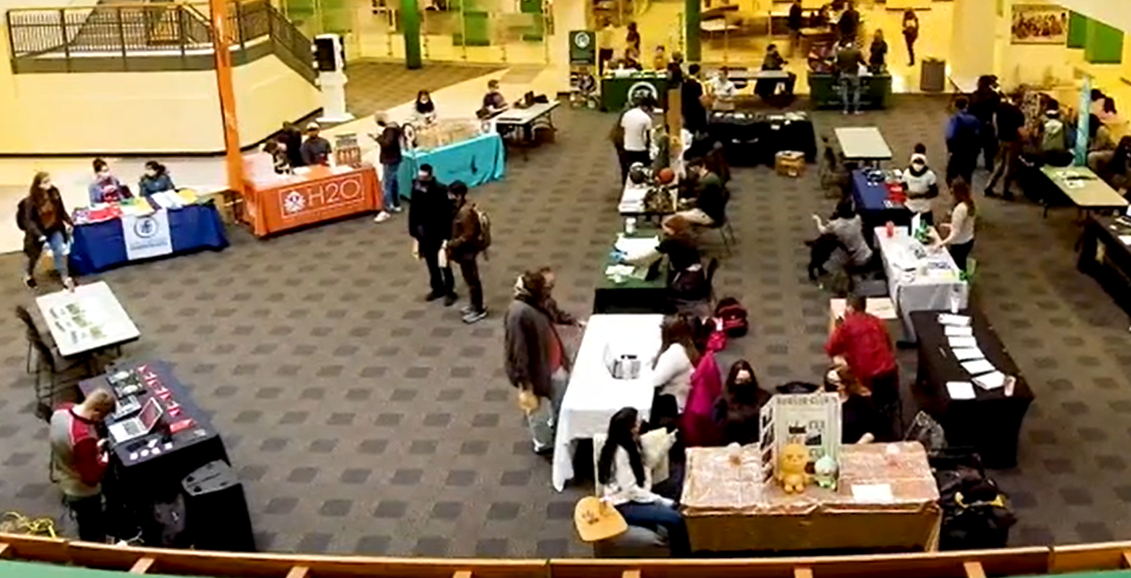
SGA/Campus Events
Romeo and Juliet Play
NPHC Plot Opening
Halloween Bash
Raider Roundup
SGA Involvement Fair
Raiderthon
April Craze

Slide 5
Student Life Survey
Collected Responses in February
Begun Working with Administration on Notable Findings:
  Interest in a sports bar type dining establishment
  Finding alternative ways to connect with and get information to students
  Interest in increased variety of events on campus - concerts, comedians, magicians, etc.
  Solutions to these findings will be pursued into the next academic year

Slide 6
Newly Passed Resolutions
Resolution 22-01: A Resolution Congratulating the Men’s Basketball Team
Resolution 22-02: A Resolution for Increasing Opportunities for Students with Disabilities
Resolution 22-03: A Resolution Regarding House Bill 616 and Florida House Bill 1557

Slide 7
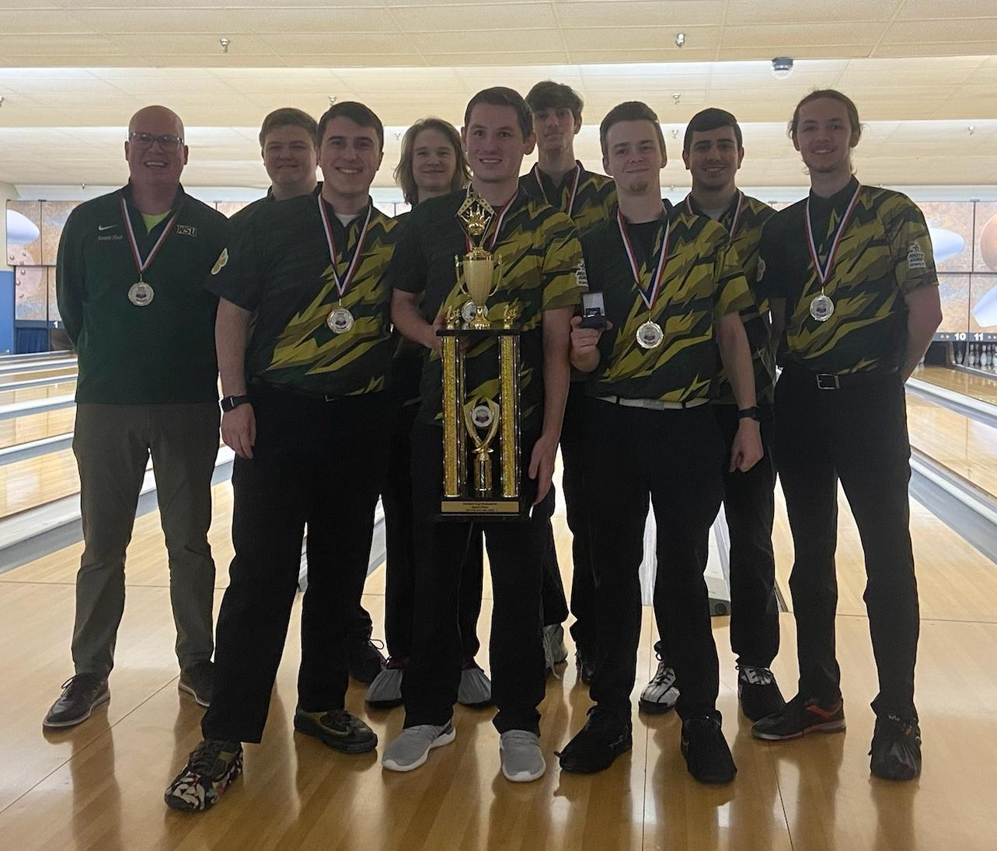
…and of course the bowling update!

Slide 8
Questions?

Slide 9

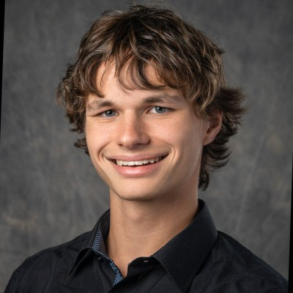
Next Year’s Administration
President: Blake Bailey
Vice President: Brandon Blair

