Slide 1


Creating a Culture of Inclusive Excellence

Slide 2

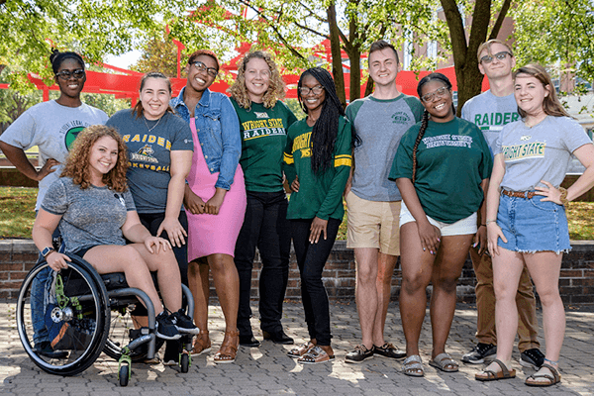
What is Inclusive Excellence?
We utilize a broad definition of diversity
Meld inclusiveness and academic excellence into one concept (to be excellent, we must be inclusive)
Shift responsibility for diversity, equity and inclusion to EVERYONE on campus, as opposed to one unit or department
Move away from only numerical goals
Focus on structural cultural transformation of our university into a community that embeds diversity, equity and inclusion throughout the institution

Slide 3
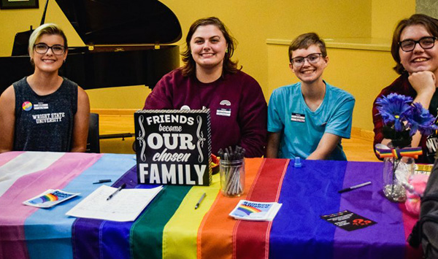
Division of Inclusive Excellence
The Division for Inclusive Excellence is the hub for diversity, equity and inclusion (DEI) work. Led by the Vice President for Inclusive Excellence, Dr. Matthew C. Chaney.

Slide 4
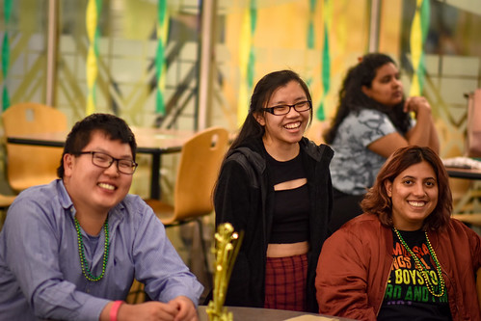
Office of the Vice President for Inclusive Excellence
Create a campus culture where everyone’s humanity is valued, respected, celebrated and appreciated.
Strategize new and innovative ways to recruit and retain a diverse student body
Strategize new and innovative ways to recruit and retain a diverse workforce
Lead the Culture and Identity Centers who educate, nurture and support our students and campus community in dynamic ways

Slide 5
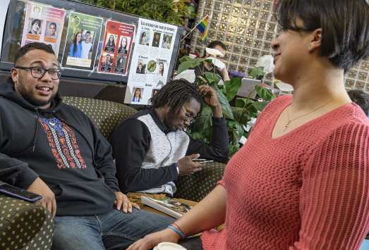
Culture & Identity Centers
Asian and Native American Center
Bolinga Black Cultural Resources Center
Latino Center
LGBTQA Center
Women’s Center

Slide 6
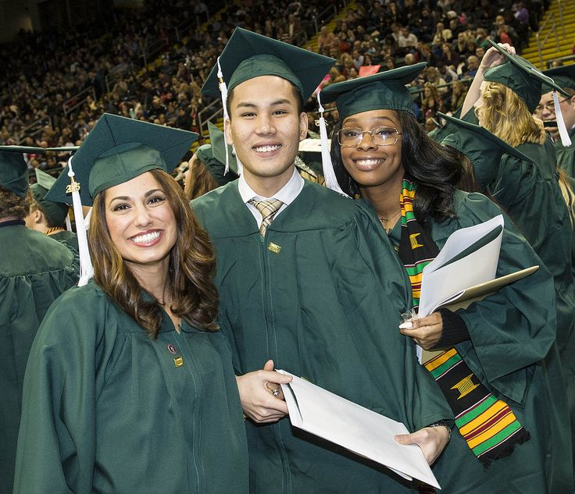
IE Accomplishments
Adopted Inclusive Excellence as the official diversity, equity and inclusion (DEI) strategy
Appointed Wright State’s first Vice President for Inclusive Excellence
Formed President's Council for Inclusive Excellence (PCIE)
Facilitated the Inclusive Excellence, Resilience, and the President’s Three R’s Human Resources professional development program for faculty and staff
Created a proposed Inclusive Excellence statement

Slide 7
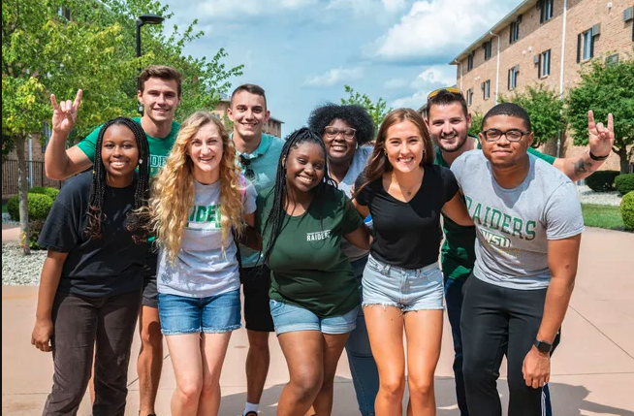
IE Goals
Campus Climate Survey
Campus-wide Diversity Report
Develop Wright State’s first Strategic Diversity Plan
Strategize new and innovative ways to collect DEI data

Slide 8

Questions

