Slide 1
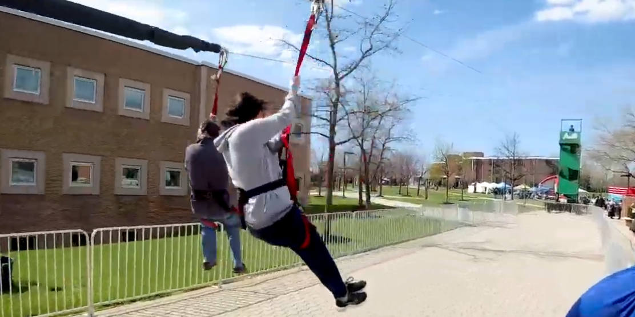
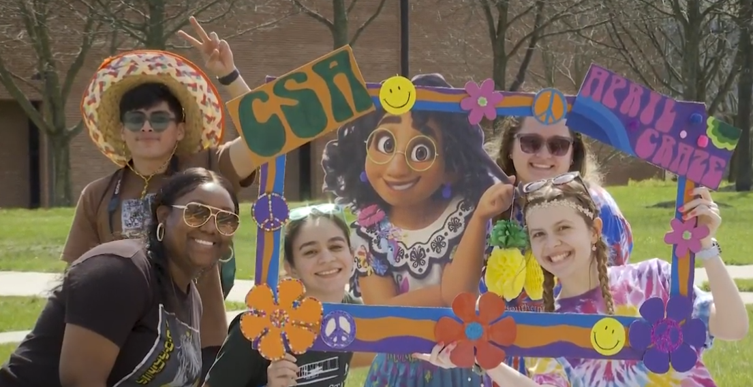
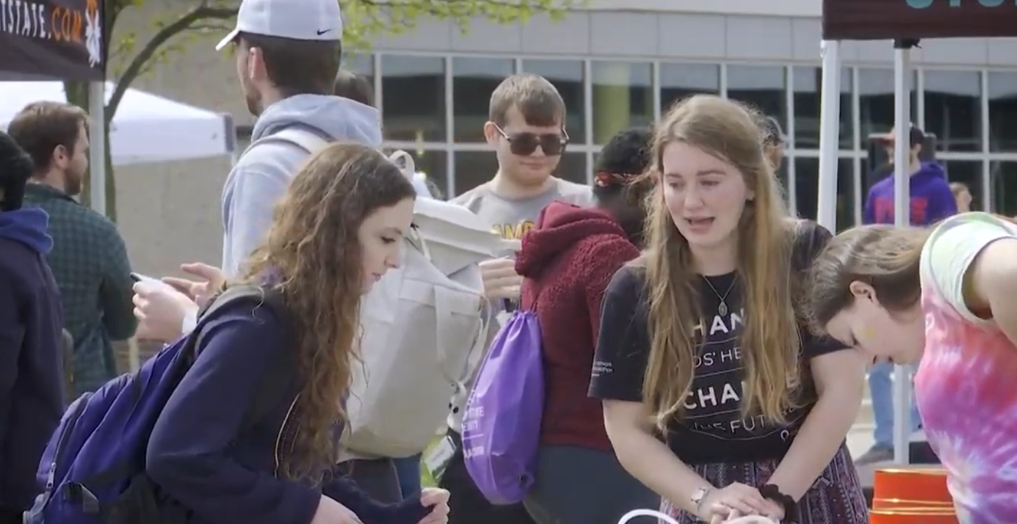
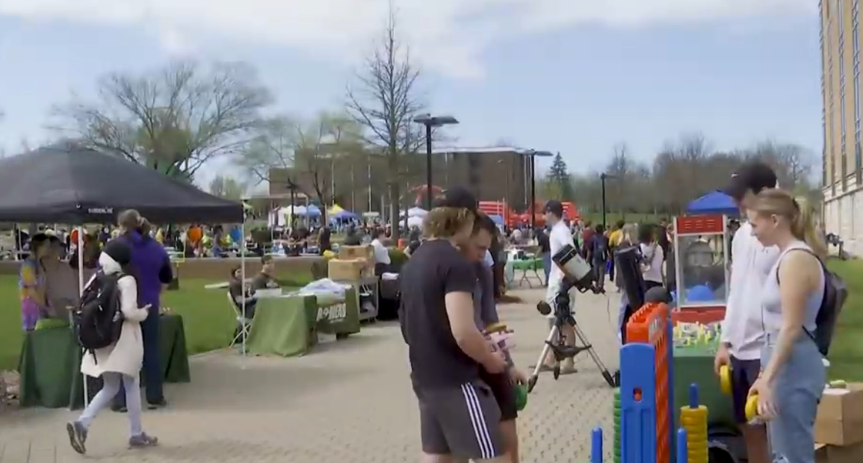
Division of Student Affairs

Slide 2
COVID Update
April 1 changes
  Campus masking policy changed to align with CDC community risk level
    Green (masking optional)
    Yellow (masking in classrooms and labs)
    Red (masking throughout campus)
  Halted mandatory surveillance testing
    Still distributing tests through a free vending machine

Slide 3
Student Involvement and Recreation
We are re-engaging our students
  2019-20 Event bookings = 11,837
  2020-21 Event bookings = 1,573
  2021-22 Event bookings = 7,396
Our 131 student organizations were involved in planning many of these
We will continue to re-engage our students this fall with an investment in programming and facilities and an effort to make planning events less cumbersome for student organizations.
We will also focus on enhancing inclusive programming in partnership with the Division of Inclusive Excellence
The Men’s bowling club won the club national championship last weekend.
Student Mitchell Foland was named the national club basketball player of the year.
Cheerleading & the Jazz Band traveled with the varsity men’s basketball team to the NCAA tournament.

Slide 4
Student Involvement and Recreation
Over 100 students attended one of the following outdoor adventures:
  Colorado Backpacking
  Appalachian Trail Hiking
  Rafting in the New River Gorge
  Snowshoeing in New Mexico
  Kayaking in Florida
  Backpacking in the Grand Canyon
  Ice climbing in Michigan
  Backpacking in the Red River Gorge

Slide 5
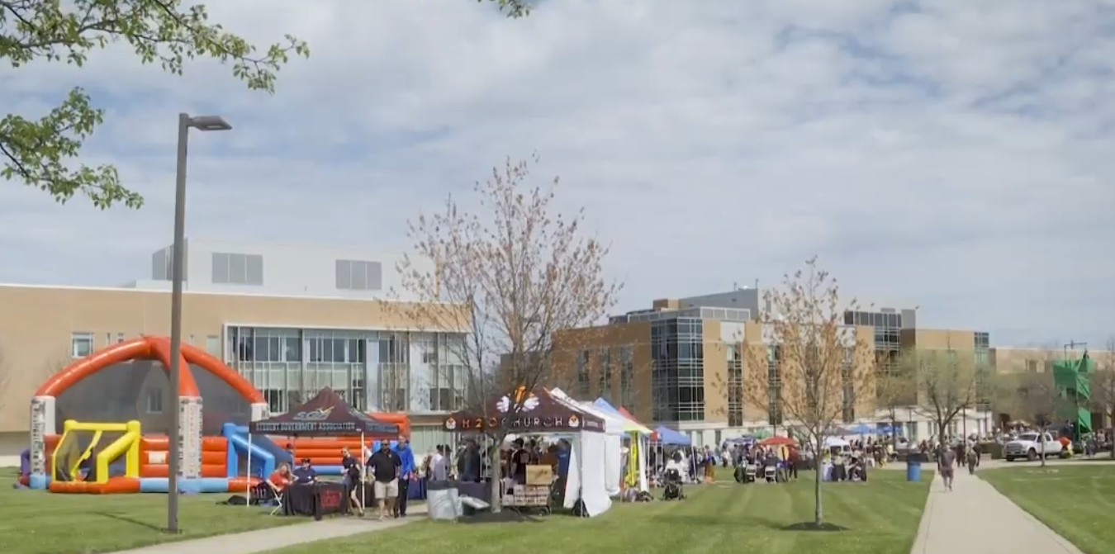

Slide 6
Housing and Residence Life
Return to Normal
  Approximately 70% of First Year class lives on campus (64% previous benchmark)
  Demand for 2021-22 up 14.8% (200 individuals), without a residency requirement. Almost half of increase were Internationals.
  Current demand for Fall 2022 exceeds Fall 2019
  Activities, Events and Residential Student Organizations prospered.
Crawford Hoying impact
  Facilities: paint, landscaping, lighting inside & out, fire alarm panels, street repairs, fitness trail, disc golf course
  New amenities in place & in plans: Honors lobby, dance studio, renovated College Park apartments, and clubhouse plans
  Rate reductions by 30% position campus to compete with off-campus.

Slide 7
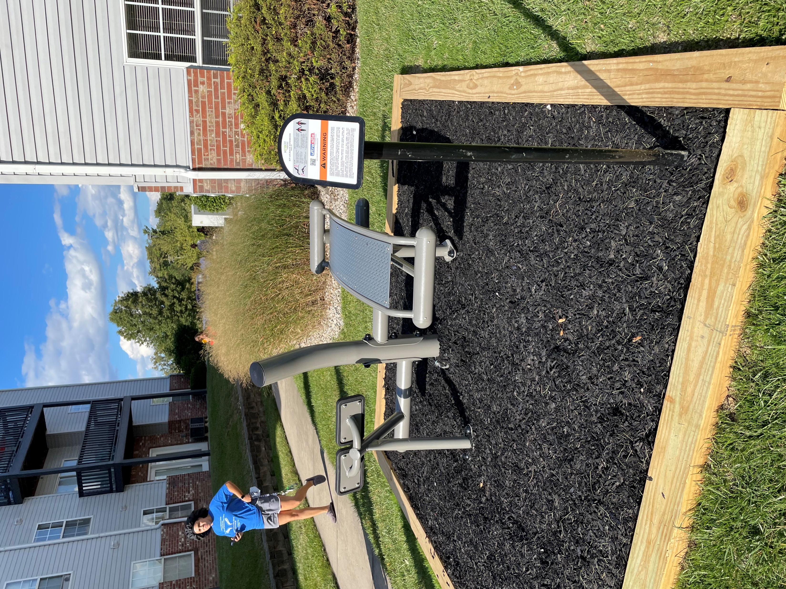
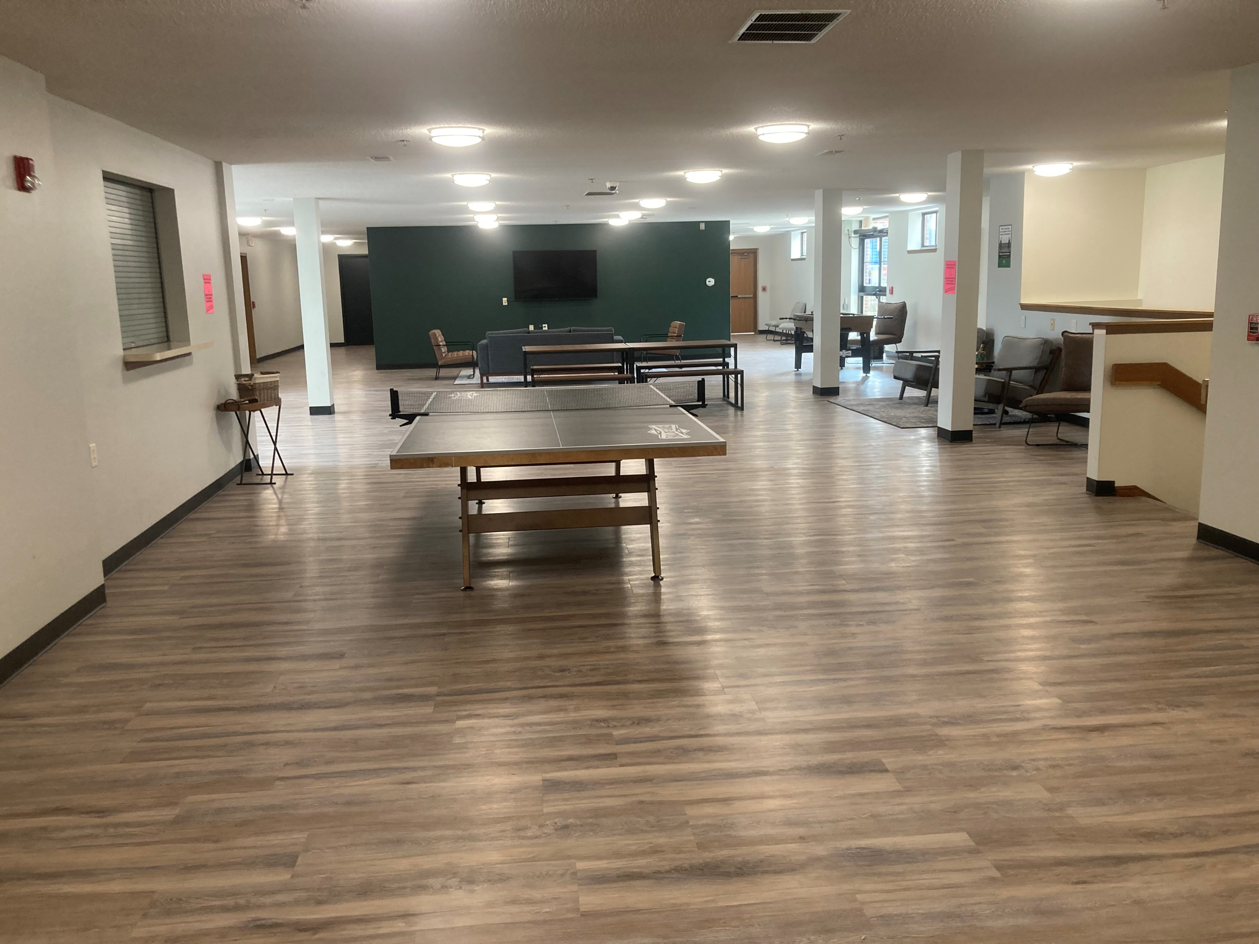
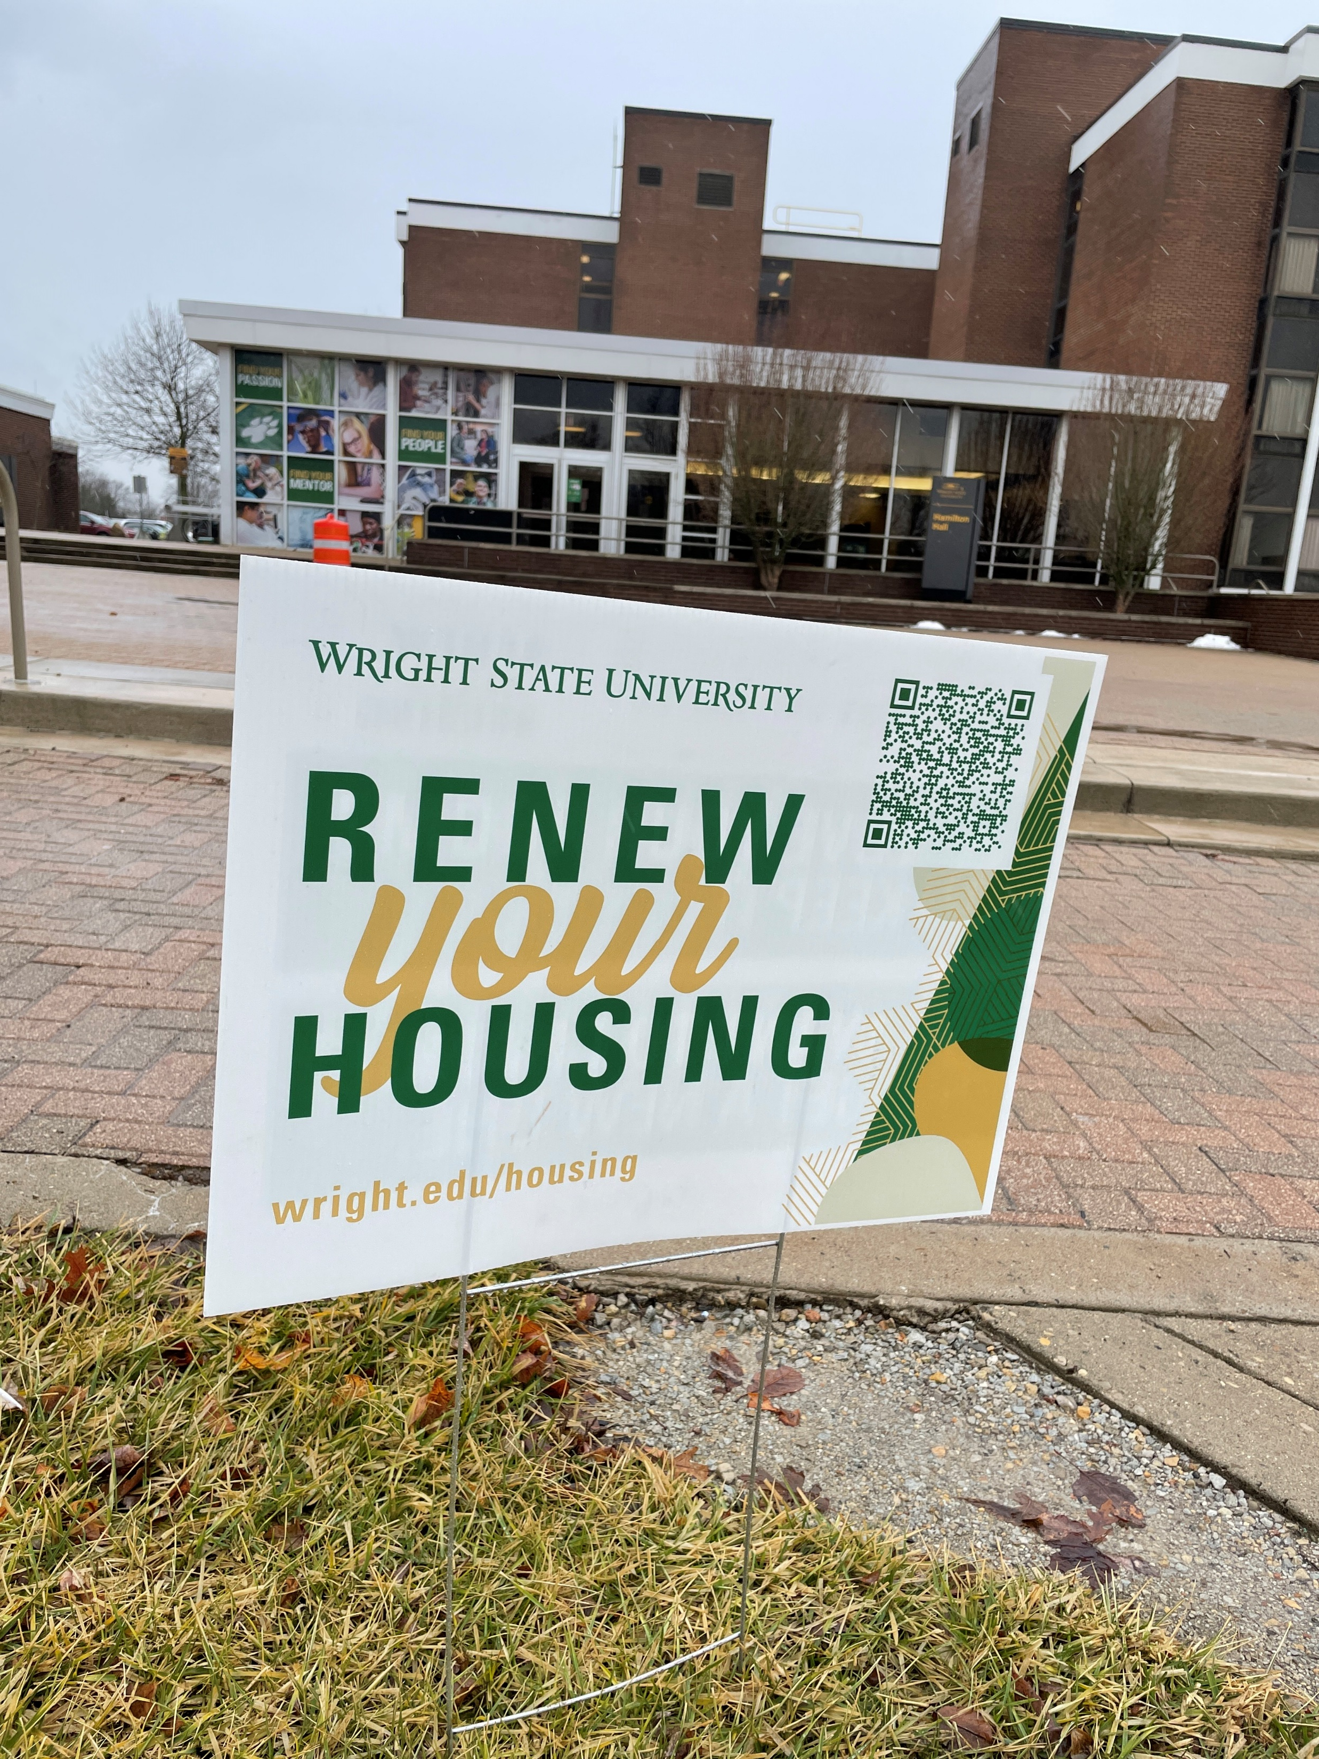
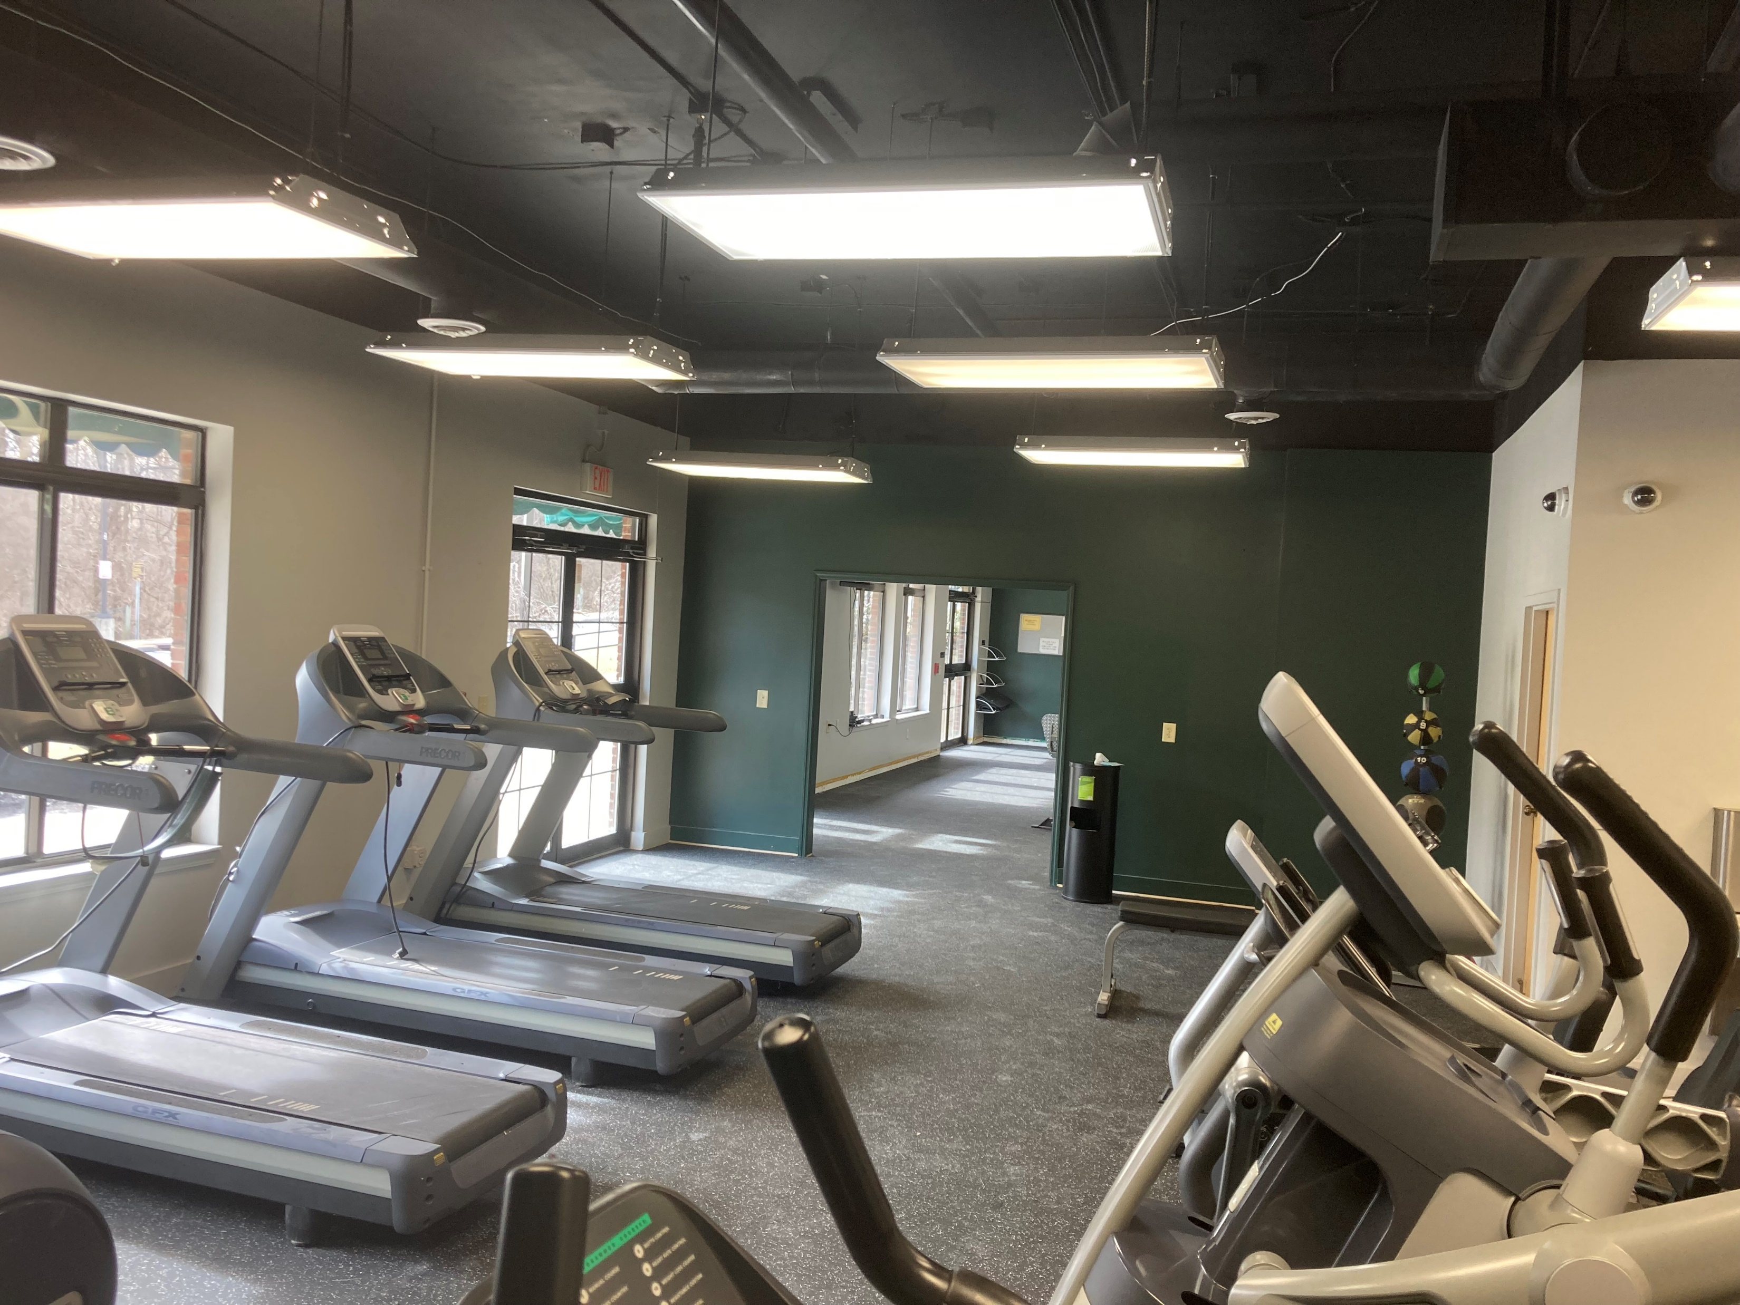
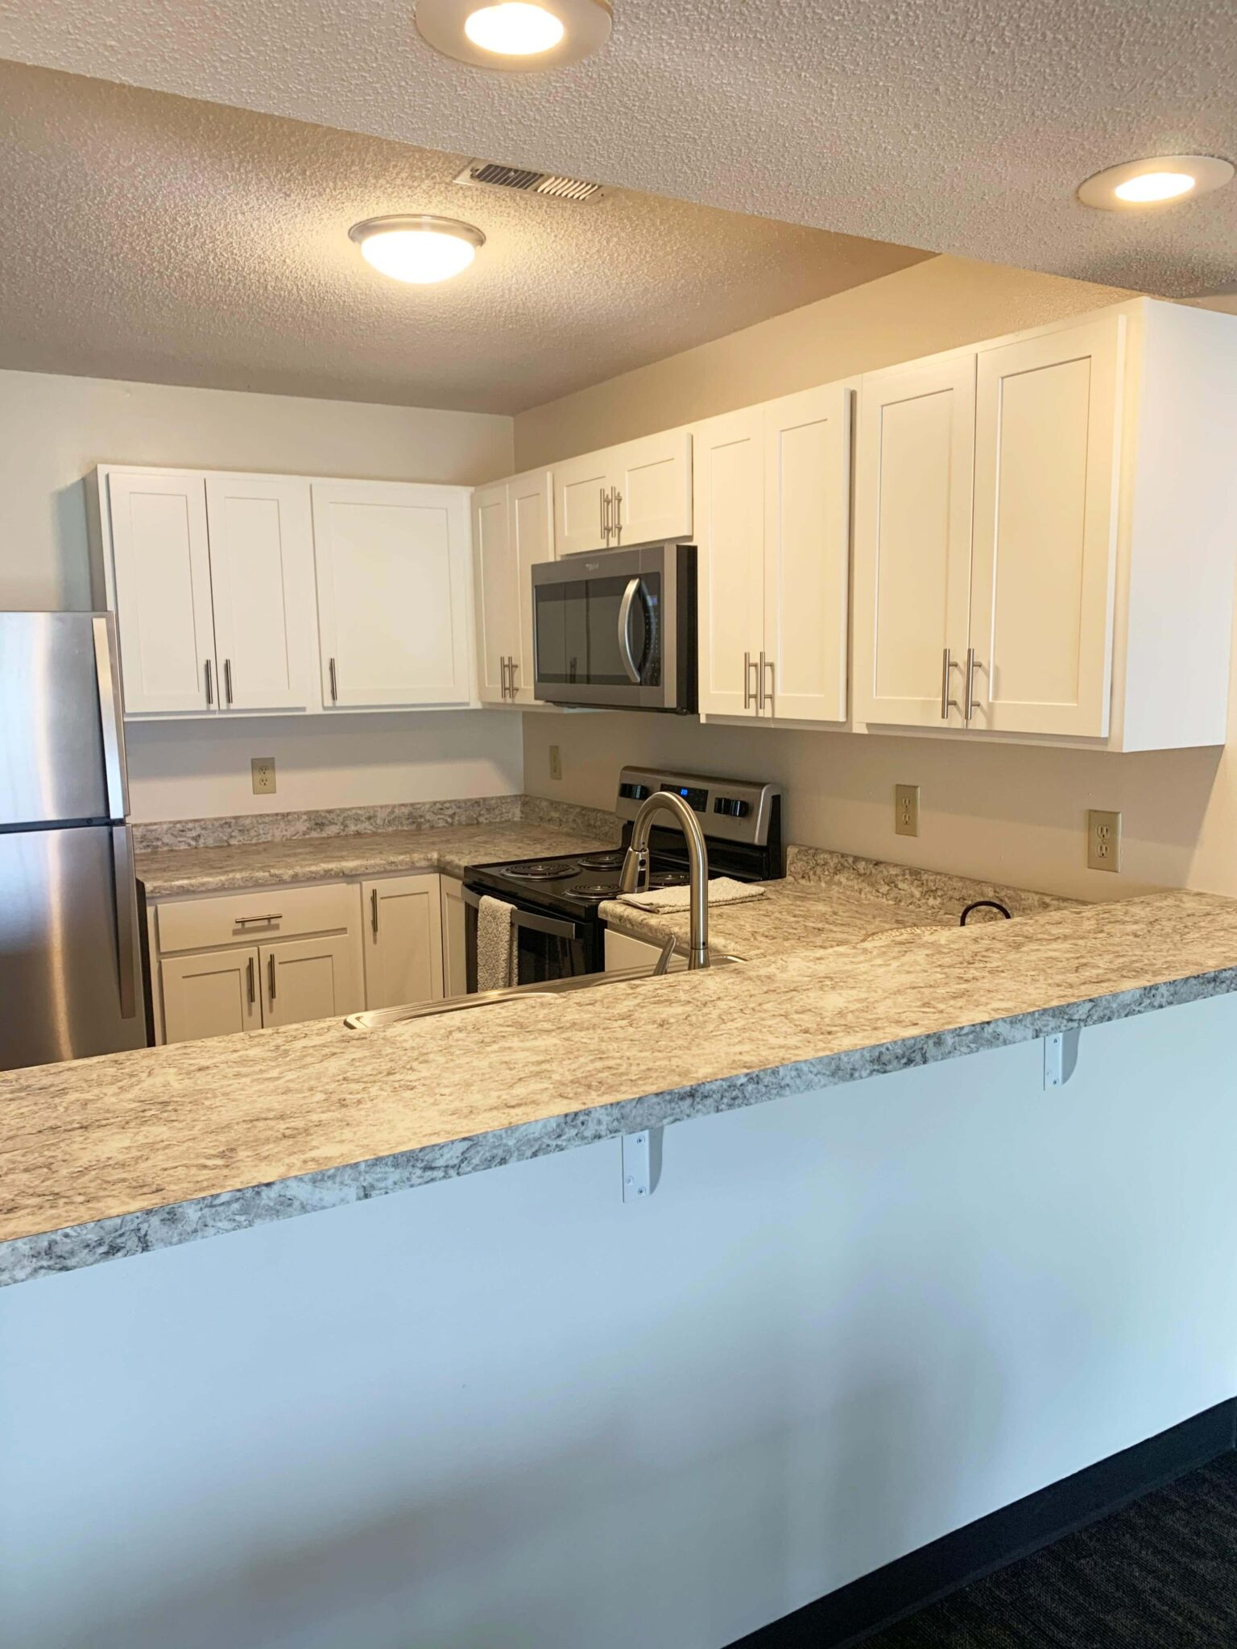

Slide 8
Student Mental Health
Student mental health needs have increased at Wright State and across the country, largely as a result of the pandemic
This need will continue even after the pandemic declines
Counseling and Wellness (CWS) experienced a 20% increase in the number of clients this year as compared to last year
65% of those clients completed therapy in 10 or fewer sessions
CWS clinical staff increased productivity by 21% as compared to the previous year
We partnered with the Psychiatry department at BSOM to offer psychiatric services to students and will continue to do so for the coming year

Slide 9
Student Conduct
Conduct incidents decreased severely during the pandemic
What we would consider normal student misconduct is returning as restrictions have been lifted.
The office collaborated with SGA to host a successful Academic Integrity Week
  Included tabling, passing out academic integrity guides, having students take an academic integrity pledge, and giveaways

Slide 10
Student Legal Services (SLS)
Over 20 years at Wright State providing low cost, quality legal representation to our students.
Recently renewed the contract with a fee increase from $11/semester to $16/semester
2021-22 YTD have assisted 437 unique clients as compared to 350 during the pandemic

Slide 11
Questions?

