Slide 1
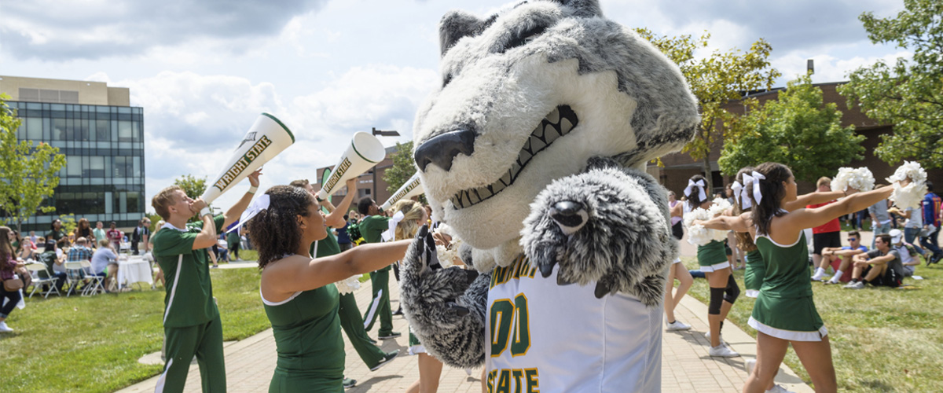
University Coordinating Retention Committee
Co-chairs:
  Tim Littell
  Assoc Vice Provost, Student Success
  Laura Luehrmann
  Professor & Chair, SoSIS
Notes:
Laura: start, and next slide
Tim: Data slide and last slide

Slide 2

Structure
Work To-date
Fall 2022
DFW Workshop
Retention Committee Kickoff
Keynote (Eboni Pringle, Kent State)
Spring 2023
Analysis of data
Identified “difficult courses”
Curricular Analytics
University Retention Coordinating Committee
COLA Retention Committee
COSM Retention Committee
CHEH Retention Committee
CECS Retention Committee
Lake Retention Committee
Notes:
Charged with improving retention and graduation rates, college retention committees and a university-wide coordinating committee comprised of nearly 70 faculty, staff, and administrators from both the Dayton and Lake campuses have been meeting since last November to devise success strategies and tactics informed by high-impact best practices shared through workshops and trainings held earlier in the Fall with experts on course completion and persistence.
Throughout this spring semester, the committees have been analyzing data including 5-year trend data on courses that have high failure rates. From these data, and what was learned in the workshops, committees are developing success plans that will impact course completion and ultimately persistence, retention, and degree-attainment.

Slide 3
DFW Rates
34 courses targeted across 21 academic prefixes among the 5 colleges
Source: Grade Distribution Dashboard, Institutional Research, PRELIMINARY DATA
Notes:
UNIVERSITY AND COLLEGE RETENTION COMMITTEES
With a number of data sets provided by IR, the college committees studied and analyzed 5-year trend data to identify 34 courses across 21 academic prefixes among the 5 colleges targeted for success planning. These courses range from 0-level courses to 4000-level courses with nearly half in the general education core curriculum. The average DFW rate for these courses is 28.7% (average overall is 17.2% for all courses – more than a 10 point difference) but in the most recent Fall semester that rate was 30%.
The data show that DFW rates are even higher for our Pell-eligible and underrepresented students.
Some of the success strategies are already underway others will be implemented over the coming months.
The targeted “difficult courses” serve as a hub for the varied tactics and approaches to improving course outcomes; whether it is increased tutoring or supplemental instruction, program re-sequencing, course redesign or the many other strategies we can consider. The work ahead will include curricular analytics where we can examine degree pathways and identify barriers or pinch points that can hinder a student’s time to degree.
Data Literacy Institute
Success plans will be finalized in the Fall semester, and working closely with the Center for Faculty Excellence and our newly appointed Student Success Fellow, the Coordinating Committee will help prioritize the resources and support necessary for implementing these plans. This will be the foundation for the next Campus Completion Plan which will be due to the state next year at this time.
The primary goal is to improve course completion, which in turn will impact the student’s ability to persist and be retained – and, ultimately, earn their degree.

Slide 4
Timeline
Analyze the problem
Spring Semester 2023
Set specific goals & Develop a strategy
BY OCTOBER 15, 2023: Finalize action plans to include strategies and high-impact practices
Implement the strategy
BEGIN FALL 2023 AND SPRING 2024
Evaluate the results
BY JULY 1, 2024: Assess
Revise goals
OCTOBER 15, 2024: Review and revise
Communicate results
Beginning APRIL 2024 and ongoing
Multi-faceted & Long-term Plan
Notes:
Success plans will be finalized in the Fall semester, and working closely with the Center for Faculty Excellence and our newly appointed Student Success Fellow, the Coordinating Committee will help facilitate the resources and support for implementing these plans. This will be the foundation for the next Campus Completion Plan which will be due to the state next year at this time.
This is a long-term, multi-faceted plan.
The primary goal is to improve course completion, which in turn will impact the student’s ability to persist and be retained – and, ultimately, earn their degree.
What questions do you have?

