Slide 1

Levels of Course Quality
There are many different levels of quality when reviewing online and blended learning courses.
QUALITY COURSES
QUALITY COURSES
Floor #4: Highest-Level Quality Courses
Floor #3: Higher-Level Quality Courses
Floor #2: High-Level Quality Courses
Floor #1: Entry-Level Quality Courses
Notes:
Levels of Course Quality
There are many different levels of quality when reviewing online and blended learning courses.
Floor #4: Highest-Level Quality Courses
Floor #3: Higher-Level Quality Courses
Floor #2: High-Level Quality Courses
Floor #1: Entry-Level Quality Courses

Slide 2


Floor #1: Entry-Level Quality Courses
What standards do we use to determine which courses make it through the door to Floor #1: Entry-Level Quality Courses?
Notes:
Floor #1: Entry-Level Quality Courses
What standards do we use to determine which courses make it through the door to Floor #1: Entry-Level Quality Courses?

Slide 3

Quality Matters
QM is an international organization that has developed a widely respected rubric of course design standards.
Notes:
Quality Matters
QM is an international organization that has developed a widely respected rubric of course design standards.

Slide 4

How Many?
Any guesses at how many classes at Wright State have made it through the quality front door to at least the first floor?
Notes:
How Many?
Any guesses at how many classes at Wright State have made it through the quality front door to at least the first floor?

Slide 5
How Many? = None
At this point, Wright State has no courses that have been judged to meet entry-level quality standards.
0
Notes:
How Many? = None
At this point, Wright State has no courses that have been judged to meet entry-level quality standards.

Slide 6

CHEH LDR OL: Knocking on the Door
The first course at Wright State that is going through the QM Peer Review process is CHEH LDR Organizational Leadership.
CHEH LDR
Organizational Leadership
Notes:
CHEH LDR OL: Knocking on the Door
The first course at Wright State that is going through the QM Peer Review process is CHEH LDR Organizational Leadership.

Slide 7

Quality Matters Overview
QM has over 1,500 college and university members that use QM for PD, Peer Review, and Quality Standards.
Notes:
Quality Matters Overview
QM has over 1,500 college and university members that use QM for PD, Peer Review, and Quality Standards.

Slide 8
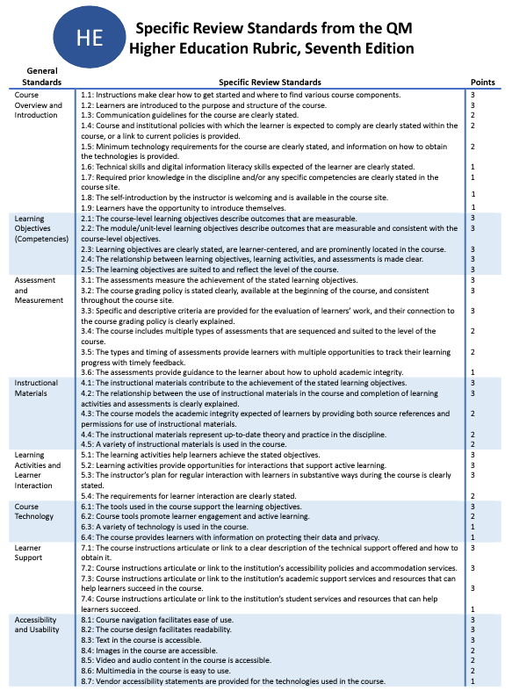
QM Rubric Standards
The QM Rubric includes eight general standards and 44 specific review standards that require alignment with LO.
ALIGNMENT
1. Course Overview and Introduction
2. Learning Objectives (Competencies)
3. Assessment and Measurement
4. Instructional Materials
5. Learning activities and learner interaction
6. Course Technology
7. Learner Support
8. Accessibility and Usability
Notes:
QM Rubric Standards
The QM Rubric includes eight general standards and 44 specific review standards that require alignment with LO.
Quality Matters requires alignment between Learning Objectives (Course LO 2.1, Module LO 2.2) and assessments (3.1), instructional materials (4.1), learning activities (5.1), and course technologies (6.1).

Slide 9

Quality Matters ID Principles
The Quality Matters rubric is based on effective instructional design principles important for F2F and Online classes.
Face-to-Face Class
Online
Notes:
Quality Matters ID Principles
The Quality Matters rubric is based on effective instructional design principles important for F2F and Online classes.

Slide 10

QM → Faculty Choice
It is faculty choice if they wish to utilize Quality Matters and to what degree they wish to implement it.
Personal Certifications
I want to earn some personal certifications such as becoming a Peer Reviewer, Master Reviewer, APPQMR Facilitator, QM Coach, etc.
“Unofficial” Peer Review
Can I have an Internal review that gives me suggestions that I can use to improve my course?
“Official” QM
Course Certification
I want public validation of the quality of my course.
Professional Development
I want to learn more about using effective instructional design principles to continually improve my courses.
“Official” QM
Program Certification
I want public validation of the quality of our program.
Nothing.
I am good.
Notes:
QM → Faculty Choice
It is faculty choice if they wish to utilize Quality Matters and to what degree they wish to implement it. Some of the Quality Matters options faculty may think about implementing in the future could be:
Nothing! Thank you.
Professional Development: I want to learn more about using effective instructional design principles to continually improve my courses.
Personal Certifications: I want to earn some personal certifications such as becoming a Peer Reviewer, Master Reviewer, APPQMR Facilitator, QM Coach, etc.
“Unofficial” Peer Review: Can I have an Internal review that gives me suggestions that I can use to improve my course?
“Official” QM Course Certification: I want public validation of the quality of my course.
“Official” QM Program Certification: I want public validation of the quality of our program.

Slide 11

QM Ohio Consortium
The Ohio QM Consortium is the largest QM Consortium in the world and offers Ohio members substantial advantages.
Discounted costs for QM certification roles (Peer Reviewer)
Bartering System for
Peer Reviews
Allows us to conduct APPQMR workshops
Notes:
QM Ohio Consortium
The Ohio QM Consortium is the largest QM Consortium in the world and offers Ohio members substantial advantages.
Discounted costs for QM certification roles (Peer Reviewer)
Bartering System for Peer Reviews
Allows us to conduct APPQMR workshops
Annual free Ohio QM conference
Opportunities for faculty/staff conference presentations

Slide 12

QM Ohio Annual Conference (May 10, 2024)
The Ohio QM Consortium’s annual conference is held on Friday, May 10, 2024, at Ohio Dominican University
Free for members
Members are permitted to submit a proposal for presenting
Great opportunity for networking
Ohio Conference
Friday, May 10, 2024
Ohio Dominican University
Great opportunity for collaboration
Notes:
QM Ohio Annual Conference (May 10, 2024)
The Ohio QM Consortium’s annual conference is held on Friday, May 10, 2024, at Ohio Dominican University

Slide 13

APPQMR PD Workshop
QM’s flagship workshop to learn the underlying principles of the QM Rubric and critical elements of the review process.
One-day workshop
Good for faculty, staff, and administrators involved in course development.
Prerequisite for Peer reviewer certification.
Professional development to learn more about instructional design principles
Quality Matters: APPQMR Workshop
Recommended for those wishing to have courses reviewed
Normally, the cost of the APPQMR workshop is $330.00 and $30 cost for the workbook.
The Provost’s office covers the cost of both, so there is no charge for Wright State employees.
Notes:
APPQMR PD Workshop
Workshop to learn the underlying principles behind the QM Rubric and the critical elements of the review process.
One-day workshop
Good for faculty, staff, and administrators involved in course development.
Prerequisite for Peer reviewer certification.
Professional development to learn more about instructional design principles
Recommended for those wishing to have courses reviewed

Slide 14

Completion of QM APPQMR Workshop
The completion of the QM APPQMR workshop provides respected PD credential to accrediting organizations.
Notes:
Completion of QM APPQMR Workshop
The completion of the QM APPQMR workshop provides respected PD credential to accrediting organizations.

Slide 15
QM APPQMR Sessions Scheduled
Please encourage your colleagues to attend a Quality Matters APPQMR workshop (Virtual or In-Person).
Wednesday, November 22, 2023,
8:30 am to 4:30 pm, Virtual WebEx
Tuesday, December 12, 2023,
8:30 am to 4:30 pm, Virtual WebEx
Thursday, December 14, 2023,
8:30 am to 4:30 pm, Millet Hall 403
Thursday, January 4, 2024,
8:30 am to 4:30 pm, Virtual WebEx
Notes:
QM APPQMR Sessions Scheduled
Please encourage your colleagues to attend a Quality Matters APPQMR workshop (Virtual or In-Person).
Wednesday, November 22, 2023,
8:30 am to 4:30 pm, Virtual WebEx
Tuesday, December 12, 2023,
8:30 am to 4:30 pm, Virtual WebEx
Thursday, December 14, 2023,
8:30 am to 4:30 pm, Millet Hall 403
Thursday, January 4, 2024,
8:30 am to 4:30 pm, Virtual WebEx

Slide 16


Attend and Participate
You need to attend 100% of the APPQMR workshop AND participate in all activities to complete workshop.
Certificate of completion
Digital Badge
(LinkedIn, Facebook, etc.)
Notes:
Attend and Participate
You need to attend 100% of the APPQMR workshop AND participate in all activities to complete the workshop. Upon completion of the APPQMR workshop, participants get a certificate of completion and a Digital Badge for addition to digital sites such as LinkedIn. Since Quality Matters is an internationally recognized and respected organization, the certificate of completion has meaning to other organizations.

Slide 17

Questions/Comments

