Slide 1

HLC Focused Visit: Update and Report

Slide 2
Many Thanks!
Thank you to everyone who has risen with our challenges in preparing for our focused visit!
Faculty
Staff
Committees
Department Chairs & Program Directors
Fellow Administrators

Slide 3

Everyone’s commitment and willingness to pitch in has kept us on track and on schedule.
Committee meetings (UCC & GCC)
Other meetings (Teams, phone, email, cell, text)
Professional development
Webinars

Slide 4

It Takes a Team
Initially, we were given only 154 days to complete 2.25 years of work*
You’ve all been incredibly supportive, and I couldn’t be more grateful to you!
(*not previously completed)

Slide 5

We’re Almost There
The HLC visit has been rescheduled for April 24th & 25th, 2023.
We will have a first draft of the Focused Visit Report out for everyone to review by the first week of Feb.

Slide 6
What to Expect in the Report
We have made progress and can report a great deal of momentum.
However, a focused visit report is not like a standard assurance argument.
Every focused argument must be based on evidence, or proof that we have done what we say we did.
To be honest, our puzzle still has some missing pieces.
We must be transparent about where evidence doesn’t exist or where we haven’t closed certain loops.

Slide 7

Our Report Must
Accurately describe our challenges.
Explain what we’re doing to address our challenges.
Describe what we’ll do going forward to restore our institution to full compliance.
We must be
Factual
Transparent
Truthful
Disclosure: We’re investigating the purchase of technological platforms that will expand and empower the Watermark products we already use.

Slide 8
What to expect for our focused visit
HLC will meet with:
Students
Board of Trustees
Faculty
Faculty Senate
The Core Oversight Committee
Administration
Institutional Research
Lake Campus
Registrar’s Office
Others (TBD)
HLC will ask specific questions regarding criteria 4B and 5C.
HLC also operates by the philosophy, “see something, say something.”
And if they see something they will ask questions.

Slide 9
February, 2023
The report will be posted for public review and comment (please participate!).
We will schedule listening sessions regarding the report and we look forward to your participation.
Our final report must be submitted to HLC by February 27th, 2023, no later than 12:00pm, noon.

Slide 10
By February 27th, 2023
Our Assessment & Accreditation website will be completed for the focused visit.
Our documentation and evidence will be publicly available—and available to HLC.
Our final focused visit report will also be posted.

Slide 11
After the focused visit
Depending upon HLC’s determinations about how we go forward.
We must perform as HLC prescribes.
Of course, we need to collaborate in redesigning our campus-wide assessment efforts and systems in preparation for our reaffirmation visit in August of 2026.

Slide 12
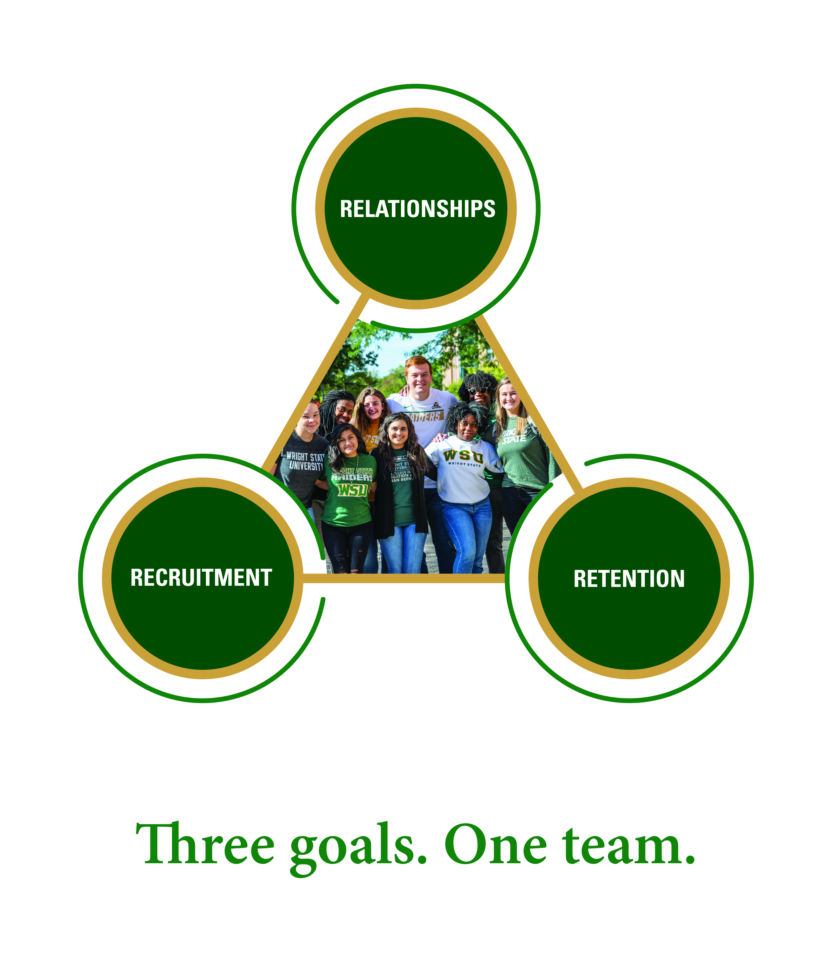
I’m very optimistic!
“If it weren’t for dreams we’d still be on the ground!”
The collaborations we’ve already experienced, the rapport we’ve already established, and everything we’ve learned…

Slide 13


