Slide 1
Academic Affairs Website
Presentation to the Faculty Senate
February 13, 2023

Slide 2
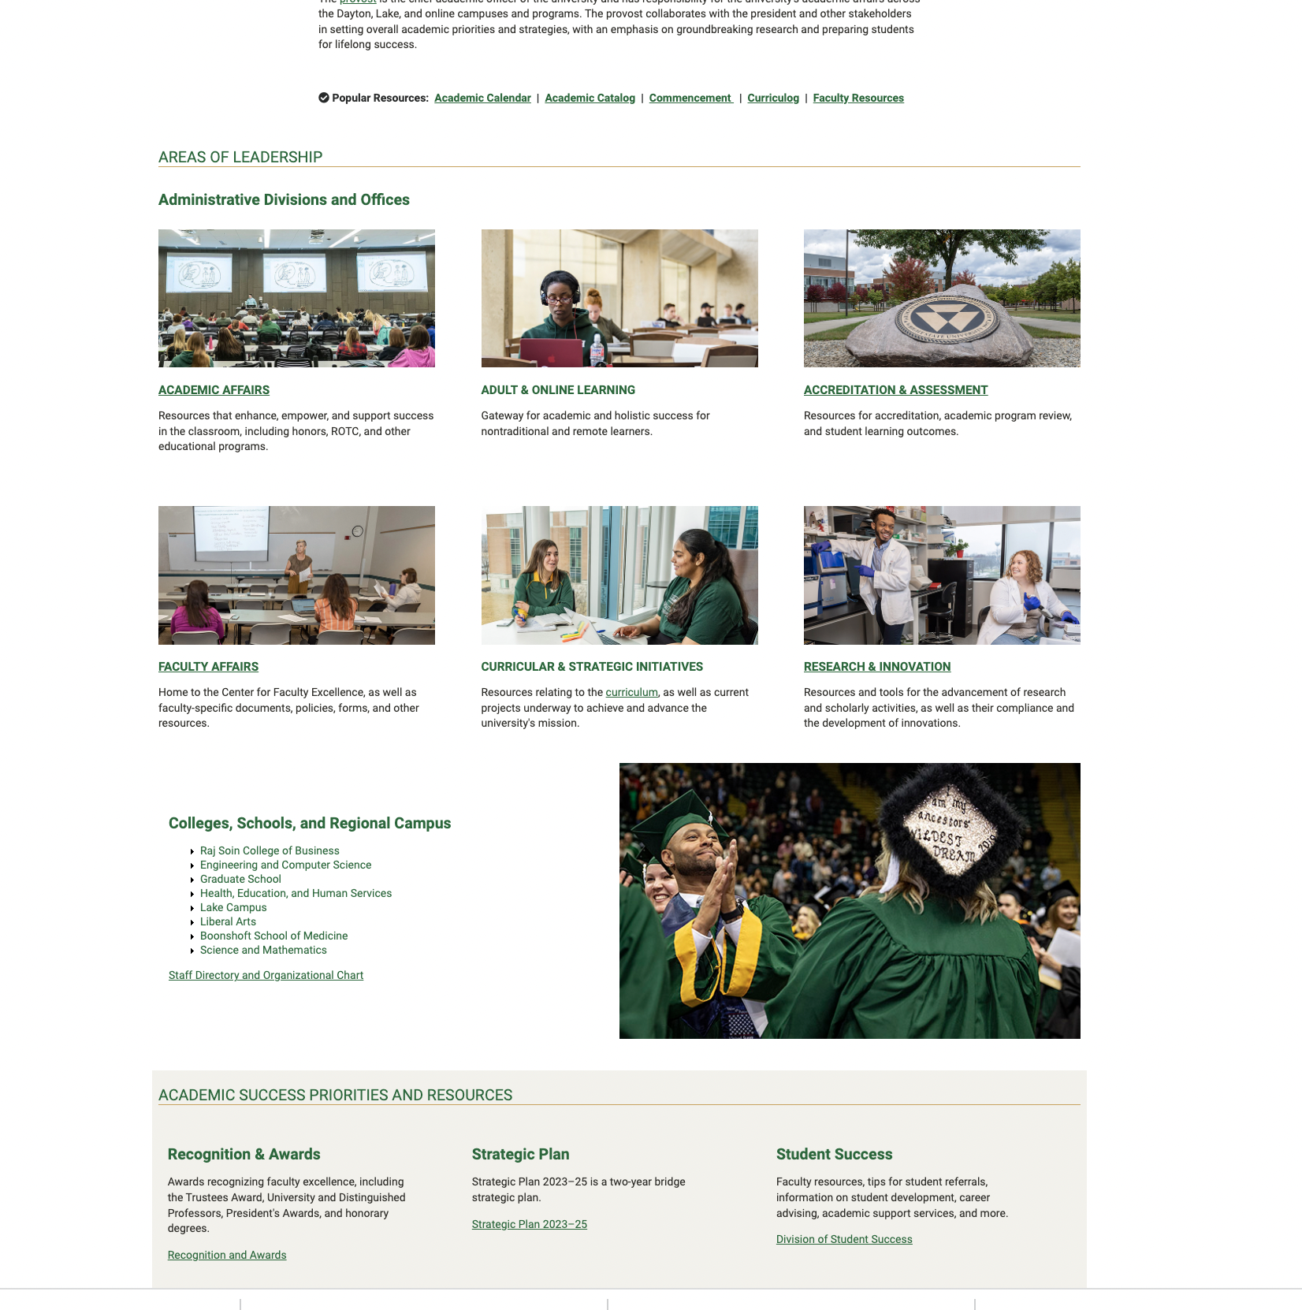
Office of the Provost

Slide 3
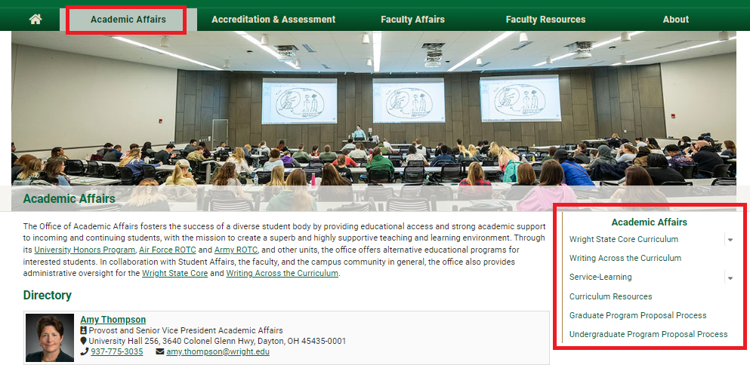
Academic Affairs

Slide 4
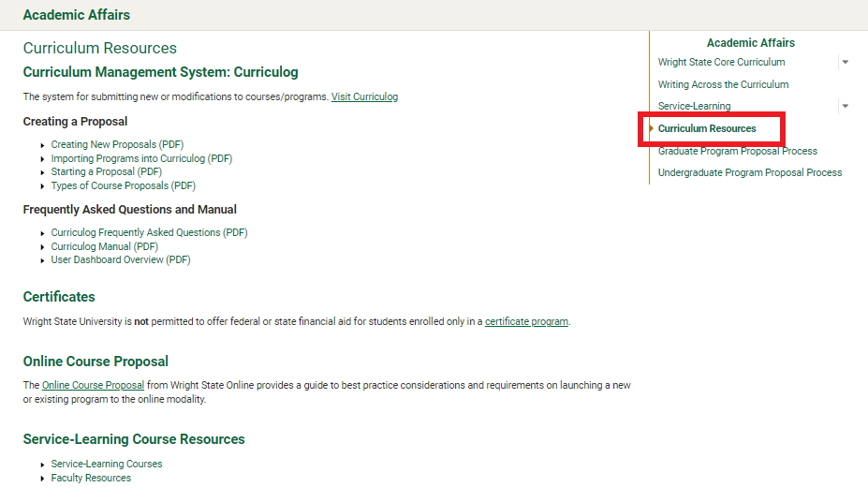
Curriculum Resources

Slide 5
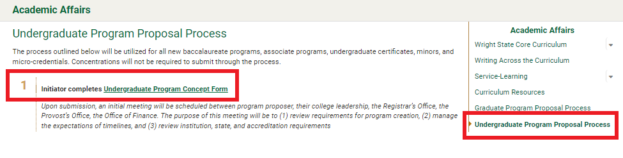
Program Proposal Process

Slide 6
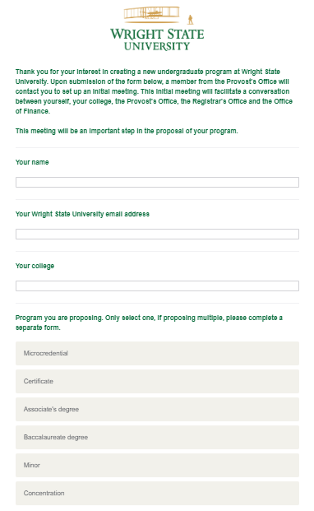
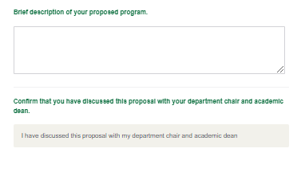
Program Proposal Process

Slide 7
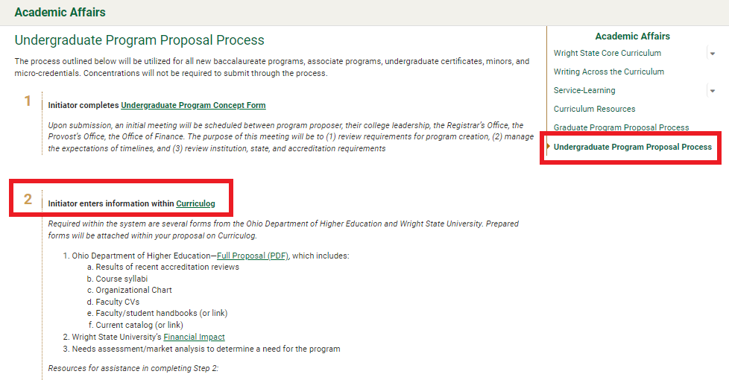
Program Proposal Process

Slide 8
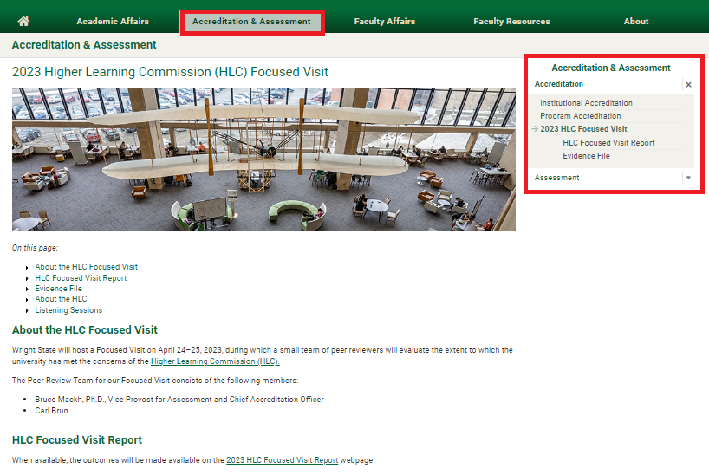
HLC Website

Slide 9
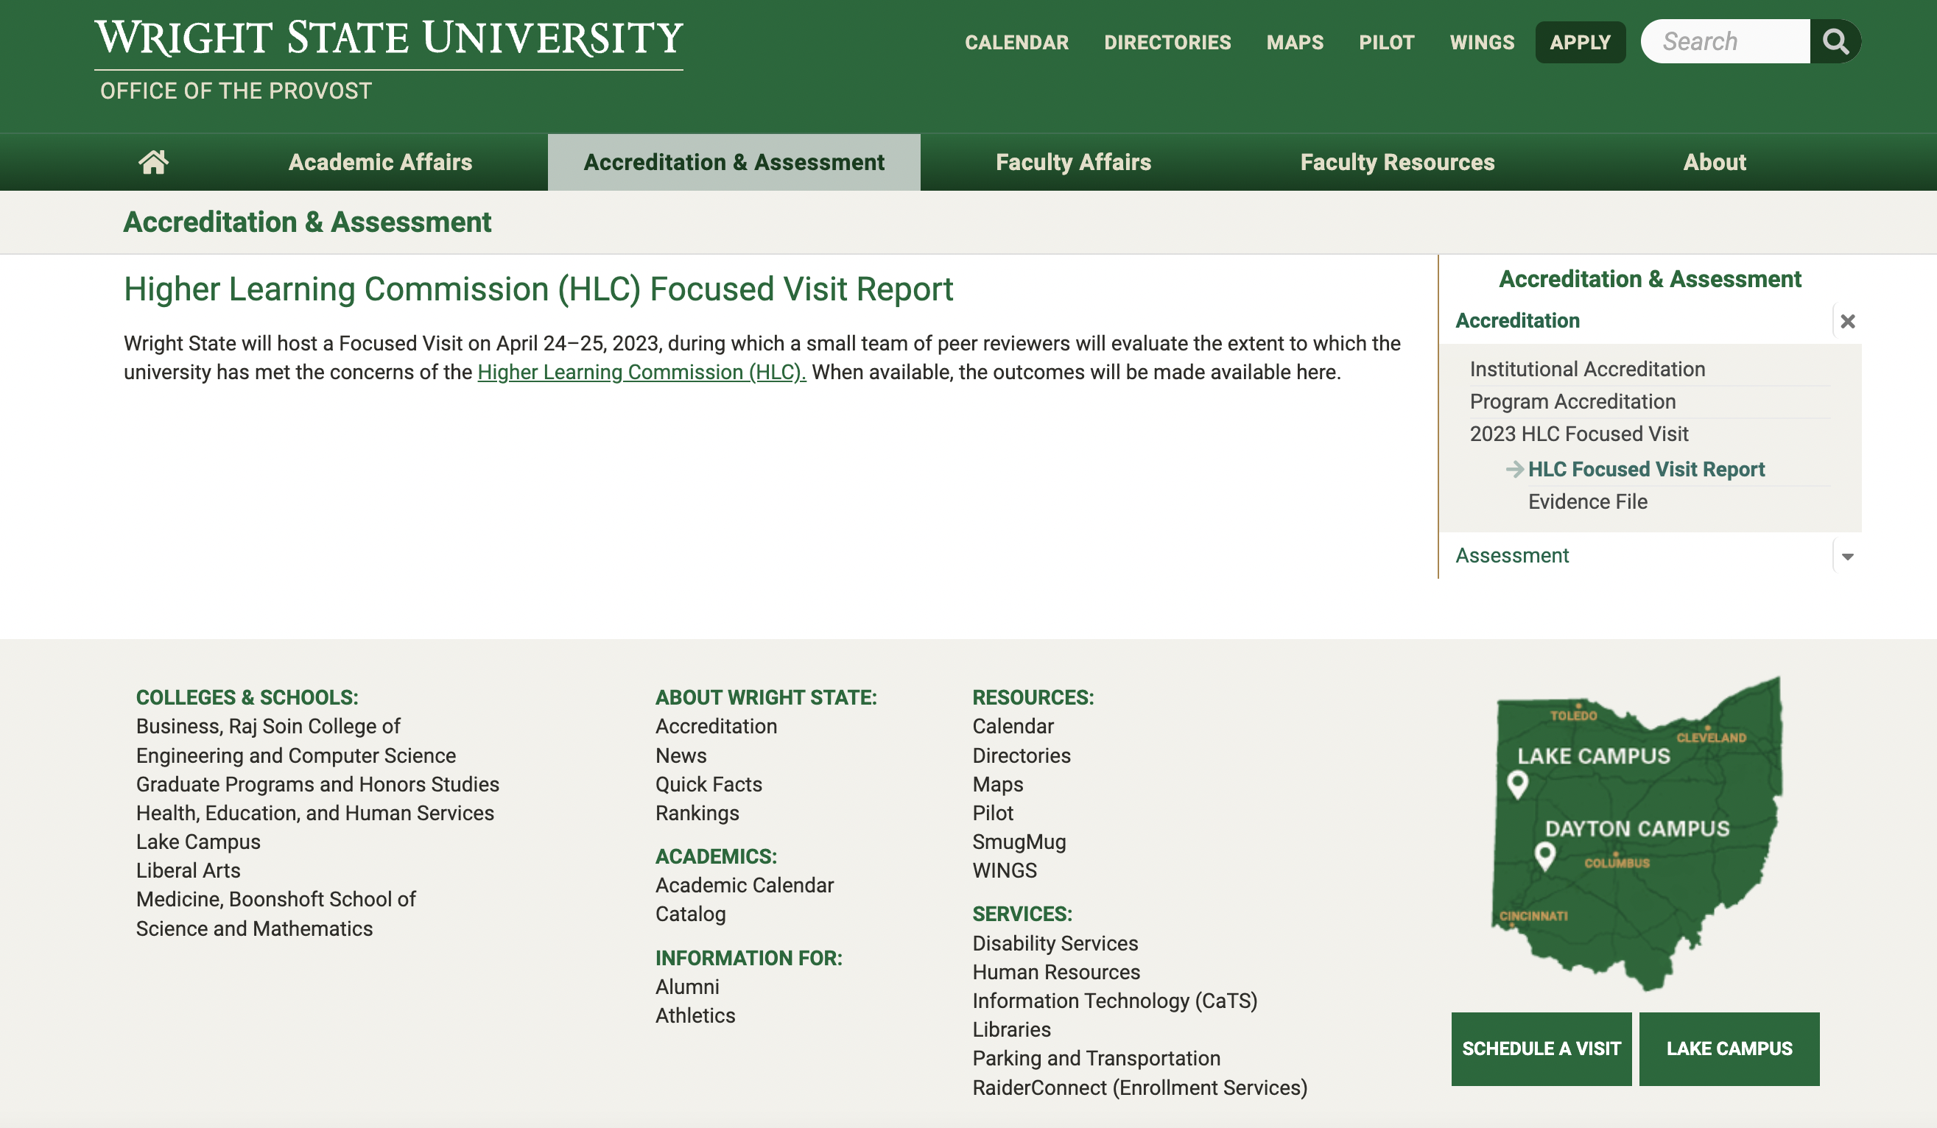
2023 HLC Focused Visit Report

Slide 10
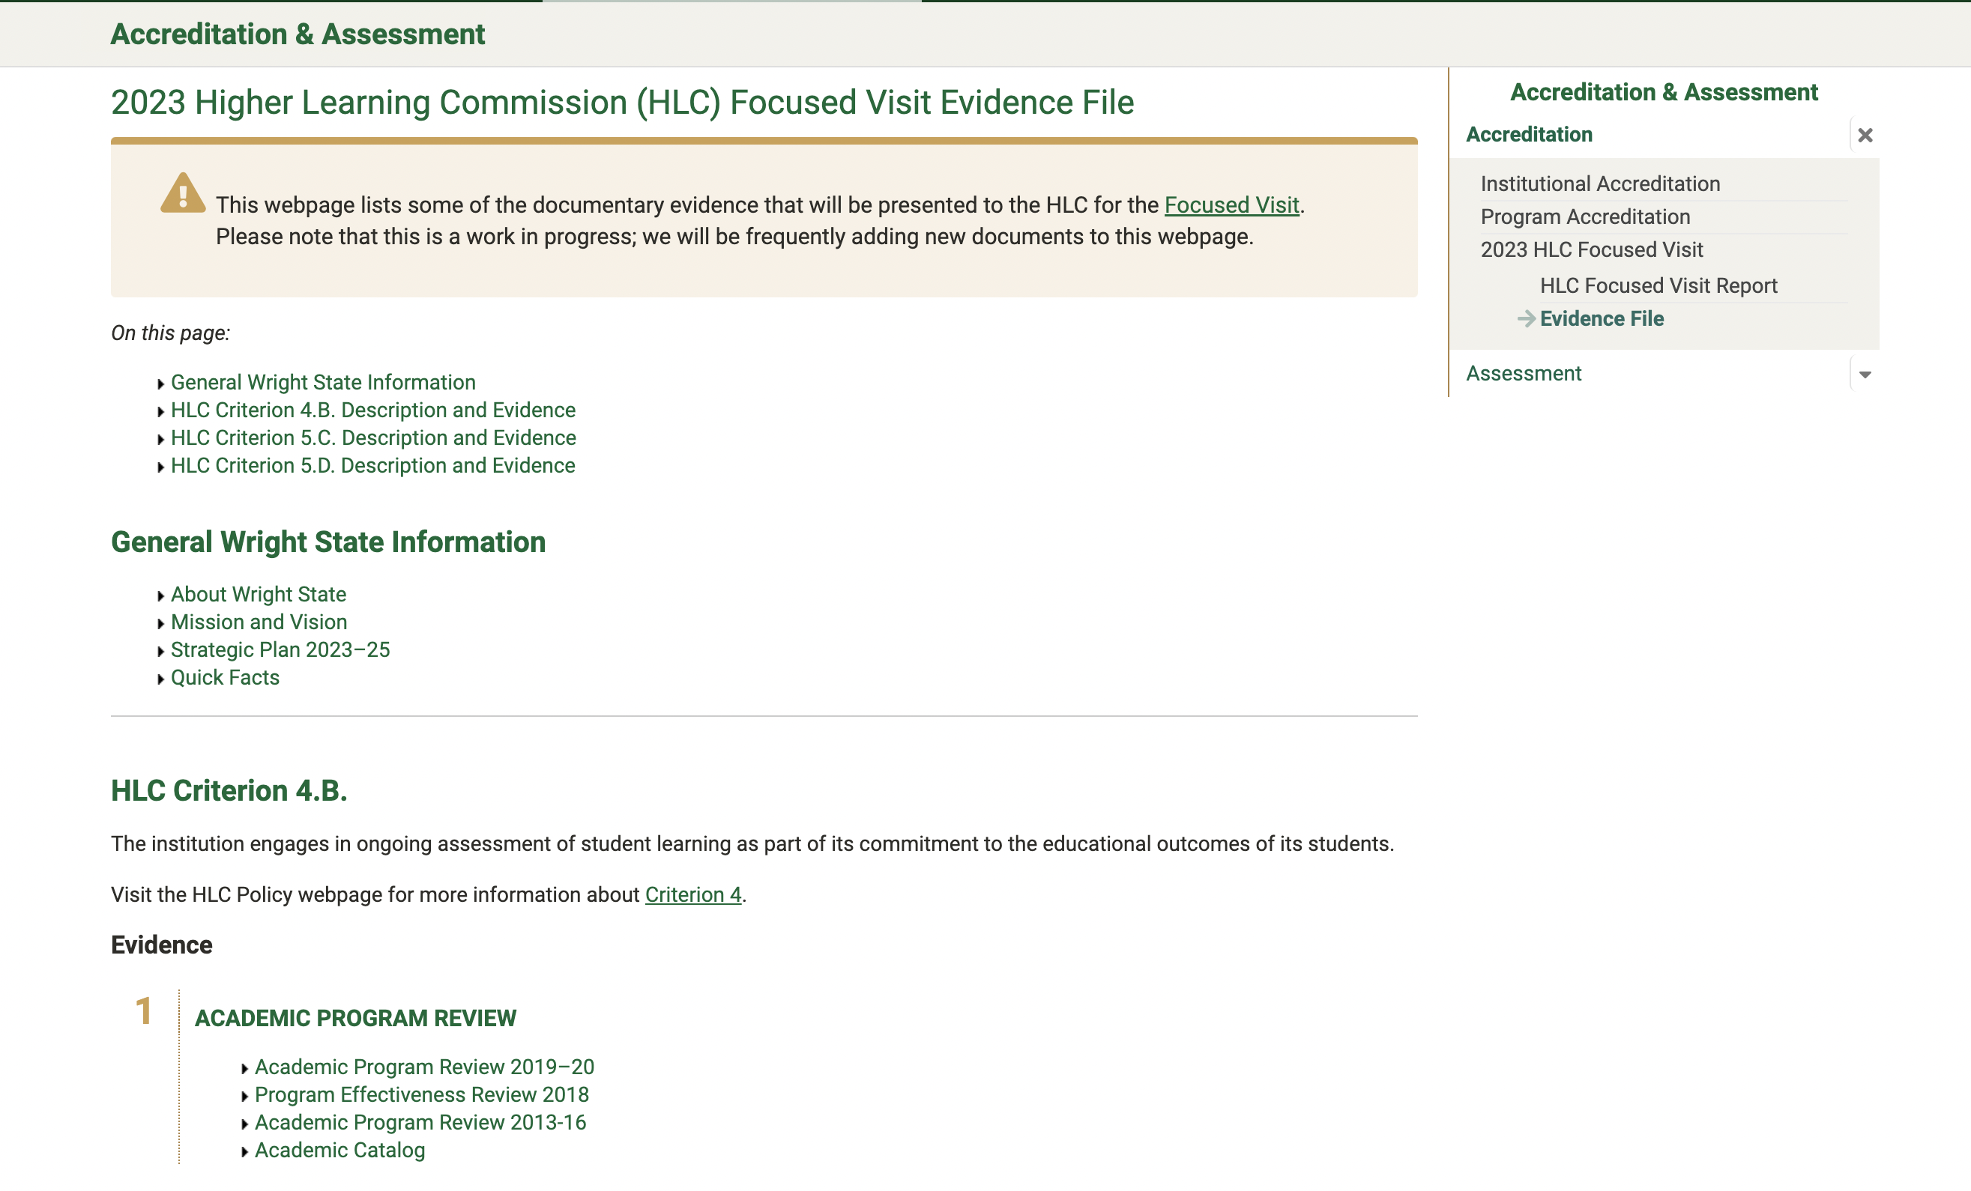
HLC Evidence File

Slide 11
The Provost’s Team
Amy Thompson, Provost, amy.thompson@wright.edu
Elissa Falcone, Director of Curricular and Strategic Initiatives, elissa.falcone@wright.edu
Carol Loranger, Faculty Affairs, carol.loranger@wright.edu
Bruce Mackh, Accreditation and Assessment, bruce.mackh@wright.edu
Wafa Hozien, Academic Affairs, wafa.hozien@wright.edu
Diana Shafer, diana.schaefer@wright.edu

Slide 12
Thank You!

