Slide 1
Mental Health Task Force Update
Dean Jim Denniston, Ph.D.
Huma Bashir, Ed.D., Chair
School of Social Work and Human Services

Slide 2
Overview
Presidential Task Force created in fall 2022 chaired by Provost Thompson
Mental health is a leading concern of college students and tied to student retention and success
Representation from both campuses and numerous stakeholders

Slide 3

Student Mental Health Pre-Pandemic
8
Higher Education Grappled with Escalating Student Demand for Services
Percentage of US Adolescents Reporting a Major Depressive Episode¹ in the Past Year
Adolescents aged 12-17, 2010-2018
16%
14%
12%
10%
8%
6%
4%
2%
0%
14.4%
12.5%
12.8%
13.3%
10.7%
11.4%
8.2%
9.1%
8%
2010
2011
2012
2013
2014
2015
2016
2017
2018
7x
Rate at which demand for counseling center appointments outpaced enrollment growth¹
Share of college students with depression or anxiety disorder, 2020
47%
1) Counseling center utilization increased 38.4% while enrollment increased by only 5.6% from 2009-2015.
©2021 by EAB. All Rights Reserved. eab.com
Sources: Bahrampour, Tara, “Mental health problems rise significantly among young Americans,” The Washington Post, March 2019; LeViness, Peter, Carolyn Bershad, and Kim Gorman. “Association for University and College Counseling Center Directors Annual Survey,” 2018; Center for Collegiate Mental Health, 2018 Annual Report; Bauer-Wolf, J., “Study: College Presidents Prioritizing Student Mental Health,” Inside Higher Ed, 2019; The Chronicle of Higher Education; EAB interviews and analysis.
Notes:
Ratio off counselor’s to students = 1 Clinical FTE: 1,800 students

Slide 4









Shining a Stark Spotlight on Mental Health
9
A Newly Urgent Priority for University Leaders Due to Pandemic Impact
Mental Health Took Center Stage across the Past Two Years
Most Pressing Challenges Facing Presidents Due to COVID-19
ACE Survey of U.S. College & University Presidents, Feb. 2021
Did Covid Break Students’ Mental
Health?
1 Mental health of students
College Students Suffering from Mental Health Issues at a Higher Pace during Pandemic
2
Mental health of faculty and staff
3 Long-term financial viability
One-Third of Students Seek Counseling for Pandemic Effects
4
Enrollment numbers for spring semester 2021
College Students Brace for the
‘Second Curve’ of COVID-19 – Its Mental Health Impact
5 Racial equity issues
Source: The Chronicle of Higher Education; Inside Higher Ed; CBS 8; NBC; ACE Spring Term Survey of College Leaders; The Chronicle; Inside Higher Ed College and University President Survey; Course
Hero, Faculty Wellness and Careers; EAB interviews and analysis.
©2021 by EAB. All Rights Reserved. eab.com

Slide 5



COVID Effect Still Not Fully Understood
10
But Data Indicates Widespread Impact on Mental Health and Wellness
No One Immune to Emotional Impacts of COVID
Share of students surveyed who reported
feeling…
Since the beginning of the pandemic, has
your mental health…
Worsened significantly
18%
Disappointment/ Sadness
78%
Worsened somewhat
23%
Worsened
34%
Lonely/Isolated
77%
Unchanged 17%
Improved
3%
75%
Of college students said their mental health had been negatively impacted by the pandemic
Stress/Anxiety
87%
Improved somewhat
3%
Improved significantly
1%
©2021 by EAB. All Rights Reserved. eab.com
Source: Active Minds Student Mental Health Survey (September 2020).

Slide 6

Improving Student Success Outcomes
11
Helping Students Maintain and Enhance Their Well-Being
A Demonstrated Impact on Academic Performance
#2
Mental illness is the second most common reason that students drop out of school
-0.4
Average drop in GPA for students with anxiety and mild to severe depression
Source: Eisenberg D and Lipson S, “The Economic Case for Mental Health Services in Higher Education,”; Calettstout D, “Mental Health Laws for Students Should Involve Students,” The Cougar, 2017; Field K, “Stretched to Capacity,” The Chronicle, 2016; Sky factor, "Academic Resiliency And First-Year College Students," 2017; EAB interviews and analysis.
©2021 by EAB. All Rights Reserved. eab.com

Slide 7

Students Increasingly Turn to Faculty…
15
…Who Are Asking for Additional Guidance on How to Support Them
But Faculty Feel Ill-Equipped to Intervene…
Felt adequately
Less than 30%
trained to have mental health conversations
8 in 10
Professors had a 1:1 conversation with a student about mental health in the last year
…and Desire More Support
More than 70%
Of professors want to better understand mental health
©2021 by EAB. All Rights Reserved. eab.com
Source: The Chronicle of Higher Education; EAB interviews and analysis.

Slide 8
Goals
16
1 Make It Easier to Refer Students
2
Provide a Starting Point for Conversations
3
Include Students in Well-Being Initiatives
4
Integrate Wellness into the Classroom
5
Proactively Signal Support for Mental Health
©2021 by EAB. All Rights Reserved. eab.com

Slide 9
Current Work
JED Foundation Campus-fully integrated
Provide MH First Aid and QPR trainings to all staff, faculty, and MH student mentors
Crisis Intervention plan and postvention
Notes:
QPR is an emergency response to someone in crisis and can save lives. QPR is the most widely taught Gatekeeper training in the world
Question, Persuade, Refer

Slide 10

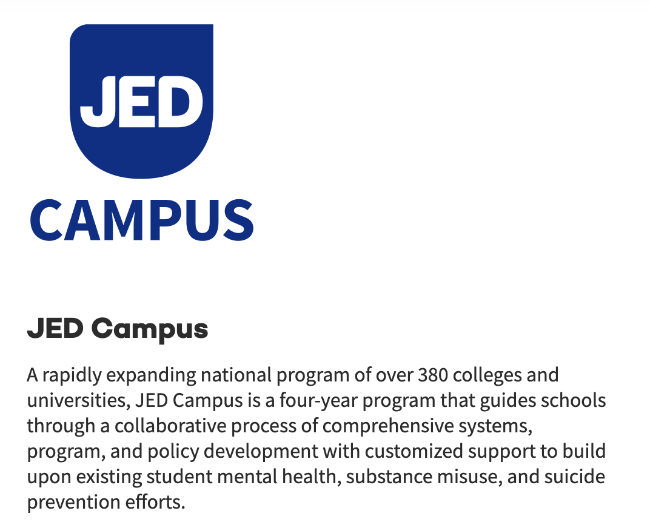


Slide 11


JED Campuses in Ohio
28 JED Campuses in Ohio
6 active, 18 alumni campuses
Notes:
Alumni
Cleveland State
Kent State
Ohio State
Shawnee State

Slide 12
JED Campus Program Overview
4-year partnership between JED and Wright State University
$42,000 program
$28,000 scholarship awarded to WSU by the Morgan Stanley Scholarship Fund
Contract with JED Foundation to begin August 2023

Slide 13
JED Campus Program Overview
JED will:
Provide a campus advising team and assistance in building a campus team
Conduct a baseline, School Self-Assessment, including the Healthy Minds Assessment
Conduct focus group with students to assess attitudes toward mental health
Provide a baseline report
Conduct a two-day site visit to develop a mental health strategic plan

Slide 14
JED Campus Program Overview
Provide WSU with access to JED Playbook a comprehensive resource library, which may include sample policies, programs, educational campaigns, and research, to serve as a reference to the Team; (2) tools or platforms for communicating with other JED Program members; and (3) any newsletters published by the JED Program
Conduct a final assessment and campus visit, and provide guidance that will allow WSU to continue to support mental health and suicide prevention efforts after the end of the contract

Slide 15
Current Work of the Mental Health Task Force
Incorporate mental and physical health well-being on campus
Increase capacity at the CWC to see more students and more often
MOUs with community partners to provide services for after hours
Linking programs like CMHC, MASW and SOPP, and Nursing (NP) to provide services

Slide 16
Current Work
Campus-wide trainings will help support this incorporation of a trauma-informed approach in a classroom
Creating resilience-oriented or culture of care policies, programs, and most importantly, actions
Campaigns for public and health safety
Syllabi and Pilot statements

Slide 17
Next Steps….
Conduct Mental Health and Crisis Trainings across the campus
Examine grant opportunities to increase workforce development in mental health services
Implement the JED Foundation Framework and conduct mental health assessment surveys

Slide 18
Resources for Faculty
When a Student Needs Support
Wright.edu/help is a great resource for helping students or making referrals. This site contains contact information for emergency or essential departments that can assist your students all in one location.
Raider Cares is Counseling and Wellness Services’ 24-hour crisis phone service. You can reach the Raider Cares Line by calling 937-775-456
To schedule your Initial Appointment, go to: https://wright-cw.titaniumhwc.com/ and select the "Schedule Initial Appointment" button
https://www.wright.edu/student-affairs/resources-and-support
Faculty and Staff resources.
https://www.wright.edu/student-affairs/counseling-wellness-and-advocacy/counseling-and-wellness/information-for-faculty-and-staff

Slide 19
Thank you!
Questions?

