Slide 1
Summer 2023 Moves

Slide 2
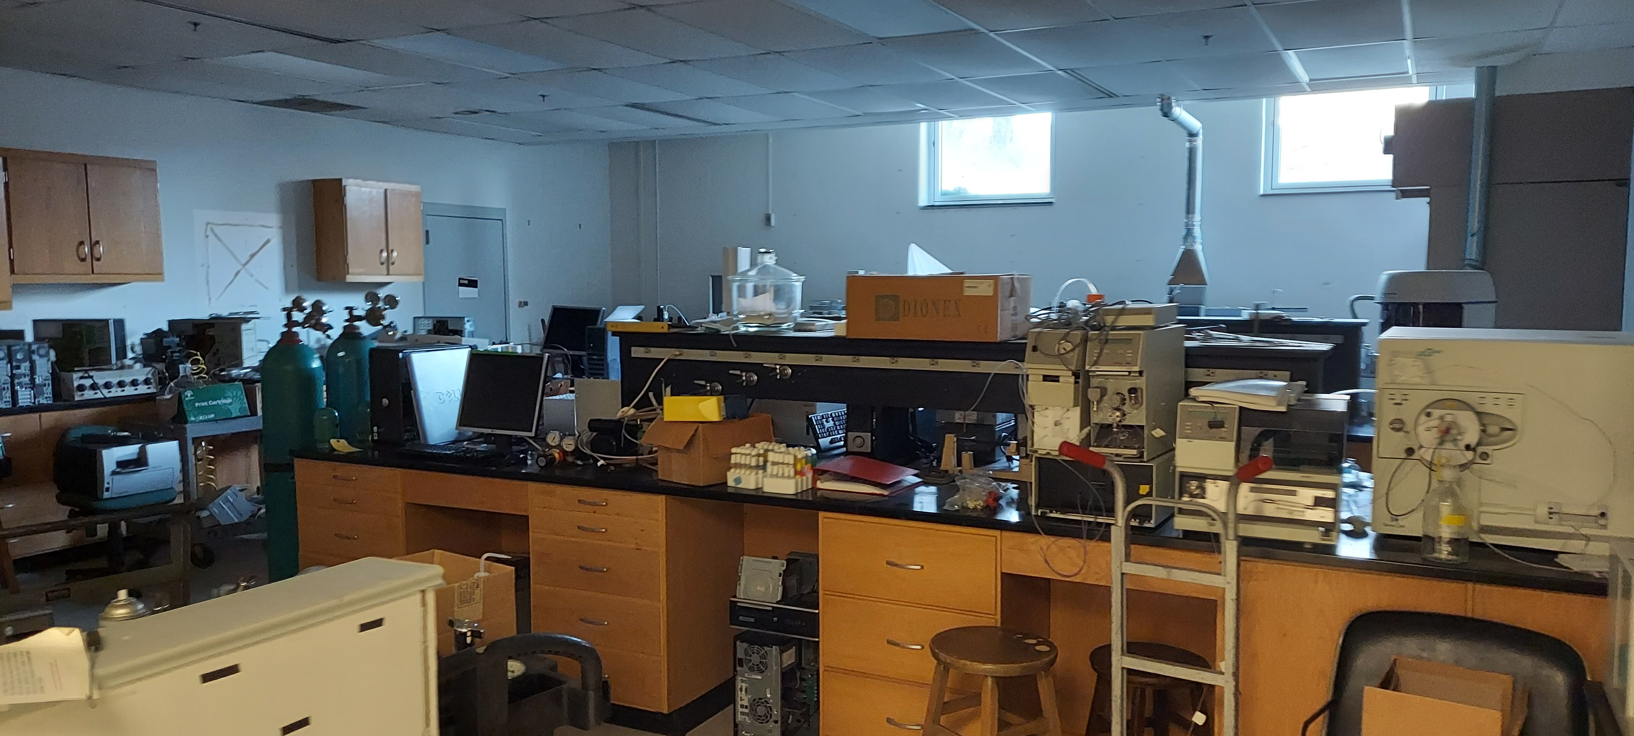
Background:
Decline in enrollment and staffing have led to a surplus of space
Fall 2016 – 16,655 student headcount
Fall 2022 – 9,503 student headcount
Fall 2016 – 2,827 FTE employees
Fall 2022 – 1,733 FTE employees
Located in pockets across campus.
Space walk through and benchmarking identified approx. 170,000sf surplus
Notes:
Fall 2016 Enrollment – WSU Factbook
Fall 2022 Enrollment – WSU Quick facts page on website
Fall 2016 FTE – FMS COGNOS report provided by Institutional Research
Fall 2022 FTE - FMS COGNOS report provided by Institutional Research
170,000 Surplus from fall 2019 Benchmark calculations

Slide 3

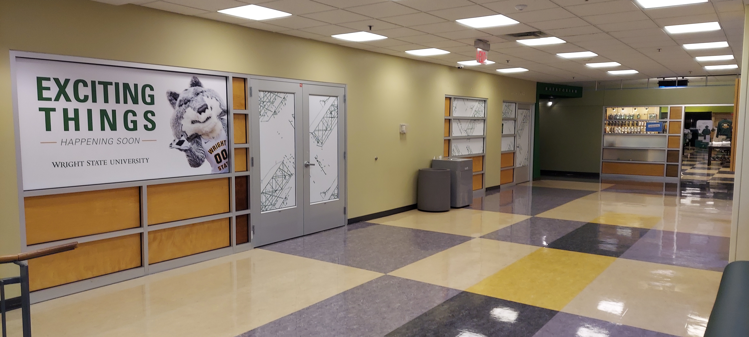
Focus:
Support interdisciplinary approaches in new College of Health, Education and Human Services
Improve and enhance student oriented spaces.
Accommodate growth in academic programs.
Consolidate university uses to maximize available space

Slide 4
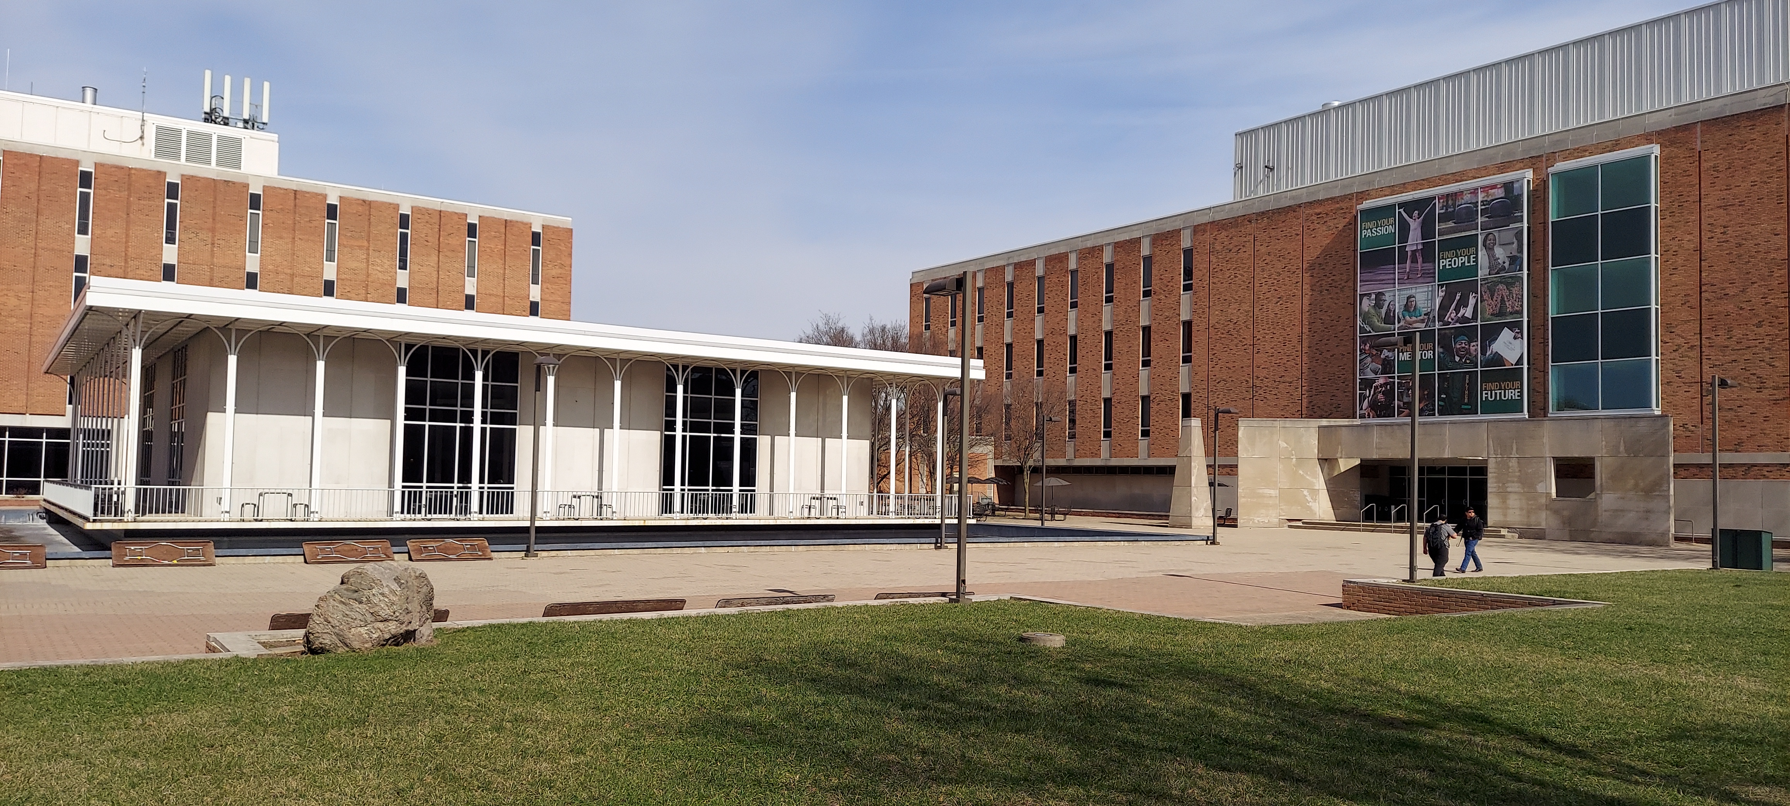
Millett Hall - Allyn Hall
Millett - single building large enough to house CHEH academic units and allow for growth
Future Phase for Nursing skills and simulation labs
Allyn – comfortably accommodate COLA
New student lounge
Deans on first floor

Slide 5
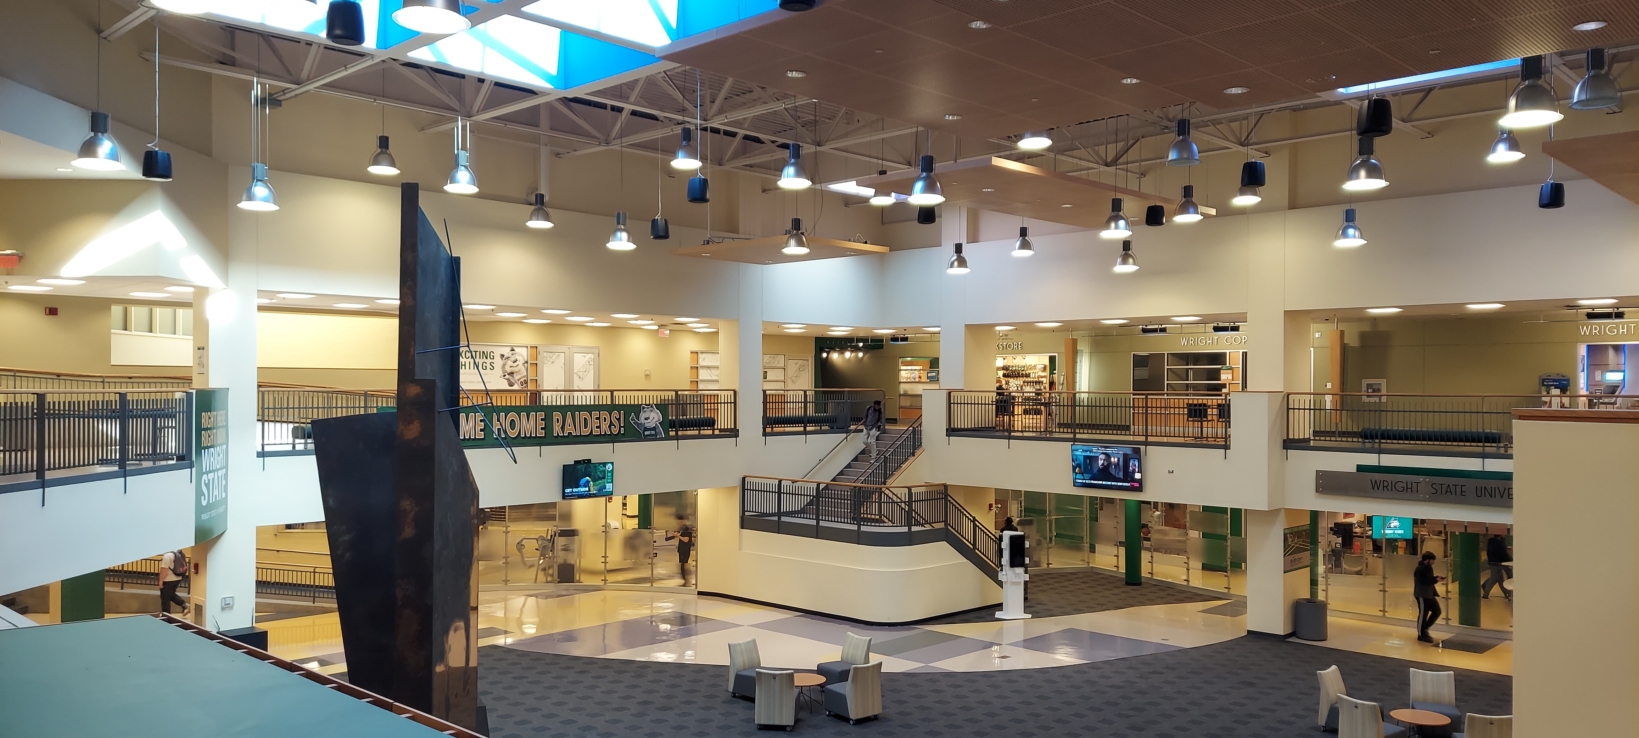
Student Union
Relocate Culture and Identity Centers
Permanent home for UCIE
New Bookstore
New Student Organization and Student Involvement and Leadership Suite
New Career Services Suite
Relocate Retirees, Advancement and Alumni Association

Slide 6
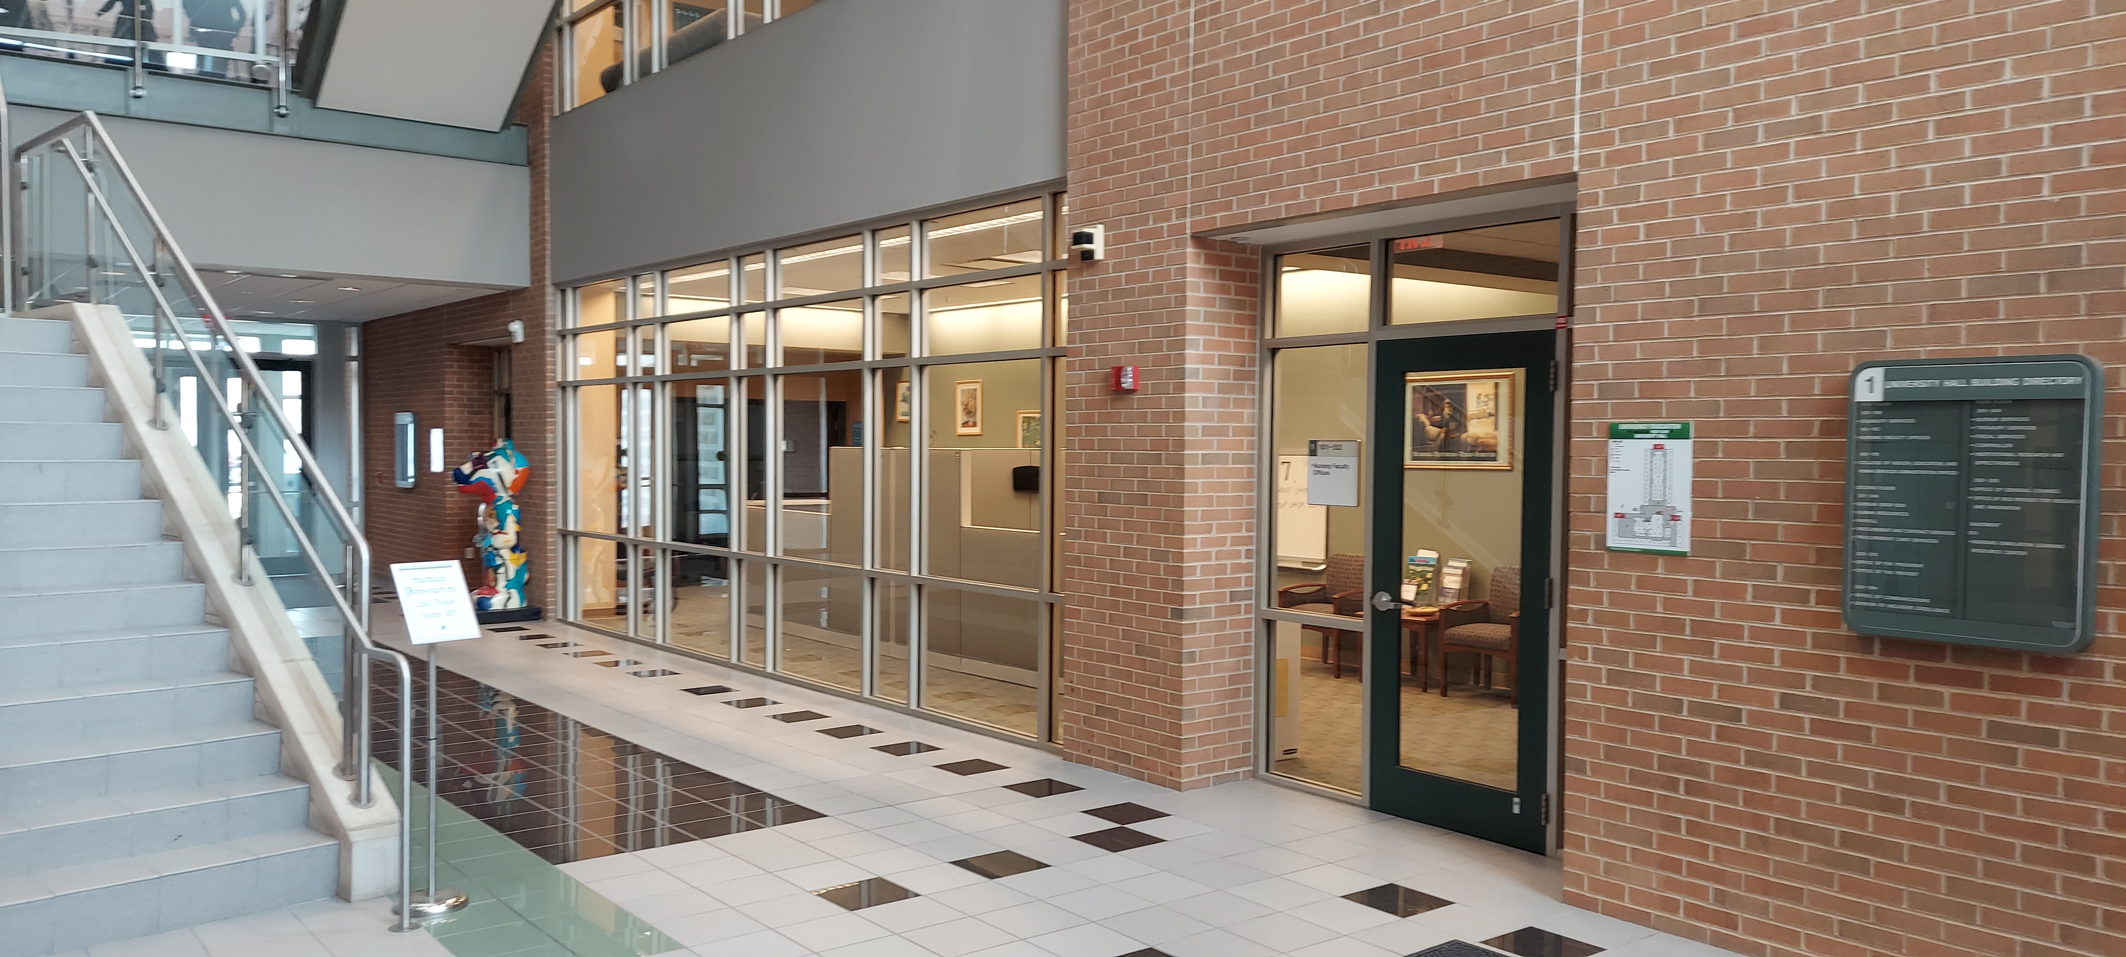
University Hall
Redesigned Raider Connect supported by Financial Aid, Bursar, Registrar.
Repurpose Nursing suite for new College of Graduate Programs and Honors Studies

Slide 7
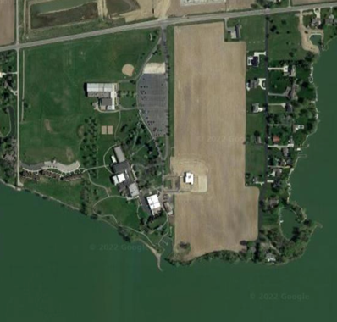
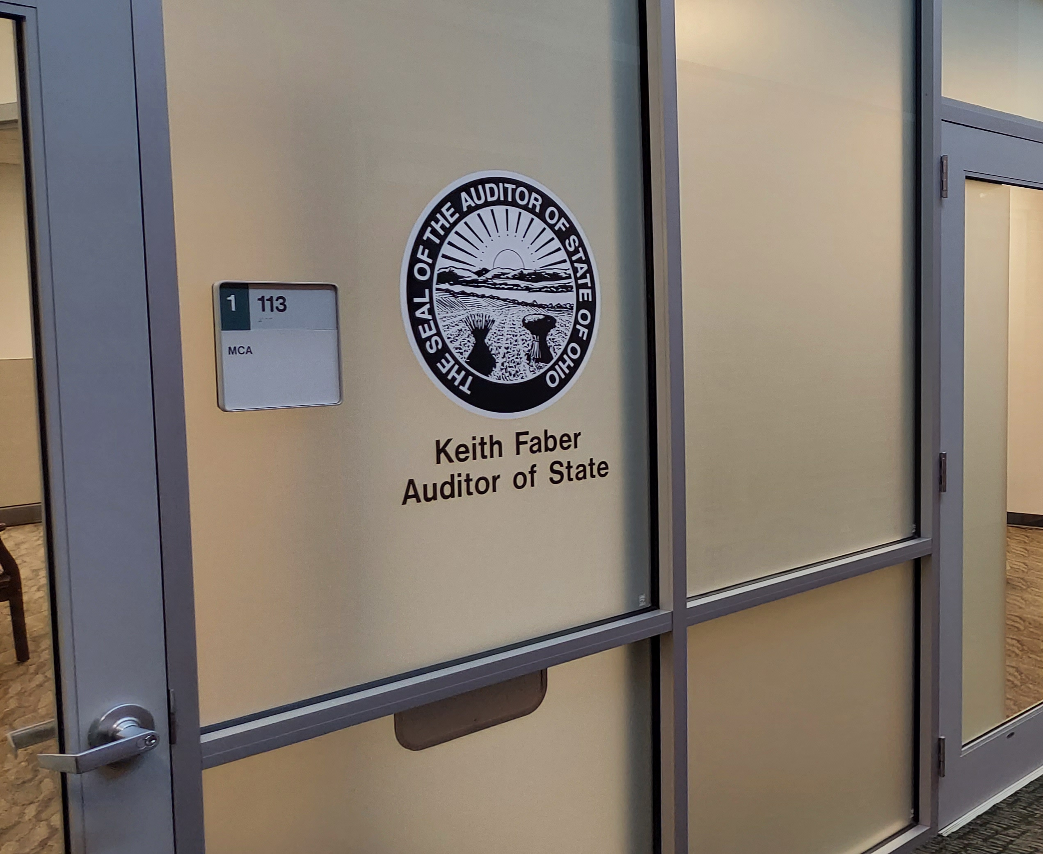
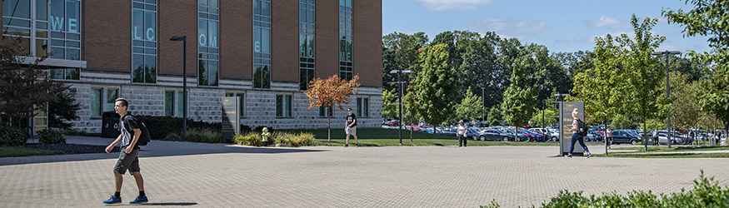
Other
WSUPD to Allyn annex
NEC collaboration with WPAFB
State Auditor in Med Sci
Project Life to Campus Services
Air Handlers
Roof replacements
Russ Flooring
Paver Replacements
Lake WFDC
Lake wetland creation
Lake Pavilion restoration

