Slide 1
Core Review and Alignment
Recommendations
November, 2023

Slide 2
Questions you want us to address?

Slide 3
Why Review the Core...???
OT36, March of 2021
  Ohio Transfer Module (OTM) requirements, categories and learning outcomes
  Significant number of students that transfer into/out of WSU
    1/3 of our students transfer into WSU
    40% of first-time, first year students enter WSU with college credit
Faculty Senate has shared responsibility for the Core (Policy 4130)
Higher Learning Commision (HLC), Standards 3 and 4 – overseeing, evaluating general education offering

Slide 4
Considerations
Alignment of WSU requirements to learning outcomes in OT36
Any barriers that may exist for students because of differences between the WSU Core and OT36 requirements
The distinctiveness of WSU’s Core for today’s students and their need for development and career preparation
The enhancement of efforts regarding recruitment, enrollment, retention and degree completion of WSU applicants/students
What should every WSU graduate have?

Slide 5
Core Review and Alignment Committee
Established by the Faculty Senate in Fall of 2021
Brian Boyd, CHEH (Co-Chair)
Sarah McGinley, CoLA (Co-Chair)
Ann Bowling, CHEH, Chair of Core Oversight
Nathan Klingbiel, CECS, Chair of Undergraduate Student Success
Ivan Medvedev, CoSM
Brandon Morris, RSCoB
Jeanette Marchand, CoLA (2022-present),
Patrick Sonner, BSoM
Amanda Spencer, Academic Advising (2022-present)
Pamela Tsang, CoSM
Nate Tymes, Lake Campus
Hideo Tsuchida, Director for Articulation, Transfer and Institutional Partnerships (ex-officio)
Bruce Mackh, Vice Provost for Assessment and Chief Accreditation Officer (ex-officio, 2023-present)
---
Judson Murray, CoLA (2021-22)
Diana Stanforth, CHEH (2021-22)
Tammy Kahrig (2021-22), Vice Provost of Undergraduate Curriculum & Instruction (ex-officio, 2021-22)
Wafa Hozien, Vice Provost for Academic Affairs (ex-officio, 2022-23)

Slide 6
Core Review and Alignment Committee
Meeting regularly since November of 2021
  Reviewing existing CORE requirements at WSU
  Reviewing learning outcomes and requirements in OT36
  Examining what other Ohio institutions are doing with respect to OT36
  Open Forums for faculty, staff, students in April of 2022
  Status update to each college and the Faculty Senate in the Fall of 2022
  Subcommittees in 2022-23
    Global Traditions; Diversity, Equity, and Inclusion (DEI); and the current Multicultural (MC) designation
    Second Writing course and Integrated/Intensive Writing
    Science requirements beyond the 6 hours (and 1 lab course) required by OT36
  Working toward a final recommendations document: May-Oct, 2023

Slide 7
Recommendations
The WSU CORE will include categories from the Ohio Articulation and Transfer Policy, currently the Ohio Transfer 36 (OT36), as determined by the Ohio Department of Higher Education. This sets 24 hours within the WSU CORE as the following:
  Element A: English Composition/Oral Communications: at least 3 semester hours
  Element B: Mathematics, Statistics, and Logic: at least 3 semester hours
  Element C: Arts and Humanities: at least 6 semester hours
  Element D: Social and Behavioral Sciences: at least 6 semester hours
  Element E: Natural Sciences: at least 7 semester hours, including at least one semester hour of a laboratory course
  OT36 approval NOT required
  Courses submitted must also submit OT36 Application; processes for approval independent

Slide 8
Recommendations
Element C: Arts and Humanities: 6 semester hours
Element D: Social and Behavioral Sciences: 6 semester hours
---
  Two different disciplines for each element
  At least one Global Inquiry (GI) course
  At least one History (HST) course

Slide 9
Recommendations
Additional Core Requirements
Second Writing Course (3)
  Course must satisfy the OT36 learning outcomes (TME002) but does NOT need to be OT36 approved.
Integrated Writing (IW)*
  Students must take at least three IW courses. This three-course requirement can be met in one of two ways:
    Two IW courses in the Core and one IW course the Major
    One IW course in the Core and two IW courses in the Major
Inclusive Excellence (IE)*
  At least two courses
Additional hours (up to eight)
  Must be approved in one of the Elements A-E

Slide 10
First Year Seminar (FYS) Courses
The committee had initial discussions regarding requiring FYS for all students. The committee is generally supportive of FYS courses, as they have been initially proposed, and recognizes their benefits. However, the committee did not finalize any decision on including FYS in the WSU Core. The committee recommends that the FYS working group and the Undergraduate Student Success Committee (USSC) are the appropriate bodies to continue this work.
The Faculty Senate Executive Committee has decided to include FYS in the Core – see Resolution

Slide 11
Procedural and Implementation Recommendations
Deans, Department Chairs, and Faculty - coordinate with respect to areas of expertise, redundancy, demand, etc.
Course proposal and OT36 application prepared simultaneously. Each process independent of one another.
A clear process will be articulated and established for submitting courses for OT36 approval.
UCC, or another group charged by the UCC, to determine a process to eliminate courses from the WSU Core.
Invest in areas of the Core unique to WSU, such as Integrated Writing (IW), Global Inquiry (GI), and Inclusive Excellence (IE)
  Managing course offerings
  Provide resources and oversight for the instructors of these courses

Slide 12
Questions...???

Slide 13
Related Links...
https://www.wright.edu/academic-affairs/wright-state-core
https://www.wright.edu/academic-affairs/program-requirements
https://policy.wright.edu/policy/4130-wright-state-core
https://transfercredit.ohio.gov/educational-partners/educational-partner-initiatives/ohio-transfer-36/overview

Slide 14
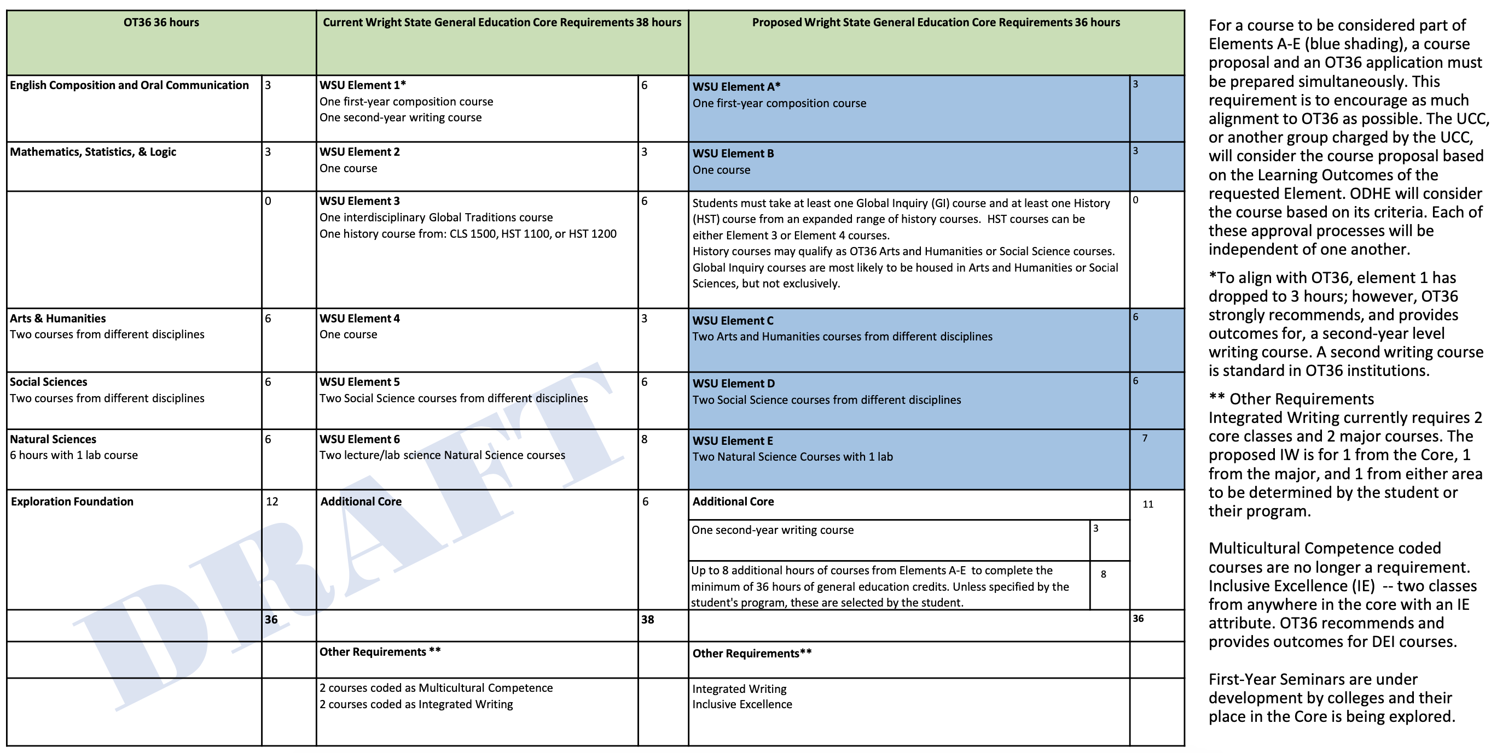
Recommendations – Visual Summary

