Slide 1


2022–2023 Faculty Awards for Excellence:

Slide 2
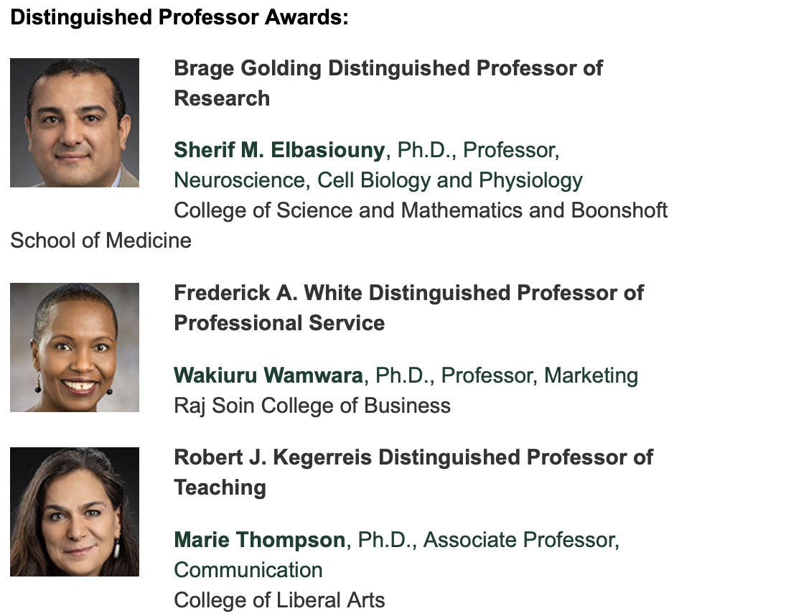

Slide 3
