Slide 1
Counseling and Wellness Services
Barbara Marsh, DSW, MSW, LISW-S, LICDC-CS
Director
Senate Faculty Meeting
February 12, 2024

Slide 2

Introduction
Counseling and Wellness Services (CWS) is a department of the Provost’s Office and is the University’s student mental health and health promotion service.
Mission
Promote optimal student wellness and mental health through the provision of quality education, consultation, and clinical service and training.

Slide 3

Counseling and Wellness Services Location
Student Union 053
Lower Level
937-775-3407
Monday – Friday 8:30 am to 5:00 pm

Slide 4



How to Access Counseling and Wellness Services
Counseling and Wellness Website
Call the Counseling and Wellness Office
Walk-Ins are Welcome

Slide 5
Services Offered
Counseling and Wellness Services (CWS) is staffed by licensed Psychologists, Social Workers, and Counselors and offers a wide range of therapeutic services.
Individual Counseling
Group Counseling
Face to face and telehealth individual counseling is available.
A wide variety of groups are offered, including anxiety, depression, grief and skills groups,
Psychological Assessment
Psychiatry
Health Promotion and Prevention
Partnership with the Booneshoft School of Medicine to offer medical management of mental health and substance use conditions.
Offers several types of assessment as a standalone service.
Mental health promotion and prevention outreach to minimize mental health problems and optimize positive mental health for students and staff.

Slide 6
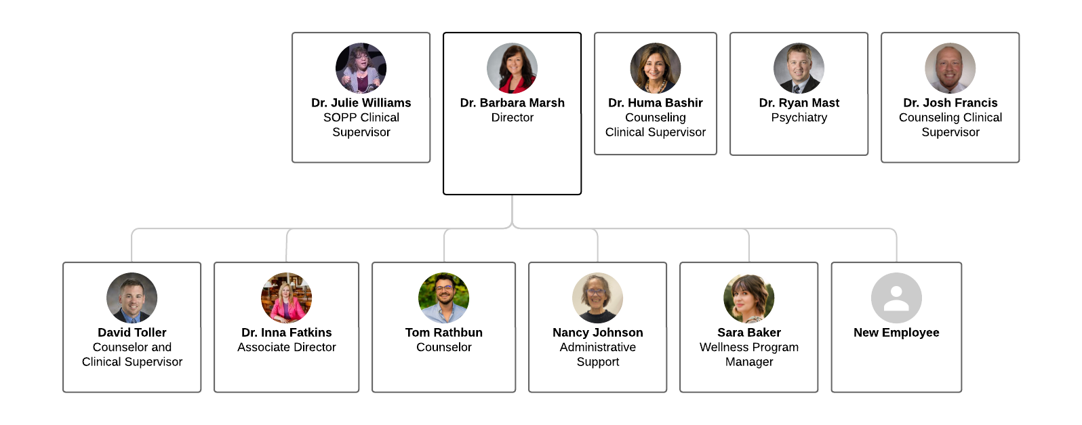
Staffing Updates
New Director and Therapist was hired in October 2023
Associate Director, Therapist, Office Support and Program Manager of Health and Wellness hired January 2024.
Increased student interns from 6 to 13 (psychology, social work, counseling, nursing).
Added a marketing student employee.

Slide 7
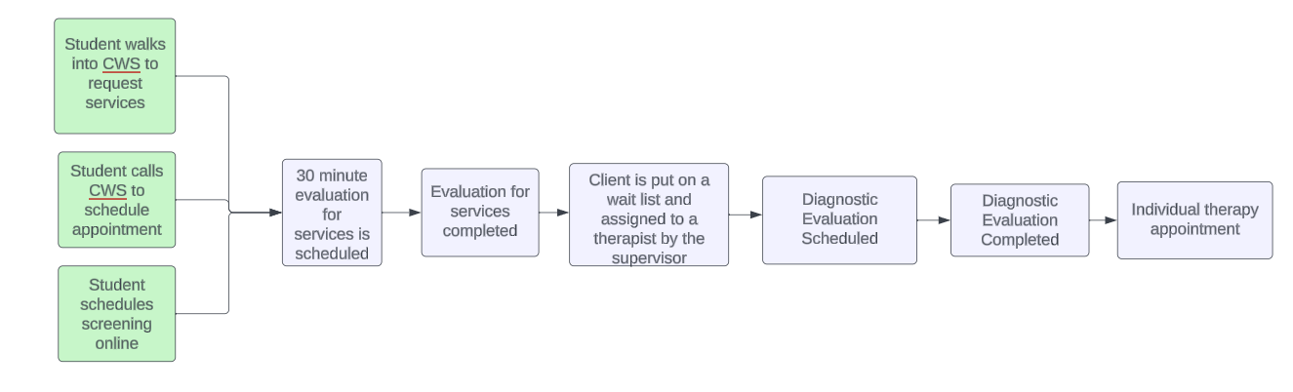
Improving the Access and Availability of Counseling Services
Eliminated the 30-minute Evaluation for Services Appointment
Increased the number of online assessment appointments from 24 in September to 146 appointments in January.
Decreased wait time from 6-8 weeks to 0.
Increased show rates from 54% to 63%.
Increase access to telehealth services in 2024

Slide 8

Increasing Access to Psychiatry Services
According to the 2023 Center For Collegiate Mental Health Annual Report, only 21% of the 195 counseling centers surveyed offered psychiatric services.
Through an Ohio Department of Higher Education grant and a partnership with Booneshoft School of Medicine, Counseling and Wellness Services is able to offer psychiatric services four days per week.

Slide 9


Expanding Prevention Initiatives
Program Manager will focus on prevention initiatives across campus with staff and students.
Mental Health First Aid trainings were implemented in August 2023.
Mental Health First Aid will now be required for all staff and faculty. Selected staff will become trainers.
Peer Mentoring Training will be offered to selected students to become Certified Mental Health Peer Mentors and become train–the–trainers.
Hired a student Marketing Assistant to update and enhance the website, create a social media presence, and increase the visibility of CWS on campus.
Question, Persuade, and Refer Training is offered by Public Safety.
Narcan Training is offered by Public Safety.
Nalox Boxes will be installed across campus.

Slide 10

Expanding Prevention Initiatives

Slide 11
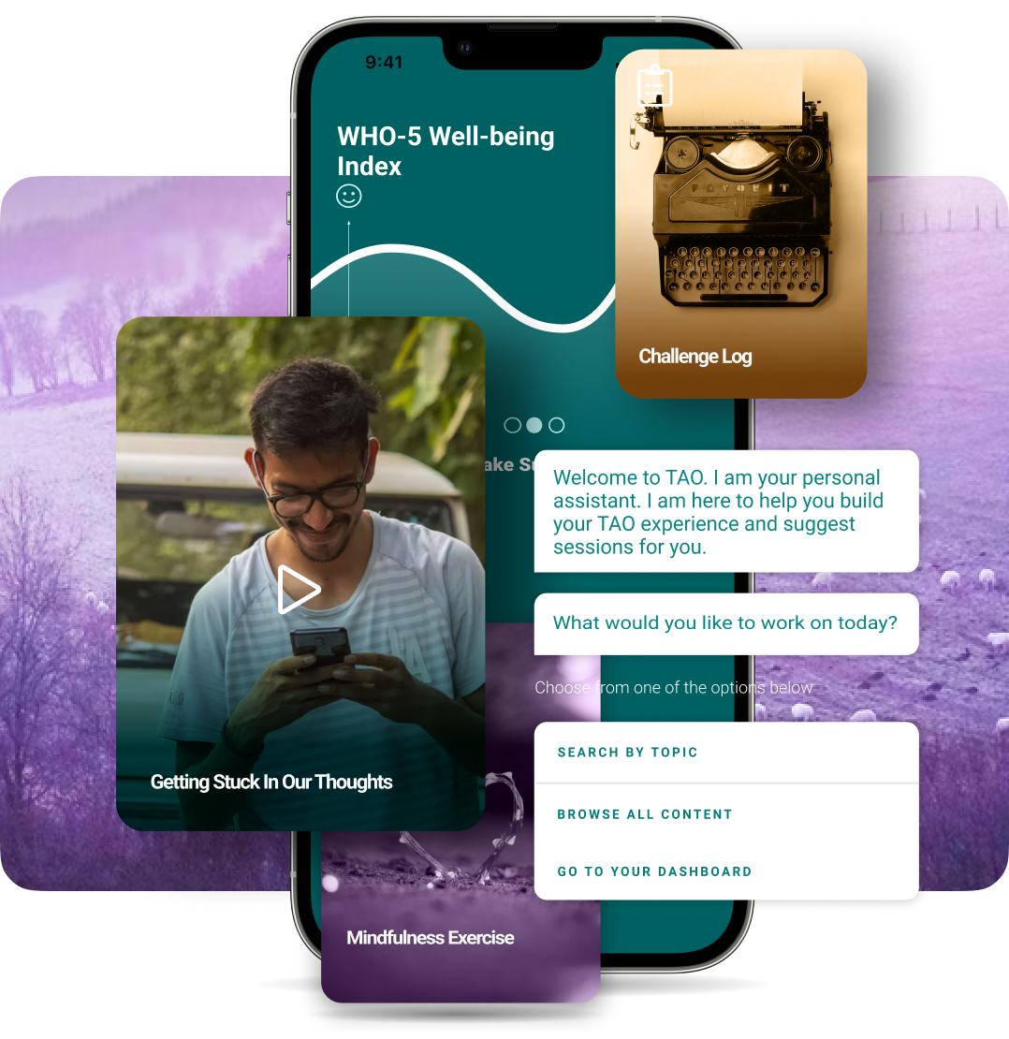


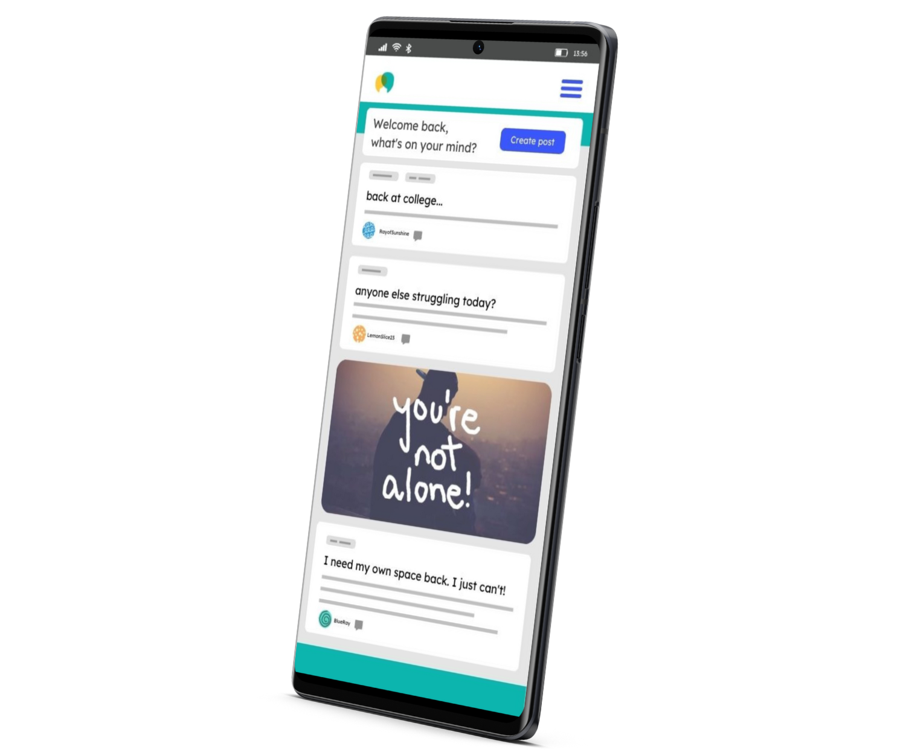
Other Resources
TAO is a suite of online tools for life skills education, well-being, resilience and behavioral health, with content available 24/7/365.
Trained Peers are there to provide peer support and help maintain a vibrant, welcoming space on Togetherall.

Slide 12

Additional Crisis Services
Raider Cares
Raider Cares is Counseling and Wellness Services’ 24-hour crisis phone service. You can reach the Raider Cares Line by calling 937-775-4567.
988 Suicide and Crisis Lifeline
Call 988
Chat 988 at 988lifeline.org
Text Suicide and Crisis Lifeline at 741741

Slide 13
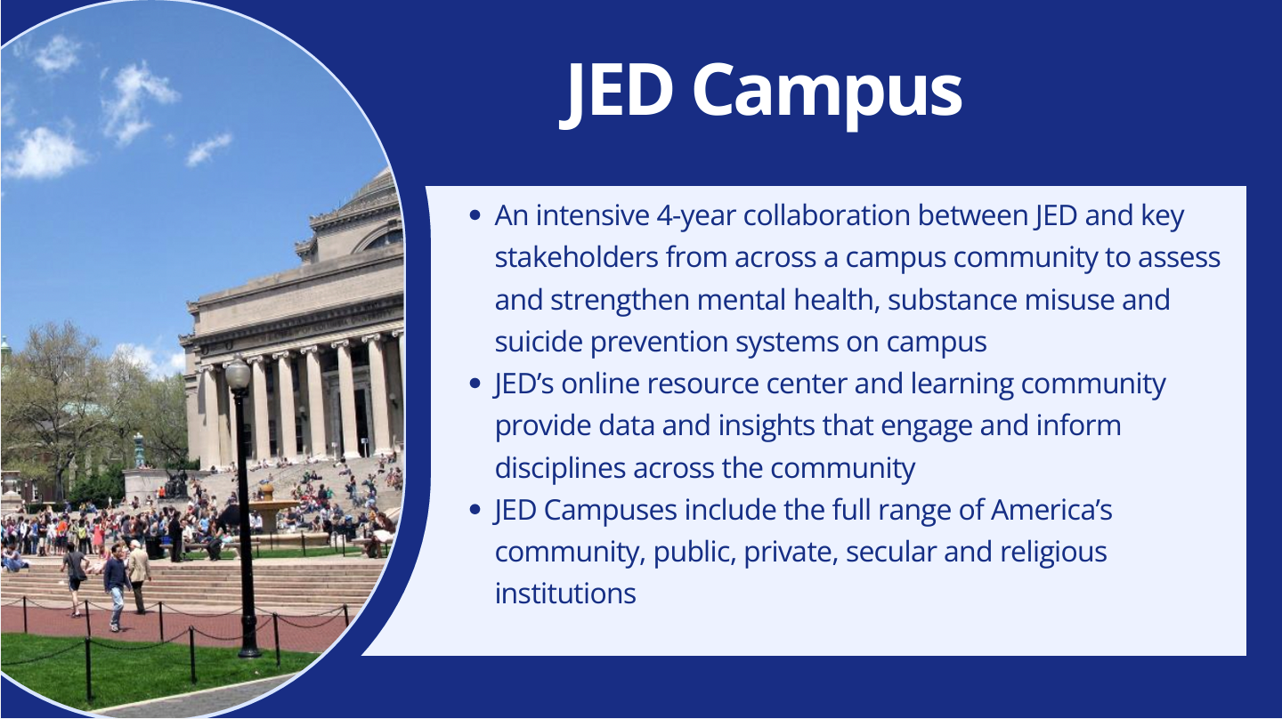

Slide 14
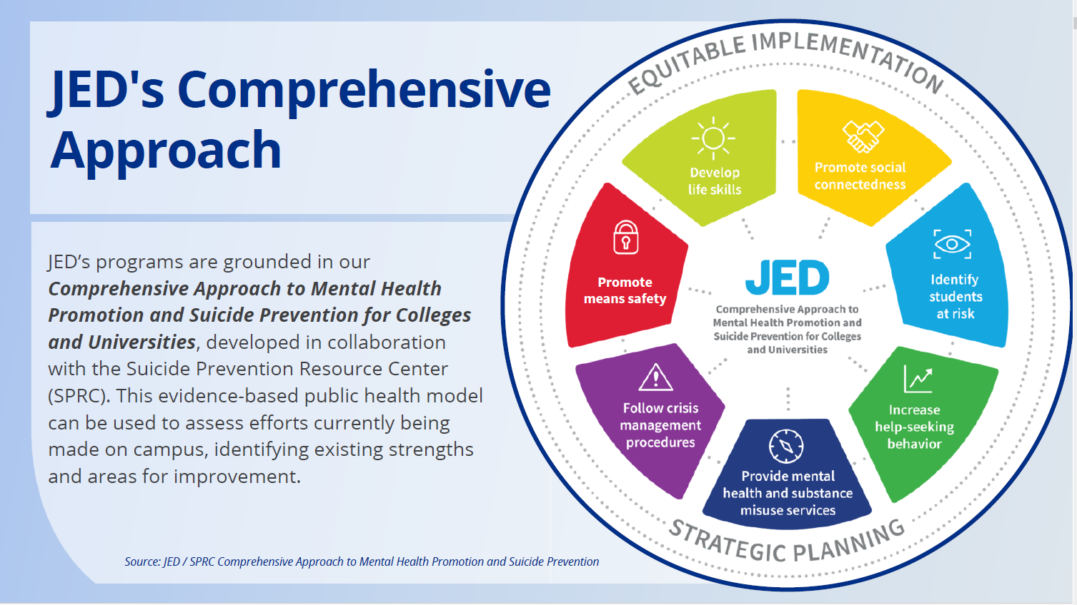

Slide 15
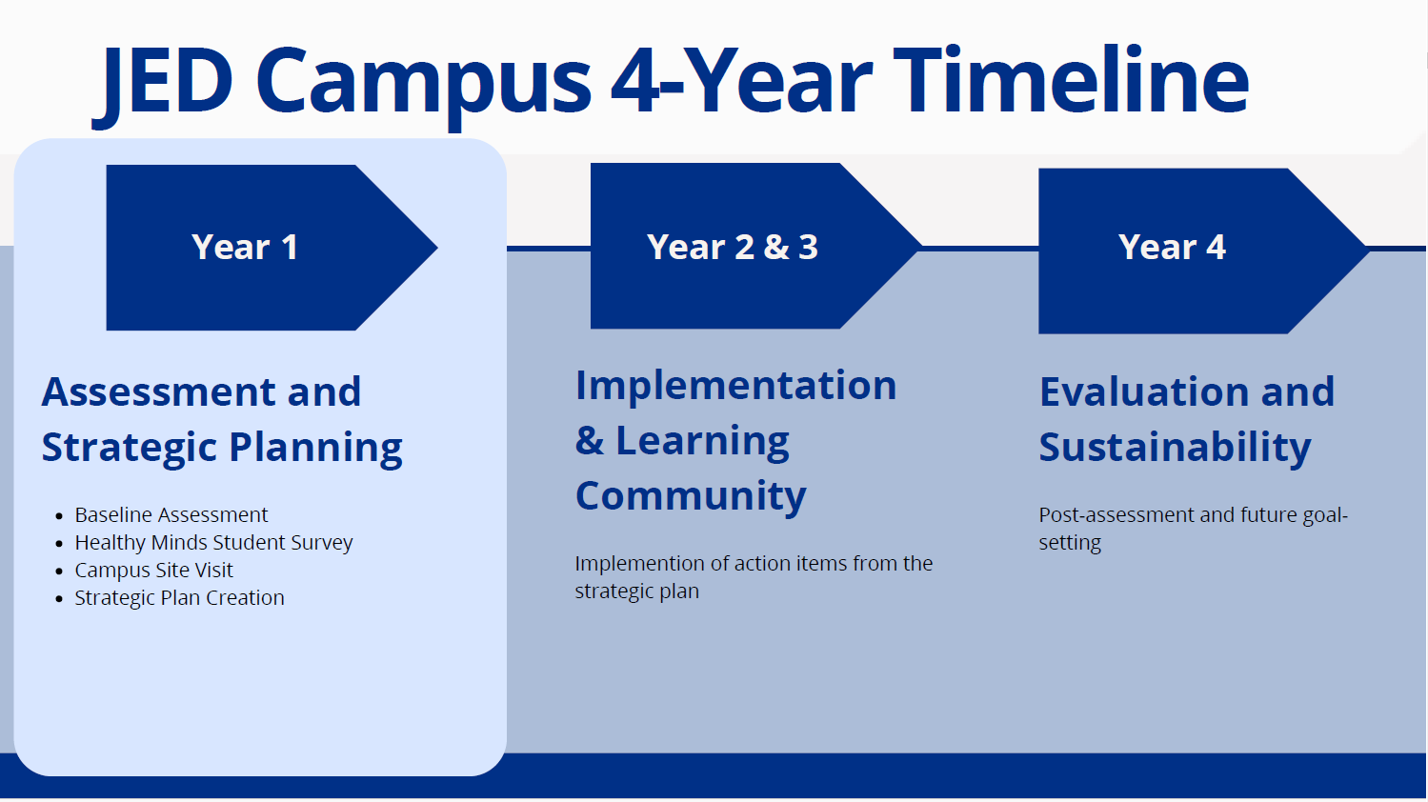

Slide 16
Improving Behavioral Health Emergency Response
On January 22, a shooting took place at Cedar Hall on campus.
Met with the victim and students at Cedar Hall that evening.
Text and email communication was sent out across the University.
Counseling and Wellness service numbers, as well as Raider Cares, were broadcast on local media.
Additional intake appointments were opened for students at Counseling and Wellness as needed.
Counseling and Wellness staff provided a resource table in the student union. We interacted with 114 students, 14 staff/faculty and 3 parents.
Provided a full debriefing session with all Residence Life staff and students. Approximately 60 individuals were in attendance.
Coordinated with Ohio Crisis Response to convene a separate Black student debriefing session.
Provided a debriefing session with students at Cedar Hall.
Provided a debriefing with resident assistants at Cedar Hall.
Continue to offer additional resources or debriefings as needed.
Integrate behavioral health response into emergency operation plans.

Slide 17
Next Steps
Continue to modify operations to create a positive experience for students.
Modifying electronic health record documentation.
Increase prevention efforts.
Increase visibility on campus by increasing marketing efforts.
Increase outreach on campus with students through tabling, events, etc.
Continue to place a diverse group of interns within services.
Increase collaboration and partnerships with other departments across campus.
Integrate a behavioral health emergency response plan into the university operations.
Support the implementation of JED strategic initiatives.

Slide 18

Thank you
Barbara Marsh, DSW, MSW, LISW-S, LICDC-CS
Director, Counseling and Wellness Services
937-775-3409
Barb.marsh@wright.edu

