Slide 1

Engaging by Design:
The Role of Regular and Substantive Interaction in Learning (QM5) (50 min)
Wright State University Faculty Senate:
Sheri Stover and Bret Retherford

Slide 2


Sheri Stover & Bret Retherford
Sheri Stover, Ph.D.
Wright State University
Professor and Program Director IDL
sheri.stover@wright.edu
Bret Retherford, M.Ed.
Wright State University
Instructional Designer
bret.retherford@wright.edu

Slide 3


Title IV of the Higher Education Act (HEA) 1965
The HEA Title IV was established to strengthen educational resources of colleges and universities and provide financial assistance to students.
Correspondence Education: No Financial Aid
Distance Education: Eligible for Financial Aid
Don’t get complacent thinking that only not-for-profits are “guilty” of having online courses that are considered “Correspondence Courses”. The rules to meet “Distance Education” can be tricky, so you need to be careful in the design of your online courses.

Slide 4
RSI Time Table
RSI was established in 1992. However, starting in 2021, accreditors (HLC) started integrating an RSI check into their quality assurance check.
YEAR | EVENT
1992 | HEA distinguishes correspondence vs. distance education
2006 | Early regulatory focus on interaction
2008 | RSI appears clearly in federal regulations
2010-2016 | Enforcement era: audits & OIG findings
2017 | WGU audit raises national attention
2019 | Negotiated rulemaking on distance ed
2020 | New RSI definition published
2021 | Accreditors integrate RSI into quality assurance

Slide 5

Will HLC Require Proof of RSI?
We never know what HLC will focus on, but they might come as ask how WSU ensures Distance Ed classes meet RSI requirements.

Slide 6

RSI- Not That Difficult
Once most of my colleagues hear about the RSI requirements, they say, that was not so difficult.
RSI

Slide 7




Higher Learning Commission (WSU → HLC)
As a recognized accrediting agency, HLC is tasked with ensuring Wright State meets federal definitions of distance education with RSI criteria.
HLC reviews on
Accreditation visits
Substantive change reviews (e.g., new distance programs)
Ongoing monitoring processes
Eligible
Reclaim past financial aid
Not eligible
Impose fines or restrictions

Slide 8

Potential Consequences to Students
Inability to get direct loans, Pell grants, Teacher Education Assistance Grants, Federal work-study grants, and other financial aid.
74% = WSU students Financial Aid
73% = All students Financial Aid
Student Loans
& Grants

Slide 9
Distance Education (DE)
DE courses need to meet Regular & Substantive (RSI) criteria to be eligible for Student Financial Aid
RSI Regular Interaction
RSI Substantive Interaction
Notes:
RSI Overview

Slide 10
RSI DoE Definition [Regular Interaction]
Communication between instructor and students occurs consistently and at predictable intervals, not randomly or when student initiates it.
Interactions are a PREDICTABLE and SCHEDULED bases
PROACTIVE interactions based on monitoring the student’s academic engagement or responding to a students’ request.
Interactions INITIATED by an academically qualified instructor who meets accreditation requirements. Therefore, RSI cannot be satisfied by feedback from other students, Teaching Assistants, and Graduate Assistants. Feedback can come from these parties, but must also come from the qualified instructor.
Time frame is measured on weekly interactions. Distance education classes should have 2 of the 5 Substantive requirements each week.
Notes:
RSI DoE Definition [Regular Interaction]
Communication between instructor and students occurs consistently and at predictable intervals, not randomly or when student initiates it.

Slide 11
Distance Education (DE)
DE courses need to meet Regular & Substantive (RSI) criteria to be eligible for Student Financial Aid
RSI Regular Interaction
RSI Substantive Interaction
Notes:
RSI Overview

Slide 12

RSI Substantive Interaction (2/4 Criteria)
HLC must find 2/4 RSI Substantive Criteria in the DE course syllabus. *Hint: RSI activities must be predictable, regular, substantive, and instructor initiated.
Substantive Interaction
Substantive Interaction: Engaging students in teaching, learning, and assessment, consistent with the content under discussion, and also includes at least two of the following four components:
Regular Interaction: An institution ensures regular interaction between a student and instructor(s) prior to completion of the course:
Providing the opportunity for substantive interactions with the student on a predictable and regular basis commensurate with the length of time and the amount of content in the course or competency; and
Monitoring the student’s academic engagement and success and ensuring that an instructor is responsible for promptly and proactively engaging in substantive interaction with the student when needed, on the basis of such monitoring, or upon request by the student.
SUBSTANTIVE INTERACTION FIVE COMPONENTS:
Providing direct instruction;
Assessing or providing feedback on a student’s coursework;
Providing information or responding to questions about the content of a course or competency;
Facilitating a group discussion regarding the content of a course or competency; or,
Other instructional activities approved by the institution’s or program’s accrediting agency.
Need RSI to be considered Distance Education and not a Correspondence to be eligible for Financial Aid.
Notes:
RSI Requires DE Courses Meet 2 of 4 Criteria:
HLC must find 2/5 RSI criteria in the DE course syllabus. *Hint: RSI activities must be predictable, regular, substantive, and instructor initiated.
Providing direct instruction;
Assessing or providing feedback on a student’s coursework;
Providing information or responding to questions about the content of a course or competency;
Facilitating a group discussion regarding the content of a course or competency; or,
Other instructional activities approved by the institution’s or program’s accrediting agency. *Hint: The fifth criteria is rarely used, so we won’t be looking at it today.

Slide 13

(1) Providing direct instruction (Tips/Sanity)
SYLLABUS
Notes:
(1) Providing direct instruction (Tips/Sanity)
Use ChatGPT to create discussion prompts that are specific for your class

Slide 14
(1) Providing direct instruction:
Provide examples of how Distance Education courses can meet RSI requirements by having the instructor providing direct instruction.
EXAMPLES THAT DO NOT MEET RSI GUIDELINES:
VIDEO LECTURE: Adding pre-recorded weekly video lectures. [No. This does not meet RSI guidelines]. Passive lectures without instructor-student interaction do not satisfy RSI requirements.
WEEKLY READINGS: Students are directed to read textbook chapters each week. [No. This does not meet RSI guidelines]. Passively reading assignments without instructor-student interaction does not satisfy RSI requirements.
SYLLABUS
EXAMPLES THAT DO MEET RSI GUIDELINES:
LIVE LECTURE VIA WEB CONFERENCING (Weekly): Adding a weekly synchronous web conference class using web conferencing tools like Zoom. [Yes. This does meet RSI guidelines]. Synchronous classes allow instructor-student interaction where students can ask questions and engage with the material.
PRE-RECORDED LECTURE W/DISCUSSION FORUM FOLLOW UP (Weekly): Instructor records weekly video that is paired with discussion forum for students to ask questions. [Yes. This does meet RSI guidelines]. This allows instructor-student interaction because it proactively gives students an opportunity to ask questions and get clarification.
Notes:
(1) Providing direct instruction:
Provide examples of how Distance Education courses can meet RSI requirements by having the instructor providing direct instruction.
EXAMPLES THAT DO NOT MEET RSI GUIDELINES:
VIDEO LECTURE: Adding pre-recorded weekly video lectures. [No. This does not meet RSI guidelines]. Passive lectures without instructor-student interaction do not satisfy RSI requirements.
WEEKLY READINGS: Students are directed to read textbook chapters each week. [No. This does not meet RSI guidelines]. Passively reading assignments without instructor-student interaction does not satisfy RSI requirements.
EXAMPLES THAT DO MEET RSI GUIDELINES:
LIVE LECTURE VIA WEB CONFERENCING (Weekly): Adding a weekly synchronous web conference class using web conferencing tools like Zoom. [Yes. This does meet RSI guidelines]. Synchronous classes allow instructor-student interaction where students can ask questions and engage with the material.
PRE-RECORDED LECTURE W/FOLLOW UP (Weekly): Instructor records weekly video that is paired with discussion forum for students to ask questions. [Yes. This does meet RSI guidelines]. This allows instructor-student interaction because it proactively gives students an opportunity to ask questions and get clarification.

Slide 15
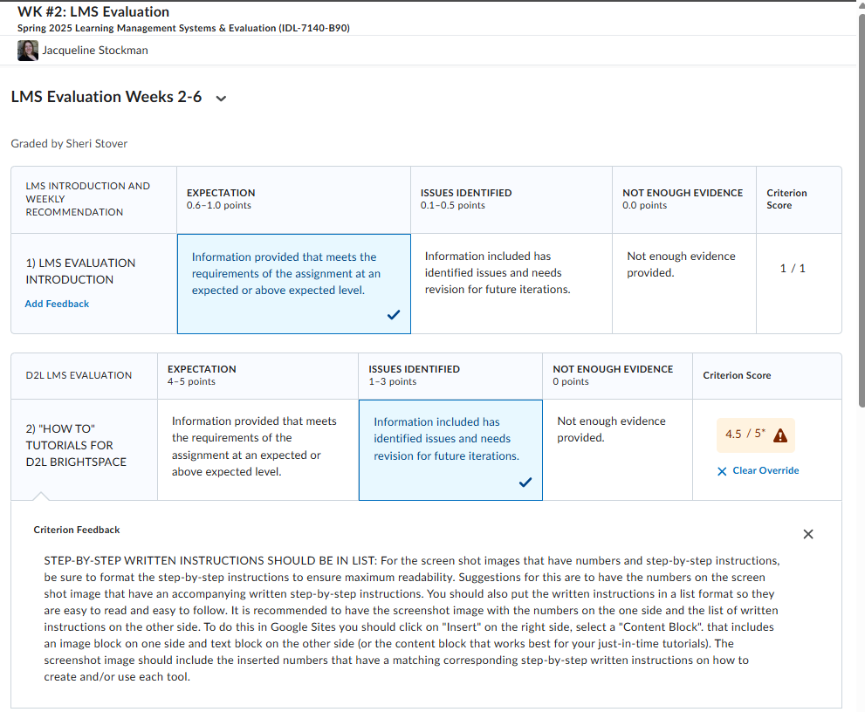
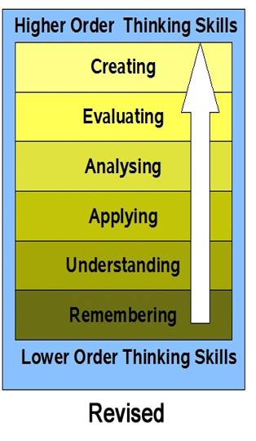
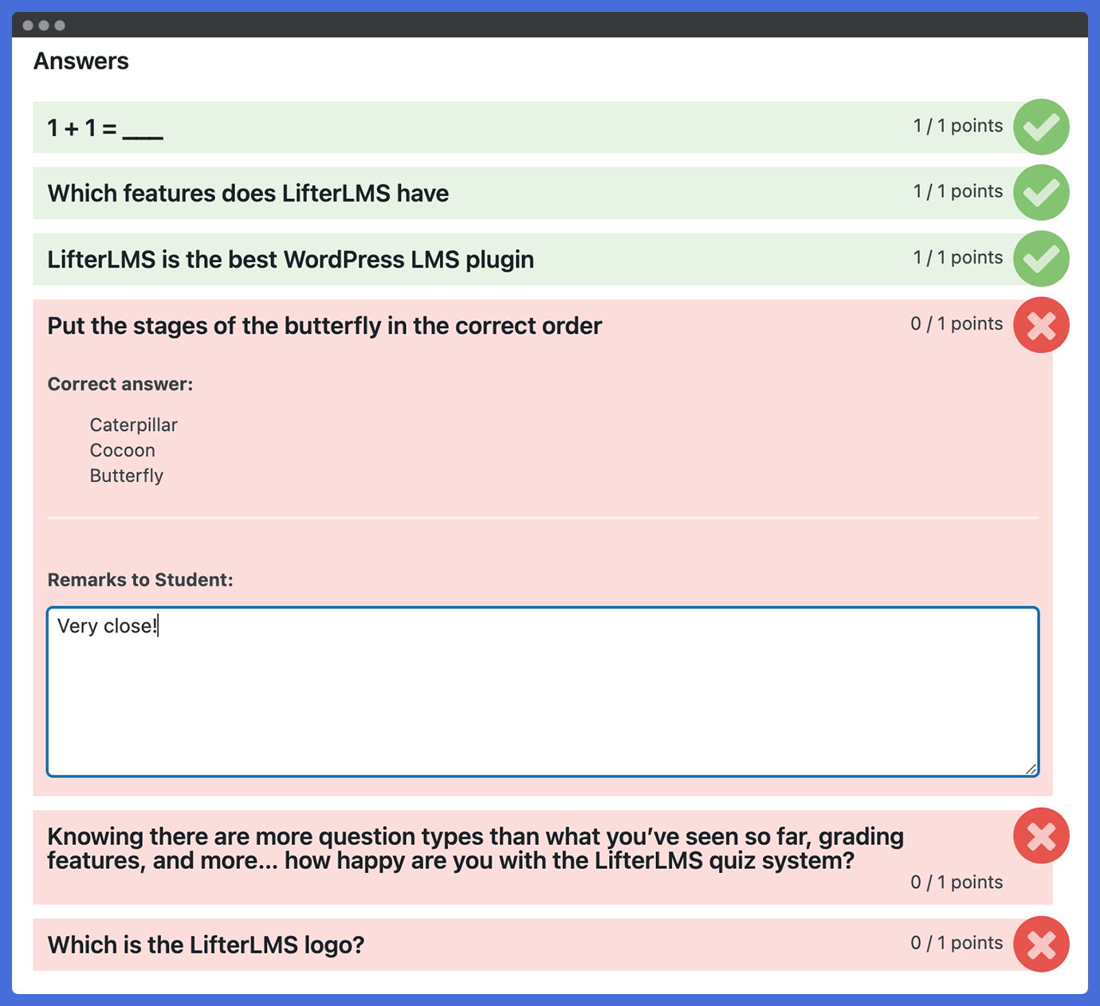
(2) Assessing or providing feedback on a student’s coursework (Tips/Sanity)
SYLLABUS
LMS Electronic Rubrics w/customized feedback
LMS Auto grade Quiz w/feedback
Notes:
(2) Assessing or providing feedback on a student’s coursework :
Provide examples of how Distance Education courses can meet RSI criteria by having the instructor providing direct instruction.

Slide 16
(2) Assessing or providing feedback on a student’s coursework
Provide examples of how DE courses can meet RSI criteria.
EXAMPLES THAT DO NOT MEET RSI GUIDELINES:
AUTOMATICALLY GRADED LMS M-C QUIZES: Incorporating LMS multiple-choice quizzes that give instant, generic correct or incorrect feedback. [No. This does not meet RSI guidelines]. Automatically graded MC quizzes lack substantive engagement and lacks instructional depth.
PEER FEEDBACK WITHOUT INSTRUCTOR F/U: Students give each other feedback on draft paper without instructor guidance or feedback. [No. This does not meet RSI guidelines]. This relies solely on peer interaction without instructor participation.
SYLLABUS
EXAMPLES THAT DO MEET RSI GUIDELINES:
INSTRUCTOR PROVIDES INDIVIUALIZED FEEDBACK: Instructor provides individualized strengths and areas of improvement. [Yes. This does meet RSI guidelines]. Meets RSI because it provides substantive, course-related feedback that helps students learn and improve.
ASSIGNMENT FEEDBACK SUMMARY: Instructor includes summary of common mistakes and feedback in the weekly announcement. [Yes. This does meet RSI guidelines]. This allows instructor-student interaction because it gives feedback to this cohort of students. This should be combined with individualized feedback.
Notes:
(2) Assessing or providing feedback on a student’s coursework
Provide examples of how Distance Education courses can meet RSI criteria by having the instructor providing direct instruction.
EXAMPLES THAT DO NOT MEET RSI GUIDELINES:
AUTOMATICALLY GRADED LMS M-C QUIZES: Incorporating LMS multiple-choice quizzes that give instant, generic correct or incorrect feedback. [No. This does not meet RSI guidelines]. Automatically graded MC quizzes lack substantive engagement and lacks instructional depth.
PEER FEEDBACK WITHOUT INSTRUCTOR F/U: Students give each other feedback on draft paper without instructor guidance or feedback. [No. This does not meet RSI guidelines]. This relies solely on peer interaction without instructor participation.
EXAMPLES THAT DO MEET RSI GUIDELINES:
INSTRUCTOR PROVIDES INDIVIUALIZED FEEDBACK: Instructor provides individualized strengths and areas of improvement. [Yes. This does meet RSI guidelines]. Meets RSI because it provides substantive, course-related feedback that helps students learn and improve.
ASSIGNMENT FEEDBACK SUMMARY: Instructor includes summary of common mistakes and feedback in the weekly announcement. [Yes. This does meet RSI guidelines]. This allows instructor-student interaction because it gives feedback to this cohort of students. This should be combined with individualized feedback.

Slide 17




(3) Providing information or responding to questions about the content of a course or competency (Tips/Sanity).
SYLLABUS
CUSTOMIZED: Add any information to connect current events to course content.
CUSTOMIZED & CANNED: Instructor feedback for common issues from past assignments.
CANNED: Include weekly schedule with readings, assignments, activities, etc.
CUSTOMIZED & CANNED: Proactively identify student misconceptions have with content.
Works well for all learning environments (i.e. F2F, Online, Blended-Learning, etc.).
Notes:
(3) Providing information or responding to questions about the content of a course or competency (Tips/Sanity)
I post a weekly announcement with canned and customized content.

Slide 18
(3) Providing information or responding to questions about the content of a course or competency
Provide examples of how DE courses can meet RSI criteria.
EXAMPLES THAT DO NOT MEET RSI GUIDELINES:
DELAYED OR ABSENT INSTRUCTOR FEEDBACK ON ASSIGNMENTS: Not providing enough feedback robust enough or quick enough to correct for future assignments [No. This does not meet RSI guidelines]. Students need instructor interaction to keep them on track so they don’t keep making the same mistakes or misunderstanding content.
ONLY LOGISTICAL COMMUNICATION: Instructors only provide logistical answers on deadlines, login issues, course navigation, etc. [No. This does not meet RSI guidelines]. This does not allow students to interact with instructors to gain their content knowledge and gain substantive information.
SYLLABUS
EXAMPLES THAT DO MEET RSI GUIDELINES:
FREQUENT (I.E., WEEKLY) CONTENT-SPECIFIC ANNOUNCEMENTS: Instructor proactively posts announcements (weekly) that clarify complex topics. [Yes. This does meet RSI guidelines]. This provides instructor expertise to summarize students’ common misunderstandings and provide explanations proactively.
ASSIGNMENT FEEDBACK SUMMARY: Instructor includes summary of common mistakes and feedback in the weekly announcement. [Yes. This does meet RSI guidelines]. This allows instructor-student interaction because it gives feedback to this cohort of students. This should be combined with individualized feedback.
Notes:
(3) Providing information or responding to questions about the content of a course or competency
Provide examples of how Distance Education courses can meet RSI criteria by having the instructor providing direct instruction.
EXAMPLES THAT DO NOT MEET RSI GUIDELINES:
DELAYED OR ABSENT INSTRUCTOR FEEDBACK ON ASSIGNMENTS: Not providing enough feedback robost enough or quick enough to correct for future assignments [No. This does not meet RSI guidelines]. Students need instructor interaction to keep them on track so they don’t keep making the same mistakes or misunderstanding content.
ONLY LOGISTICAL COMMUNICATION: Instructors only provide logistical answers on deadlines, login issues, course navigation, etc. [No. This does not meet RSI guidelines]. This does not allow students to interact with instructors to gain their content knowledge and gain substantive information.
EXAMPLES THAT DO MEET RSI GUIDELINES:
FREQUENT (I.E., WEEKLY) CONTENT-SPECIFIC ANNOUNCEMENTS: Instructor posts announcements (weekly) that clarify complex topics. [Yes. This does meet RSI guidelines]. This provides instructor expertise to summarize students’ common misunderstandings and provide explanations.
ASSIGNMENT FEEDBACK SUMMARY: Instructor includes summary of common mistakes and feedback in the weekly announcement. [Yes. This does meet RSI guidelines]. This allows instructor-student interaction because it gives feedback to this cohort of students. This should be combined with individualized feedback.

Slide 19
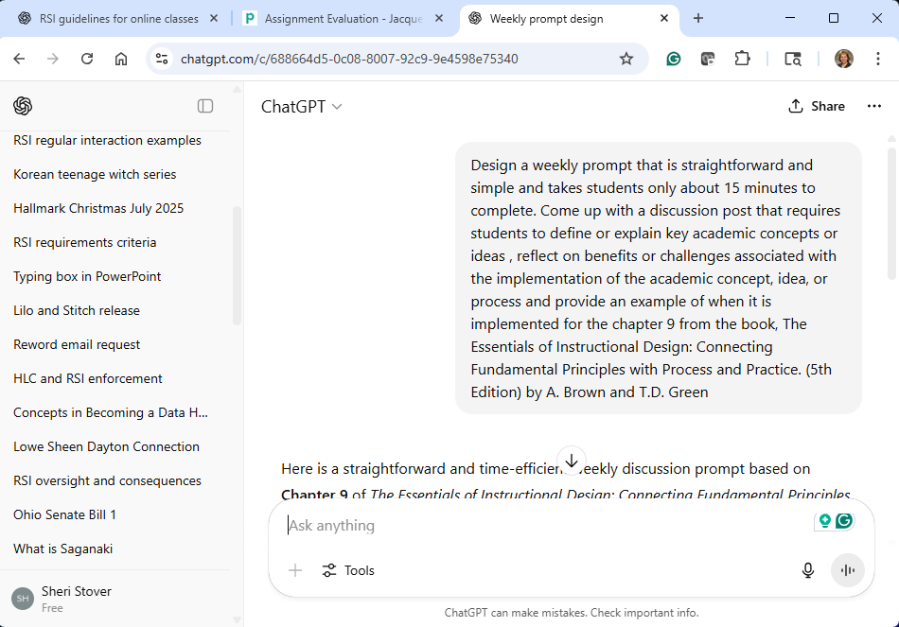
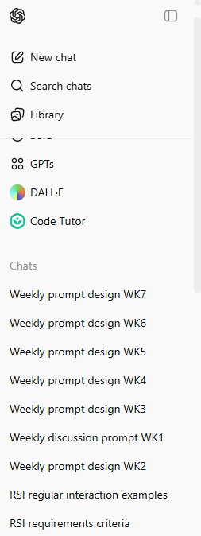
(4) Facilitating a group discussion regarding the content of a course or competency (Tips/Sanity)
Used free ChatGPT
SYLLABUS
Design a weekly prompt that is straightforward and simple and takes students only about 15 minutes to complete. Come up with a discussion post that requires students to define or explain key academic concepts or ideas , reflect on benefits or challenges associated with the implementation of the academic concept, idea, or process and provide an example of when it is implemented for the article, Motivational Theories section (page 218-236) of: Craig et al. (2020). Science of Learning and Readiness State of the Art Report. Accessible here (this directly opens the PDF file): https://apps.dtic.mil/sti/pdfs/AD1106815.pdf
Put discussion prompt framework at front, and keep pasting new textbook chapter at end
Keep revising prompt until gives desired prompt
Works well for all learning environments (i.e. F2F, Online, Blended-Learning, etc.).
Notes:
(4) Facilitating a group discussion regarding the content of a course or competency
Use ChatGPT to create discussion prompts that are specific for your class

Slide 20
(4) Facilitating a group discussion regarding the content of a course or competency
Provide examples of how DE courses can meet RSI criteria.
EXAMPLES THAT DO NOT MEET RSI GUIDELINES:
UNGUIDED STUDENT DISCUSSION Students post and reply to each other in a forum, but the instructor never engages. [No. This does not meet RSI guidelines]. This lacks instructor presence and facilitation when the instructor does not engage in the conversation.
AUTOMATED DISCUSSION (AI OR PEER-GRADED ONLY): Students participate in a forum that’s moderated by automated feedback tools, not the instructor. [No. This does not meet RSI guidelines]. RSI requires substantive instructor involvement.
SYLLABUS
EXAMPLES THAT DO MEET RSI GUIDELINES:
INSTRUCTOR LED LIVE DISCUSSION (I.E. ZOOM): Instructor facilitates a scheduled live session via Zoom where students discussion concepts. [Yes. This does meet RSI guidelines]. Meets RSI because it provides substantive, course-related feedback that helps students learn and improve.
INSTRUCTOR-MONITORED ASYNCHRONOUS FORUM: Instructor poses open-ended prompts and responds to students’ posts. [Yes. This does meet RSI guidelines]. This allows instructors to provide guidance and steer the conversation toward deeper understanding.
Notes:
(4) Facilitating a group discussion regarding the content of a course or competency
Provide examples of how DE courses can meet RSI criteria.

Slide 21
RSI Posts in Public Facing Syllabus:
Here is an example of the RSI information that I include in my public facing syllabus.
Regular and Substantive Interaction (RSI) Expectations: .
While this class is online, you can expect regular and substantive interaction (RSI) from the instructor of this class to include:
Providing direct instruction: Each week students will watch a weekly lecture. After watching the video, students will go to the Discussion Prompt and respond to the Lecture prompt.
Assessing or providing feedback on a student’s coursework: All student assignments will receive robust, specific, and individualized feedback on areas for needed improvement.
Providing information or responding to questions about the content of a course or competency: The instructor will provide weekly announcements to give weekly requirements and specific feedback on the class progress.
Facilitating a group discussion regarding the content of a course or competency: Each week the instructor will provide specific feedback on student's responses to the discussion prompt.
Notes:
RSI Posts in Public Facing Syllabus:
Here is an example of the RSI information that I include in my public facing syllabus.

Slide 22
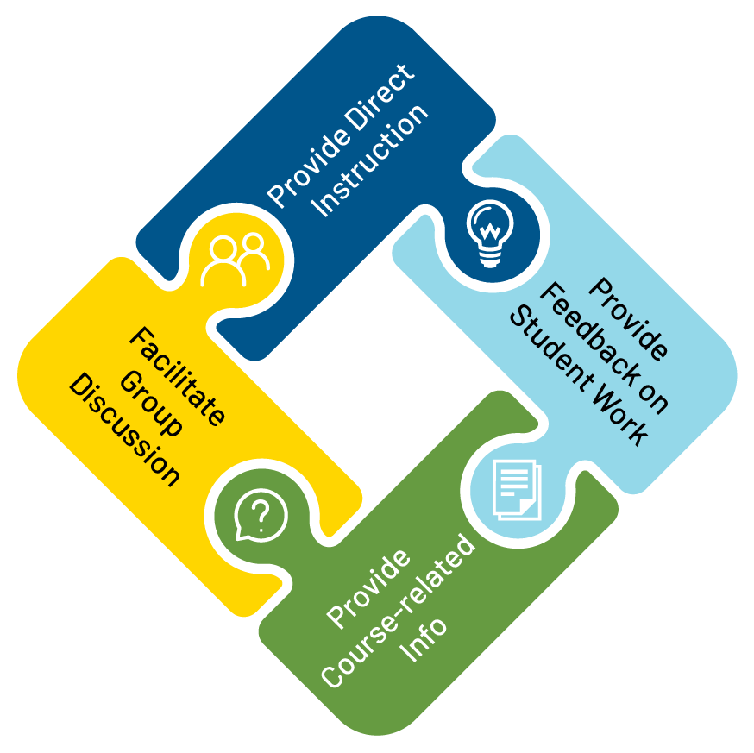
RSI
Summary
Notes:
RSI Summary

Slide 23
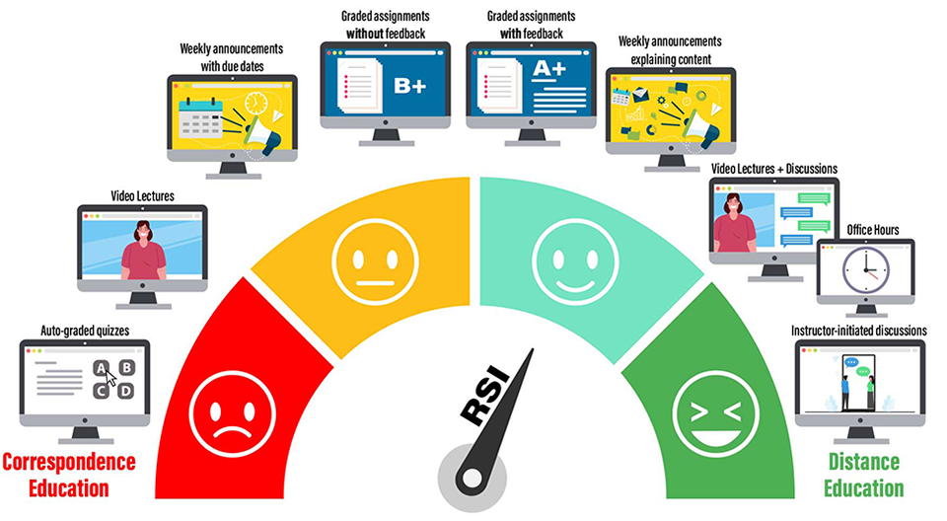
Meeting RSI Guidelines:
To meet RSI guidelines, distance education classes need Regular and Substantive Interaction between Instructors and students.
Notes:
Meeting RSI Guidelines:
To meet RSI guidelines, distance education classes need Regular and Substantive Interaction between Instructors and students.

Slide 24
RSI- Not That Difficult
Now that you know what RSI, just a few simple changes was ensure your course meets RSI guidelines.
RSI
Notes:
RSI- Not That Difficult
Now that you know what RSI, just a few simple changes was ensure your course meets RSI guidelines.

Slide 25
Questions/Comments

